Slide 1
Umple Mini-Course
Part 1: The Basics
Timothy C. Lethbridge, I.S.P, P.Eng.
University of Ottawa, Canada
tcl@eecs.uottawa.ca
http://www.umple.org

Slide 2
Umple: Simple, Ample,
UML Programming Language
Open source textual modeling tool and code generator
    Adds modeling to Java,. C++, PHP
    Key features
      Referential integrity on associations
      Constraints
      Infinitely nested state machines, with concurrency
      Patterns, mixins, traits, and more
Tools
  Command line compiler
  Web-based tool (UmpleOnline) for demos and education
  Eclipse plugin

Slide 3
Websites
Entry-point: http://umple.org
Github: https://github.com/umple/umple
These slides (more to be added for final day): http://www.site.uottawa.ca/~tcl/tmp/UmpleMiniCourse/
  Or http://bit.ly/2r8eHEv

Slide 4
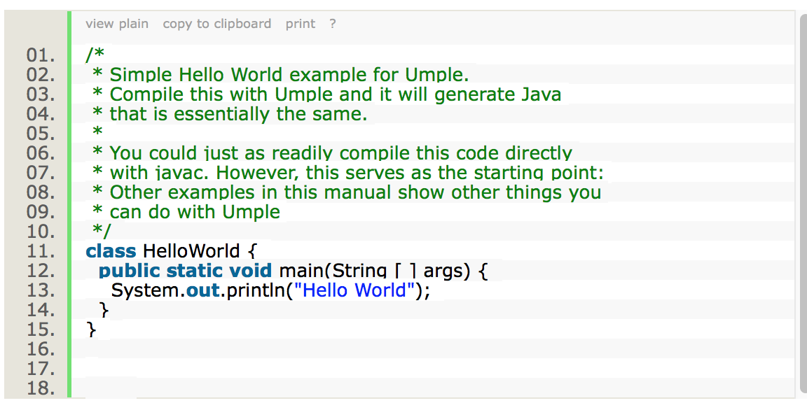
The User Manual and Hello World
Go to http://helloworld.umple.org
Look at the first example
  Observe: just a plain method

Slide 5
What Are we Going to Learn About in This Mini-Course? What Will You Be Able To Do?
  Modeling using class diagrams
    Attributes, Associations, Methods, Patterns, Constraints
    Review of translating requirements into a model
    Practice with a variety of examples
  Modeling using state diagrams
    States, Events, Transitions, Guards, Nesting, Actions, Activities
  Concurrency
  Separation of Concerns in Models
    Mixins, Traits, Aspects
  Analysis of Models
  Building complete systems

Slide 6
What Technology Will You Need (1)?
For homework, and ideally for in-class work
  A computer (laptop) with Java 8 JDK and Umple
  Mac and Linux are the easiest platforms, but Windows should work
If you don’t have a computer in class, then you will need a smartphone to respond to some test questions.

Slide 7
What Technology Will You Need (2)?
We will mostly be using
  Umpleonline in a web browser: http://try.umple.org
  Umple on the command line: http://dl.umple.org
  Java 8 JDK on the command line: http://bit.ly/1lO1FSV
Options
  Umple in Eclipse https://github.com/umple/umple/wiki/InstallEclipsePlugin
  cmake and gcc for compiling C++ code
If you are adventurous, you can gain some speed by setting up a local UmpleOnline server
https://github.com/umple/umple/wiki/SettingUpLocalUmpleOnlineWebServer

Slide 8
Tell Me About Yourselves?
Year of Study?
Experience with UML?
What modeling tools have you used?
Experience with generating code?
Experience with Java? C++? Formal Methods?
Go to this survey:
https://www.surveymonkey.com/r/TellMe-IsraelUmple

Slide 9
Exercise: Compiling and Changing a Model
Look at the example at the bottom of http://helloworld.umple.org (also on next slide)
  Observe: attribute, association, class hierarchy, mixin
Click on Load the above code into UmpleOnline
  Observe and modify the diagram
  Add an attribute
  Make a multiplicity error, then undo
  Generate code and take a look
  Download, compile and run if you want

Slide 10
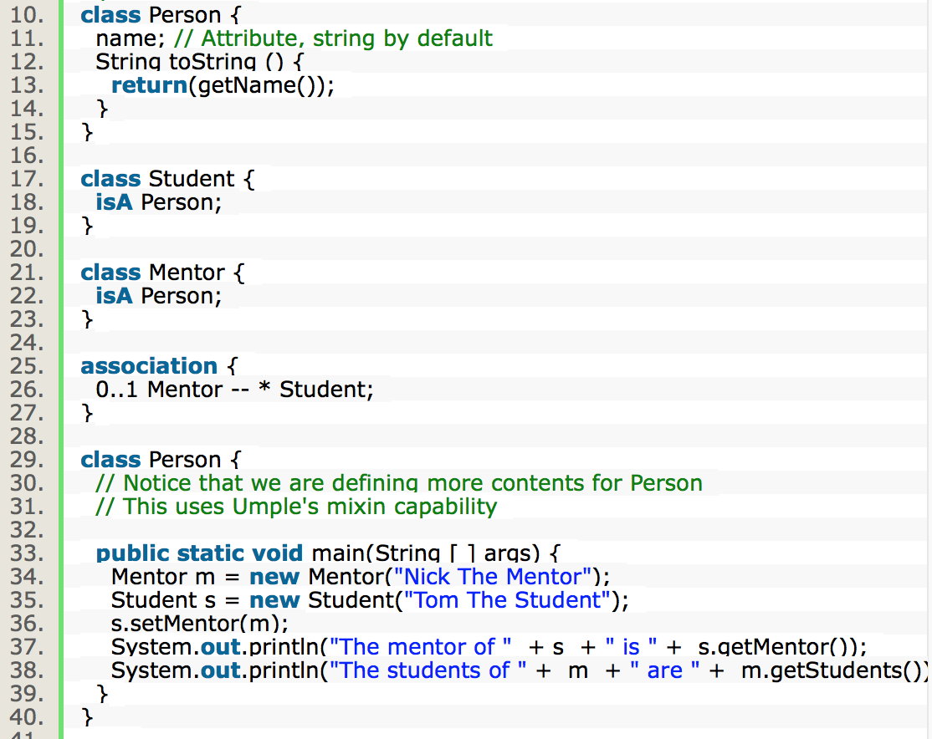
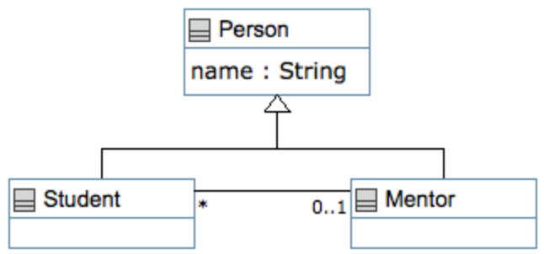
Hello World Example 2 in the User Manual

Slide 11
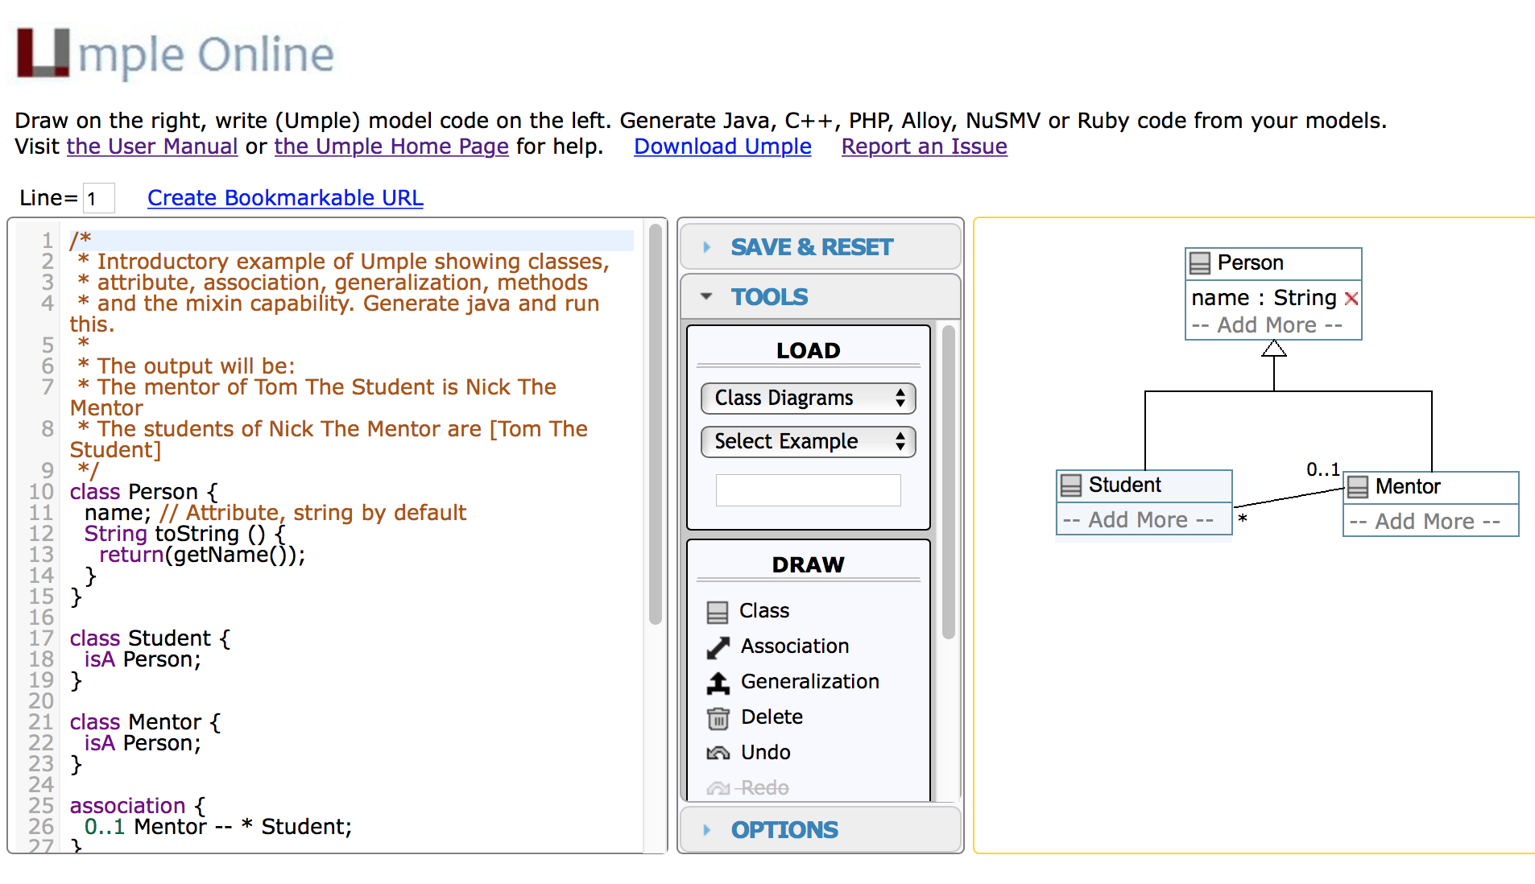
Hello World Example 2 in UmpleOnline

Slide 12
Demo of Compiling on the Command Line
To compile on the command line you will need Java 8
Download Umple from http://dl.umple.org
Basic compilation
  java -jar umple.jar model.ump
  java -jar umple.jar --help
To generate and compile the java to a final system
  java –jar umple.jar model.ump -c -

Slide 13
Exploration of UmpleOnline
Explore class diagram examples
Explore options
  View – hide and showing text, diagram
    Control-t (text), control-d (diagram) as shortcuts
  View – hide and showing methods, attributes
  Generate different default diagram types
    Control-g (Graphviz), control-s (state), control-e
Generate code and look at the results
  In Umple you never should modify generated code, but it is designed to be readable for educational purposes

Slide 14
Quick Walkthrough of the User Manual
http://manual.umple.org
Note in particular
  Key sections: attributes, associations, state machines
  Grammar
  Generated API
  Errors and warnings
  Editing pages in github

Slide 15
Attributes
”Instance variables”
  Part of the state of an object
  Simple data that will always be present in each instance
Specified like a Java or C++ field or member variable
But, intended to be more abstract!
  Always private by default
  Should only be accessed get, set methods
  Can be stereotyped (upcoming slides)
  Can be constrained (discussed later)

Slide 16
Umple Builtin Datatypes
String // (default if none specified)
Integer
Float
Double
Boolean
Time
Date
The above will generate appropriate code in Java, C++ etc.
  e.g. Integer becomes int
Other (native) types can be used but without guaranteed correctness

Slide 17
Some Stereotypes Used on Attributes
By default, each attribute adds an argument to the generated constructor
To prevent this, use one of these
autounique x; // sets attribute to 1, 2, 3 …
lazy b; // sets it to null, 0, “” depending on type
a = "init value";
defaulted s = "def"; // resettable to the default
internal i; // doesn’t generate any get/set either
More more details: http://attributes.umple.org

Slide 18
Immutability
Useful for objects where you want to guarantee no possible change once created
  e.g. a geometric point
Generate a constructor argument and get method but no set method
immutable String str;
No constructor argument, but allows setting just once.
lazy immutable z;

Slide 19
Generalization in Umple
Umple uses the isA keyword to indicate generalization
class Shape {
colour;
}
class Rectangle {
isA Shape;
}

Slide 20
Interfaces
Declare signatures of a group of methods that must be implemented by various classes
Also declared using the keyword isA
Essentially the same concept as in Java
Let’s explore examples in the user manual …

Slide 21
User-Written Methods in Umple
Methods can be added to any Umple code.
Umple parses the signature only; the rest is passed to the generated code.
You can specify different bodies in different languages
We will look at examples in the user manual …

Slide 22
Time for a Test
Go to the following URL for a little test
https://www.surveymonkey.com/r/Test1-UmpleIsrael

Slide 23
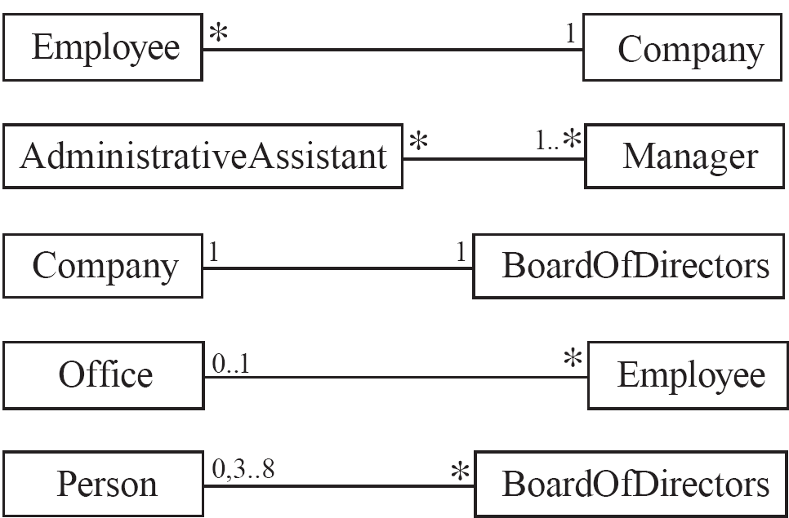
Basic Associations
Manage dynamic links among instances of classes
  Multiplicity symbols indicate how many instances

Slide 24
Many-to-One Associations
  A company has many employees,
  An employee can only work for one company.
    This company will not store data about the moonlighting activities of employees!
  A company can have zero employees
    E.g. a ‘shell’ company
  It is not possible to be an employee unless you work for a company
Employee
*
1
Company

Slide 25
Associations in Umple
class Employee {
id;
firstName;
lastName;
}
class Company {
name;
1 -- * Employee;
}

Slide 26
Referential Integrity
When an instance on one side of the association changes
  The linked instances on the other side know …
  And vice-versa
This is standard in Umple associations, which are bidirectional

Slide 27
Role Names (optional, in most cases)
Allow you to better label either end of an association
class Person{
id;
firstName;
lastName;
}
class Company {
name;
1 employer -- * Person employee;
}

Slide 28
Many-to-Many Associations
  An assistant can work for many managers
  A manager can have many assistants
  Assistants can work in pools working for several managers
  Managers can have a group of assistants
  Some managers might have zero assistants.
  Is it possible for an assistant to have, perhaps temporarily, zero managers?
*
1..*
*
*
*
*
Assistant
*
Manager
supervisor
Open in Umple

Slide 29
One-to-One Associations (Use Cautiously)
  For each company, there is exactly one board of directors
  A board is the board of only one company
  A company must always have a board
  A board must always be of some company
1
1
Open in Umple

Slide 30
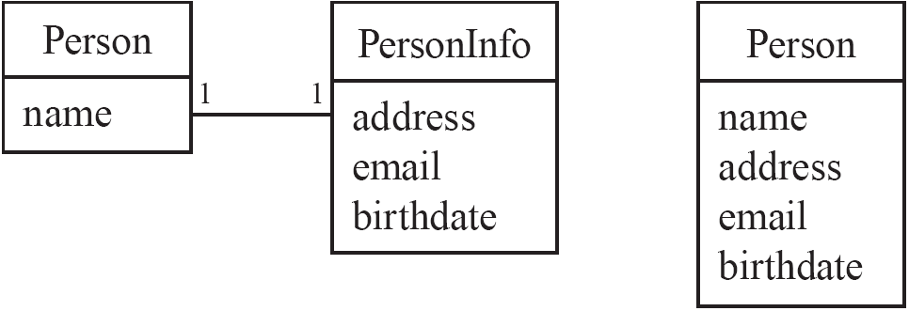
Typical Erroneous Use of One-to-One
Avoid this do this

Slide 31

Unidirectional Associations
Associations are by default bi-directional
It is possible to limit the direction of an association by adding an arrow at one end
In the following unidirectional association
    A Day knows about its notes, but a Note does not know which Day is belongs to
    Note remains ‘uncoupled’ and can be used in other contexts
class Day {
* -> 1 Note;
}
class Note {}
Open in Umple

Slide 32

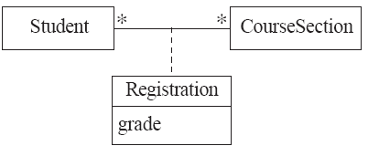
Association Classes
Sometimes, an attribute that concerns two associated classes cannot be placed in either of the classes
The following are nearly equivalent
  The only difference:
    in the association class there can be only a single registration of a given Student in a CourseSection
Open in Umple and extended example

Slide 33
Association Classes (cont.)
Umple code
class Student {}
class CourseSection {}
associationClass Registration {
* Student;
* CourseSection;
}
Open in UmpleOnline, and then generate code

Slide 34
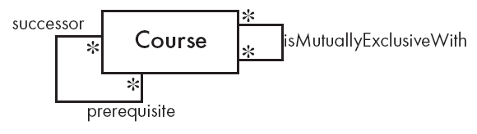
Reflexive Associations
An association that connects a class to itself
class Course {
* self isMutuallyExclusiveWith; // Symmetric
}
association {
* Course successor -- * Course prerequisite;
}
Open in Umple

Slide 35
Modeling Hierarchies of Instances
Either:
  Use a reflexive 1 -- * association
  Or use the composite pattern:
class Employee {
name;
}
class Manager {
isA Employee;
0..1 -- * Employee subordinate;
}
Class OrdinaryEmployee {
isA Employee;
}

Slide 36
In-Class Modeling Exercises
Build a class diagram for the following. If you think there are key requirements missing, then add them.
1. A building can have many floors and several elevators. Each elevator serves a set of floors
2. A football (soccer) team has players. Each player plays a position. The team plays some games against other teams during each season. The system needs to record who scored goals, and the score of each game.

Slide 37
Homework after First Class
Model the following in Umple:
A bus company has a set of busses of three different types. Each type has a different capacity. The company runs busses on various routes. Each route stops at a set of routes. Some routes run every n minutes from a start time to a stop time each day, other than holidays. Other routes run at specific times.
Write some Umple code (Java methods) to create some instances of your each of your classes and then print out the results.

Slide 38
How to Submit your Bus System
1. Write the Umple code and compile it
2. Run the system and after it works save the output as a text file
3. Generate a graphviz class diagram and save as a file too
4. Create a zip file with: Umple code + diagram + text file
Submit the zip file to the following link: http://bit.ly/2r0ynvq
or
https://www.dropbox.com/request/HcOJzhfuZmXmhDuzmAMx

Slide 39
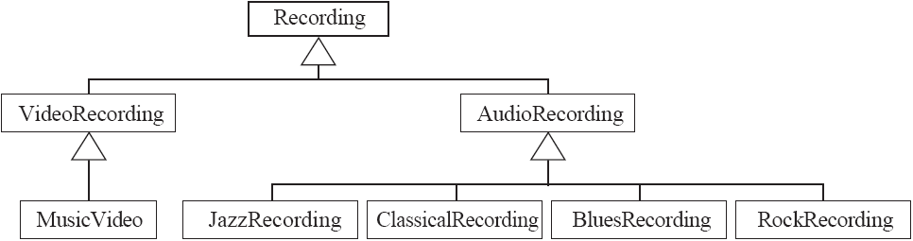
Avoiding Unnecessary Generalizations
Skip the next 6 slides if time is short: Students read at home
Inappropriate hierarchy of
Classes
What should the model be?

Slide 40
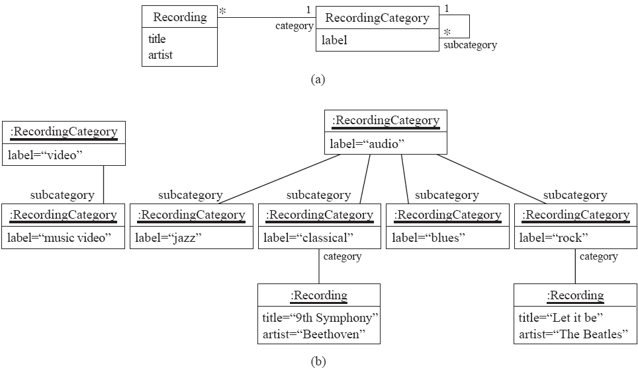
Avoiding Unnecessary Generalizations (cont)
Open in Umple
Improved class diagram, with its corresponding instance diagram

Slide 41
Associations Versus Generalizations
Associations describe the relationships that will exist between instances at run time.
  When you show an instance diagram generated from a class diagram, there will be an instance of both classes joined by an association
Generalizations describe relationships between classes in class diagrams.
  They do not appear in instance diagrams at all.
  An instance of any class should also be considered to be an instance of each of that class’s superclasses

Slide 42
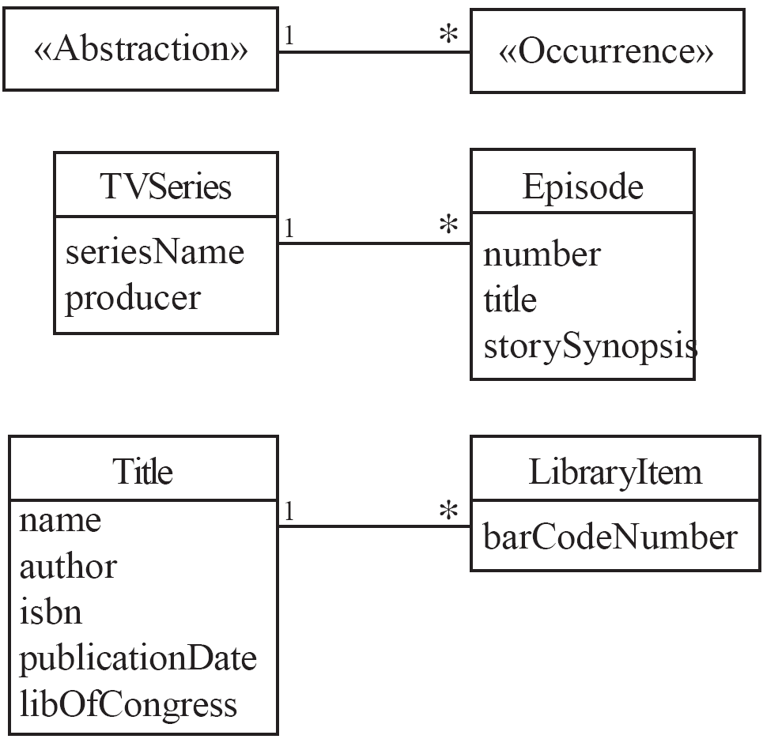
An Important Association Pattern: Abstraction-Occurrence

Slide 43
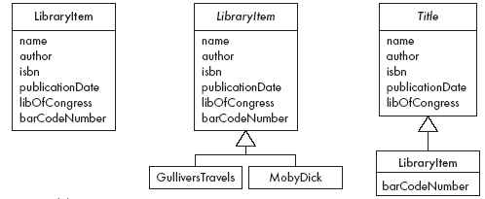
Antipatterns to Abstraction Occurrence
Don’t do these!!

Slide 44
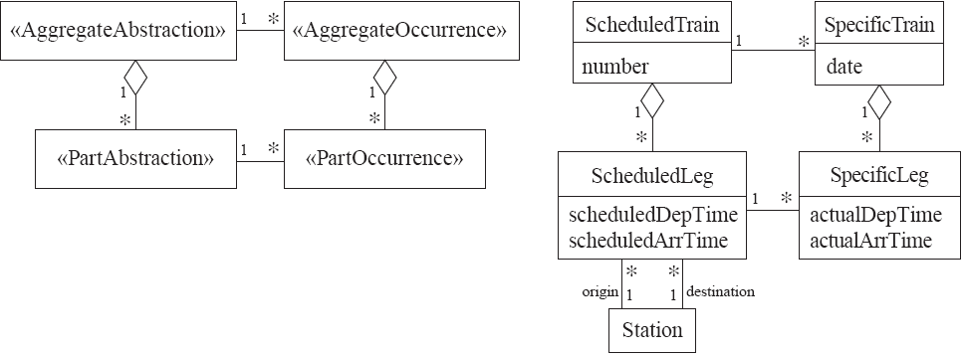
Square Abstraction-Occurrence
Try modeling these in Umple

Slide 45
More Details on Associations
We will revisit associations in Mini-Course 2
But explore http://associations.umple.org for more detail right now

Slide 46
Time for Another Short Test
Go to the following link
https://www.surveymonkey.com/r/Test2-UmpleIsrael

Slide 47
Wrapup on Part 1: Umple Philosophy 1-4
P1. Modeling is programming and vice versa
P2. An Umple programmer should never need to edit generated code to accomplish any task.
P3. The Umple compiler can accept and generate code that uses nothing but UML abstractions.
      The above is the inverse of the following
P4. A program without Umple features can be compiled by an Umple compiler.
  e.g. input Java results in the same as output

Slide 48
Umple Philosophy 5-8
P5. A programmer can incrementally add Umple features to an existing program
  Umplification
P6. Umple extends the base language in a minimally invasive and safe way.
P7. Umple features can be created and viewed diagrammatically or textually
P8. Umple goes beyond UML

Slide 49
The Course Continues in Part 2
We will look at:
  Multi-valued and derived attributes
  Keys
  Enumerations
  Patterns: Singleton and delegation
  Constraints
  Basic state machines

