Slide 1
Model-Oriented Programming:
Bridging the Model-Code Divide
Modeling in Software Engineering (MiSE 2013)
Omar Badreddin, Timothy C. Lethbridge
University of Ottawa
tcl@eecs.uottawa.ca
http://www.eecs.uottawa.ca/~tcl
http://www.umple.org

Slide 2
Key Ideas of
Model-Oriented Programming (MOP)
It should be possible to
  Use a ‘nice’ textual form for any modeling construct
  Embed code in model
  Embed model in code
Umple allows this transparently for
  Java
  C++
  PhP
  And even all at the same time!

Slide 3
Why Model-Oriented Programming
Real programmers still like code
Outside the critical systems domain, most models are just documentation
  And tend to be:
    Wrong
    Not executable anyway
Those of us who have done real model-driven development know doing so is a ‘no brainer’ for productivity + quality
  We just have to bridge the model-code divide

Slide 4
Why not just use a ‘UML Action Language’ like Alf?
We don’t really need yet another language for such elements
People want to
  Leverage their existing code and libraries
  Do this in small increments

Slide 5
Umple as a MOP tool
It ‘eats its own dogfood’
  The Umple compiler is developed with itself
  http://code.google.com/p/umple/source/browse/trunk/cruise.umple/src/Umple.ump
  http://metamodel.umple.org
Umple allows embedding of code for
  Methods
  State machine actions, activities, guards
  Arbitrary code before/after any generated API for manipulating associations, attributes etc.

Slide 6
Examples
Small example: http://helloworld.umple.org
  State machines: http://statemachines.umple.org

Slide 7
Evidence of benefit
Empirical studies show
  Umple code is easier to understand than Java
  Helps students learn to model: CSEE&T

Slide 8
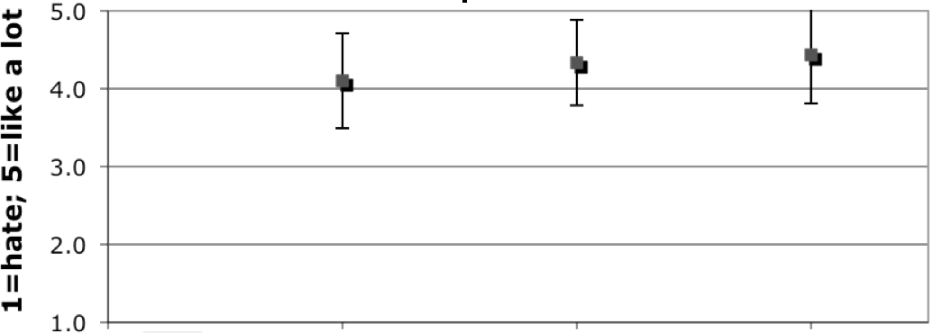
Ability to generate code to represent the model
Availability of a textual form for models and diagrams
Ability to edit diagram or text & have the other reflect changes

Slide 9
Questions?

