Slide 1
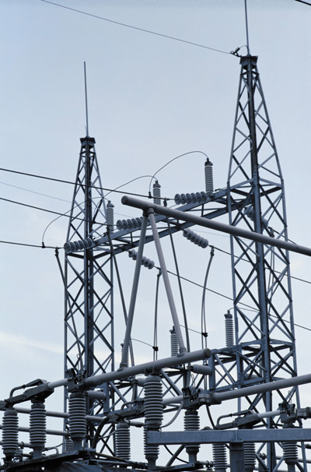
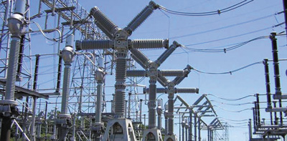
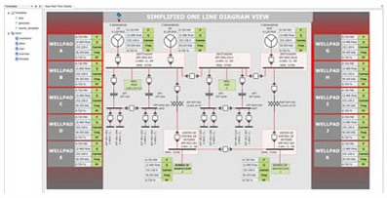
SCADA in electrical power delivery
Maxwell Dondo PhD PEng SMIEEE
Notes:
Images: http://www.electricenergyonline.com/show_article.php?mag=&article=321

Slide 2
Outline
Evolution of grid automation
SCADA introduction
SCADA Components
Smart Grid
SCADA Security

Slide 3

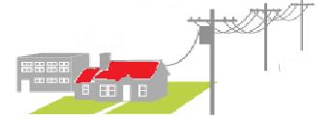
Grid Evolution
Traditionally power delivery was unsophisticated
  Generation localised around communities
  Simple consumption (e.g. lights)
  Simple communication with consumer
  Consumer billed monthly
System relied on consumer phone calls for fault notifications
Ground crews dispatched to fix problems
Time consuming process

Slide 4

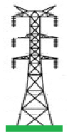
Grid Evolution
EPUs (Electric Power Utilities) became more sophisticated to meet energy demands
Complex generation systems
Longer interconnected transmission lines
Sophisticated substations
Complex distribution systems
Automation systems common
Sophisticated communications became necessary

Slide 5
Morden Electric Grid
Generation (usually 25kV or less)
  Thermal
  Hydro
  Nuclear
  “Green” Sources
Transmission Lines
  AC or DC
  Transmit power at high voltage over long distances
  High voltage, low current to reduce losses e.g. 735kV for James Bay transmission lines.
Notes:
Source: http://www.thecanadianencyclopedia.ca/en/article/electric-power-transmission/

Slide 6
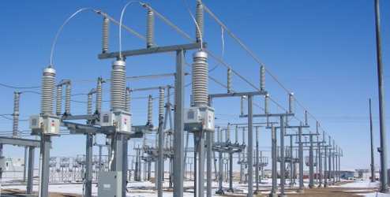
Morden Grid: Substations
Substations ordinarily contain
  Transformers step up/down voltages for transmission or distribution e.g. Distribution substation: 115kV/27.6kV
  Instrument transformers (CTs/VTs), meters
  Circuit breakers, switches, isolators, relays
Substations are capable of local control and monitoring
Substation can be of different varieties (e.g. simple switching station or very sophisticated distribution substation)
Notes:
http://www.wue.coop/aboutwue

Slide 7
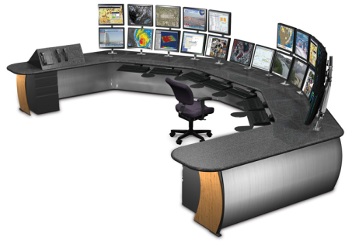

Grid Automation
Grid evolved
  from manned substations to remotely monitored and controlled system
  from electromechanical systems to dial-up system
  from unsophisticated one-way communication to two-way communication
Automation became a requirement
Regulatory reporting requirement
Automation became integrated with preventative/predictive maintenance
Need computers to process grid’s operational and non operational data
Achieved through automation called SCADA
Notes:
Control Centre: http://www.techinteriors.com/market_process.php

Slide 8
SCADA Definition
A complex computer based system that uses modern applications to analyse the electric power grid system to acquire data, monitor and control facilities and processes.
SCADA applications can support dispatchers, operators, engineers, managers, etc. with tools to predict, control, visualize, optimise, and automate the EPU.

Slide 9
Summary of SCADA History
Originally EPUs used electro-mechanical automation
Dial-up modems used for remote access
In 1970s computer-based SCADA commenced
Suppliers (e.g. IBM, Siemens, GE) supplied complete proprietary systems
More advanced with client-server computers
Advanced functions became common (e.g. EMS. DMS, load forecasting, dispatch, protection engineering, regulatory reporting, etc)
Communication link evolved from noisy narrow bandwidth telephone lines to SONET, Microwave, radio, power line carrier, cellular networks

Slide 10
Traditional SCADA Components
SCADA Master Terminal Unit (MTU): The server that acts as SCADA system
RTU (remote terminal unit) : remote telemetry data acquisition units located at remote stations
IED (intelligent electronic devices) smart sensors/actuators with intelligence to acquire data, process it, and communicate
HMI (human-machine interface) : software to provide for visualisation and interaction with SCADA

Slide 11
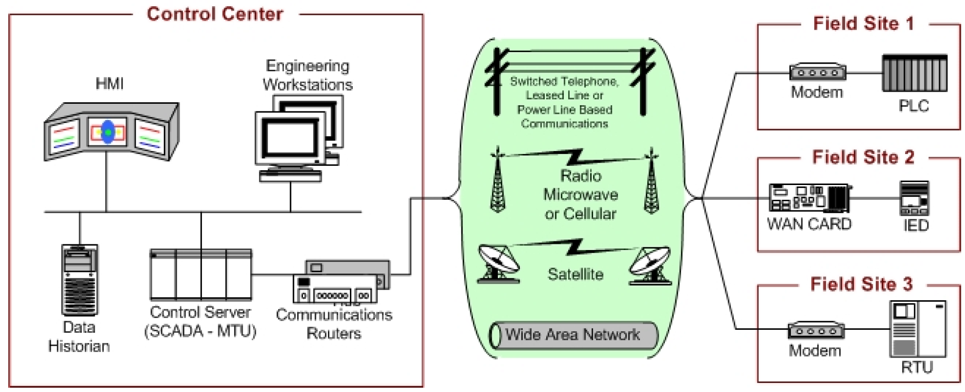
Overall SCADA System architecture
Can be broken down into 3 categories
NIST representation of SCADA system
  Control Center
  Programmable Logic Controllers(PLCs), Remote Terminal Units (RTUs), IEDs
  Communications Network
  SCADA host software

Slide 12
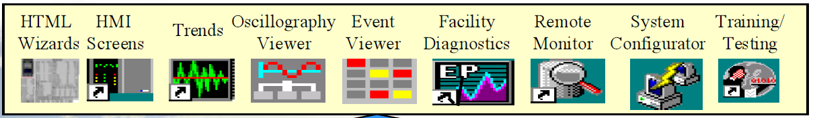
Control Center
Provides for real-time grid management
SCADA Server
  Also known as the MTU (master terminal unit)
HMI for visualisation and human interaction
Programming/Engineering workstations
Data historian, a database storage for operational activities
Control server, hosts software to communicate with lower level control devices
Communication routers
Could be connected to other regional control centers (desired for large networks)
Notes:
Image bottom: https://www.gedigitalenergy.com/products/
-control center collects operational data from substations, provides operator visualisations for real-time status of network.

Slide 13
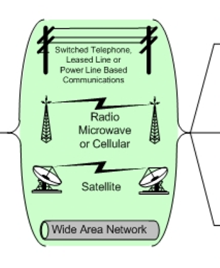
Communication Link
Phone line/leased line, power line carrier
Radio
Cellular network
Satellite
Fibre optic

Slide 14

Communication topologies
Star
Ring
Mesh
Tree
Bus

Slide 15


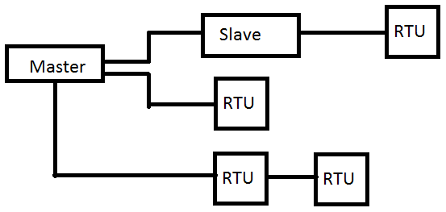
Implementation Examples
Many possible topologies
Direct connection
Connection with slave
Other. See IEEE C37.1

Slide 16

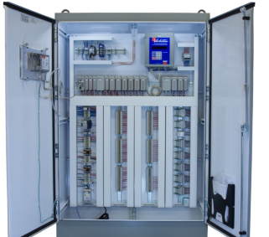
Protocols and standards
Allow communications between devices
MODBUS: master-slave application-layer protocol
  Attackers with IP access can run Modbus client simulator to effect many types of attacks.
DNP3 : Distributed Network Protocol is a set of open communication protocols
  IEEE recommended for RTU to IED messages
  Has no in-built security: Messages can be intercepted, modified and fabricated.
IEC 60870 suite:
  Substation control centre communication (IEC 60870-5-101/104)
  Communication with protection equipment (IEC 60870-5-103)
  IEC 62351 intends to implement security (end-to-end encryption; vendors reluctant to implement due to complexity)
Other proprietary protocols

Slide 17
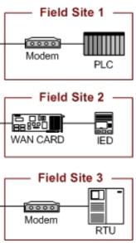
Field Components
Acquire telemetry, relay data from system
Covert it to digital signals if necessary
Send data to MTU or engineering stations
Receive control, settings, resets from MTU
SCADA MTU
Field component
Control,
Settings
Device Ports
Telemetry Meters
Relays, etc

Slide 18
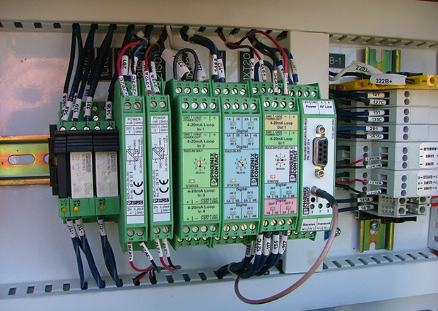
Field Components: RTU
Reads status and alarms through relay and control circuit auxiliary contacts. Meter reading.
Manual/remote control e.g. activate alarm. RTU control outputs connected to control relays
No data storage
Some PLCs equipped to be RTUs
May aggregate IED data
Either open standard or proprietary based
  Modbus, DNP3, IEC 60870-5-101/104
Serial communication
  RS232, RS485
Notes:
http://www.electricenergyonline.com/show_article.php?mag=&article=321

Slide 19
Field Components : IED
Similar to RTU, is open or proprietary based
Acquires data from electrical devices, e.g. relay or circuit breaker status, switch position.
Reads meter data such as V, A, MW, MVAR. Some modern meters have IED capabilities, they can communicate their readings with RTU or MTU.
Control functions include:
  CB control, voltage regulators, recloser control.
Newer substations only use modern IEDs
IEDs can support horizontal communication
Notes:
IEDs and RTU are connected using serial RS232 to the substation communication bus.

Slide 20
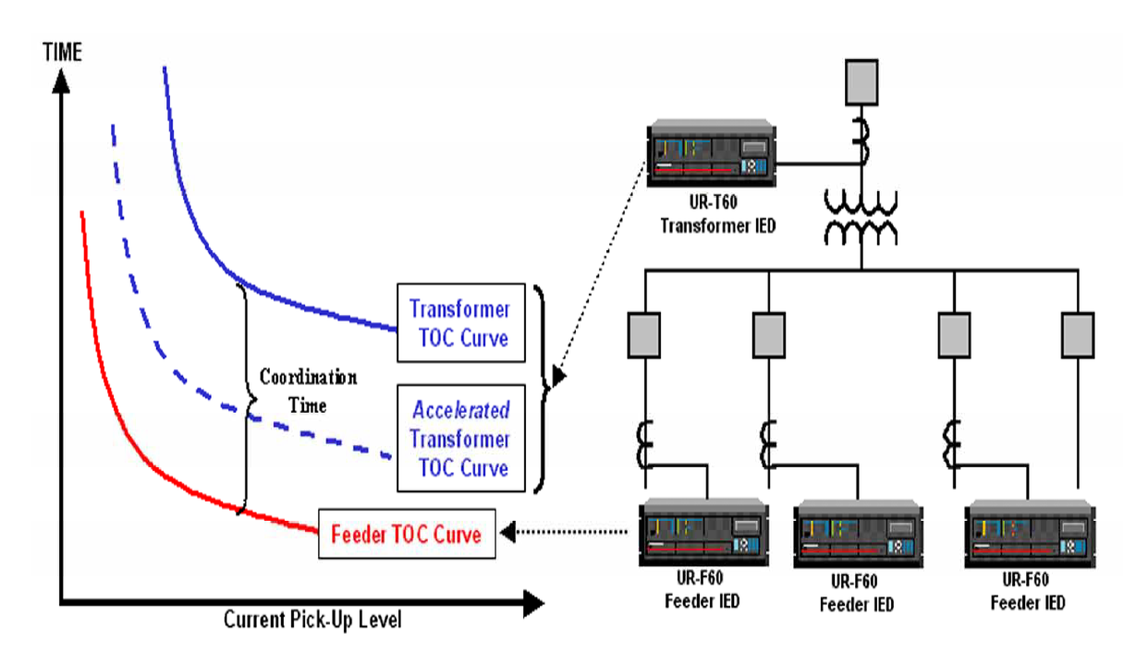
GE Example
Notes:
Time overcurrent relays: https://www.gedigitalenergy.com/

Slide 21
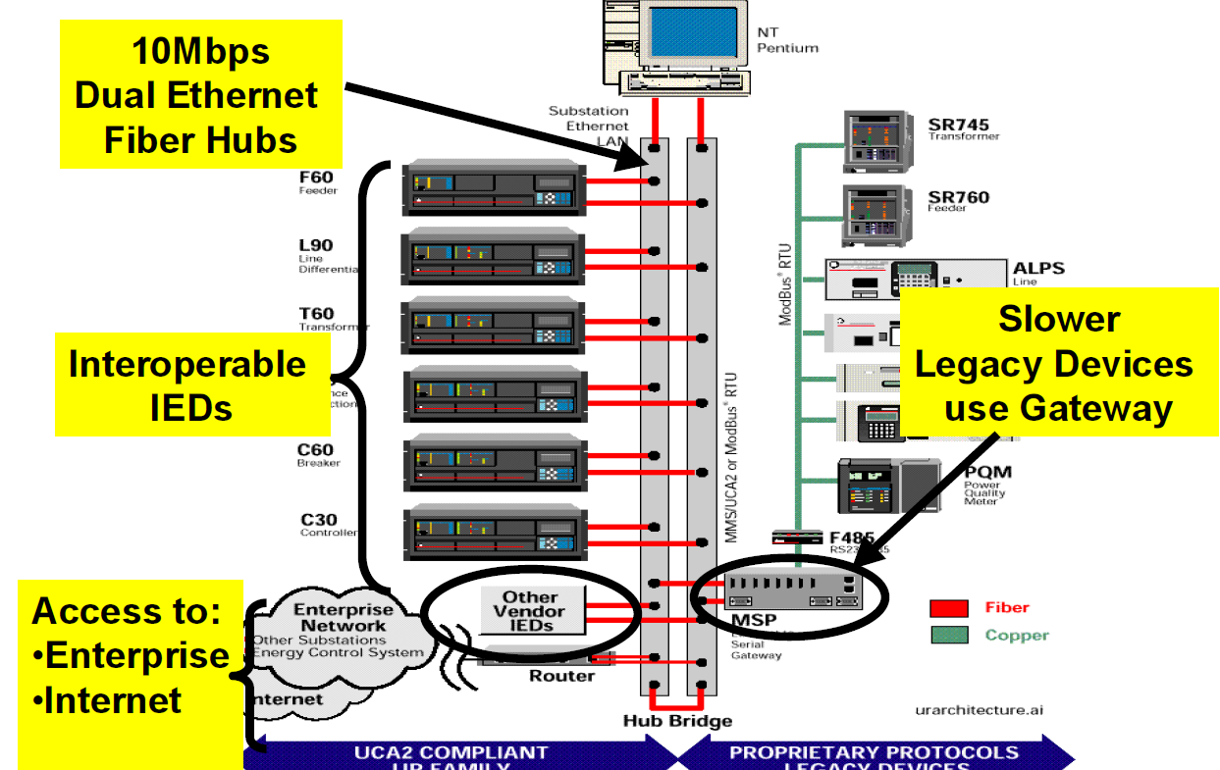
GE Example
Notes:
https://www.gedigitalenergy.com/

Slide 22
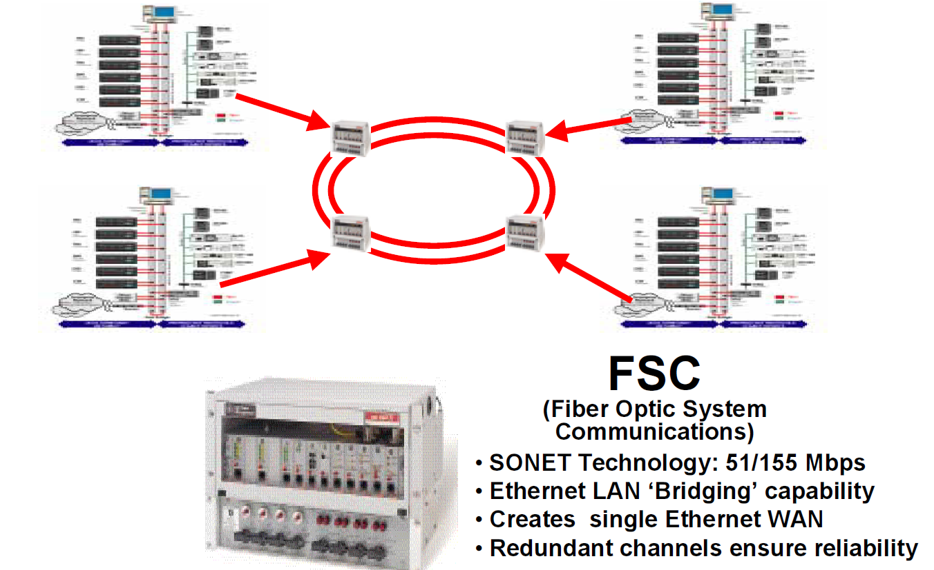
GE Example
Notes:
https://www.gedigitalenergy.com/

Slide 23











SCADA and internet connection

Slide 24
Smart Grid
Concept of a fully automated power distribution system that can monitor and control all aspects of the system
Ideally a smart grid provides voltage/power flow optimisation and self healing (after disruption)
SCADA, WAMS, AMI provide and enable the “brains” of the smart grid concept
SCADA makes real-time automated decisions to regulate voltages, optimal power flows, etc.

Slide 25


Smart Grid
Supports sophisticated two-way communication
Allows efficient power dispatch
Easy to integrate with other sources e.g. green energy
Supports smart metering
Can coordinate with home area networks (HANs) for efficient consumption
Supports efficient self-healing after faults
Notes:
Wind turbine image: http://enthone.com/Industries/Heavy_Equip_Energy/Solar_and_Wind_Turbines/Wind_Turbines.aspx
Solar panel image: http://www.processindustryforum.com/hottopics/advantages-and-disadvantages-of-solar-energy

Slide 26
SCADA Security
Traditionally isolated networks
No security measures deemed necessary; security by obscurity
Only threats were insiders and physical sabotage
Modem war-dialing was also possible threat
With interconnected EPU, SCADA is connected over wide area networks and internet
That has exposed SCADA to attacks

Slide 27

SCADA Security Holes
Increased automation widens SCADA network’s attack surface

Slide 28
Typical SCADA threats (actors)
Espionage
  Spies (industrial and state actors)
  Terrorists
Script kiddies
Insiders, e.g. disgruntled employees
Criminal elements (blackmail)
Business competitors
Hacktivists (ideological activists)

Slide 29
SCADA Vulnerabilities
Vulnerabilities are weaknesses in the cyber system that threats (actors) exploit to carry out attacks
Examples of forms vulnerabilities:
  Technical
    Hardware
    Software and protocol
    Network
  Policy

Slide 30
Vulnerability examples
CVE-2015-1179: Allows remote attackers to inject arbitrary web script; found in Mango Automation systems
CVE-2015-0981: Allows remote attackers to bypass authentication and read/write to arbitrary database fields via unspecified vectors.
CVE-2015-0096 (MS15-018) : Stuxnet, a worm targeting ICSs such as SCADA.
Other examples from 2014: CVE-2014-8652 , CVE-2014-5429
GE Energy's XA/21: 2003 flaw responsible for alarm system failure at FirstEnergy's Akron, Ohio control center
Notes:
Mango Automation is a flexible software application that allows you to view, log, graph, animate, alarm, and report on data from sensors, equipment, PLCs, databases, webpages, etc
GE Energy's XA/21: http://www.nipc.gov/dailyreports/2003/August/DHS_IAIP_Daily_2003-08-18.pdf
The flaw was responsible for the alarm system failure at FirstEnergy's
Akron, Ohio control center

Slide 31
Attack Examples
Stuxnet: Intercepts and makes changes to data read from and written to a PLC
Night Dragon : Suspected SCADA data exfiltration from Exxon, Shell and BP
Others: Havex (Trojan targeting ICSs and SCADA), Blacken (Targets users of SCADA software Simplicity)
Many others targeting the PCs used in SCADA.

Slide 32
Securing SCADA
Define SCADA security networking policy
  Access control
  Identify all SCADA assets and their connectivity
  Schedule regular vulnerability assessments
User training and awareness (e.g. what to do when you pick up a USB stick in parking lot)
Technical
  Isolate SCADA from internet as much as possible
  Encryption of data
  Implement strict firewall rules between SCADA network and all other networks.
  Perform anomaly detection

Slide 33
Securing SCADA
  Put in place effective policies
  Limit access to SCADA network; implement tight security access controls
  Use hardened hardware
  Patch regularly, don’t use unpatched software or vulnerable systems
  Implement vendor security features (No defaults)
  Audit (include red teaming) SCADA IT systems for security holes

Slide 34
Summary
SCADA systems enhance power delivery by providing grid situational awareness and control
Delivers operational and non-operational data through a variety of communication methods
SCADA is an important part of the Smart Grid
SCADA system is traditionally insecure, security measures needed

Slide 35
References
IEEE Standard for SCADA and Automation Systems C37.1, 2007
IEC 61850 Communication networks and systems in substations
Guide to Supervisory Control and Data Acquisition (SCADA) and Industrial Control Systems Security, NIST, 2007
G. Clarke, and D. Reynders, Practical Modern SCADA Protocols, Elsevier 2004

Slide 36
Thank You maxwell.dondo@drdc-rddc.gc.ca

