Slide 1

EDUCON2019: Dubai, UAE g9toengineering a virtual community of practice in knowledge creation
Riadh Habash, PhD, P.Eng
the message
to transfer knowledge and practice in context
where knowledge content is a means to an end, not an end in itself.

Slide 2
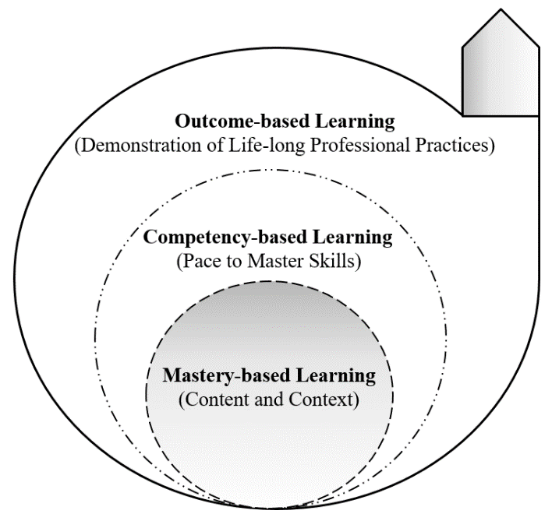
Learning for life-long professional practice

Slide 3
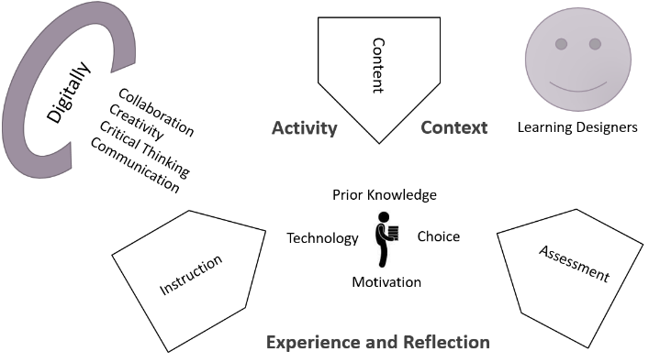
Digital tools to support the language of reflection

Slide 4

Knowledge Creation
(High-level use of technology)
Analyze data; collaborate with peers and teachers; develop and use simulations, build products; create presentations.
Information Consumption
The “bucket theory of knowledge”
Practice skills and procedures; take test or turn in homework; find information in the Internet; write reports, etc.

Slide 5
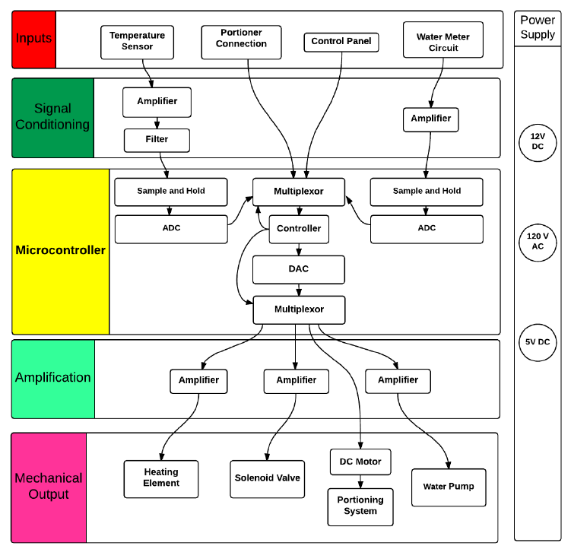
whole mechatronics
as a “system- case- project-based” platform for teaching mechatronics engineering.

Slide 6
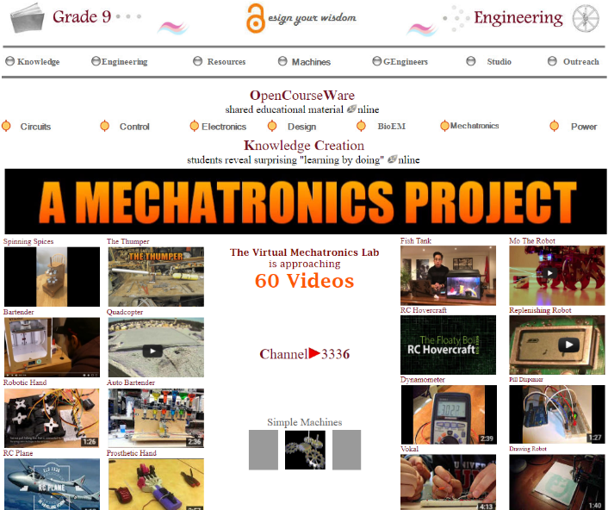
g9toengineering.com was developed by the author in 2007 and maintained by students from an undergraduate mechatronics class to enable knowledge creation and sharing.

Slide 7
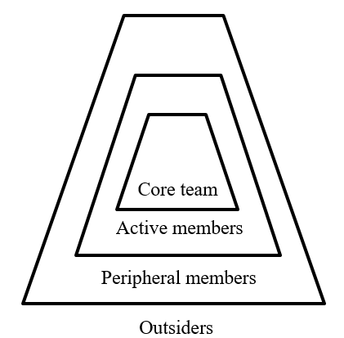
student competition teams and clubs
the mechatronics class
other engineering classes
the uOttawa virtual community of practice

Slide 8
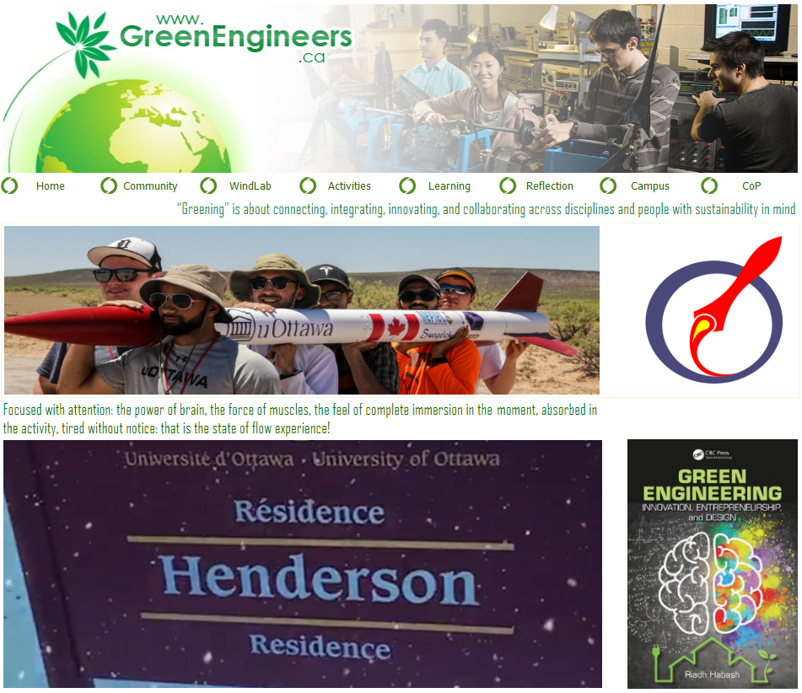
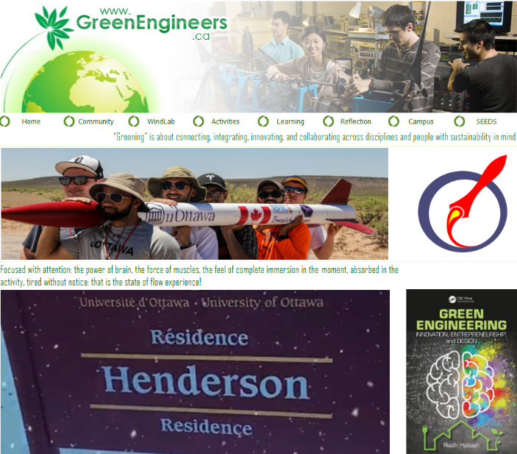
Greenengineers.ca
is a complementary virtual community of practice hub developed by the author in 2010 to strengthen the main OER especially by student competition teams and clubs.

Slide 9
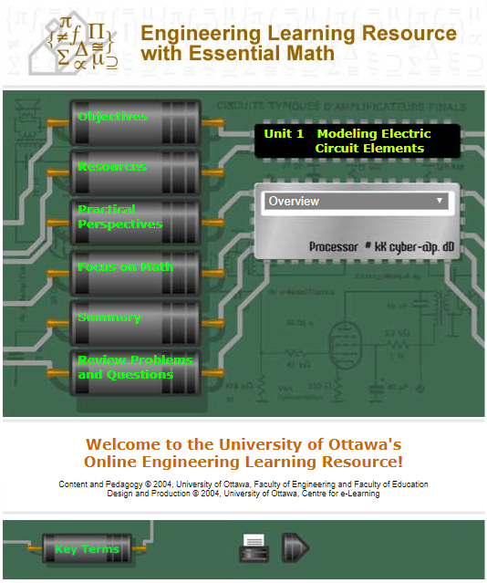
Math as a tool
is an interactive OER developed by the author in 2004 to make a connection between electric circuits and math.

Slide 10
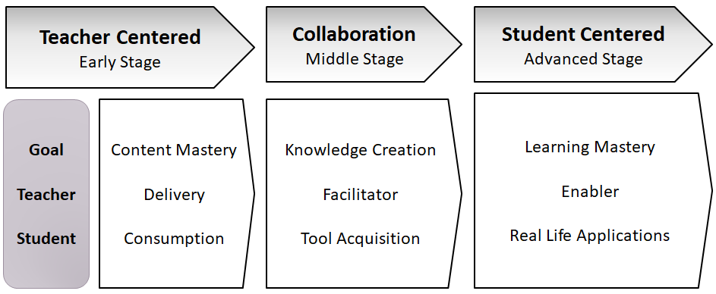
Toward state of flow experience

Slide 11
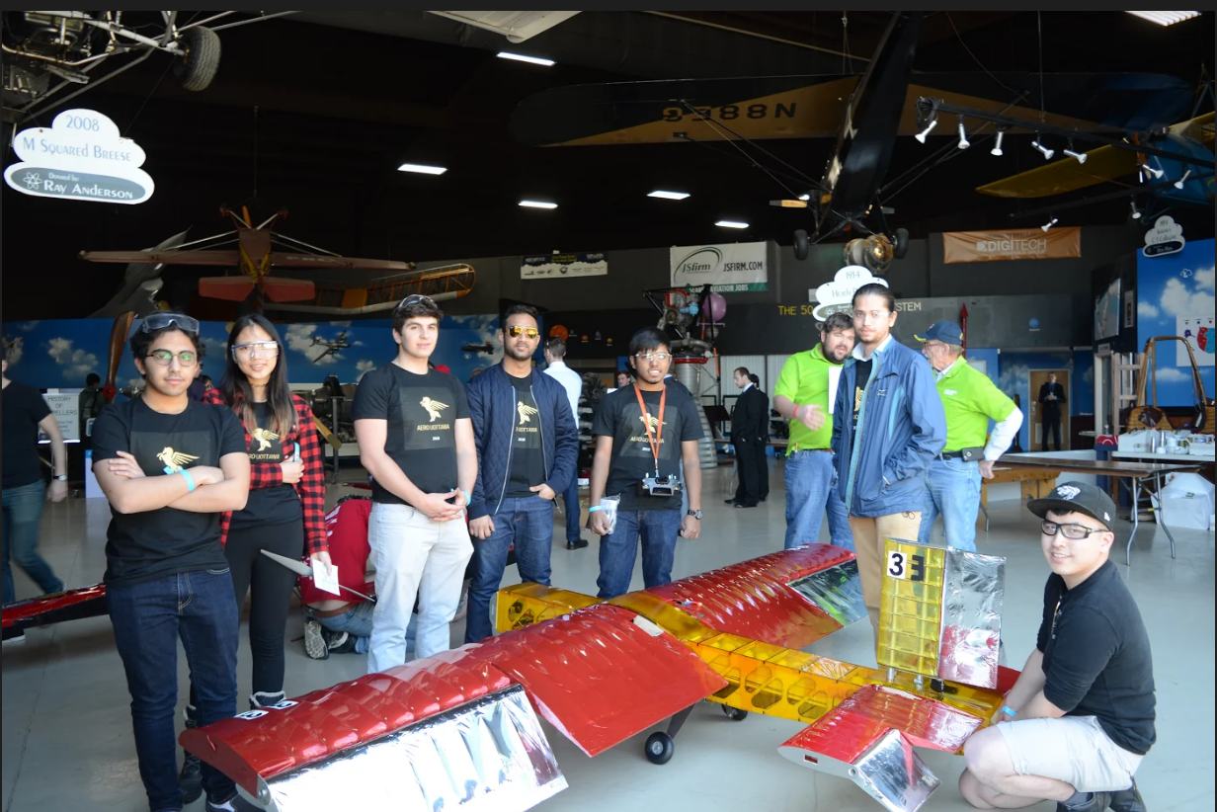
A state of flow experience
with
uOttawa SAE Aerospace
March 9, 2018
Florida Air Museum

Slide 12
Questions
a learning journey from routine and unfeeling to
enlightenment
empowerment
emancipation
entrepreneurial mindset.

