Slide 1
Professional Ethical Practice The Case of Engineering and Computing
The word “ethics” comes from the Greek word “ethos” and is defined as the study of standards of right and wrong; part of science and philosophy dealing with moral conduct, duty, and judgment.
The unexamined life is not worth living. Socrates

Slide 2
Historical Perspectives
Much of what is known about moral reasoning mostly began with the ancient Greeks, especially with the philosophers Socrates, Plato, and Aristotle. From the time of ancient Greece up to the current times, there appeared two principal schools of ethics.
Some moralists maintained that ethical conceptions are inspired in human from above, and they consequently connected ethics with religion.
Other thinkers realized the source of morality in human and maintained that the main motivation power of all human actions is found in what is called pleasure and happiness, and all action is toward this end.

Slide 3
Moral, Ethics, and Law
Morals refer to social conventions about right and wrong that are widely shared so that they become the basis for an established consensus.
Ethics comes from the Greek word “ethos” and is defined as the study of standards and codes of behavior expected of an individual by a group.
Law is a system of rules that tells what one can and cannot do. Laws are enforced by a set of institutions such as the police, courts, and lawmaking bodies.

Slide 4
Evolution of Morals and Ethics
In Western history, much of what is known about formal moral reasoning generally began with the ancient Greeks, especially with the philosophers Socrates (470–399 bc), Plato (427–347 bc), and Aristotle (384–322 bc).
Socrates argued that there was only one true moral code, and it was simple: “No person should ever willingly do evil”. Socrates never wrote down any of his philosophy.
His student, Plato was the first professional philosopher in the West. He established a school of philosophy called the Academy, where the word academic comes from.
Aristotle, on the other hand, focused on the moral character of the individual, which prepares them for ethical challenges.

Slide 5
Chinese and Indian Ethics
Chinese ethics begins with the writings of Confucius, who lived from 551 to 479 bc. Confucius’ written works reflect a practical rather than a theoretical approach to moral problems, unlike Western philosophy after Plato that emphasizes more theoretical thinking. This way of thinking is often called “pre-theoretical”. Confucian ethics emphasizes the role of ideal character traits. As such, it has much in common with the Western concept of virtue ethics.
Indian philosophical and ethical thinking have their origins in the ancient texts known as the Vedas, further developed through the Upanishads, Jainism, Buddhism, and also expressed in the Bhagavad Gita.

Slide 6
What is Ethics?
Ethics may be defined in different ways:
It refers to well-based standards of right and wrong that prescribe what humans ought to do, usually in terms of rights, obligations, benefits to society, fairness, or specific virtues.
Ethics is also understood as the discipline or field of study dealing with one’s ethical standard, moral duty or obligation. This typically gives rise to a set of principles or values which in turn are used to judge the appropriateness of particular conduct or behaviour.

Slide 7
Modern Ethics
Beginning in the 1500s, modern history saw an emerging change in the understanding of ethics, one related to a revolution in science and technology.
Immanuel Kant (1724–1804) connected duty to ethics. His ethics relies on the notion that “morality is grounded in reason, not in tradition, intuition, conscience, emotion, or attitudes such as sympathy”.
Kant recognizes two general categories of duties. A perfect duty is one everyone must always observe, such as duty not to harm another person, and imperfect duties, such as acting with kindness.

Slide 8
Three Branches of Ethics
Metaethics, which addresses the origin and definition of people’s ethical principles. It deals with whether morality exists. Universal truths, God’s will, the meaning of ethical terms, and how reason plays a role in ethical decisions are all a part of metaethics.
Normative morals refer to generally accepted standards of right and wrong in society, often learned during childhood, but ethics are learned at the time of conflict of the problems.
Applied ethics involves the application of normative ethical theories to particular cases. It deals with difficult moral questions and controversial moral issues that people actually face in their lives in various areas.

Slide 9
Ethical Theories
Metaethics:
What does it mean to say something is ethically good?
How, if at all, do we know what is right and wrong?
How do moral attitudes motivate action?
Are there objective values?
Normative Ethics:
Virtue: Courage, generosity, compassion.
Deontology: Act being performed irrespective of consequences.
Consequentialist: The end justifies the means.

Slide 10
Ethics Theories
Applied Ethics
It is a special category of ethical philosophy and the most real of the three categories.
It deals with tough moral questions and controversial moral issues that people face in their lives including abortion, euthanasia, death penalty, gay/lesbian rights, etc.
May be divided into several fields like business, environmental, engineering, health, etc.

Slide 11
Engineering and Computing Ethics
Engineering and computing ethics is an area of applied ethics although other theories of ethics come into play in engineering ethics.
It is the field that examines and sets standards for an engineer’s obligations to the public, clients, employers, and the profession.
Ethical issues involve quality, safety, legal compliance, conflict of interest (bribery and gifts), and treatment of confidential or proprietary information.

Slide 12
Scopes of Engineering Ethics

Slide 13
Categories of Engineering Ethics

Slide 14
Professional Ethics
Professional ethics encompasses the personal, organizational, and corporate standard of attitude and behavior expected of professionals.
Usually, professional attitude and behavior are guided by “codes of conduct,” while the operational activities within a profession are guided by “codes of practice.”
A professional engineer should apply the code of ethics not in passive performance but as a set of principles guiding the professional conduct.

Slide 15
Technology Ethics
Technology ethics is a transdisciplinary area that draws on theories and techniques from several knowledge domains (such as engineering, science, social sciences, technology, applied ethics, and philosophy) to provide insights into ethical dimensions of technological systems and practices for advancing a technological society.
Technologies, particularly revolutionary technology, generate many ethical problems. Sometimes the problems can be treated easily under extant ethical policies.

Slide 16
Social Ethics
Social ethics deals with human needs and aspirations. It involves a code of conduct created by a society in order to ensure a smooth functioning of the said society.
Engineering has enormous role to help provide benefits to society and the idea of social responsibility is very common in engineering ethics. It helps to provide basic needs such as water, food, housing, and energy, and does that on a way crucial for industrial sector to function.

Slide 17
Regulations and By-Laws
The Act specifies the required Regulations and By-laws and the Association defines the details.
Regulations
These provide the specific rules for engineers
For example:
the Act states that academic and experience requirements are needed for licensing
Association sets these requirements in detail
By-Laws
These provide specific rules for running the Association
For example:
Frequency of council meetings, number of members on the discipline committee and complaints committee, etc.

Slide 18
Self Regulation
Professions that have been given the right and responsibility of self-regulation, including the engineering profession, have tended to opt for the first alternative, espousing sets of underlying principles as codes of professional ethics which form the basis and framework for responsible professional practice.
Arising from this context, professional codes of ethics have sometimes been incorrectly interpreted as a set of “rules” of conduct intended for passive observance.
Therefore, a code of professional ethics is more than a minimum standard of conduct; rather, it is a set of principles which should guide professionals in their daily work.

Slide 19
Code of Conducts and Ethics
A code of ethics is the characteristic of a profession. It is an aspirational system of principles and rules or the guideline that sets satisfactory behaviors for a given group of people or profession.
It makes obvious what the public anticipates from the profession. It expresses the rights, duties, and obligations of the members of the profession.
Professionally, the code of ethics is a comprehensive guide to professional conduct. It is usually designed to help practitioners maintain the highest level of ethical conduct, standards of practice and integrity with respect to their professional activities.

Slide 20
The Beginning of Code of Ethics
In the mid-twentieth century there was a proliferation of important ethics codes that still guide engineering professional behavior and research activities.
The first reference to a National Society of Professional Engineers (NSPE) code of ethics is found in the May 1935 issue of The American Engineer in the form of a suggestion for membership consideration.
In 1946, the Board approved the canons of ethics for engineers as prepared by a joint committee sponsored by the Engineers’ Council for Professional Development, a coordinating body of technical engineering societies.

Slide 21
In Canada
Engineers Canada is the national organization of the 12 provincial and territorial associations that regulate the profession of engineering in Canada. Established in 1936, Engineers Canada serves the associations, which are its constituent and sole members, through the delivery of national programs which ensure the highest standards of engineering education, professional qualifications and ethical conduct.
Provincial and territorial associations of professional engineers are responsible for the regulation of the practice of engineering in Canada. Each association has been established under a professional engineering Act of its provincial or territorial legislature and serves as the regulatory body for the practice of engineering within its jurisdiction.

Slide 22
Engineers Canada
Engineers Canada is the national organization of the provincial and territorial associations that regulate the practice of engineering in Canada and license the country's 290,000 members of the engineering profession.
Engineering is a self-regulated profession. Engineers Canada exists to support the provincial and territorial engineering regulatory bodies. Together, we work to advance the profession in the public interest.
Engineers Canada has national position statements on key issues relating to the public interest, including infrastructure, labor mobility and regulating the profession. These are consensus positions of the regulatory bodies.

Slide 23
Engineers Canada
Standards
accredits undergraduate engineering programs
develops professional practice and qualifications guidelines as it relates to the public interest
facilitates international and interprovincial labour mobility
owns the official marks on the terms ENGINEER, ENGINEERING, PROFESSIONAL ENGINEER, P.ENG., CONSULTING ENGINEER, INGÉNIEUR, ING., INGÉNIEUR CONSEIL, GÉNIE and INGÉNIERIE
Outreach
promotes the engineering profession
conducts federal government relations
develops policies and positions
provides insurance, financial and other benefits
undertakes national media relations
Research
monitors university enrollment
promotes diversity in the engineering profession
tracks labor market trends

Slide 24
General Interpretation of Code of Ethics
Protection of the Public and the Environment
Safety, health and welfare of the public and the protection of the environment.
Faithful Agents of Client and Employers
Engineers shall act as faithful agents or trustees of their clients and employers with objectivity, fairness, and justice to all parties.
Competence and Knowledge
Professional engineers shall offer services, advise on, or undertake engineering assignments only in areas of their competence by virtue of their training and experience.
Fairness and Integrity in the Workplace
Honesty, integrity, competence, devotion to service, and dedication to generally enhancing the quality of life are cornerstones of professional responsibility.
Professional Accountability and Leadership
Engineers have a duty to practice in a careful and diligent manner and accept responsibility and be accountable for their actions.

Slide 25
Regulation R.R.O. 1990, Reg. 941
25
The set of regulations created by Professional Engineers Ontario under the authority of the Professional Engineers Act
https://www.ontario.ca/laws/regulation/900941
Contains the Regulations and the By-Laws for Ontario
Key Sections:
Section 72 Professional Misconduct
Defines Professional Misconduct
Section 77 Code of Ethics
Rules of personal conduct to guide the engineer
We will look at these in detail in this lecture.

Slide 26
Definition of Professional Misconduct
26
72. (1) In this section,
“harassment” means engaging in a course of vexatious comment or conduct that is known or ought reasonably to be known as unwelcome and that might reasonably be regarded as interfering in a professional engineering relationship;
“negligence” means an act or an omission in the carrying out of the work of a practitioner that constitutes a failure to maintain the standards that a reasonable and prudent practitioner would maintain in the circumstances. R.R.O. 1990, Reg. 941, s. 72 (1); O. Reg. 657/00, s. 1 (1).
Notes:
These definitions use terms like “reasonable” and “reasonably”. These are well known legal terms and we will see this terminology again when we study Tort law. One definition of a “reasonable person” is:
A phrase frequently used in tort and Criminal Law to denote a hypothetical person in society who exercises average care, skill, and judgment in conduct and who serves as a comparative standard for determining liability. (http://legal-dictionary.thefreedictionary.com/Reasonable+Person)
Reasonable behavior also depends upon the context. In legal terms, we talk about the “standard of care”, which is the degree of care or competence that one is expected to exercise in a particular circumstance or role.
For professionals, a well known English law precedent lead to what is known as the Bolam Test for reasonable duty of care for professionals (https://en.wikipedia.org/wiki/Bolam_v_Friern_Hospital_Management_Committee):
Bolam v Friern Hospital Management Committee [1957] 1 WLR 582 is an English tort law case that lays down the typical rule for assessing the appropriate standard of reasonable care in negligence cases involving skilled professionals (e.g. doctors): the Bolam test. Where the defendant has represented him or herself as having more than average skills and abilities, this test expects standards which must be in accordance with a responsible body of opinion, even if others differ in opinion. In other words, the Bolam test states that "If a doctor reaches the standard of a responsible body of medical opinion, he is not negligent".
In engineering, it is the professional association that will decide whether the standard of care was met, in other words did the engineer act reasonably or was there negligence. In applying these principles, the association will not demand extra-ordinary care, skill, ability, or infallibility of the practitioner.
An example of negligence: in the Quebec bridge case the ruling was that the designer did not follow standard engineering procedures in recalculating the dead loads which lead to the finding of negligence.

Slide 27
Definition of Professional Misconduct
27
72.(2) For the purposes of the Act and this Regulation, “professional misconduct” means,
(a) negligence,
(b) failure to make reasonable provision for the safeguarding of life, health or property of a person who may be affected by the work for which the practitioner is responsible,
(c) failure to act to correct or report a situation that the practitioner believes may endanger the safety or the welfare of the public,
(d) failure to make responsible provision for complying with applicable statutes, regulations, standards, codes, by-laws and rules in connection with work being undertaken by or under the responsibility of the practitioner,
Notes:
Item (a) [Negligence] We saw the definition of negligence in the previous slide.
Example: negligence of the designer of the Quebec bridge in failing to meet standards of practice that included the need to re-calculate dead-loads as the design progressed.
Item (b) [Protect the public] “reasonable provisions” for safeguarding the public. Again, the association (via the discipline committee) will determine if the actions were reasonable and met the standard of care expected.
Example: to design a plant that discharges untreated toxins into a river.
Item (c) [Duty to Report]
Example: We will discuss this in more detail later.
Item (d) [Breach of Standards] It is the engineer’s duty to know the applicable laws, regulations, standards, codes in performing his/her work. This is an integral part of the standard of care expected of a professional engineer.
Example: to sell a product that fails to meet electromagnetic interference standards. Conviction of a major offence is also grounds for revoking a license.

Slide 28
Definition of Professional Misconduct
28
(e) signing or sealing a final drawing, specification, plan, report or other document not actually prepared or checked by the practitioner,
(f) failure of a practitioner to present clearly to the practitioner’s employer the consequences to be expected from a deviation proposed in work, if the professional engineering judgment of the practitioner is overruled by non-technical authority in cases where the practitioner is responsible for the technical adequacy of professional engineering work,
(g) breach of the Act or regulations, other than an action that is solely a breach of the code of ethics,
(h) undertaking work the practitioner is not competent to perform by virtue of the practitioner’s training and experience,
Notes:
Item (e) [Misrepresentation] Sealing a document that was not prepared or reviewed by the practitioner
We will look at an example of this later. Note that this is also related to the Code of Ethics section 77.7.ii (don’t review other engineers work without their knowledge).
Item (f) [Duty to Warn] Must inform employer the consequences of deviations from plans
Example: A manager tells you to change a design in a particular way to save money and the consequences of the change would impact product safety. It is the duty of the engineer to go on record opposing the change. If public safety is involved in my lead to the Duty to Report requirement.
Item (g) [Breach of the Act] This item is a catchall for any illegal activity under the Act or Regulations. We will see that for the most part a breach of the code of ethics is also misconduct (except to two clauses in the code of ethics). In general, if you follow the code of ethics you are unlikely to commit professional misconduct.
Example: A P.Eng. advertising and providing engineering services to the public without a Certificate of Authorization would be covered by this clause. (and by clause R72.2.k)
Item (h) [Incompetence] is about competency.
Example: If you are an electrical engineer, you should not undertake to design and certify bridges unless you are competent to do so (which is unlikely).

Slide 29
Definition of Professional Misconduct
29
(i) failure to make prompt, voluntary and complete disclosure of an interest, direct or indirect, that might in any way be, or be construed as, prejudicial to the professional judgment of the practitioner in rendering service to the public, to an employer or to a client, and in particular, without limiting the generality of the foregoing, carrying out any of the following acts without making such a prior disclosure:
Accepting compensation in any form for a particular service from more than one party.
Submitting a tender or acting as a contractor in respect of work upon which the practitioner may be performing as a professional engineer.
Participating in the supply of material or equipment to be used by the employer or client of the practitioner.
Contracting in the practitioner’s own right to perform professional engineering services for other than the practitioner’s employer.
Expressing opinions or making statements concerning matters within the practice of professional engineering of public interest where the opinions or statements are inspired or paid for by other interests,
Notes:
Item (i) [Conflict of Interest]
The specific sub-clauses are examples of some conflicts. But these are only examples, the main clause is more general.
Even the perception of a conflict is a conflict. The fact that you are so ethical that your engineering judgement will not be swayed is not enough, you must avoid or disclose a perceived conflict of interest.
If it is not possible to remove the perceived conflict of interest, you must make prompt, voluntary, complete (PVC) disclosure. Based on this disclosure, you employer may help you remove or avoid the conflict.
Sub-item 5 is related to expert testimony (see R77.2.iii in the CoE as well). You should be paid for prep work required to deliver expert testimony (see R77.7.v adequate compensation), but you should not accept payment to influence the outcome of your investigation. You must provide honest and informed professional opinions (R77.2.iii) free from any conflict of interest (R72(2)(i)5.) You can be sure that during cross-examination you will ask if you were paid and for what you were paid for.

Slide 30
Definition of Professional Misconduct
30
(j) conduct or an act relevant to the practice of professional engineering that, having regard to all the circumstances, would reasonably be regarded by the engineering profession as disgraceful, dishonourable or unprofessional,
(k) failure by a practitioner to abide by the terms, conditions or limitations of the practitioner’s licence, provisional licence, limited licence, temporary licence or certificate,
(l) failure to supply documents or information requested by an investigator acting under section 33 of the Act,
(m) permitting, counselling or assisting a person who is not a practitioner to engage in the practice of professional engineering except as provided for in the Act or the regulations,
(n) harassment.
R.R.O. 1990, Reg. 941, s. 72 (2); O. Reg. 657/00, s. 1 (2); O. Reg. 13/03, s. 19.
Notes:
Clause 72.(2).j. [Dishonourable Conduct] Essentially states that a breach of the Code of Ethics (with two possible exceptions, i.e. 77.2.ii Promote the profession, and 77.2.iv Display licence at place of work) is considered misconduct.
Item k: [Breach of License Terms] Each type of license has some limitations.
Examples: A P.Eng. is not sufficient to offer services directly to the public. A Provisional License requires the holder to work under the supervision of a license holder.
Item l: [Obstruction] This clause means you must cooperate with investigations of the Association. Section 33 of the Act: Registrar’s investigation of professional misconduct, in particular s.33.(3) Obstruction of investigator
Item m: [Aiding and Abetting] Being complicity in misrepresentation of another
Item n: [Harassment] We saw the definition of Harassment in Section (1).
Examples: Racial slurs, name calling, racist jokes, negative stereotyping, bullying, threats

Slide 31
PEO Code of Ethics Stakeholders
31
77.1 It is the duty of a practitioner
to the public
to the practitioner's employer
to the practitioner's clients
to other members of the practitioner's profession
and to the practitioner
to act at all times with
…
Notes:
Clause 77.1 applies to society as a whole, i.e. All stakeholders.

Slide 32
PEO Code of Ethics Core Duties
32
77.1. (continued) to act at all times with:
i. fairness and loyalty to the practitioner's associates, employers, clients, subordinates and employees;
ii. fidelity to public needs;
iii. devotion to high ideals of personal honour and professional integrity;
iv. knowledge of developments in the area of professional engineering relevant to any services that are undertaken; and
v. competence in the performance of any professional engineering services that are undertaken.
Notes:
77.1.i. Fairness and Loyalty to all
These are pretty broad terms and cover a lot of ground. For example, If you are:
loyal to your employer, you won’t: sell trade secrets, use work resources for personal gain, etc.
If you are fair to clients, you won’t overcharge for your work just because you know the client can afford it and doesn’t know better
If you are loyal and fair to associates, your won’t backstab or badmouth them to gain a competitive advantage (job promotion for example).
77.1.ii. Fidelity to public needs
In this context, fidelity means faithful, loyal and obedient. This clause means you should act with obedience to public needs. The fact that the public gets their own loyalty clause highlights the fact that the duty to the public is paramount (as stated in R77.2.i and DOPM R72.(2)(b)).
77.1.iii. Honor and Integrity
Applies to practitioner as a person (personal honor) as well as a the professional (profession integrity). Although you probably would not be open to a charge of professional misconduct for things you do that are unrelated to work, this clause holds you to a higher (personal) standard of conduct.
77.1.iv. Continuing Education
Must remain current on developments in the field. Must be knowledgeable of the latest codes and standards that apply.
77.1.v. Competence
Do not undertake work for which you are not competent.

Slide 33
PEO Code of Ethics Duty to Public
33
77.2. A practitioner shall,
i. regard the practitioner's duty to public welfare as paramount;
ii. endeavour at all times to enhance the public regard for the practitioner's profession by
extending the public knowledge thereof and
discouraging untrue, unfair or exaggerated statements with respect to professional engineering;
Notes:
77.2.i Duty to public paramount
This clause provides some guidance in resolving ethical dilemmas.
77.2.ii Promote the profession
Promote and protect the reputation of the profession.
Failure to meet 77.2 ii. is unlikely to result in professional misconduct, but it is still unethical and will damage the profession.

Slide 34
PEO Code of Ethics Truthfulness and Transparency
34
77.2. (continued) A practitioner shall
iii. Not express publicly, or while the practitioner is serving as a witness before a court, commission or other tribunal, opinions on professional engineering matters that are not founded on adequate knowledge and honest conviction;
iv. Endeavor to keep the practitioner's licence, temporary licence, limited licence or certificate of authorization, as the case may be, permanently displayed in the practitioner's place of business.
Notes:
77.2.iii Honest and informed opinions
Don’t give uninformed opinions. As a professional you are trusted, and if you provide an uninformed opinion it may be interpreted as professional guidance and you are liable.
77.2.iv Display License
This is the only clause in the Code of Ethics whose breach of would not be considered malpractice.

Slide 35
PEO Code of Ethics Duties to Employer
35
77.3. A practitioner shall
act in professional engineering matters for practitioner’s employer as a faithful agent or trustee and shall
regard as confidential information obtained by the practitioner as to the business affairs, technical methods or processes of an employer and
avoid or disclose a conflict of interest that might influence the practitioner's actions or judgment.
Notes:
77.3 Duties to Employer
Faithful agent
Example: don’t tell competitors your employer is bidding on a big lucrative contract.
protect confidential information
Example: don’t use employers trade secrets while moonlighting for another client (that may be a competitor). We will see that moonlighting is acceptable, but there are stings attached and this is one of them.
avoid or disclose conflict of interest
There is more than one mention of conflict of interest in the DOPM and CoE. This one relates to your duty to your employer.

Slide 36
PEO Code of Ethics Conflict of Interest
36
77.4. A practitioner must disclose immediately to the practitioner's client any interest, direct or indirect, that might be construed as prejudicial in any way to the professional judgment of the practitioner in rendering service to the client.
Notes:
77.4 Conflict of Interest
A duty to your client (also a duty to your employer under clause R77.3)

Slide 37
PEO Code of Ethics Moonlighting
37
77.5. A practitioner who is an employee-engineer and is contracting in the practitioner's own name to perform professional engineering work for other than the practitioner's employer, must
provide the practitioner's client with a written statement of the nature of the practitioner's status as an employee and the attendant limitations on the practitioner's services to the client, must
satisfy the practitioner’s duty to the practitioner’s employer, and must
inform the practitioner’s employer of the work.
Notes:
77.5 Moonlighting
You must inform your client and your employer. Your duty is to your employer first. Your client must understand that responsibilities to your employer will take precedence and may limit the amount of time you can give them. There are other limitations to your services to your client:
for example, R77.3 your duty of confidentiality of employers trade secrets, processes, etc.
Also, you cannot charge two parties for the same work under (R72.2.i Conflict of Interest)

Slide 38
PEO Code of Ethics Cooperation
38
77.6. A practitioner must co-operate in working with other professionals engaged on a project.
Notes:
77.6 Cooperation
You may be in competition with a colleague for a promotion. This may make you want to hide your work from the colleague to gain an unfair advantage. This is unethical. You must cooperate with your colleague to respect your Duty to the Employer and Duty to the public and Duty to the profession.

Slide 39
PEO Code of Ethics Duty to other Engineers
39
77.7. A practitioner shall,
i. act towards other practitioners with courtesy and good faith,
ii. not accept an engagement to review the work of another practitioner for the same employer except with the knowledge of the other practitioner or except where the connection of the other practitioner with the work has been terminated,
iii. not maliciously injure the reputation or business of another practitioner;
Notes:
77.7.i Duty to Colleagues – courtesy and good faith
Good Faith (bona fides) is a sincere intention to be fair, open, and honest, regardless of the outcome of the interaction. The opposite is bad faith (mala fides) which is duplicity and intention to do harm.
77.7ii Duty to Colleagues – disclosure of review
77.7.iii Duty to Colleagues – not injure reputation
Example: Don’t discredit a competitor for a job or promotion. It reflects bad on the entire profession.
Actions that pit engineer vs. engineer reflect badly on the profession as a whole.

Slide 40
PEO Code of Ethics Duty to Other Engineers
40
77.7 (continued) A practitioner shall,
iv. not attempt to gain an advantage over other practitioners by paying or accepting a commission in securing professional engineering work, and
v. give proper credit for engineering work,
uphold the principle of adequate compensation for engineering work,
provide opportunity for professional development and advancement of the practitioner's associates and subordinates, and
extend the effectiveness of the profession through the interchange of engineering information and experience.
Notes:
77.7.iv Duty to Colleagues – fair competition
Secret commissions, ref. Charbonneau Commission
77.7.v Duty to Colleagues – credit where due, fair compensation (don’t undercut), help with advancement, share info/teamwork.

Slide 41
PEO Code of Ethics Honour and Duty to Report
41
77.8. A practitioner shall maintain the honour and integrity of the practitioner's profession and without fear or favour expose before the proper tribunals unprofessional, dishonest or unethical conduct by any other practitioner.
R.R.O. 1990, Reg. 941, s. 77; O. Reg. 48/92, s. 1.
http://peo.on.ca/index.php?ci_id=1815&la_id=1
Notes:
77.8 Honor and Duty to Report

Slide 42
Ethics versus Misconduct
42
A Code of Ethics defines lines you should not cross
Misconduct define the lines you must not cross.
In general, Codes of Ethics go beyond what is required of the law
Conversely, just because something is not illegal does not make it right.
Respecting the Code of Ethics protects you
If you respect the code of ethics you are free of misconduct
Notes:
Codes of Ethics are designed to go beyond what is required of the law. Alternatively, just because something is not illegal does not make it ethical.

Slide 43
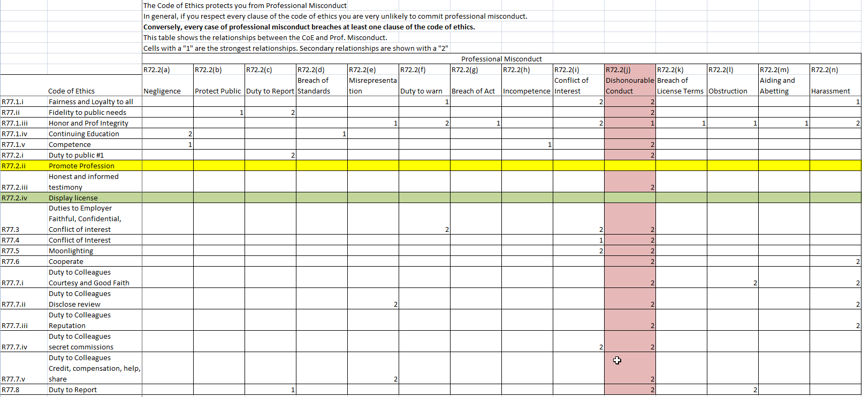
Ethics versus Misconduct
43
This table shows the relationships between the code of ethics (R77) and the definition of professional misconduct (R72)
Notes:
Codes of Ethics are designed to go beyond what is required of the law. Alternatively, just because something is not illegal does not make it ethical.
This table shows the relationship between the code of ethics (rows) and the definition of professional misconduct (columns).
Every case of professional misconduct breaches at least one section of the code of ethics.
The table shows that every breach of the code of ethics can be interpreted as professional malpractice.
The red column shows that almost every breach of the code of ethics can be considered professional malpractice under section 72.2.j Dishonorable Conduct.
There are two exemptions to the rule that a breach of the code of ethics is professional misconduct:
Green Row is R77.2.iv (Display license)...breach of this clause is unethical, but not illegal.
The Yellow row is R77.2.ii Promote the Profession (“endeavour at all times to enhance the public regard for the practitioner's profession by extending the public knowledge thereof and discouraging untrue, unfair or exaggerated statements with respect to professional engineering;)...it is unlikely that breach of this clause of the code of ethics alone would result in professional misconduct.

Slide 44
Ethical Decision Making
44
Ethical decision making is not always easy.
Ethical Dilemmas, where one needs to balance his/her duty to multiple stakeholders is common.
Remember: Public safety is paramount (R77.2.i)
The key is to be systematic
There are two scenarios for ethical decision making:
You need to determine a course of action
You need to decide if a course of action taken was ethical and/or misconduct.

Slide 45
Ethical Decision Making
45
If you need to determine a course of action:
Get the facts straight
Develop optional courses of action
“Do nothing” is an option
Consider consequences of each course of action
Both Ethical and Professional Conduct
Clearly outline your logic (reference sections of Regs)
Chose the best option
Identify potential impacts of the selected course of action
Notes:
Validate the facts. Garbage in – garbage out in the decision process
Develop some alternative scenarios, do nothing is a valid scenario
Consider the consequences of each scenario – consider ethical and misconduct sections of the regulations as well as legal, by-laws, codes, standards
Chose the best option – remember that public safety is paramount. Be sure to provide references to the relevant sub-sections of regulations 72, 77

Slide 46
Ethical Decision Making
46
If you need to decide if ethics/conduct were breached:
Read and understand the case
Get the facts straight
Clearly list your assumptions
Identify the sections of the code of ethics that are relevant
Identify sections of the definition of misconduct that apply
Clearly outline your decision (reference sections of Regs)
Notes:
Validate the facts. Garbage in – garbage out in the decision process
Exam questions are always a bit ambiguous. That is part of the test. Clearly outline the assumptions you make.
Consider the consequences of the scenario – consider ethical and misconduct sections of the regulations as well as legal, by-laws, codes, standards
Clearly outline your logic – remember that public safety is paramount. Be sure to provide references to the relevant sub-sections of regulations 72, 77

Slide 47
Case Study Duty to Report (R77.8,R72.2.c)
47
If engineer observes unsafe, unethical or illegal actions
Code of ethics requires that action be taken.
May be necessary to “blow the whistle”
Get the facts
Consider possible solutions
Try to resolve issue with responsible person
Escalate internally if necessary
Contact the Association for mediation and guidance if necessary
Do not “go public”
Failure to report is Professional Misconduct (R.R.O. 1990, Reg. 941 section 72.2(c))
PEO provides guidance on reporting:
http://www.peo.on.ca/index.php/ci_id/16158/la_id/1.htm
Notes:
Reporting process:
1. Get the facts and identify urgency
Make sure you have the facts. Get documented proof and assess the severity of the problem. Is it illegal? Is it unethical? Is it unsafe?
2. Consider the solution
Prepare for the discussion. Determine a suitable solution. You can’t just complain, you should come forward with at least one proposed solution.
3. Speak to the key person (internal)
Determine the right person to speak to. If you are an employee, speak to your immediate manager. If you are a contractor, speak to your client. Start with an informal conversation with the relevant person, and describe the problem and proposed solution. Often, when notified of the issue the manager or client will be eager to solve the problem.
4. Go higher internally if needed (internal)
If the first person you speak to does not take the problem seriously and has no valid reason for refusing to resolve the issue, escalate the problem internally.
5. Report to the Association
When all internal avenues are exhausted, contact the Association. The Association may be able to mediate in some cases, however illegal activities must eventually be reported if public health or welfare are involved.
If you fail to take these steps, you have acted un-ethically and are subject to discipline for professional misconduct and potentially open to legal action (if the issue was a violation of a law or regulation other than the Professional Engineers Act).

Slide 48
Case Study Duty to Report (R77.8,R72.2.c)
48
Engineer learns employer is dumping toxic waste into river
This is violation of Environmental Protection Act (illegal)
What should the engineer do?

Slide 49
Case Study Duty to Report Possible Answer
49
1. Get the facts and identify urgency (internal)
Confirm via testing that the discharge is toxic. If it is, the practice is not only unethical, it is illegal under the EPA. Immediate action is necessary(R72(2)(b), R77.2.i Protect public, R72(2)(c),R77.8 Duty to Report)
2. Consider the solution (internal R77.1.i Duty to Employer)
Investigate possible cost-effective solutions.
3. Speak to the key person (internal R77.7.i Duty to Colleague)
Identify the person in charge of waste disposal within the company. An informal discussion with the responsible person should be initiated. In many cases, the person responsible will be eager to solve it.
4. Go higher internally if needed (internal R77.1.i Duty to Employer)
If the key person is not receptive to the presentation of the problem, you must escalate up the management chain. This is still internal. Your goal is not to embarrass anyone, but to reduce the organizations liability.
5. Report to the Association (R72(2)(c), R77.8)
When all internal avenues are exhausted, contact the Association. The Association will provide guidance and help.
If you fail to take these steps, you have acted un-ethically and are subject to discipline for professional misconduct and potentially open to legal action (since the issue is a violation of the law).
Notes:
Reporting process:
1. Get the facts and identify urgency
The engineer must confirm via testing that the effluent is toxic. If it is, the practice is not only unethical, it is illegal under the EPA, so immediate action is necessary.
2. Consider the solution
The engineers should investigate possible cost-effective solutions such as treating the waste to remove the toxins, removing the waste and disposing of it properly, or changing the process so that the waste products are not dangerous.
3. Speak to the key person (internal)
The engineer should identify the person in charge of waste disposal within the company, because that person will be most effective in resolving the issue. An informal discussion with the responsible person, and the engineers manager should be initiated. In many cases, the person responsible may not be aware of the problem and will be eager to solve it.
4. Go higher internally if needed (internal)
If the key person is not receptive to the engineers presentation of the problem the engineer must escalate up the management chain. This is still internal, and is the expected remedial action in most organizations. The engineers goal is not to embarrass anyone, but to reduce the organizations liability for illegal activity.
5. Report to the Association
When all internal avenues are exhausted, contact the Association. The Association may be able to mediate in some cases, however illegal activities must eventually be reported if public health or welfare are involved.

Slide 50
Case Study Use of Computer Programs
50
Ethical concerns created by use of software
Liability of computer errors
Software piracy
Plagiarism from Internet
Protection against computer viruses

Slide 51
Case Study Liability of Computer Errors
51
Engineering failure results from faulty software
Engineer uses and bases decision on software output.
Incorrect or misunderstood output results in failure.
Engineer is responsible for failure
When software used in engineering decisions engineer should
Be competent in area in which software is used
Know what assistance software is providing
Know theory and assumptions used by software
Know range and limits of its validity
Test software to ensure accuracy.

Slide 52
Case Study Software Piracy
52
An Engineer borrows a software licence key from a friend to perform some calculations for work.
Unauthorized use or copying is theft
Software protected by copyright / trademark laws.
Canadian Alliance Against Software Theft / Business Software Alliance detects and prosecutes copyright infringement.
Ethical use of software
Stimulates software development
Increases creativity, productivity and job opportunities.

Slide 53
Case Study The Engineer’s Seal
An engineer is asked by his employer to seal an engineering document.
The employer says the deadline is in 2 days and the engineer that prepared the document is on vacation.
What do you do?
Seal must be signed and dated to be valid
Notes:
Inform the employer that you cannot seal the document without reviewing it and that you cannot review it without the knowledge of the engineer that prepared it.
To seal the document without reviewing it would be professional misconduct (R72.(2)(e)) and you could lose your license.
Furthermore, and if the documents are incorrect and lead to damages you and your company will be liable for fraud or negligence under Tort Law. So it is not in the employers best interest either.
It would also be a breach of ethics (R77.7.ii Disclose review) and professional misconduct (R72.(2)(j) Dishonorable Conduct) if you were to review the document without the other engineers knowledge.
You should help your employer and your colleague (R77.1.i.), but you must be competent (R77.1.v) and you must:
inform your colleague of the request for you to review and seal the document. This is required (R77.7.ii), this is professional courtesy (R77.7.i)
review the document with the same standard of care that you would use if you had prepared the document, and
if it is acceptable seal the document
Give credit to the engineer that did most of the work (R77.7.v)
if the work is not acceptable, you should let your employer and colleague know what needs to be done to fix it and that you cannot seal the document as is.

Slide 54
Case Study Engineer’s Seal Possible Answer
54
Facts:
To seal the document without reviewing it would be misconduct (R72(2)(e)) and you could lose your license.
If the documents are incorrect and lead to damages, you and your company may be liable for negligence under Tort Law. So it is not in the employers best interest for you seal/sign without reviewing.
It would also be a breach of ethics (R77.7.ii Disclose review) and misconduct (R72(2)(j) Dishonorable Conduct) if you were to review the document without the other engineers knowledge.
You must be competent to perform the review (R77.1.v Competence)
You should:
inform the employer of the facts above,
help your employer and your colleague (R77.1.i. Fairness and Loyalty),
inform your colleague of the request for you to review and seal the document. This is required (R77.7.ii Disclose Review), and is professional courtesy (R77.7.i Courtesy and Good Faith).
review the document with the same standard of care that you would use if you had prepared the document, and
if it is acceptable seal and sign the document
Give credit to the engineer that did most of the work (R77.7.v Duty to Colleagues)
if the work is not acceptable, you should let your employer and colleague know what needs to be done to fix it and that you cannot seal the document as is.

Slide 55
Duty of the Association Enforcement and Discipline
55
Duty of associations is to protect public
Respond to complaints from public.
Association investigates, mediates, takes legal action if necessary.
Unlicensed: Enforcement
Licensed: Discipline

Slide 56
Enforcement and Discipline
56
Enforcement of Act
Against law to practise without license.
Association enforces law by prosecuting offenders in court.
Professional Discipline
Licensed member can be disciplined for misconduct, incompetence, unethical behavior and other reasons
Fines, revocation or suspension of licence, restriction of work.

Slide 57
Enforcement
57
Enforcement: legal action PEO takes against individuals or entities who practise engineering without a licence, or offer engineering services to the public without a Certificate of Authorization.
Sections 39 and 40 of the Professional Engineers Act give PEO the authority to take action.
Section 40(1) sets maximum fines for individuals and firms practising without the necessary licences (P.Eng., and/or C of A). Fines are $25,000 for a first offence and $50,000 for each subsequent offence.
Section 40(2) authorizes fines of up to $10,000 for a first offence and $25,000 for each subsequent offence, for people who:
use the title "professional engineer" or an abbreviation or variation as an occupational designation;
use a term, title or description that will lead to the belief that the person may engage in the practice of professional engineering; or
use a seal that will lead to the belief that the person is a professional engineer.
Notes:
Enforcement is legal action PEO takes against individuals or entities who practise engineering without being licensed, or offer engineering services without holding a Certificate of Authorization. With only a few exceptions, only people who are licensed with PEO can practise professional engineering, and only people or entities who hold Cs of A issued by PEO can offer or provide professional engineering services to the public.
Sections 39 and 40 of the Professional Engineers Act give PEO the authority to take action. Section 40(1) sets maximum fines for individuals and firms practising without the necessary licences (P.Eng., and/or C of A). These fines are $25,000 for a first offence and $50,000 for each subsequent offence. Section 40(2) authorizes fines of up to $10,000 for a first offence and $25,000 for each subsequent offence, for people who:
use the title "professional engineer" or an abbreviation or variation as an occupational designation;
use a term, title or description that will lead to the belief that the person may engage in the practice of professional engineering; or
use a seal that will lead to the belief that the person is a professional engineer.
Section 40(3) states similar requirements for those entities that do not have a C of A.

Slide 58
Discipline
58
Association staff receive and administer the complaints
Discipline decisions are made by a discipline committee composed of engineers.
Main reasons for disciplinary action
Professional misconduct
Incompetence
Breach of the code of ethics
Physical of mental incapacity
Conviction of a serious offence

Slide 59
Complaints Committee
59
Complaints Committee from R.S.O. 24(1)
http://www.e-laws.gov.on.ca/html/statutes/english/elaws_statutes_90p28_e.htm#BK24
The Complaints Committee shall consider and investigate complaints made by members of the public or members of the Association regarding the conduct or actions of a member of the Association or holder of a certificate of authorization, a temporary licence, a provisional licence or a limited licence
Determine whether or not to forward complaint to discipline committee

Slide 60
Common Professional Complaints (1 of 2)
60
Conflict of Interest
Personal preference or financial interest which interferes with duty to employer.
Payment from more than one source for same service
Secret commission
Must avoid conflicts of interest
If cannot be avoided, must provide prompt, voluntary and complete (PVC) disclosure to all involved

Slide 61
Common Professional Complaints (2 of 2)
61
Breach of standards
Design work: Engineer must follow commonly accepted codes and standards.
First step in design process: Information gathering
Start of project: Engineer should find appropriate design standards / safety regulations.

Slide 62
Discipline Committee
62
Discipline Committee from R.S.O. 28(1) – 28(4)
http://www.e-laws.gov.on.ca/html/statutes/english/elaws_statutes_90p28_e.htm#BK28
Duty to:
hear and determine allegations of professional misconduct or incompetence of a member
Power to:
Revoke a license
Suspend a license
Impose terms, conditions or limitations including successful completion of a particular course or course of study
Fine of up to $5000
Publicly shame (publish in Dimensions)

Slide 63
Summary of the CIPS Code of Ethics and Professional Conduct
63
http://www.cips.ca/ethics
CIPS members must protect the public interest and discharge with integrity all duties and services owed to:
the public
CIPS members
other IT professionals, and
clients.
The obligation to protect the public interest is paramount
Integrity and trustworthiness are fundamental and are key elements of each requirement of the Code or Ethics
Dishonourable or questionable conduct will result in CIPS taking disciplinary action.
Notes:
CIPS members must protect the public interest and discharge with integrity all duties and services owed to:
the public
CIPS members
other IT professionals, and
clients.
The obligation to protect the public interest is paramount, and must prevail when there are conflicts with other obligations.
Integrity and trustworthiness are fundamental qualities and are key elements of each requirement of the Code or Ethics and Professional Conduct.
If integrity and trustworthiness are lacking, the member’s usefulness to the client and reputation within the profession will be destroyed regardless of how competent the member may be.
Dishonourable or questionable conduct will result in CIPS taking disciplinary action.

Slide 64
Summary of the CIPS Code of Ethics and Professional Conduct
64
http://www.cips.ca/ethics
Protect the Public Interest and Maintain Integrity
Work with due regard for public health, public safety and the environment
Uphold the reputation of CIPS and the profession
Report problems that may injure persons, organizations, property or the economy
Not discriminate on any grounds, such as race, sex, sexual orientation, nationality, social origin, family status or disability
Notes:
Public safety is paramount.
Reputation of the profession is at stake.
Duty to report
No Prejudice or discrimination

Slide 65
Summary of the CIPS Code of Ethics and Professional Conduct
65
2. Demonstrate Competence and Quality of Service
Exercise uncompromised professional judgment
Be honest and candid when providing service
Maintain professional competency and remain current
Be aware of and compliant with legislation, standards and bodies of knowledge
Respect rights of third parties, such as giving credit where it is due
Conduct all activities with due regard for ownership, property rights and privacy.
Notes:
Competency has to do with the sufficiency of the member’s qualifications, knowledge, and skills and the ability to use them effectively in the interest of the client.
Members must not undertake work without honestly feeling competent to handle it, or able to become competent without undue delay, risk, or expense to the client.

Slide 66
Summary of the CIPS Code of Ethics and Professional Conduct
66
3. Maintain Confidential Information and Privacy
Do not disclose having been retained by a client unless the nature of the matter requires such disclosure or the client has expressly given permission to disclose such information
Do not repeat gossip about a client’s business or affairs
Treat all client business information as confidential, and respect copyrights, trade secrets, privacy and terms of licence or applicable agreements.
Understand and comply with any obligations imposed under privacy legislation, including The Personal Information Protection and Electronics Document (PIPEDA) privacy Act and other laws.
Notes:
Duty of Secrecy: Clients have a right to expect that anything disclosed, seen or overheard will remain confidential
Do not even disclose having been retained by the client

Slide 67
Summary of the CIPS Code of Ethics and Professional Conduct
67
4. Avoid Conflicts of Interest
Do not place personal or professional interests or those of colleagues above the interest of the public or those of clients
Make reasonable efforts to notify all parties involved to make full disclosure if any conflict is seen to occur by an independent third party
Do not create hidden reciprocal relationships with third parties who stand to gain as a result of their work
Inform clients of any interest which might be seen to impair professional judgement.
Notes:
CIPS members must avoid situations where there is a significant risk that the interest of the member may conflict with the public and/or client.
A conflicting interest is one that would be likely to affect adversely the CIPS member’s judgement or service on behalf of, or loyalty to, a client of prospective client.

Slide 68
Summary of the CIPS Code of Ethics and Professional Conduct
68
5. Uphold Responsibility to the IT Profession
Participate and act with integrity in a manner that upholds the reputation and good standing of CIPS and the profession
Participate with and support fellow CIPS members in their professional development, and provide opportunities for the professional development of new CIPS members, potential CIPS members, colleagues and subordinates
Make reasonable efforts to volunteer time and expertise by participating in activities to promote the advancement of CIPS and the profession
Exemplify the values of equality, tolerance and respect for others.
Notes:
CIPS members must assist in maintaining the integrity of CIPS and the IT profession and should participate in its activities.
Members’ conduct towards CIPS members and the IT professionals should be characterized by courtesy and good faith.
CIPS members have an obligation to support and advance the interests of CIPS and the profession, and to respect the rights and professional aspirations of their colleagues.

Slide 69
CIPS Code of Ethics Case Study 1
69
Your company has developed safety critical software that you believe may not have been adequately tested
You mention this to your manager, and he tells you “you are too inexperienced to make that judgment, the expert testers are confident the software is OK”.
What do you do?
Notes:
Get the facts straight
Do you have proof that the software was not tested properly?
Can you propose the tests that should be done and estimate the cost?
Do the expert testers agree with your bosses claim
2. Develop optional courses of action
Do nothing
Try to convince your boss that more testing is needed
Try to convince the testers that more testing is needed
Go public
Report to CIPS
3. Consider consequences of each course of action
Protect the Public Interest and Maintain Integrity
Work with due regard to public safety (public safety is paramount)
Uphold the reputation of CIPS and the Profession (don’t go public)
Duty to Report
Demonstrate Competence and Quality of Service
Exercise uncompromised professional judgment (validate the facts, speak to testers)
Maintain Confidential Information
Don’t repeat gossip (get the facts)
Client info confidential (don’t go public)
4. Select Best Option (or combination)
Validate the fact that the software has not been tested adequately. Talk to the testers about you concern. They may validate the boss’ statement or agree with you.
If more testing is needed (testers agree) then discuss with your boss
If boss still refuses, escalate internally
If there is still no will to correct the deficiency, report to CIPS for guidance

Slide 70
CIPS Code of Ethics Possible Answer
70
Get the facts straight
Do you have proof that the software was not tested properly?
Can you propose the tests that should be done and estimate the cost?
Do the expert testers agree with your bosses claim of adequate testing?
2. Develop optional courses of action
Do nothing
Try to convince your boss that more testing is needed
Try to convince the testers that more testing is needed
Go public
Report to CIPS

Slide 71
CIPS Code of Ethics Possible Answer (Continued)
71
3. Consider consequences of each course of action
Protect the Public Interest and Maintain Integrity
Work with due regard to public safety (public safety is paramount)
Uphold the reputation of CIPS and the Profession (don’t go public)
Duty to Report
Demonstrate Competence and Quality of Service
Exercise uncompromised professional judgment (validate the facts, speak to testers)
Maintain Confidential Information
Don’t repeat gossip (get the facts)
Client info confidential (don’t go public)

Slide 72
CIPS Code of Ethics Possible Answer (Continued)
72
4. Select Best Option (or combination)
Validate the fact that the software has not been tested adequately. Talk to the testers. They may validate the boss’ statement (testing adequate) or agree with you.
If more testing is needed (testers agree) then discuss with your boss (give facts, solution, duty to report).
If boss still refuses more test, escalate internally (give facts, solution, duty to report).
If there is still no will to correct the deficiency, report to CIPS for guidance.

Slide 73
CIPS Code of Ethics Case Study 2
73
You know how to crack the encryption on cell phone calls and have the hardware and software available to do this.
Is there any ethical situation when you might consider it ‘right’ to use this knowledge.
Notes:
We will simply discuss scenarios in class.

Slide 74
IEEE Code of Ethics IEEE is the trusted voice for engineering, computing and technology information around the globe https://www.ieee.org/about/corporate/governance/p7-8.html
to hold paramount the safety, health, and welfare of the public, to strive to comply with ethical design and sustainable development practices, and to disclose promptly factors that might endanger the public or the environment;
to avoid real or perceived conflicts of interest whenever possible, and to disclose them to affected parties when they do exist;
to be honest and realistic in stating claims or estimates based on available data;
to reject bribery in all its forms;
to improve the understanding by individuals and society of the capabilities and societal implications of conventional and emerging technologies, including intelligent systems;
to maintain and improve our technical competence and to undertake technological tasks for others only if qualified by training or experience, or after full disclosure of pertinent limitations;
to seek, accept, and offer honest criticism of technical work, to acknowledge and correct errors, and to credit properly the contributions of others;
to treat fairly all persons and to not engage in acts of discrimination based on race, religion, gender, disability, age, national origin, sexual orientation, gender identity, or gender expression;
to avoid injuring others, their property, reputation, or employment by false or malicious action;
to assist colleagues and co-workers in their professional development and to support them in following this code of ethics.

Slide 75
The IEEE/ACM Software Engineering Code of Ethics – 1 of 2
75
See http://www.acm.org/about/se-code
Short version:
Software engineers shall act consistently with the public interest.
2. Software engineers shall act in a manner that is in the best interests of their client and employer consistent with the public interest.
3. Software engineers shall ensure that their products and related modifications meet the highest professional standards possible.
4. Software engineers shall maintain integrity and independence in their professional judgment.

Slide 76
The IEEE/ACM Software Engineering Code of Ethics – 2 of 2
76
Short version continued:
5. Software engineering managers and leaders shall subscribe to and promote an ethical approach to the management of software development and maintenance.
6. Software engineers shall advance the integrity and reputation of the profession consistent with the public interest.
7. Software engineers shall be fair to and supportive of their colleagues.
8. Software engineers shall participate in lifelong learning regarding the practice of their profession and shall promote an ethical approach to the practice of the profession.

Slide 77
IEEE/ACM SE Code of Ethics Some Details of the Long Version (1 of 9)
77
1. Public Interest
Accept responsibility for your work
Approve software only if you have a well-founded belief that it is
Safe
Meets specs
Passes its tests
Does not diminish quality of life
Does not harm privacy
Does not harm the environment

Slide 78
IEEE/ACM SE Code of Ethics Some Details of the Long Version (2 of 9)
78
1. Public Interest continued
Disclose any actual or potential danger
Co-operate to address matters of public concern
Be fair and avoid deception
Consider issues that limit access to software
Disabilities
Allocation of resources
Economic disadvantage
Volunteer for good causes
In particular, public education about the discipline

Slide 79
IEEE/ACM SE Code of Ethics Some Details of the Long Version (3 of 9)
79
2. Client and employer
Provide service in your area of competence
Disclose limitations of your education or experience
Do not use software obtained illegally or unethically
Use client’s or employer’s facilities only as authorized
Respect privacy and confidentiality
Except where this violates the public interest of law
Identify and report when a project is likely to fail, to prove too expensive or have other problems
Avoid conflict of interest

Slide 80
IEEE/ACM SE Code of Ethics Some Details of the Long Version (4 of 9)
80
3. Product
Strive for achievable goals, high quality, acceptable cost and reasonable schedule
Ensure everyone understands the tradeoffs
Use quantitative estimates and state the level of uncertainty
Use appropriate methods and standards
Depart from them only when ethically or technically justified
Ensure requirements are clear and meet the user’s needs
Ensure adequate testing
Document decisions
Maintain the integrity of data
Treat maintenance with the same professionalism as new development

Slide 81
IEEE/ACM SE Code of Ethics Some Details of the Long Version (5 of 9)
81
4. Judgment
Temper technical judgment by the need to support and maintain human values
Only endorse items
you have supervised
you agree with
and in your area of competence
Maintain professional objectivity
E.g. avoid promoting bad ideas to please others
Avoid deceptive financial practices
Avoid associating with anybody that is in a conflict of interest

Slide 82
IEEE/ACM SE Code of Ethics Some Details of the Long Version (6 of 9)
82
5. Management
Ensure software engineers are informed of standards before being held to them
Ensure everybody knows policies and procedures for such things as security and privacy
Be fair in assigning work
Assign work accounting for the person’s level of education and experience, as well as their need to further this
Ensure everybody knows the conditions of employment
Offer fair and just remuneration
Do not ask anyone to do anything inconsistent with this code
Do not punish anyone for expressing ethical concerns.

Slide 83
IEEE/ACM SE Code of Ethics Some Details of the Long Version (7 of 9)
83
6. Profession
Promote public knowledge of software engineering
Participate, as appropriate, in professional organizations
Support others in following this code
Obey all laws unless, in exceptional circumstances, they are inconsistent with the public interest
Where reasonable, express concerns to people breaking this code
Otherwise report violations of the code to authorities

Slide 84
IEEE/ACM SE Code of Ethics Some Details of the Long Version (8 of 9)
84
7. Colleagues
Assist colleagues in professional development
Credit the work of others and refrain from taking undue credit
Review the work of others in a fair way
Listen to the opinions, concerns or complaints of others
Do not interfere in the career of others unless concern for the employer, client or public interest suggests otherwise
Call on other professionals in areas outside your own competence

Slide 85
Online Ethics Center Engineering and Science
The Online Ethics Center (www.onlineethics.org) for engineering and science seeks submissions of high-quality ethics education resources in science and engineering for inclusion in its collection. Interdisciplinary materials are particularly welcome, as are resources that promote active learning at the undergraduate or graduate level. Materials are also needed to assist faculty new to teaching in science and engineering ethics.
You may visit the above online resource and in particular read the “Resources” section where they will come across hundreds of case studies, essays, codes and policies, multimedia and educational activities, and subject aides.
Students may work in teams to develop various tasks related to the above activities for submission to the online resource according to the class instructor’s guidance. For resource submissions, see the “Submit Materials” page.

Slide 86
The Ethical Engineer: EthicalEngineer.ttu.edu
The EthicalEngineer project brings together multiple academic institutions and organizations to discuss the ethical practice of engineering in an international environment.
The focus of this project is a website dedicated to engineering undergraduates with the goal of providing students with a global portal through which they can share their comments on engineering dilemmas.

Slide 87
A Project Idea: Ethical Energy
Identify an ethical issue of interest with future energy systems. Explore and explain different views on the above matter. Ethical perspectives employed in contest range from traditional ethics (which considers whether actions are required, recommended, or forbidden) to issues of individual (micro-ethical) and collective (macro-ethical) responsibility. The contest may focus throughout on responsibilities rather than outcomes. This ethical development task may include allocations of cost and benefits, risks and rewards, social and environmental justice, professional and organizational ethics.
In this task, collaborate with peers or you may work with others outside the class to narrow down the objectives of the task. You may access online resources to create a 3-min video that reflects the above subject.

Slide 88
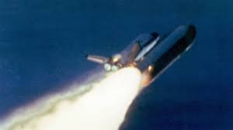
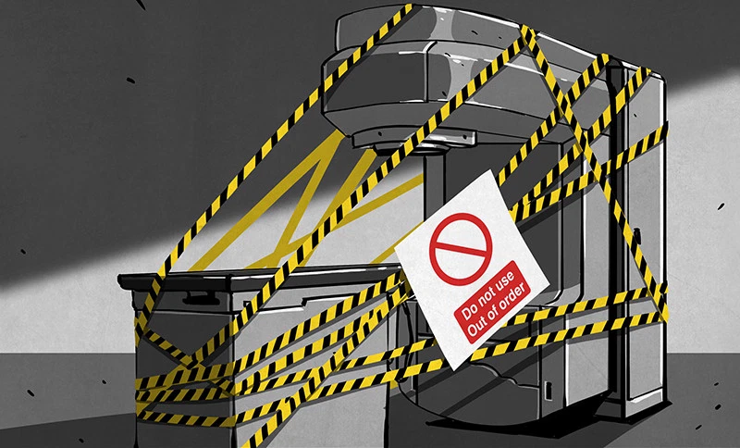
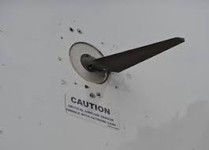
Technological Ethical Issues
AI – self learning weapons, robots, drones
https://www.machine-ethics.net/machine-ethics-compendium/
https://en.m.wikipedia.org/wiki/Machine_ethics
Self driving cars – safe? Bug free? Beta test? Ethical choices?
https://youtu.be/ixIoDYVfKA0
https://www.cnbc.com/2020/01/08/us-safety-agency-opens-probe-into-fatal-tesla-crash-in-indiana.html
https://www.extremetech.com/extreme/303538-another-tesla-crash-another-investigation-into-autopilot
https://www.ted.com/playlists/329/new_tech_new_morals
Historical lessons in Technology Ethics – recurring flaw - Hubris
Challenger disaster https://www.upi.com/Top_News/US/2016/01/28/Engineer-who-warned-of-1986-Challenger-disaster-still-racked-with-guilt-three-decades-on/4891454032643/
Therac 25 automation https://www.computer.org/csdl/magazine/co/2017/11/mco2017110008/13rRUxAStVR
737 MCAS SWhttps://www.seattletimes.com/seattle-news/times-watchdog/the-inside-story-of-mcas-how-boeings-737-max-system-gained-power-and-lost-safeguards/

Slide 89
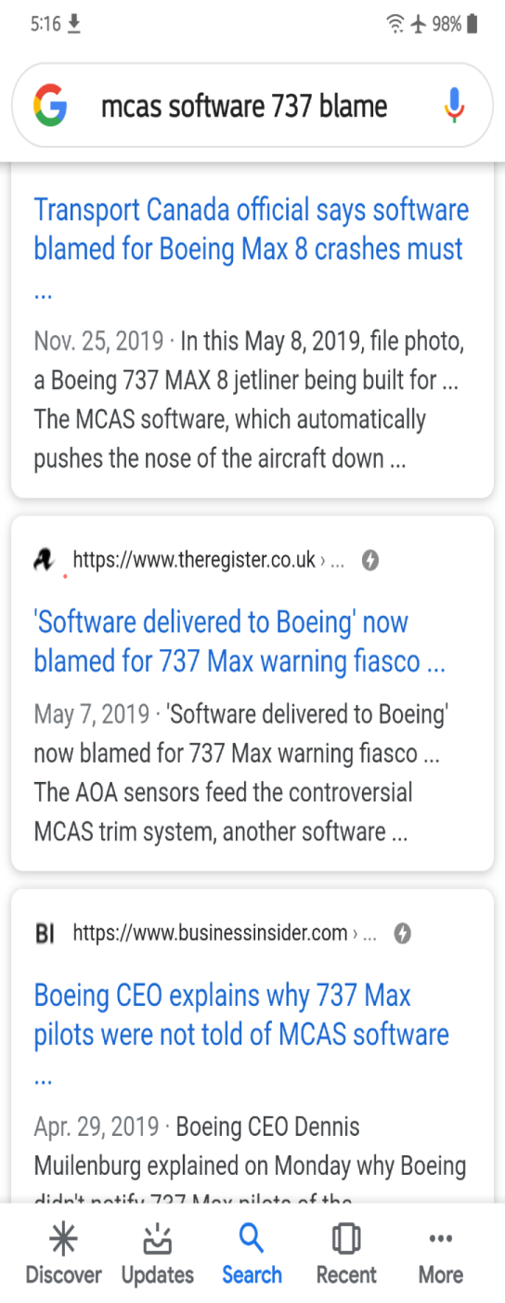
737 MCAS Takes Blame!

Slide 90
Software Errors Caused deaths

Slide 91
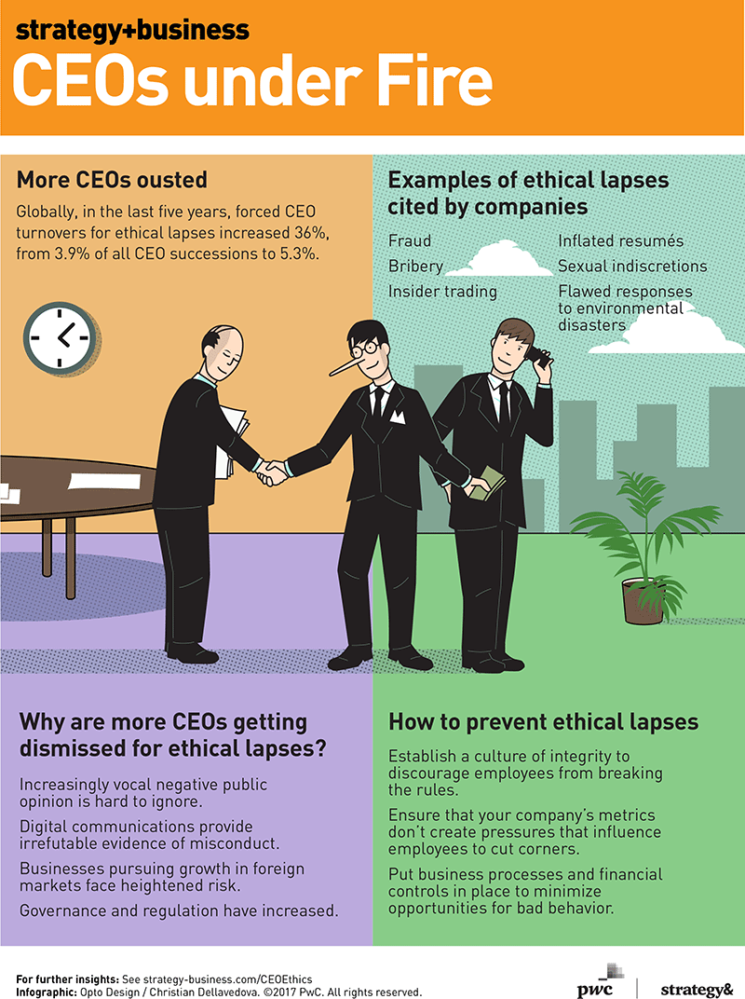
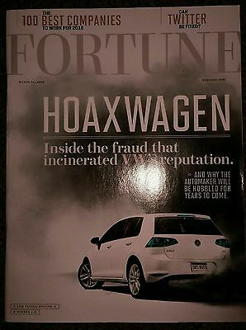
Auto Industry Ethical Lapses

Slide 92
Difficult Ethical Decisions

Slide 93
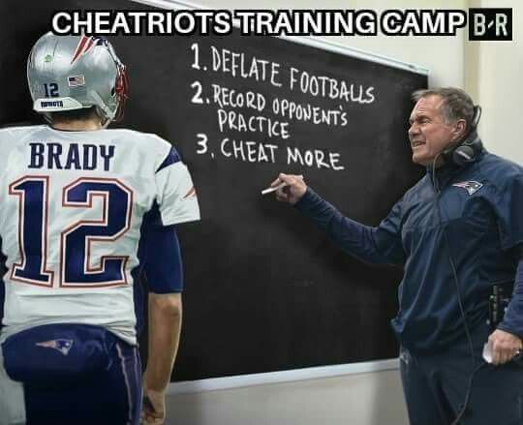
Ends Justify the Means?

Slide 94
Knowledge Acquisition
What is ethics about? Are there universal ethical principles?
What is the meaning of “duty” or “right” or “morally good”?
Explain the difference between values, morality, and professional ethics.
What are the three major ethical theories?
What ethics can professionals learn from the past?
How does ethics differ from law?
Why should engineers and computing specialists study ethics?
What are the greatest ethical challenges engineers and computing specialists currently face in their workplaces?

