Slide 1
Performance Evaluation for Learning Algorithms
Nathalie Japkowicz
School of Electrical Engineering
& Computer Science
University of Ottawa
nat@site.uottawa.ca

Slide 2
Motivation: My story
A student and I designed a new algorithm for data that had been provided to us by the National Institute of Health (NIH).
According to the standard evaluation practices in machine learning, we found our results to be significantly better than the state-of-the-art.
The machine learning community agreed as we won a best paper award at ISMIS’2008 for this work.
NIH disagreed and would not consider our algorithm because it was probably not truly better than the others.

Slide 3
Motivation: My story (cont’d)
My reactions were:
  Surprise: Since my student and I properly applied the evaluation methodology that we had been taught and read about everywhere, how could our results be challenged?
  Embarrassment: There is obviously much more to evaluation than what I have been told. How can I call myself a scientist and not know what the scientists of other fields know so well?
  Determination: I needed to find out more about this and share it with my colleagues and students.

Slide 4
Information about this tutorial
This tutorial is based on the book I have co-written after going through the experience I just described.
It will give you an overview of the complexity and uncertainty of evaluation.
It will also give you a brief overview of the issues that come up in different aspects of evaluation and what the possible remedies may be.
Finally, it will direct you to some resources available that can help you perform more robust evaluations of your systems.

Slide 5

Book Details
Evaluating Learning Algorithms:
A Classification Perspective
Nathalie Japkowicz & Mohak Shah
Cambridge University Press, 2011
Review:
"This treasure-trove of a book covers the important topic of performance evaluation of machine learning algorithms in a very comprehensive and lucid fashion. As Japkowicz and Shah point out, performance evaluation is too often a formulaic affair in machine learning, with scant appreciation of the appropriateness of the evaluation methods used or the interpretation of the results obtained. This book makes significant steps in rectifying this situation by providing a reasoned catalogue of evaluation measures and methods, written specifically for a machine learning audience and accompanied by concrete machine learning examples and implementations in R. This is truly a book to be savoured by machine learning professionals, and required reading for Ph.D students."
Peter A. Flach, University of Bristol

Slide 6
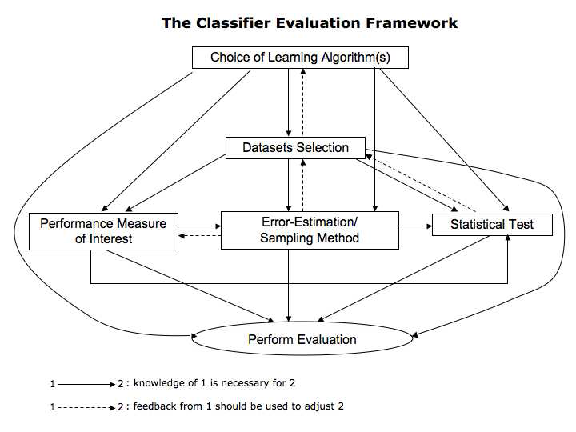
The main steps of evaluation

Slide 7
What these steps depend on
These steps depend on the purpose of the evaluation:
  Comparison of a new algorithm to other (may be generic or application-specific) classifiers on a specific domain (e.g., when proposing a novel learning algorithm)
  Comparison of a new generic algorithm to other generic ones on a set of benchmark domains (e.g. to demonstrate general effectiveness of the new approach against other approaches)
  Characterization of generic classifiers on benchmarks domains (e.g. to study the algorithms' behavior on general domains for subsequent use)
  Comparison of multiple classifiers on a specific domain (e.g. to find the best algorithm for a given application task)

Slide 8
Outline of the tutorial:
Part I (from now until the coffee break!)
  Choosing a performance measure.
  Choosing a statistical test.
Part II (from after the coffee break to the lunch break!)
  What about sampling?
  What data sets should we use?
  Available resources
Part III (if there is time before lunch and we’re not too hungry!)
  Recent research

Slide 9
Part I
Topic 1: Choosing a Performance Measure

Slide 10
Which Classifier is better?
Almost as many answers as there are performance measures! (e.g., UCI Breast Cancer)
Algo | Acc | RMSE | TPR | FPR | Prec | Rec | F | AUC | Info S
NB | 71.7 | .4534 | .44 | .16 | .53 | .44 | .48 | .7 | 48.11
C4.5 | 75.5 | .4324 | .27 | .04 | .74 | .27 | .4 | .59 | 34.28
3NN | 72.4 | .5101 | .32 | .1 | .56 | .32 | .41 | .63 | 43.37
Ripp | 71 | .4494 | .37 | .14 | .52 | .37 | .43 | .6 | 22.34
SVM | 69.6 | .5515 | .33 | .15 | .48 | .33 | .39 | .59 | 54.89
Bagg | 67.8 | .4518 | .17 | .1 | .4 | .17 | .23 | .63 | 11.30
Boost | 70.3 | .4329 | .42 | .18 | .5 | .42 | .46 | .7 | 34.48
RanF | 69.23 | .47 | .33 | .15 | .48 | .33 | .39 | .63 | 20.78

Slide 11
Which Classifier is better?
Ranking the results
Algo | Acc | RMSE | TPR | FPR | Prec | Rec | F | AUC | Info S
NB | 3 | 5 | 1 | 7 | 3 | 1 | 1 | 1 | 2
C4.5 | 1 | 1 | 7 | 1 | 1 | 7 | 5 | 7 | 5
3NN | 2 | 7 | 6 | 2 | 2 | 6 | 4 | 3 | 3
Ripp | 4 | 3 | 3 | 4 | 4 | 3 | 3 | 6 | 6
SVM | 6 | 8 | 4 | 5 | 5 | 4 | 6 | 7 | 1
Bagg | 8 | 4 | 8 | 2 | 8 | 8 | 8 | 3 | 8
Boost | 5 | 2 | 2 | 8 | 7 | 2 | 2 | 1 | 4
RanF | 7 | 6 | 4 | 5 | 5 | 4 | 7 | 3 | 7

Slide 12
What should we make of that?
Well, for certain pairs of measures, that makes sense, since each measure focuses on a different aspect of learning.
  For example, the TPR and the FPR are quite different, and often, good results on one yields bad results on the other.
  Precision and Recall also seem to tradeoff each other.
How about the global measures (Acc, RMSE, the F-measure, AUC, the Information Score)?
  They too disagree as they each measure different (though more difficult to pinpoint as they are composite measures) aspects of learning.

Slide 13
Is this a problem?
It is not a problem when working on a specific application since the purposes of the application are clear and the developer knows which performance measure is best to optimize in that context.
It does become a problem, however, when the general usefulness of a new algorithm is assessed. In that case, what performance measure should be chosen?
  If only one or a few measures are chosen, then it can be argued that the analysis is incomplete, and misleading.
  If many measures are chosen, the results become too mitigated for any clear statement to be issued.

Slide 14
What to do, then?
One suggestion which tries to balance pragmatics (getting the paper accepted!) with fairness (acknowledging the weakness of the new algorithm!) is to divide the evaluation procedure into two parts:
  In the first part, choose a few important metrics on which the new method excels in order to demonstrate this new method’s worth.
  In a second part, overview the results that the new method obtains on a large selection of performance measures.
  Try to explain these observations; do not be too strict (i.e., if the new method consistently ranks as one of the best three methods tested, then it is not that bad. Similarly, if it ranks very badly on only one performance measure, then it is not that bad either).

Slide 15
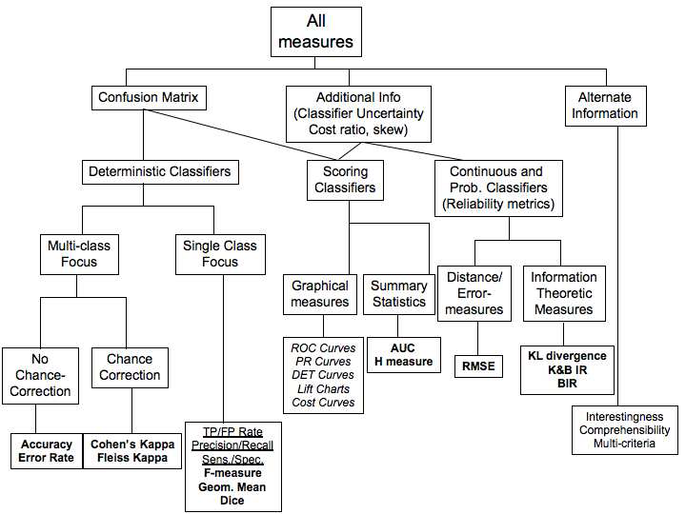
Overview of Performance Measures

Slide 16
A Few Confusion Matrix-Based Performance Measures
Accuracy = (TP+TN)/(P+N)
Precision = TP/(TP+FP)
Recall/TP rate = TP/P
FP Rate = FP/N
ROC Analysis moves the threshold between the positive and negative class from a small FP rate to a large one. It plots the value of the Recall against that of the FP Rate at each FP Rate considered.
True class → Hypothesized | class V | Pos | Neg
Yes | TP | FP
No | FN | TN
 | P=TP+FN | N=FP+TN
A Confusion Matrix

Slide 17
Issues with Accuracy
True class → | Pos | Neg
Yes | 200 | 100
No | 300 | 400
 | P=500 | N=500
True class → | Pos | Neg
Yes | 400 | 300
No | 100 | 200
 | P=500 | N=500
Both classifiers obtain 60% accuracy
They exhibit very different behaviours:
  On the left: weak positive recognition rate/strong negative recognition rate
  On the right: strong positive recognition rate/weak negative recognition rate

Slide 18
Issues with Precision/Recall
True class → | Pos | Neg
Yes | 200 | 100
No | 300 | 400
 | P=500 | N=500
True class → | Pos | Neg
Yes | 200 | 100
No | 300 | 0
 | P=500 | N=100
Both classifiers obtain the same precision and recall values of 66.7% and 40% (Note: the data sets are different)
They exhibit very different behaviours:
  Same positive recognition rate
  Extremely different negative recognition rate: strong on the left / nil on the right
Note: Accuracy has no problem catching this!
18

Slide 19
Is the AUC the answer?
Many researchers have now adopted the AUC (the area under the ROC Curve).
The principal advantage of the AUC is that it is more robust than Accuracy in class imbalanced situations.
Indeed, given a 95% imbalance (in favour of the negative class, say), the accuracy of the default classifier that issues “negative” all the time will be 95%, whereas a more interesting classifier that actually deals with the issue, is likely to obtain a worse score.
The AUC takes the class distribution into consideration.
19

Slide 20
Is the AUC the Answer? (cont’)
While the AUC has been generally adopted as a replacement for accuracy, it met with a couple of criticisms:
  The ROC curves on which the AUCs of different classifiers are based may cross, thus not giving an accurate picture of what is really happening.
  The misclassification cost distributions (and hence the skew-ratio distributions) used by the AUC are different for different classifiers. Therefore, we may be comparing apples and oranges as the AUC may give more weight to misclassifying a point by classifier A than it does by classifier B (Hand, 2009) ➔Answer: the H-Measure, but it has been criticized too!

Slide 21
Some other measures that will be discussed in this tutorial:
Deterministic Classifiers:
  Chance Correction: Cohen’s Kappa
Scoring Classifiers:
  Graphical Measures: Cost Curves (Drummond & Holte, 2006)
Probabilistic Classifiers:
  Distance measure: RMSE
  Information-theoretic measure: Kononenko and Bratko’s Information Score
Multi-criteria Measures: The Efficiency Method (Nakhaeizadeh & Schnabl, 1998)

Slide 22
Cohen’s Kappa Measure
Agreement Statistics argue that accuracy does not take into account the fact that correct classification could be a result of coincidental concordance between the classifier’s output and the label-generation process.
Cohen’s Kappa statistics corrects for this problem. Its formula is:
  κ = (P₀ – P_{e}^{C} )/ ( 1 – P_{e}^{C}) where
  P₀ represents the probability of overall agreement over the label assignments between the classifier and the true process, and
  P_{e}^{C} represents the chance agreement over the labels and is defined as the sum of the proportion of examples assigned to a class times the proportion of true labels of that class in the data set.

Slide 23
Cohen’s Kappa Measure: Example
Predicted -> Actual | A | B | C | Total
A | 60 | 50 | 10 | 120
B | 10 | 100 | 40 | 150
C | 30 | 10 | 90 | 130
Total | 100 | 160 | 140
Accuracy = P₀ = (60 + 100 + 90) / 400 = 62.5%
P_{e}^{C} = 100/400 * 120/400 + 160/400 * 150/400 + 140/400 * 130/400 = 0.33875
κ = 43.29%
➔ Accuracy is overly optimistic in this example!

Slide 24
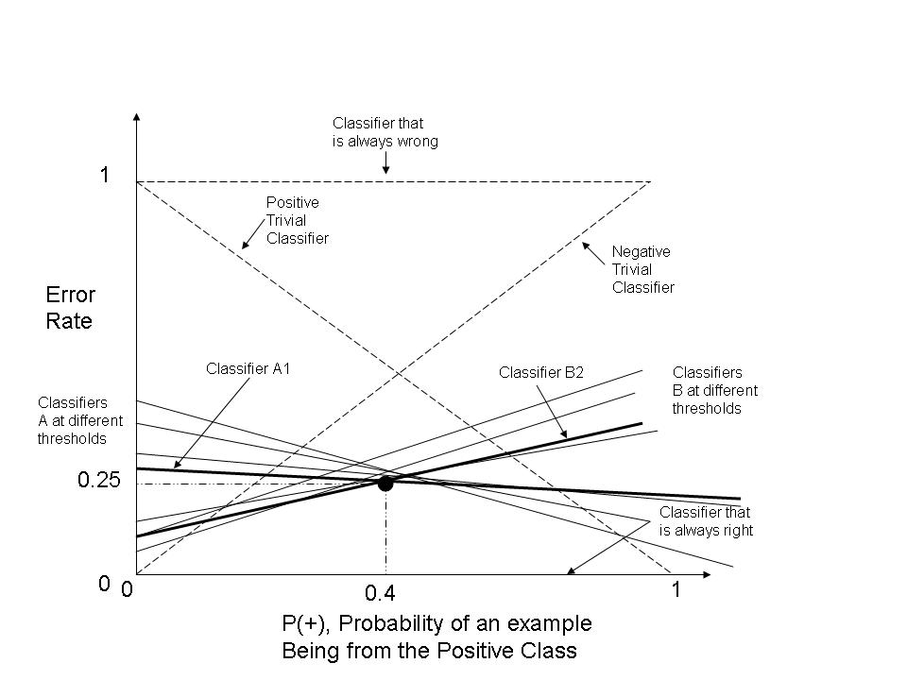
Cost Curves
Cost-curves are more practical than ROC curves because they tell us for what class
probabilities one classifier is preferable over the other.
ROC Curves only tell
us that sometimes
one classifier is
preferable over the
other

Slide 25
RMSE
The Root-Mean Squared Error (RMSE) is usually used for regression, but can also be used with probabilistic classifiers. The formula for the RMSE is:
RMSE(f) = sqrt( 1/m Σ_{i=1}^{m}(f(x_{i}) – y_{i})²))
  where m is the number of test examples, f(x_{i}), the classifier’s
  probabilistic output on x_{i} and y_{i} the actual label.
  RMSE(f) RMSE(f)
ID | f(x_{i}) | y_{i} | (f(x_{i}) – y_{i})²
1 | .95 | 1 | .0025
2 | .6 | 0 | .36
3 | .8 | 1 | .04
4 | .75 | 0 | .5625
5 | .9 | 1 | .01
RMSE(f) = sqrt(1/5 * (.0025+.36+.04+.5625+.01))
= sqrt(0.975/5) = 0.4416

Slide 26
Information Score
Kononenko and Bratko’s Information Score assumes a prior P(y) on the labels. This could be estimated by the class distribution of the training data. The output (posterior probability) of a probabilistic classifier is P(y|f), where f is the classifier. I(a) is the indicator fonction.
IS(x) = I(P(y|f) ≥ P(y)) * (-log(P(y))+log(P(y|f)) +
+ I(P(y|f) < P(y)) * (- log(1-P(y))+log(1-P(y|f)))
IS_{avg}= 1/m Σ_{i=1}^{m}(IS(x_{i}))
P(y=1) = 3/5 = 0.6
P(y=0) = 2/5 = 0.4
IS(x₁) = 1 * (-log(.6) + log(.95)) +
0 * (-log(.4) + log).05))
= 0.66
IS_{avg}= 1/5 (0.66+0+.42+.32+.59)
= 0.40
x | P(y_{i}|f) | y_{i} | IS(x)
1 | .95 | 1 | 0.66
2 | .6 | 0 | 0
3 | .8 | 1 | .42
4 | .75 | 0 | .32
5 | .9 | 1 | .59

Slide 27
Efficiency Method
The efficiency method is a framework for combining various measures including qualitative metrics, such as interestingness. It considers the positive metrics for which higher values are desirable (e.g, accuracy) and the negative metrics for which lower values are desirable (e.g., computational time).
ε_{S}(f)= Σ_{i}w_{i}pm_{i}⁺(f) / Σ_{j}w_{j}nm_{j}⁻(f)
pm_{i}⁺ are the positive metrics and nm_{j}⁻ are the negative metrics. The w_{i}’s and w_{j}’s have to be determined and a solution is proposed that uses linear programming.

Slide 28
Part I
Topic 2: Choosing a Statistical Test

Slide 29
The purpose of Statistical Significance Testing
The performance metrics just discussed allow us to make observations about different classifiers.
The question we ask here is: can the observed results be attributed to real characteristics of the classifiers under scrutiny or are they observed by chance?
The purpose of statistical significance testing is to help us gather evidence of the extent to which the results returned by an evaluation metric are representative of the general behaviour of our classifiers.

Slide 30
Hypothesis Testing
Hypothesis testing consists of stating a null hypothesis which usually is the opposite of what we wish to test (for example, classifiers A and B perform equivalently)
We then choose a suitable statistical test and statistic that will be used to reject the null hypothesis.
We also choose a critical region for the statistic to lie in that is extreme enough for the null hypothesis to be rejected.
We calculate the observed test statistic from the data and check whether it lies in the critical region. If so, reject the null hypothesis. If not, we fail to reject the null hypothesis, but do not accept it either.
Rejecting the null hypothesis gives us some confidence in the belief that our observations did not occur merely by chance.

Slide 31
Issues with Hypothesis Testing
Hypothesis testing never constitutes a proof that our observation is valid. It provides added support for our observations. We can never be 100% sure about them.
Statistical tests come in two forms: parametric and non parametric. Parametric tests make strong assumptions about the distribution of the underlying data. Non-parametric ones make weaker assumptions about the data, but are also typically less powerful (less apt at rejecting the null hypothesis when it is false) than their parametric counterparts. It is often difficult, if not impossible, to verify that all the assumptions hold.
The results of statistical tests are often misinterpreted:
  (1-p) does not represent P(H|D)
  (1-p) does not represent the probability of replication of successful replication of the observations
It is always possible to show that a difference between two alternatives, no matter how small, is significant, provided that enough data is used.

Slide 32
To test or not to test?
Given the serious issues associated with statistical testing, some researchers (Drummond, 2006, Demsar, 2008) argue that Machine Learning and Data Mining researchers should drop the habit of performing statistical tests. They argue that, this process:
  Overvalues the results, and
  Limits the search for novel ideas (because of the excess (not always warranted) confidence in the results).
The alternative, however, is to train researchers properly in the understanding and application of statistical methods, so that they can decide on their own when a statistical test is warranted, what its limitations are and when the search for new ideas is necessary.

Slide 33
How to choose a statistical test?
There are several aspects to consider when choosing a statistical test.
  What kind of problem is being handled?
  Whether we have enough information about the underlying distributions of the classifiers’ results to apply a parametric test?
Regarding the type of problem, we distinguish between
  The comparison of 2 algorithms on a single domain
  The comparison of 2 algorithms on several domains
  The comparison of multiple algorithms on multiple domains

Slide 34
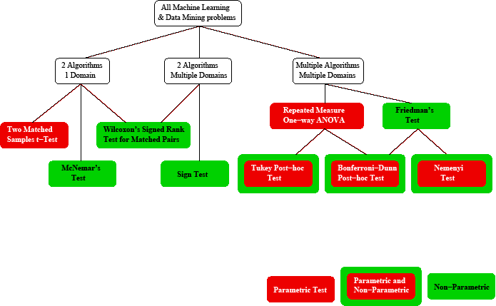
Statistical tests overview

Slide 35
Statistical Tests we will describe and illustrate in this tutorial
Two classifiers, one domain:
  The t-test (parametric)
  McNemar’s test (non-parametric)
  The Sign Test
Two classifiers, multiple domains
  The Sign Test (non-parametric)
  Wilcoxon’s signed-Rank Test (non-parametric)
Multiple classifiers, multiple domains:
  Friedman’s Test (non-parametric)
  The Nemenyi Test
We will also discuss and illustrate the concept of the effect size.

Slide 36
Two classifiers, one domain
  The t-test (parametric)
  McNemar’s test (non-parametric)
  The Sign Test (usually used for multiple domains but can also be used on a single domain).

Slide 37
The (2-matched samples) t-test
Given two matched samples (e.g., the results of two classifiers applied to the same data set with matching randomizations and partitions), we want to test whether the difference in means between these two sets is significant.
In other words, we want to test whether the two samples come from the same population.
We look at the difference in observed means and standard deviation.
We assume that the difference between these means is zero (the null hypothesis) and see if we can reject this hypothesis.

Slide 38
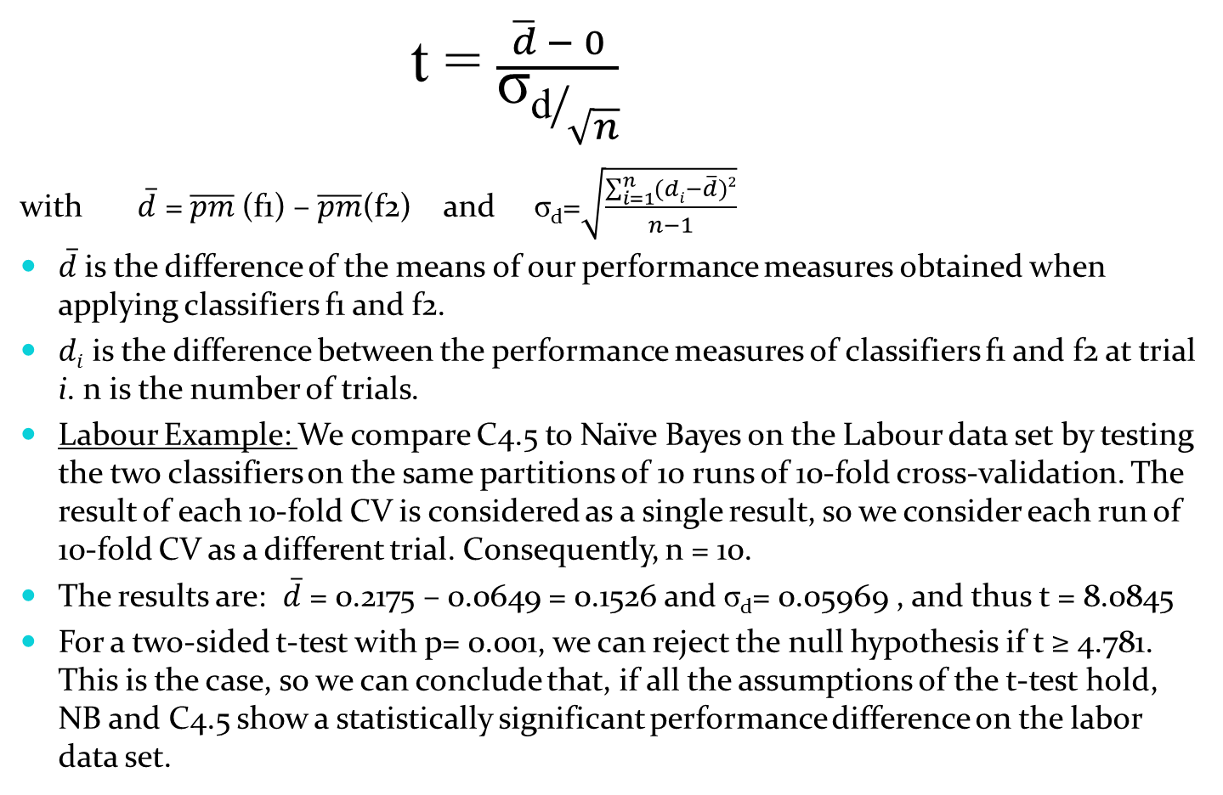
The t-statistic
The degree of freedom is n-1 = 9; Using a 2-sided test, the null hypothesis can
therefore be rejected at the 0.001 significance level (since the obtained t has to be
greater than 4.781for that to be possible).

Slide 39
Assumptions of the t-test
The Normality or Pseudo-Normality Assumption: The t-test requires that the samples come from normally distributed population. Alternatively, the sample size of the testing set should be greater than 30.
The Randomness of the Samples: The sample should be representative of the underlying population. Therefore, the instances of the testing set should be randomly chosen from their underlying distribution.
Equal Variance of the populations: The two sample come from populations with equal variance.
Labour Example:
  Normality: The labour data set contains only 57 instances altogether. At each fold of the CV process, only 6 or 7 data points are tested. However, since each trial is a run of 10-fold CV, all 57 examples are tested, so we may be able to assume pseudo-normality.
  Randomness: The labour data was collected in the 1987-1988 period. All the collective agreements for this period were collected. There is no reason to assume that 1987-1988 was a non-representative year, so we assume that the data was randomly collected.

Slide 40
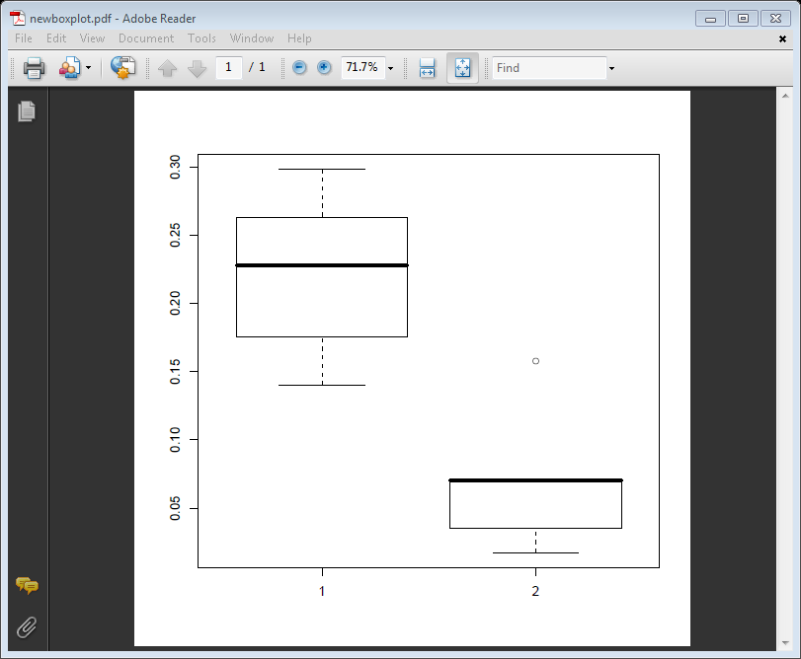
Assumptions of the t-test (cont’d)
Equal Variance: The variance of C4.5 (1) and NB (1) cannot be considered equal. (See figure)
➔ We were not warranted to use the t-test to compare C4.5 to NB on the Labour data.
➔A better test to use in this case is the non-parametric alternative to the t-test: McNemar’s Test
(See Japkowicz & Shah, 2011 for a description)

Slide 41
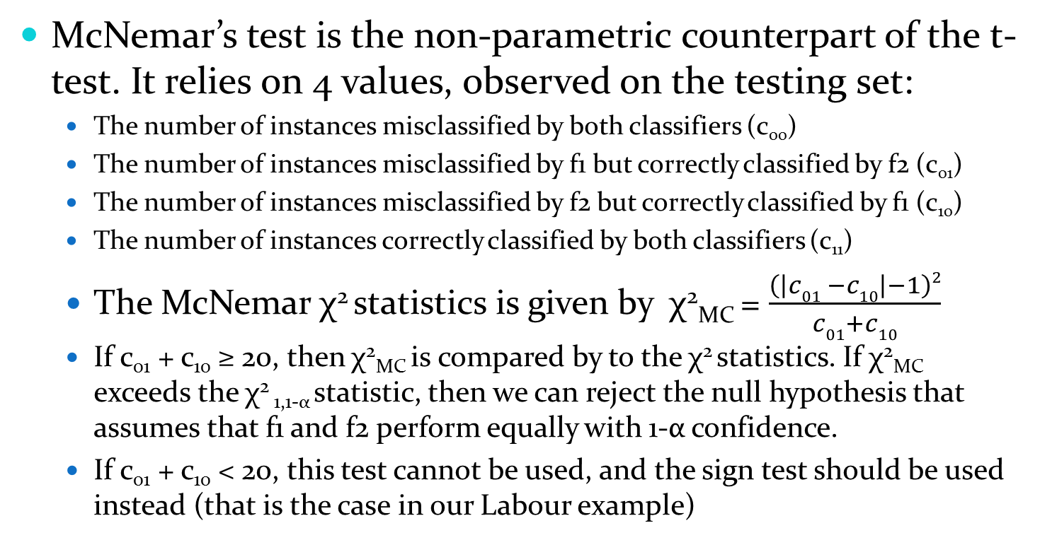
McNemar’s test

Slide 42
The Sign Test
Since the Sign test is usually used on multiple domains (though can be used on a single one with several trial (e.g., 10 folds of cross-validation)), we will discuss it in the next section which looks at multiple domains.

Slide 43
Two classifiers multiple domains
  There are no clear parametric way to deal with the problem of comparing the performance of two classifiers on multiple domains:
    The t-test is not a very good alternative because it is not clear that we have commensurability of the performance measures in such a setting.
    The normality assumption is difficult to establish as the number of domains on which the test is run must exceed 30.
    The t-test is susceptible to outliers, which is more likely when many different domains are considered.
  Therefore we will describe two non-parametric alternatives
    ➔ The Sign Test
    ➔ Wilcoxon’s signed-Rank Test

Slide 44
The Sign test
The sign test can be used either to compare two classifiers on a single domain (using the results at each fold as a trial) or more commonly, to compare two classifiers on multiple domains.
We count the number of times that f1 outperforms f2, n_{f1} and the number of times that f2 outperforms f1, n_{f2}.
The null hypothesis (stating that the two classifiers perform equally well) holds if the number of wins follows a binomial distribution.
Practically speaking, a classifier should perform better on at least w_{α} datasets to be considered statistically significantly better at the α significance level, where w_{α} is the critical value for the sign test at the α significance level .

Slide 45
Illustration of the sign test
Dataset | NB | SVM | Adaboost | Rand Forest
Anneal | 96.43 | 99.44 | 83.63 | 99.55
Audiology | 73.42 | 81.34 | 46.46 | 79.15
Balance Scale | 72.30 | 91.51 | 72.31 | 80.97
Breast Cancer | 71.70 | 66.16 | 70.28 | 69.99
Contact Lenses | 71.67 | 71.67 | 71.67 | 71.67
Pima Diabetes | 74.36 | 77.08 | 74.35 | 74.88
Glass | 70.63 | 62.21 | 44.91 | 79.87
Hepatitis | 83.21 | 80.63 | 82.54 | 84.58
Hypothyroid | 98.22 | 93.58 | 93.21 | 99.39
Tic-Tac-Toe | 69.62 | 99.90 | 72.54 | 93.94
NB vs SVM: n_{f1}= 4.5, n_{f2}= 5.5 and w_{0.05} = 8 ➔ we cannot reject the null hypothesis
stating that NB and SVM perform similarly on these data sets for level α=0.05 (1-tailed)
Ada vs RF: n_{f1}=1 and n_{f2}=8.5 ➔ we can reject the null hypothesis at level α=0.05 (1-tailed)
and conclude that RF is significantly better than Ada on these data sets at that significance level.

Slide 46
Wilcoxon’s signed-Rank Test
Wilcoxon’s signed-Rank Test, like the sign test, deals with two classifiers on multiple domains. It is also non-parametric, however, it is more powerful than the sign test. Here is its description:
  For each domain, we calculate the difference in performance of the two classifiers.
  We rank the absolute values of these differences and graft the signs in front of the ranks.
  We calculate the sum of positive and negative ranks, respectively (W_{S1} and W_{S2})
  T_{Wilcox} = min(W_{S1} ,W_{S2})
  Compare to critical value V_{α}. If V_{α} ≥ T_{Wilcox} we reject the null hypothesis that the performance of the two classifiers is the same, at the α confidence level.

Slide 47
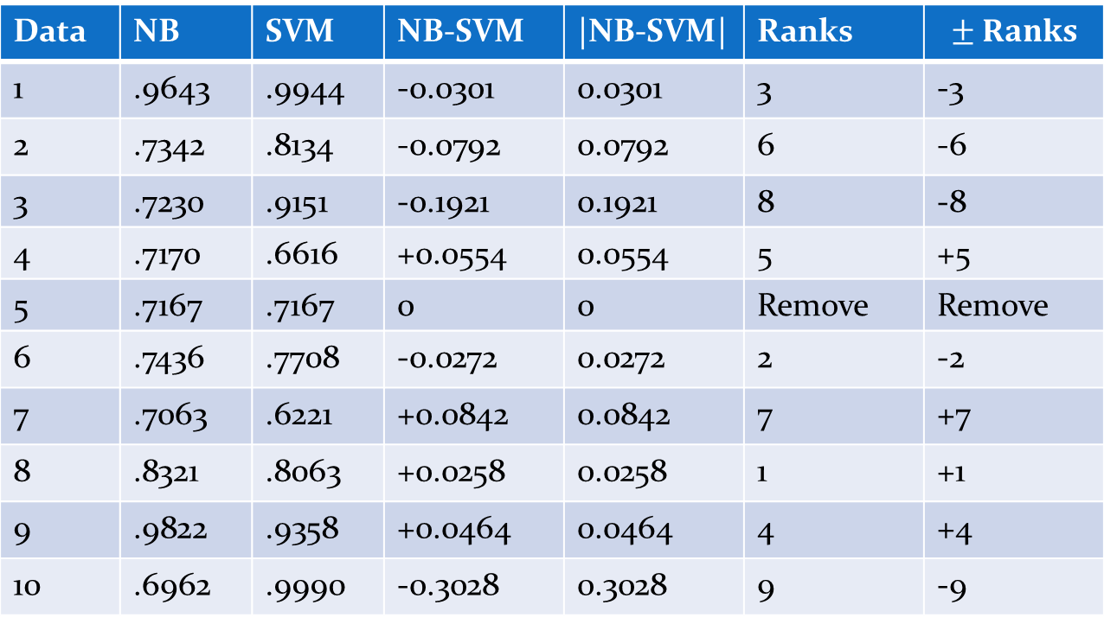
Wilcoxon’s signed-Rank Test: Illustration
Data | NB | SVM | NB-SVM | |NB-SVM| | Ranks
1 | .9643 | .9944 | -0.0301 | 0.0301 | 3 | -3
2 | .7342 | .8134 | -0.0792 | 0.0792 | 6 | -6
3 | .7230 | .9151 | -0.1921 | 0.1921 | 8 | -8
4 | .7170 | .6616 | +0.0554 | 0.0554 | 5 | +5
5 | .7167 | .7167 | 0 | 0 | Remove | Remove
6 | .7436 | .7708 | -0.0272 | 0.0272 | 2 | -2
7 | .7063 | .6221 | +0.0842 | 0.0842 | 7 | +7
8 | .8321 | .8063 | +0.0258 | 0.0258 | 1 | +1
9 | .9822 | .9358 | +0.0464 | 0.0464 | 4 | +4
10 | .6962 | .9990 | -0.3028 | 0.3028 | 9 | -9
W_{S1} = 17 and W_{S2} = 28 ➔ T_{Wilcox} = min(17, 28) = 17
For n= 10-1 degrees of freedom and α = 0.005, V = 8 for the 1-sided test. V must be larger than
T_{Wilcox} in order to reject the hypothesis. Since 17 > 8, we cannot reject the hypothesis that NB’s
performance is equal to that of SVM at the 0.005 level.

Slide 48
Multiple classifiers, Multiple Domains
For the case of multiple classifiers and multiple domains, two alternatives are possible. The parametric alternative is (one-way repeated measure) ANOVA and the non-parametric alternative is Friedman’s Test.
These two tests are multiple-hypothesis tests, also called Omnibus tests. Their null hypotheses is that all the classifiers perform equally, and rejection of that null hypothesis means that: there exists at least one pair of classifiers with significantly different performances.
In case of rejection of this null hypothesis, the omnibus test is followed by a Post-hoc test whose job is to identify the significantly different pairs of classifiers.
In this tutorial, we will discuss Friedman’s Test (omnibus) and the Nemenyi test (post-hoc test).

Slide 49
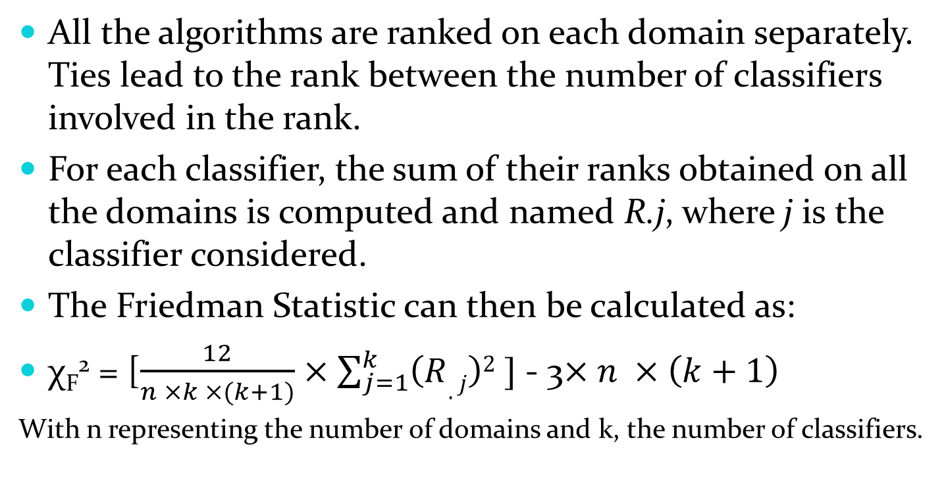
Friedman’s Test

Slide 50
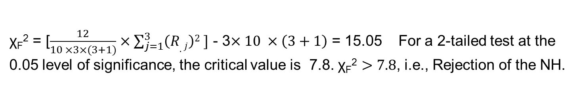
Illustration of the Friedman test
Domain | Classifier fA | Classifier fB | Classifier fC
1 | 85.83 | 75.86 | 84.19
2 | 85.91 | 73.18 | 85.90
3 | 86.12 | 69.08 | 83.83
4 | 85.82 | 74.05 | 85.11
5 | 86.28 | 74.71 | 86.38
6 | 86.42 | 65.90 | 81.20
7 | 85.91 | 76.25 | 86.38
8 | 86.10 | 75.10 | 86.75
9 | 85.95 | 70.50 | 88.03
19 | 86.12 | 73.95 | 87.18
Domain | Classifier fA | Classifier fB | Classifier fC
1 | 1 | 3 | 2
2 | 1.5 | 3 | 1.5
3 | 1 | 3 | 2
4 | 1 | 3 | 2
5 | 2 | 3 | 1
6 | 1 | 3 | 2
7 | 2 | 3 | 1
8 | 2 | 3 | 1
9 | 2 | 3 | 1
10 | 2 | 3 | 1
R _{.j} | 15.5 | 30 | 14.5

Slide 51
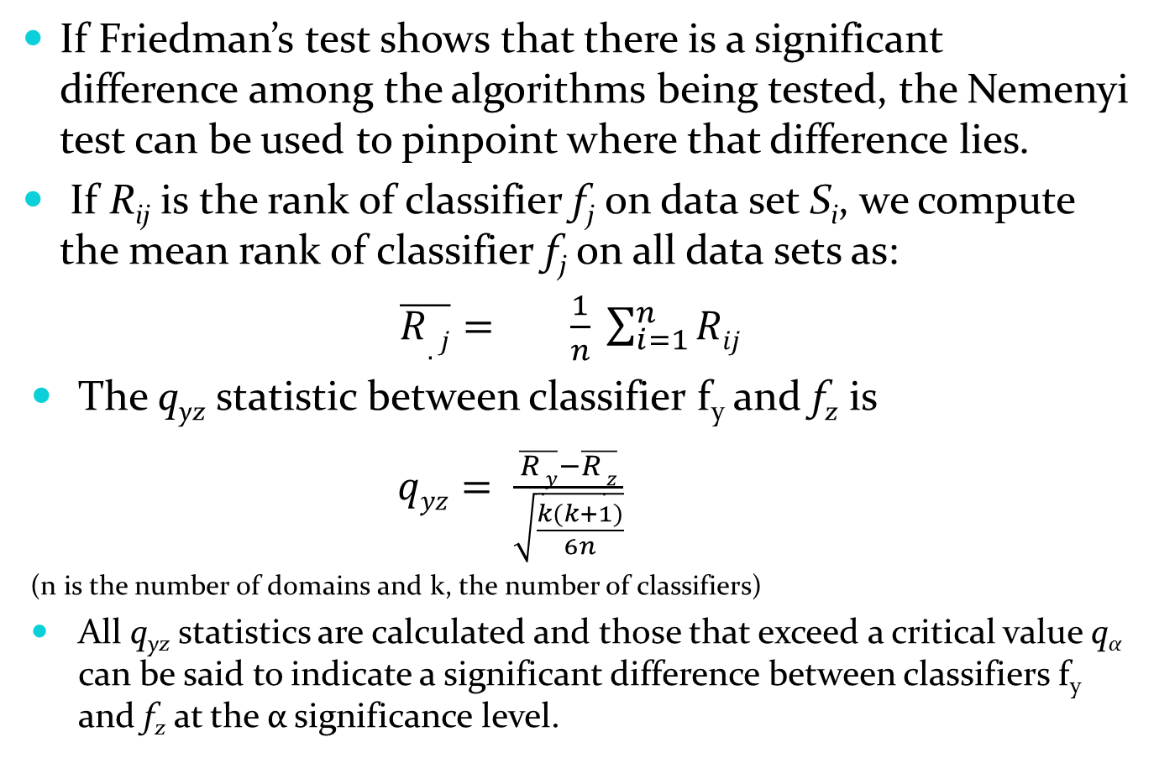
The Nemenyi test
If Friedman’s test shows that there is a significant difference among the algorithms being tested, the Nemenyi test can be used to pinpoint where that difference lies.
If R_{ij} is the rank of classifier f_{j} on data set S_{i}, we compute the mean rank of classifier f_{j} on all data sets as:
      $\overline{R.j}= \frac{1}{n} \sum_{i=1}^{n}{Rij}$
The q_{yz} statistic between classifier f_{y} and f_{z} is
$qyz= \frac{\overline{R.y}−\overline{R.z}}{\sqrt{\frac{k(k+1)}{6n}}}$
(n is the number of domains and k, the number of classifiers)
All q_{yz} statistics are calculated and those that exceed a critical value q_{α} can be said to indicate a significant difference between classifiers f_{y} and f_{z} at the α significance level.

Slide 52
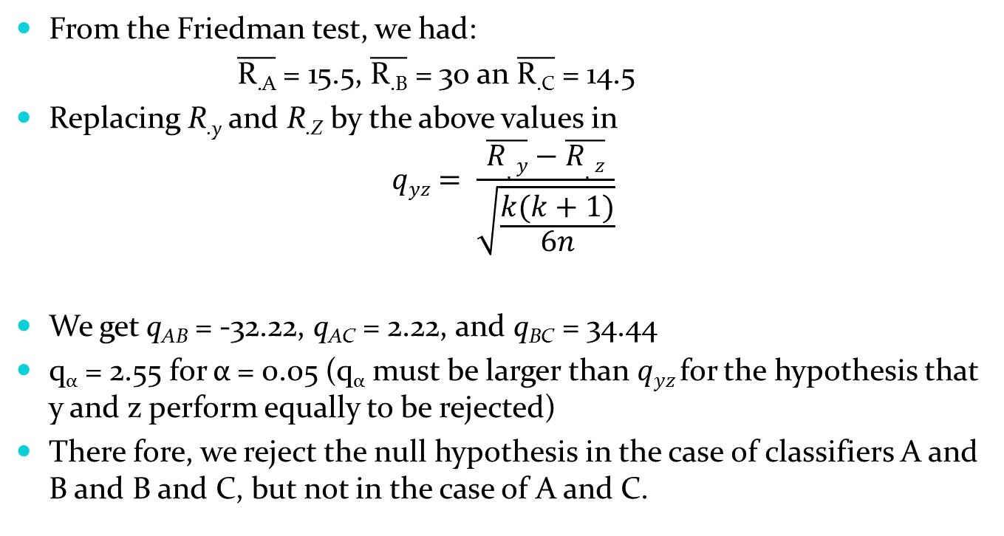
Illustration of the Nemenyi Test
From the Friedman test, we had:
    $\overline{\text{R}\text{.}\text{A}}$ = 15.5, $\overline{\text{R}\text{.}\text{B}}$ = 30 an $\overline{\text{R}\text{.}\text{C}}$ = 14.5
Replacing R_{.y} and R_{.Z} by the above values in
$$qyz= \frac{\overline{R.y}−\overline{R.z}}{\sqrt{\frac{k(k+1)}{6n}}}$$
We get q_{AB} = -32.22, q_{AC} = 2.22, and q_{BC} = 34.44
q_{α} = 2.55 for α = 0.05 (q_{α} must be larger than $qyz$for the hypothesis that y and z perform equally to be rejected)
There fore, we reject the null hypothesis in the case of classifiers A and B and B and C, but not in the case of A and C.

Slide 53
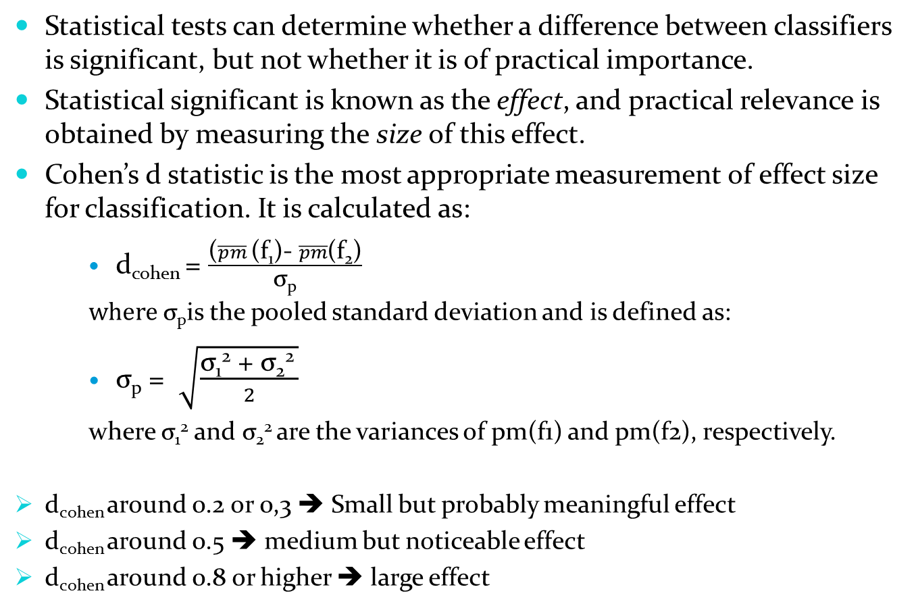
Effect Size

Slide 54
Part II
Topic 1: Sampling

Slide 55
What is the Purpose of Resampling?
Ideally, we would have access to the entire population or a lot of representative data from it.
This is usually not the case, and the limited data available has to be re-used in clever ways in order to be able to estimate the error of our classifiers as reliably as possible, i.e., to be re-used in clever ways in order to obtain sufficiently large numbers of samples.
Resampling is divided into two categories: Simple re-sampling (where each data point is used for testing only once) and Multiple re-sampling (which allows the use of the same data point more than once for testing)

Slide 56
What are the dangers of Resampling?
Re-sampling is usually followed by Statistical testing. Yet statistical testing relies on the fundamental assumption that the data used to obtain a sample statistics must be independent.
However, if data is re-used, then this important independence assumption is broken and the result of the statistical test risks being invalid.
In addition to discussing a few re-sampling approaches, we will underline the issues that may arise when applying them.

Slide 57
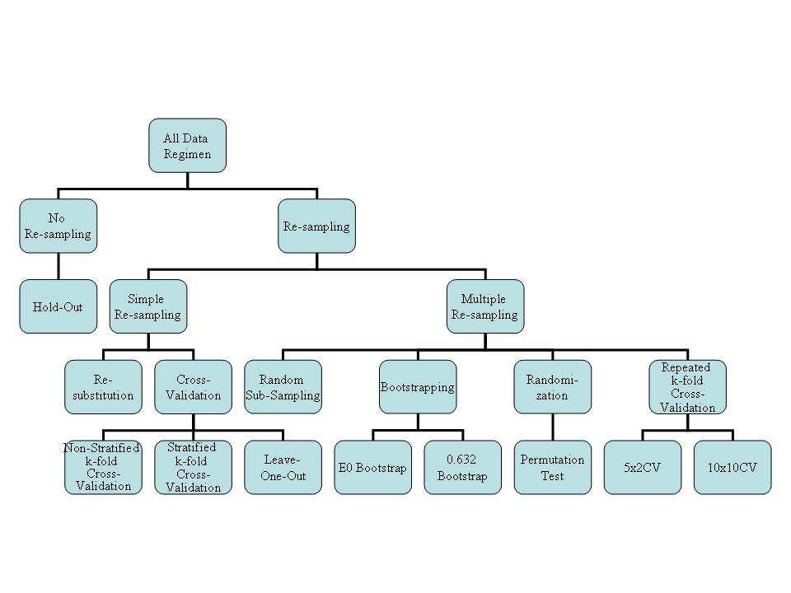
Overview of Re-Sampling Methods

Slide 58
Resampling Approaches Discussed in this Tutorial
Simple Resampling:
  Cross-Validation and its variants
Multiple Resampling:
  The 0.632 Bootstrap
  The Permutation Test
  Repeated k-fold Cross-Validation

Slide 59
k-fold Cross-Validation
Fold 1:
Fold 2:
Fold k-1:
Fold k:
…..
: training data subset
: testing data subset
In Cross-Validation, the data set is divided into k folds and at each iteration, a
different fold is reserved for testing and all the others, used for training the
classifiers.

Slide 60
Some variations of Cross-Validation
Stratified k-fold Cross-Validation:
  This variation is useful when the class-distribution of the data is skewed. It ensures that the distribution is respected in the training and testing sets created at every fold. This would not necessarily be the case if a pure random process were use.
Leave-One-Out
  In k-fold Cross-Validation, each fold contains m/k data points where m is the overall size of the data set. In Leave-one-out, k =m and therefore, each fold contains a single data point.

Slide 61
Considerations about k-fold Cross-Validation and its variants
k-fold Cross-Validation is the best known and most commonly used resampling technique.
K-fold Cross-Validation is less computer intensive than Leave-One-Out.
The testing sets are independent of one another, as required, by many statistical testing methods, but the training sets are highly overlapping. This can affect the bias of the error estimates.
Leave-One-Out produces error estimates with high variance given that the testing set at each fold contains only one example. The classifier is practically unbiased since each fold trains on almost all the data.

Slide 62
Boootsrapping
Bootstrapping assumes that the available sample is representative and creates a large number of new samples by drawing from replacement from the available sample.
Bootstrapping is useful in practice when the sample is too small for Cross-Validation or Leave-One-Out approaches to yield a good estimate
There are two Bootstrap estimates that are useful in the context of classification: the Є0 and the e632 Bootstrap.
The Є0 Bootstrap tends to be pessimistic because it is only trained on 63.2% of the data in each run. The e632 attempts to correct for this.

Slide 63
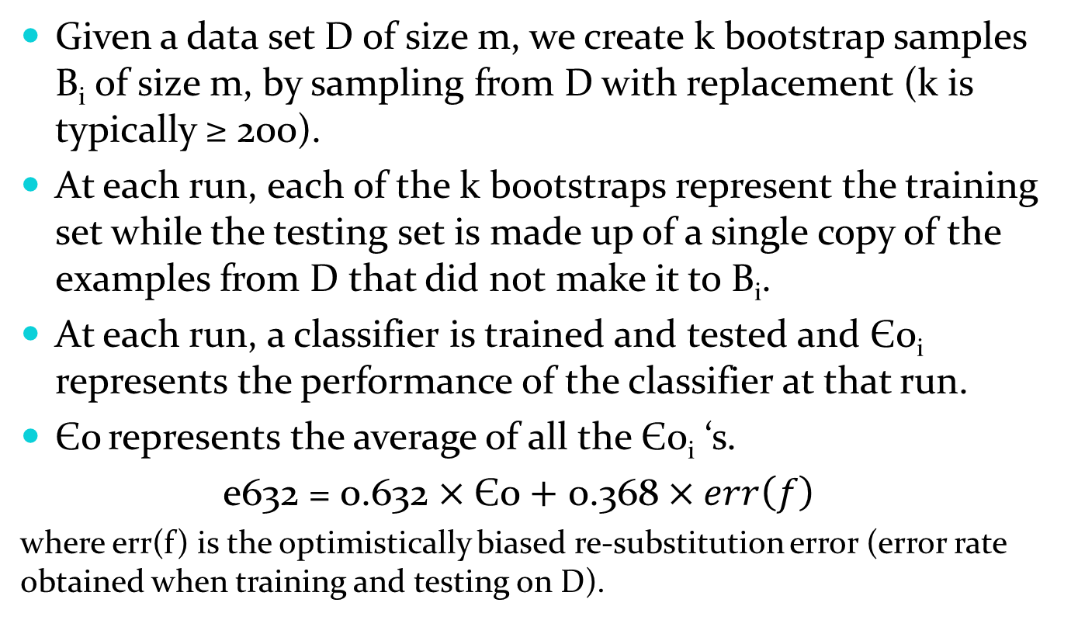
The Є0 and e632 Bootstraps

Slide 64
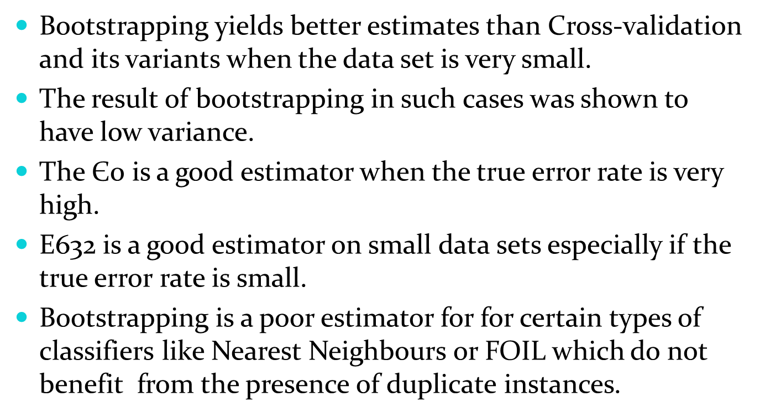
Considerations about Bootstrapping

Slide 65
The Permutation Test
Given the error estimate found on a data set, the question is:
  Is this error estimate significant, or
  Could it also have been obtained on ‘bogus’ data?
The ‘bogus’ data is created by taking the genuine samples and randomly choosing to either leave their label intact or switch them.
Once this ‘bogus’ data set is created, the classifier is ran on it and its error estimated.
This process is repeated a very large number of times in an attempt to establish whether the error estimate obtained on the true data is truly different from those obtained on large numbers of ‘bogus’ data sets.

Slide 66
Repeated k-Fold Cross-Validation(1)
In order to obtain more stable estimates of an algorithm’s performance, it is useful to perform multiple runs of simple re-sampling schemes. This can also enhance replicability of the results.
Two specific schemes have been suggested in the context of Cross-Validation: 5x2 CV and 10x10 CV
K-fold CV does not estimate the mean of the difference between 2 learning algorithms properly. The mean at a single fold behaves better. This lead Dietterich (1998) to propose the 5x2 CV fold, in which 2-fold CV is repeated 5 times.

Slide 67
Repeated k-Fold Cross-Validation(2)
Dietterich found that the paired t-test based on the the 5x2 CV scheme had lower probability of issuing a type-I error but had less power than the k-fold CV paired t-test.
Alpaydyn (1999) proposed to substitute the t-test at the end of the 5x2CV scheme by an F-test. That test had an even lower chance of issuing a type-I error and had increased power (though that new test was not compared to k-fold CV in terms of type I error or power)
Bouckaert (2003) proposed several variations of a 10x10 CV scheme. Generally speaking these schemes show a higher probability of Type-I error than 10-fold CV, but higher power.

Slide 68
Part II
Topic 2: Choosing Appropriate Data Sets for Testing Classifiers

Slide 69
Considerations to keep in mind while choosing an appropriate test bed
Wolpert’s “No Free Lunch” Theorems: if one algorithm tends to perform better than another on a given class of problems, then the reverse will be true on a different class of problems.
LaLoudouana and Tarate (2003) showed that even mediocre learning approaches can be shown to be competitive by selecting the test domains carefully.
➔The purpose of data set selection should not be to demonstrate an algorithm’s superiority to another in all cases, but rather to identify the areas of strengths of various algorithms with respect to domain characteristics or on specific domains of interest.

Slide 70
Where can we get our data from?
Repository Data: Data Repositories such as the UCI repository and the UCI KDD Archive have been extremely popular in Machine Learning Research.
Artificial Data: The creation of artificial data sets representing the particular characteristic an algorithm was designed to deal with is also a common practice in Machine Learning
Web-Based Exchanges: Could we imagine a multi-disciplinary effort conducted on the Web where researchers in need of data analysis would “lend” their data to macine learning researchers in exchange for an analysis?

Slide 71
Pros and Cons of Repository Data
Pros:
  Very easy to use: the data is available, already processed and the user does not need any knowledge of the underlying field.
  The data is not artificial since it was provided by labs and so on. So in some sense, the research is conducted in real-world setting (albeit a limited one)
  Replication and comparisons are facilitated, since many researchers use the same data set to validate their ideas.
Cons:
  The use of data repositories does not guarantee that the results will generalize to other domains.
  The data sets in the repository are not representative of the data mining process which involves many steps other than classification.
  Community experiment/Multiplicity effect: since so many experiments are run on the same data set, by chance, some will yield interesting (though meaningless) results

Slide 72
Pros and Cons of Artificial Data
Pros:
  Data sets can be created to mimic the traits that are expected to be present in real data (which are unfortunately unavailable)
  The researcher has the freedom to explore various related situations that may not have been readily testable from accessible data.
  Since new data can be generated at will, the multiplicity effect will not be a problem in this setting.
Cons:
  Real data is unpredictable and does not systematically behave according to a well defined generation model.
  Classifiers that happen to model the same distribution as the one used in the data generation process have an unfair advantage.

Slide 73
Pros and Cons of Web-Based Exchanges
Pros:
  Would be useful for three communities:
    Domain experts, who would get interesting analyses of their problem
    Machine Learning researchers who would be getting their hand on interesting data, and thus encounter new problems
    Statisticians, who could be studying their techniques in an applied context.
Cons:
  It has not been organized. Is it truly feasible?
  How would the quality of the studies be controlled?

Slide 74
Part II
Topic 3: Available Resources

Slide 75
What help is available for conducting proper evaluation?
There is no need for researchers to program all the code necessary to conduct proper evaluation nor to do the computations by hand.
Resources are readily available for every steps of the process, including:
  Evaluation metrics
  Statistical tests
  Re-sampling
  And of course, Data repositories
Pointers to these resources and explanations on how to use them are discussed in our book: <“Evaluating Learning Algorithms: A Classification Perspective” by Japkowicz and Shah, Cambridge University Press, 2011>.

Slide 76
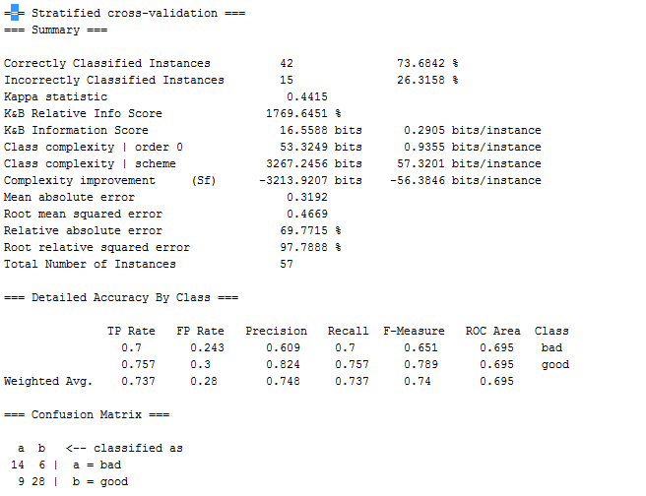
Where to look for evaluation metrics?
Actually, as most
people know, Weka is a great source for, not only, classifiers, but also computation of the results according to a variety of evaluation metrics

Slide 77
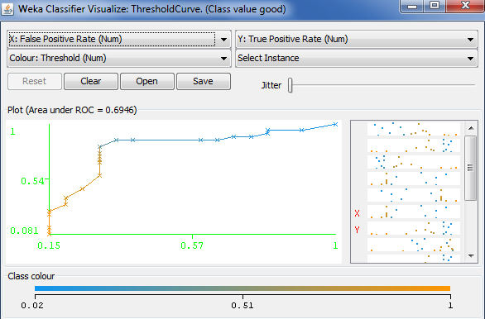
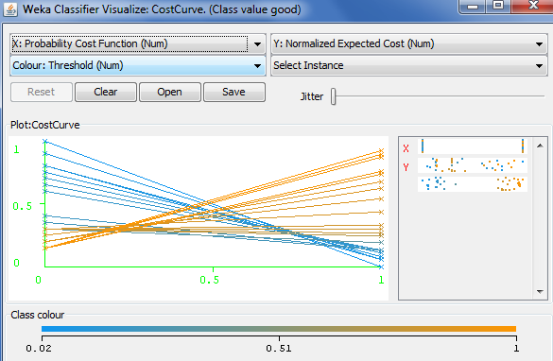
WEKA even performs ROC Analysis and draws Cost-Curves
Although better graphical analysis packages are available in R, namely the
ROCR package, which permits the visualization of many versions of ROC and
Cost Curves, and also Lift curves, P-R Curves, and so on

Slide 78
Where to look for Statistical Tests?
The R Software
Package contains
implementations
of all the statistical
tests discussed
here and many
more. They are
very simple to run.

Slide 79
Where to look for Re-sampling methods?
In our book, we have implemented all the re-sampling schemes described in this tutorial. The actual code is also available upon request. (e-mail me at <nat@site.uottawa.ca>)
    e0Boot = function(iter, dataSet, setSize, dimension, classifier1, classifier2){
    classifier1e0Boot <- numeric(iter)
    classifier2e0Boot <- numeric(iter)
    for(i in 1:iter) {
    Subsamp <- sample(setSize, setSize, replace=TRUE)
    Basesamp <- 1:setSize
    oneTrain <- dataSet[Subsamp ,1:dimension ]
    oneTest <- dataSet[setdiff(Basesamp,Subsamp), 1:dimension]
    classifier1model <- classifier1(class~., data=oneTrain)
    classifier2model <- classifier2(class~., data=oneTrain)
    classifier1eval <- evaluate_Weka_classifier(classifier1model, newdata=oneTest)
    classifier1acc <- as.numeric(substr(classifier1eval$string, 70,80))
    classifier2eval <- evaluate_Weka_classifier(classifier2model,
    newdata=oneTest)
    classifier2acc <- as.numeric(substr(classifier2eval$string, 70,80))
    classifier1e0Boot[i]= classifier1acc
    classifier2e0Boot[i]= classifier2acc
    }
    return(rbind(classifier1e0Boot, classifier2e0Boot))}

Slide 80
Part III
Recent Research
Topic 1: A Visualization-based framework for classifier evaluation
(Nathalie Japkowicz, Pritika Sanghi and Peter Tischer)
  [ECML’2008, ISAIM’2008]

Slide 81
A New Framework for Classifier Evaluation
Classifier evaluation can be viewed as a problem of analyzing high-dimensional data.
The performance measures currently used are but one class of projections that can be applied to these data.
Why not apply other (standard or not) projections to the data with various kinds (standard or not) distance measures?

Slide 82
Some Advantages of this new Framework
Projection approaches are typically intended for visualization. This yields two advantages:
  A quick and easy way for human-beings to assess classifier performance results.
  The possibility to offer simultaneous multiple views of classifier performance evaluation.
The framework offers a solution to the problem of aggregating the results obtained by a classifier on several domains.
The framework offers a way to deal with multi-class domains.

Slide 83
The Framework and its Implementation
The framework is implemented as a function of the following steps:
  All the classifiers in the study are run on all the domains of the study.
  The performance matrices (e.g., confusion matrix) of a single classifiers on every domain are aggregated into a single vector. This is repeated for each classifier
  A projection and a distance measure for that projection are chosen and applied to the vectors of Step 2.

Slide 84
Illustration of the Framework
True class → | Pos | Neg
Yes | 82 | 17
No | 12 | 114
82 | 17 | 12 | 114 | 15 | 5 | 25 | 231 | 99 | 6 | 1 | 94
True class → | Pos | Neg
Yes | 15 | 5
No | 25 | 231
True class → | Pos | Neg
Yes | 99 | 6
No | 1 | 94
Ideal
Confusion matrices
for a single classifier
on three domains

Slide 85
A Few Remarks about our Framework
It decomposes the evaluation problem neatly, separating the issue of projection from that of distance measure.
By going from a projection (or two) into a one-dimensional space to one into a two-dimensional space, we allow for two rather than one relationships to be established:
  The ranking of classifiers with respect to the ideal classifier.
  The comparison of each classifier to the others.

Slide 86
Specific Implementation Details
Our framework can be used with any projection technique and any distance function associated to the projection.
In this work, we experimented with:
  A Minimal Cost Spanning Tree (MCST) distance-preserving projection [Yang, 2004].
  Two distance functions: the Euclidean Distance (L2-norm) and the Manhattan Distance (L1-Norm). In our experiments, the L2 norm is the one normally used, unless otherwise specified.
We focus on the results obtained
  When combining the confusion matrices of various classifiers on several domains,
  When dealing with a multi-class domain.

Slide 87
Experimental Set-Up
We tested our approach on four UCI domains:
  3 Binary ones: Breast Cancer, Labour and Liver.
  1 Multi-Class One: Anneal.
We compared the performance of eight WEKA classifiers on these domains: NB, J48, Ibk, JRip, SMO, Bagging, AdaBoost, RandFor.
The focus of our study is not to discover which classifier wins or loses on our data sets. Rather, we are using our experiments to illustrate the advantages and disadvantages of our framework over other evaluation methods. We, thus, used Weka’s default parameters in all cases.
Also, though we test our approach with the MCST projection, others could have been used. This is also true of our distance functions.

Slide 88
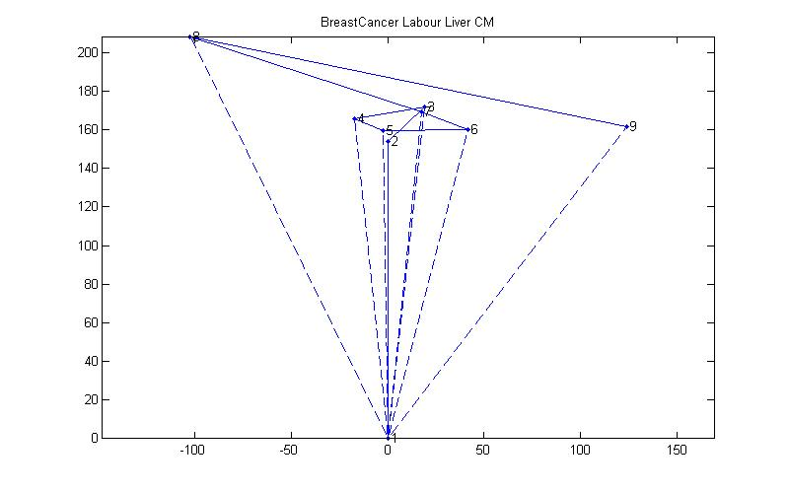
Illustration on Multiple domains: Breast Cancer, Labour and Liver
 | Acc. | F-Meas. | AUC
NB BC: La: Li: Avg: | 71.7 89.5 55.4 72.2 | .48 .92 .6 .67 | .7 .97 .64 .77
SMO BC: La: Li: Avg: | 69.6 89.5 58.3 72.46 | .39 .92 .014 .44 | .59 .87 .5 .65
Boost. BC: La: Li: Avg: | 70.3 87.7 66.1 74.7 | .46 .91 .534 .64 | .7 .87 .68 .75
8: SVM (SMO)
9: NB 1: Ideal
Abnormality detection with our
new approach is a lot easier and
accurate than it is, when relying on Accuracy,
F-Measure, or AUC listings on each domain
or their average on all domains.
Also, our new approach
Allows us to mix binary
and multi-class domains.
Averaging does not!

Slide 89
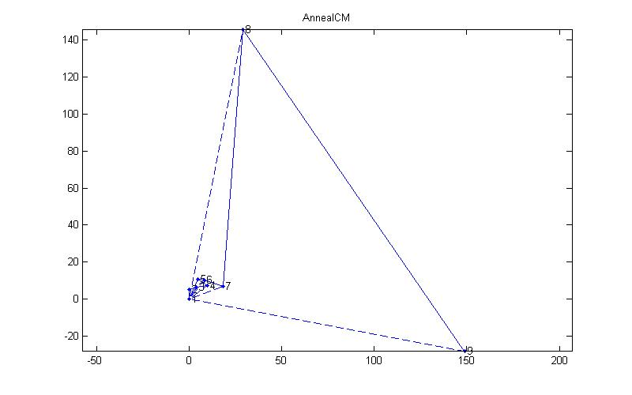
Illustration on a Multiclass domain:
Anneal (L2-Norm)
8: Adaboost
9: NB 1: Ideal
Adaboost:
a b c d e f ⬅ classified as
0 0 8 0 0 0 | a
0 0 99 0 0 0 | b
0 0 684 0 0 0 | c
0 0 0 0 0 0 | d
0 0 0 0 67 0 | e
0 0 40 0 0 0 | f
NB:
a b c d e f ⬅classified as
7 0 1 0 0 0 | a
0 99 0 0 0 0 | b
3 38 564 0 0 79 | c
0 0 0 0 0 0 | d
0 0 0 0 67 0 | e
0 0 2 0 0 38 | f
Accuracy
does not
tell us
whether
NB and
Adaboost
make the
same kind
of errors!
NB | Other Classifiers | Ada boost
86.3 | 97.4 to 99.3 | 83.6
Accuracy

Slide 90
Illustration on Anneal using the L1-Norm
1: Ideal, 8: NB
9: Adaboost
When using the L2-norm, NB and Adaboost were at approximately the same distance to Ideal.
When using the L1-norm, NB is significantly closer.
NB makes fewer errors than Adaboost, but the majority of its errors are concentrated on one or several large classes.
Because our new evaluation
framework is visual in nature,
we can process quickly the results
obtained using various distance
Measures (evaluation measure), and, thus, interpret our results
In a more informed manner. It is easier done this way than by
staring at large tables of numbers!

Slide 91
Summary
We present a new framework for classifier evaluation that recognizes that classifier evaluation consists of projecting high-dimensional data into low-dimensional ones.
By using a projection into 2-dimensional space rather than one, we propose a visualization approach to the problem. This allows for quick assessments of the classifiers’ behaviour based on the results obtained using multiple performance measures.
Each entry of the evaluation vectors we project is compared in pair-wise fashion to its equivalent in other vectors. Thus, our aggregation technique is more precise than that used with traditional performance measures. This is an advantage when considering results over various domains, or in the case of multi-class domains.

Slide 92
Future Work
As presented, our approach seems limited to the comparison of single classifier’s performance.
  How about threshold-insensitive classifiers?
  How about the computation of statistical guarantees on our results?
This can be solved by plotting either the results obtained at various thresholds, or the results obtained at various folds of a cross-validation regimen, thus plotting clouds of classifiers that could then be analyzed.
We also plan to experiment with other distance measures and projection methods.

Slide 93
Part III
Recent Research
Topic 2: Assessing the Impact of Changing environments on Classifier Performance
(Rocio Alaiz-Rodriguez and Nathalie Japkowicz)
[Canadian AI ’ 2008]

Slide 94
Purpose of the Work
Direct purpose: To test the hypothesis by David Hand (2006) that simple classifiers are more robust to changing environments than complex ones.
Indirectly: To demonstrate the feasibility and value of generating artificial, but realistic domains.
More generally: To propose an alternative to the use of the UCI domains.

Slide 95
Specific hypotheses under review
Preliminaries: Different kinds of changing environments:
  Population Drift — p(d|x) remains unchanged, but p(x) differs from training to testing set. Also known as: covariate shift or sample selection bias.
  Class Definition Change — p(x) does not change, but p(d|x) varies from training to testing set. Also known as: concept drift or functional relation change.
Hypotheses under review:
  Hypothesis 1: When either or both a population drift and a class definition change occurs, can we generally observe a drop in performance by all kinds of classifiers?
  Hypothesis 2: Do simpler classifiers maintain their performance more reliably than more complex ones in such cases?

Slide 96
Our Experimental Framework I
Our domain is a simulated medical domain that states the prognostic of patients infected with the flu and described as follows:
  Patient’s age [Infant, Teenager, YoungAdult, Adult, OldAdult, Elderly]
  Severity of flu symptoms [Light, Medium, Strong]
  Patient’s general health [Good, Medium, Poor]
  Patient’s social position [Rich, MiddleClass, Poor]
  Class: NormalRemission, Complications

Slide 97
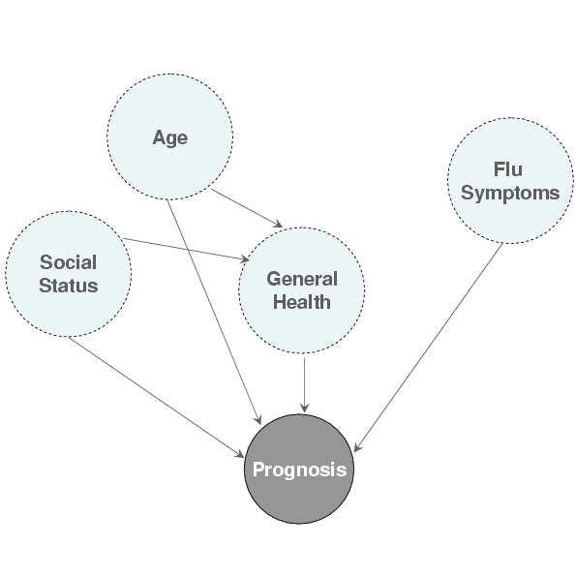
Our Experimental Framework II
In order to make the problem interesting for classifiers, we assumed that the features are not independent of one another.
We also assumed that certain feature values were irrelevant.
Attribute Dependency Graph

Slide 98
Our Experimental Framework III
We used different distributions to model the various features and the class:
Age: we assumed a region with negative growth which, according to the Population Reference Bureau contains many people in the Adult and Young Adult categories, and few people in the other categories. We used uniform distributions to model the first five categories, and an exponential distribution for the elderly category (which is not bounded upwards).
Social Status: Normal Distribution distributed around the Middle class (= 2), with variance .75. [Poor=3 and Rich= 1]
Severity of Flu Symptoms: (= Severity of the virus strain) Same distribution as Social Status.

Slide 99
Our Experimental Framework IV
General Health: We used an unobserved binary variable called “delicate person” whose probability increases with age, and generated rules based on the assumptions that (1) delicate people have worse general health than other members of the population; and (2) poorer people have worse geberal health than the richer members of society.
Class: The class labels were assigned automatically and abided by the following general principles:
  In case of stronger flu symptoms, the chances of complications are greater.
  Infants and Elderly have greater chances of complications
  People with poorer general health are more susceptible to complications

Slide 100
Our Experimental Framework V
Class Distribution, or
probability of normal remission as a function of age, severity of the flu symptoms and general health. When two lines appear, the discontinuous one applies to instances with poor social status

Slide 101
Experimental Set Up
We compared two pairs of simple/complex classifiers: 1R/Decision Tree and Simple Perceptron/Multi-Layer Perceptron
We looked at three situations:
  Population drifts with full representation
  Population drifts with some cases not represented
  Concept drifts
We studied the performance deterioration that occurs when going from no drift to one of the three types of drifts above.

Slide 102
Changes to the Testing Set I
Population Drifts with full representation:
  Developing Population (DP): high birth and death rates.
  Zero Growth Population (ZGP): Similar birth and death rates.
  Season changes (NGP/W): Winter: Flu symptoms get stronger
  Season changes (NGP/SW): Soft Winter: Flu Symptoms get milder
  Season changes (NGP/DW): Drastic Winter: Flu Symptoms get stronger and general health declines
  Population is much poorer (NGP/P)
  Population is much poorer and the winter is trastic (NGP/P+DW)

Slide 103
Changes to the Testing Set II
Population Drifts with Non-Represented cases
  We considered several situations where one or two population groups are not represented.
Class Definition Changes:
  More Complications (MC): the probability of normal remission decreases for certain ages, social statuses and flu symptoms.
  Fewer Complications (FC): the age group for which the probability of normal remission is high is widened.

Slide 104
Evaluation Measure
In order to measure the changes in performance caused by environmental changes, we introduce a new metric, called performance Deterioration (pD), defined as follows:
E_{test} – E_{ideal} , if E_{test} <= E₀
pD = E₀ – E_{ideal}
1, Otherwise
With E₀ representing the error rate of the trivial classifier, E_{test} is the classifier’s error rate on the test set, and E_{ideal} is the classifier’s error rate when trained and tested on data abiding by the same distribution.

Slide 105
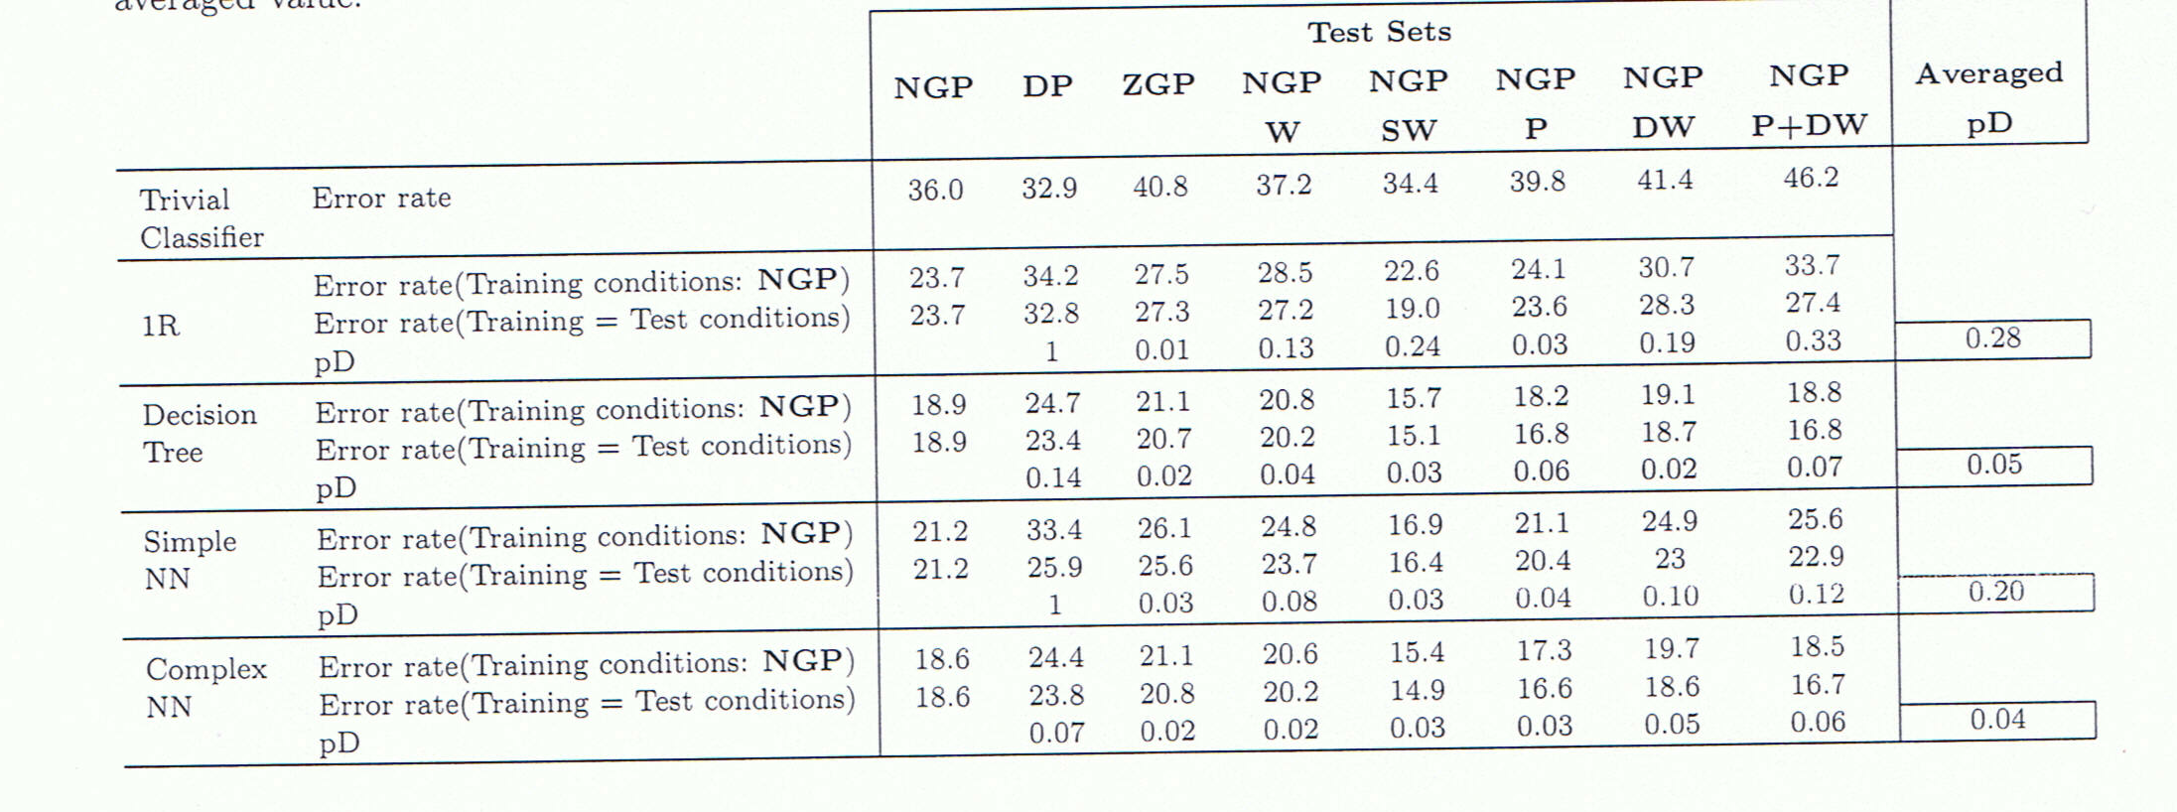
Results I: Population Drifts with Full Representation
Verification of our hypotheses:
(a) A drop in performance is observed by all classifiers
(b) Simpler classifiers suffer much more.

Slide 106
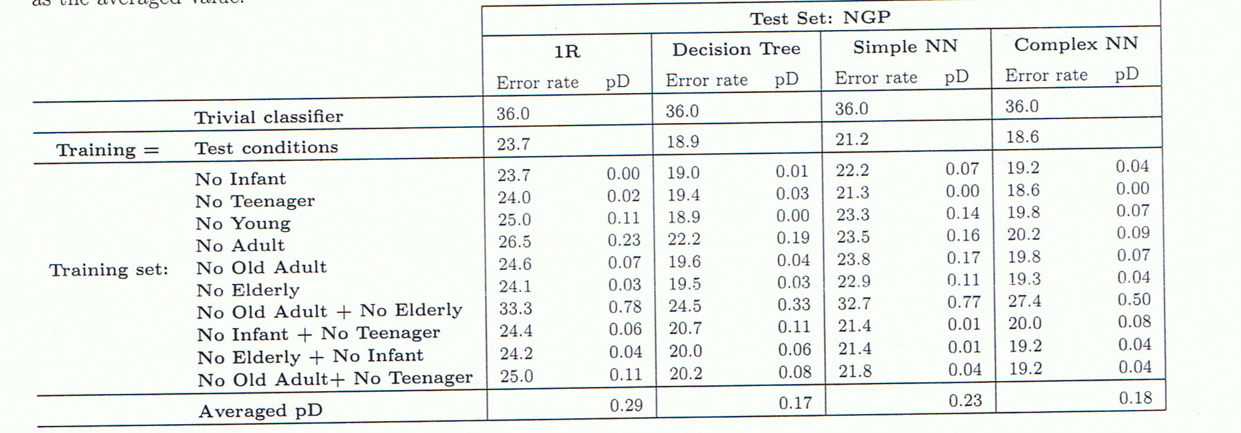
Results II: Population Drifts with Non-Represented Cases
Verification of our hypotheses:
(a) A drop in performance is observed by all classifiers
(b) Simpler classifiers suffer slightly more.

Slide 107
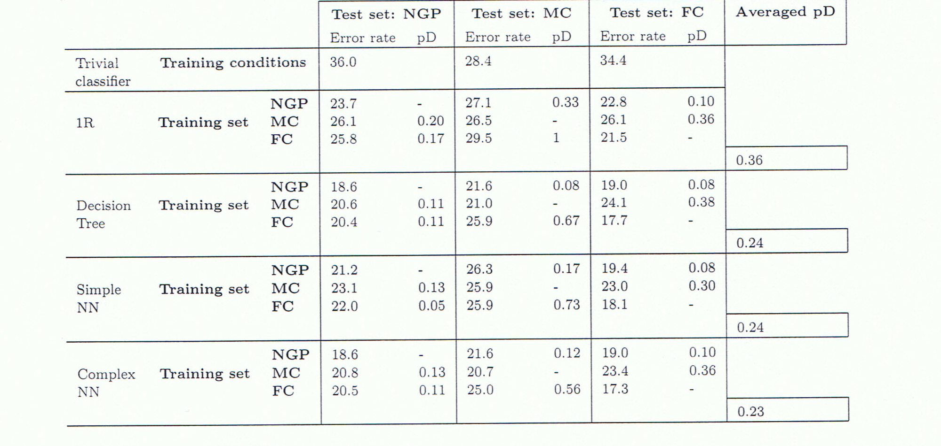
Results III: Class Definition Changes
Verification of our hypotheses:
(a) A drop in performance is observed by all classifiers
(b) Simpler classifiers don’t necessarily suffer more than complex
ones. (SimpleNN does not. 1R does)

Slide 108
Summary
Our results show that the trend hypothesized by David Hand does happen in some cases, but does not happen in others.
In all cases, however, complex classifiers that generally obtain lower error rates in the original scenario (with no changing conditions) remain the best choice since their performance remains higher than that of the simple classifiers even though their performance deterioration are sometimes equivalent.
Given the dearth of data sets representing changing environments, none of the results we present here could have been obtained had we not generated artificial though realistic data sets simulating various conditions.

Slide 109
Future Work
Develop a systematic way to generate realistic artificial data sets that could replace, or, at least, supplement the UCI domains.
Find a way to verify the realistic nature of these data sets.
Rather than generate data sets from intuition as we’ve done it here, start from actual real-world data sets and expand them artificially.

Slide 110
General Conclusions
A first step to improve the evaluation process in machine learning is to be more aware of the tradeoffs involved in choosing one evaluation method over another. This tutorial as well as the book I co-wrote will help researchers understand these issues more deeply.
In particular, the tutorial overviewed:
  Evaluation Metrics
  Statistical Tests
  Re-sampling methods
  Data set selection criteria
  Available resources
  Some recent research from our group

Slide 111
If you need help, advice, etc…
Please, contact me at:
nat@site.uottawa.ca
Thank you for attending the workshop!!!

Slide 112
References
Too many to put down here, but pp. 393-402 of the book.
If you want specific ones, come and see me at the end of the tutorial or send me an e-mail.

