Slide 1
Dempster-Shafer Theory
From
https://www.amia.org/staff/eshortliffe/Buchanan-Shortliffe-1984/Chapter-13.pdf

Slide 2
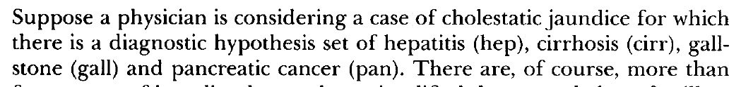
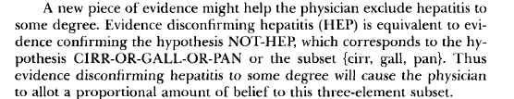
Example
One piece of evidence considered by the physician might support the diagnosis
of hepatitis or cirrhosis. These two diagnostics combined is also called intrahepatic
Cholestatis. That evidence will cause the physician to allot a proportional
amount of belief to the diagnosis of hepatitis or cirrhosis (or intrahepatic Cholestatis)
.

Slide 3
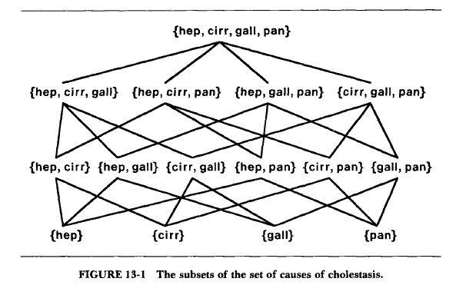
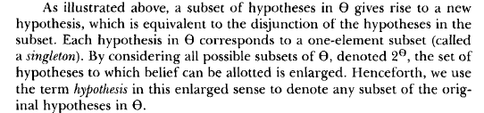

Slide 4
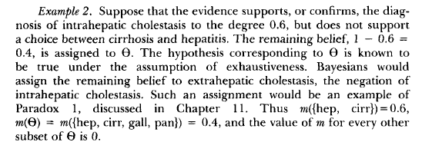
Basic Probability Assignment

Slide 5
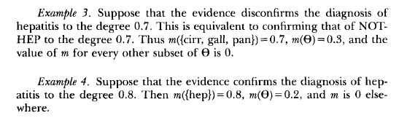
More examples

Slide 6
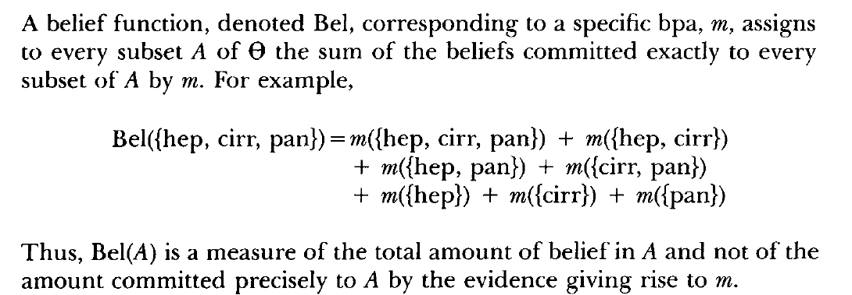
Belief Functions

Slide 7
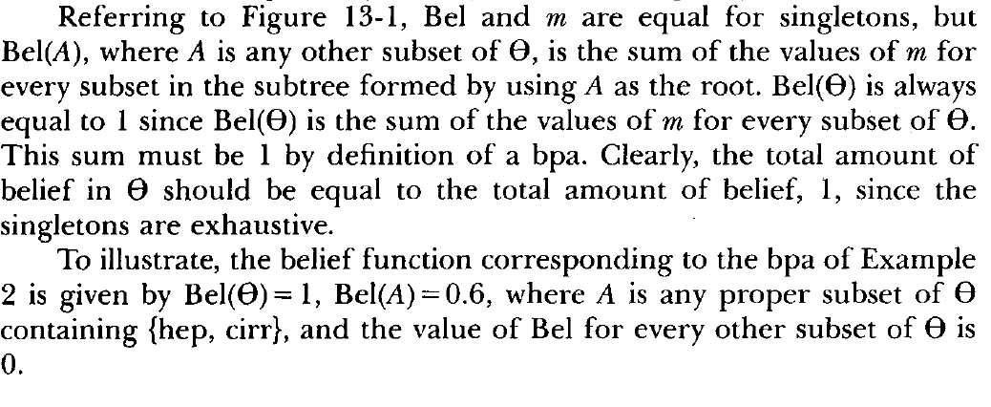
Belief Functions cont’d
In other words, in example 2, we have
Bel({hep, cirr}) = .6
Bel({heb, cirr, pan})= .6
Bel({hep, cirr, gall})= .6
Bel({hep, cirr, pan, gall})= 1

Slide 8
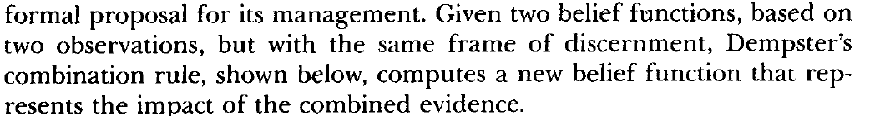
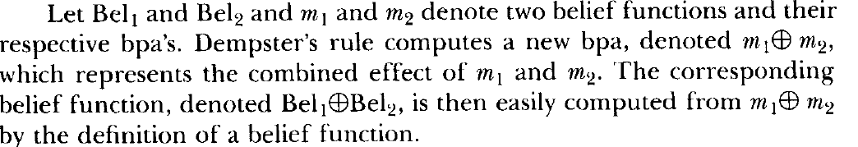
Combination of Belief Functions
We illustrate Dempster’s combination rule in two examples

Slide 9
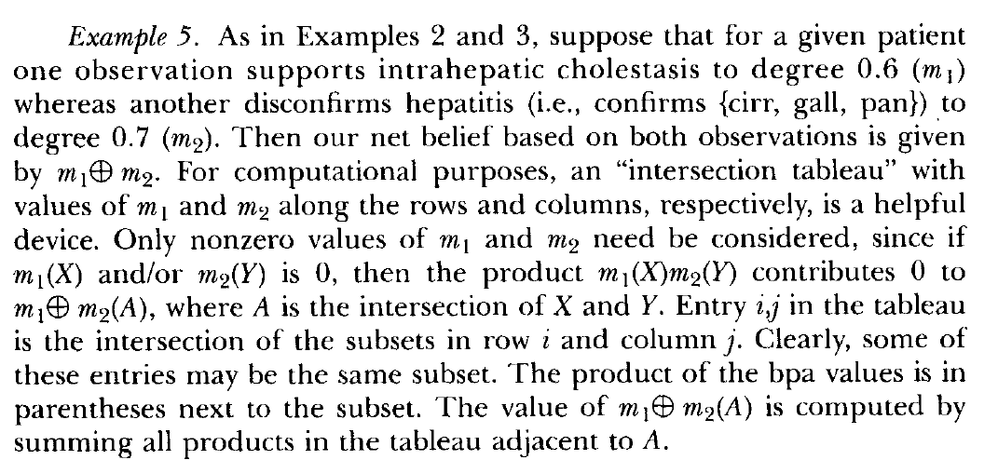
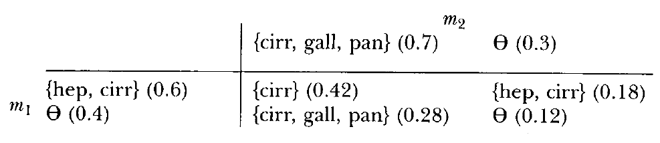
Example of Dempster’s Combination Rule

Slide 10
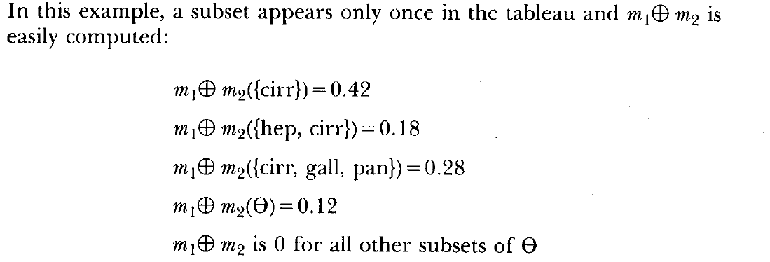
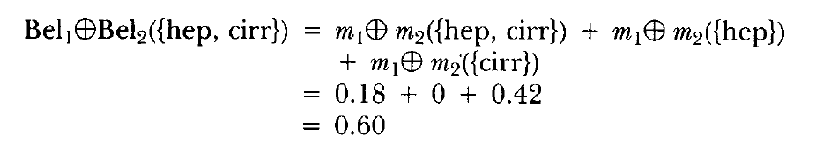
Example of Dempster’s Combination Rule (cont’d)

Slide 11
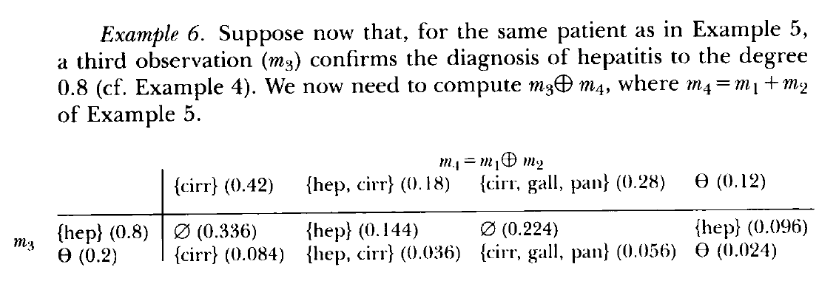
Additional example of Dempster’s combination rule

Slide 12
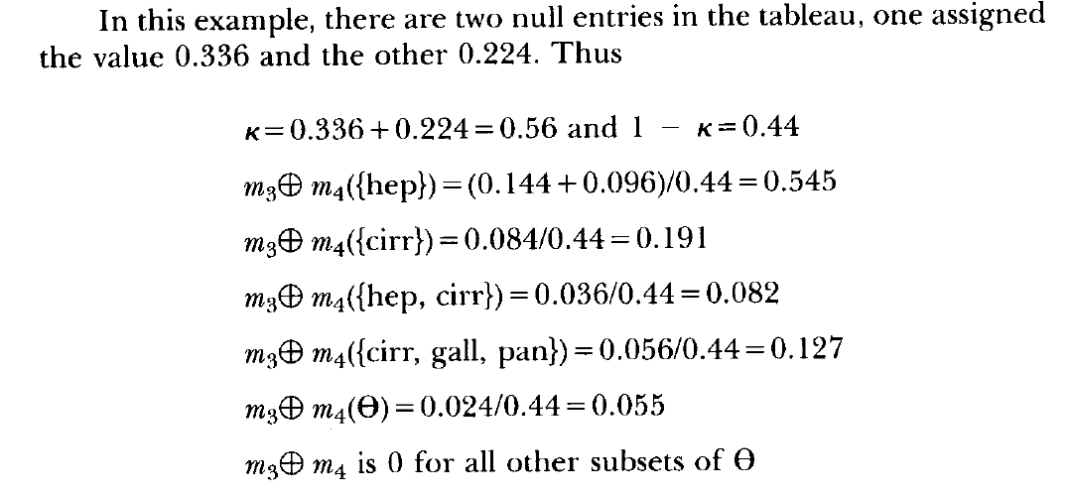
Additional example (cont’d)

Slide 13
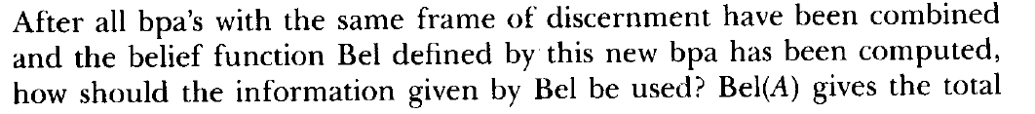
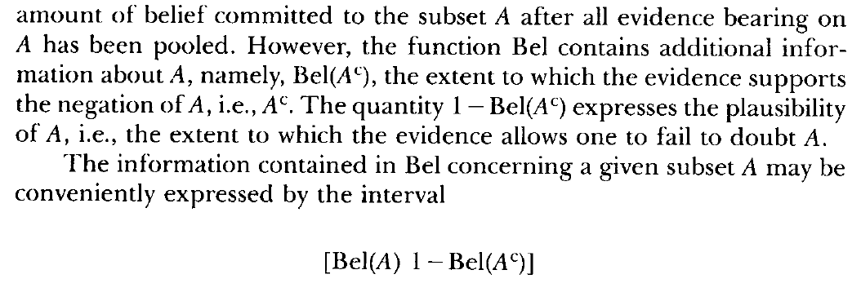
Belief Intervals

