Slide 1
Career Tips
Liam Peyton
March 11, 2016

Slide 2
Agenda
Bienvenue / Welcome
Community / Communauté
Préparation
Job Sources d’Emplois
Résumé
Evaluation
Next Steps / Prochaines étapes

Slide 3
Welcome - Bienvenue
I am your advocate / Je suis votre partisan
I want you to succeed / Je veux que vous réussissiez
Appel Moi / Contact Me - lpeyton@uottawa.ca
IMMEDIATELY if there is a problem ... administrative, academic, career, personal, health...
IMMÉDIATEMENT si il ya un problème ... administrative, scolaire, professionnelle, personnelle, la santé ...
SESA (Software Engineering Student Association)
https://www.facebook.com/UOttawaSESA
http://www.uottawa-sesa.ca/firstyearadvice
COOP/Careers / Undergrad Office/ SASS/ …

Slide 4
Community / Communauté
What is your network?
uOttawa, colleagues (e.g. SESA), friends/family/neighbours, clubs/activities
GitHub, LinkedIn, FaceBook, Instagram, Twitter, etc.
Who can help you?
Where are you visible?
When / How do you participate?

Slide 5
Preparation
What employers are looking for (in order):
Professional Attitude
PASSIONATE, SELF-MANAGED, SUCCESSFUL, ARTICULATE, COOPERATIVE
ANY Relevant Experience not just $$$
Skills: list of tools, acronyms and current concepts
What you need to do to prepare
Research it
Live it
Make Yourself Public: LinkedIn, GitHub, Facebook

Slide 6
Job Sources d’Emploies
YOUR NETWORK!!!
Including SESA, LinkedIn and Facebook groups
uOttawa
coop website Index
Work Study Navigator
-internship: SESA, profs, Hanan Anis, volunteer
Company and Government websites
OtawaInvest website
Catalog of companies in the greater ottawa area.
http://investottawa.force.com/apex/KnowledgeIndustryDatabaseV2
Job shop websites
http://ca.indeed.com/ http://www.monster.ca/
Volunteer at your favorite organization

Slide 7
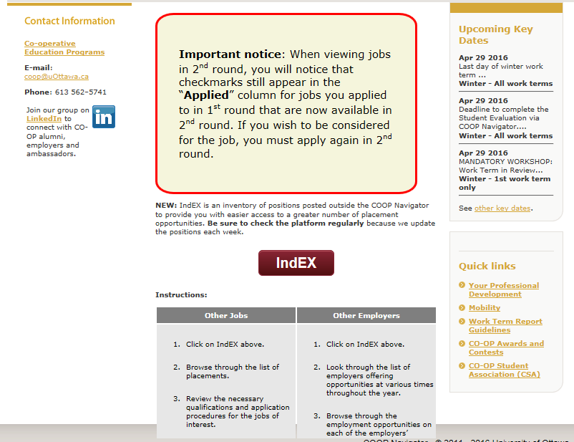
COOP Navigator - Index – companies not part of matching process

Slide 8
Resume
What needs to be on a resume?
Hint: What is the purpose of the resume?
To select the candidates which best match the job description and the unstated requirements for interviewing
Never ever lie. BUT a resume is to promote you, to advertise for an interview. It is not a life history it is not a confessional. Do not include items that are irrelevant. Do include items that are relevant to showing you are qualified

Slide 9
Resume Sections
Header: name, email, phone number, github link, Linked Link
Skills
every acronym, tool, product, and concept possible …especially the ones listed in the jobs you are applying for … Language, OS, Web, CMS, DB, SCRUM, Agile, Web Service, REST (Google, Coursera, …learn what you are missing)
Experience
Any experience … not just paid .. List as projects. U can include class and personal projects (especially if displayed on github). List start and end date in years .. Not months
Education
No dates. Include degree you complete this year. (in progress) if you are NOT graduating this year
Other: Possibly Awards, Other Experience (planning an event)

Slide 10
Interview
What is the answer to any question?
Hint: What is the purpose of the interview?
To determine if you are the right person for the job AND whether or not the interviewer(s) would like to work with you
The answer is: “Yes, I am the right person for the job, because…. “
Why should they believe you?
Always always try and illustrate your points with examples from your experience
What impression do you want to make?
Its often not whether you gave the right answer … but how you thought about the question, how you interacted with your interviewers, how you looked, how you conducted yourself

Slide 11
Evaluation
What is your network, skills, experience, attitude?
How can you improve it
Are you finding jobs to apply for?
Why not? What do you need to research?
Are you getting interviews?
Why not? What is missing or wrong on your resume? Fix it!
Are you getting job offers?
Why not? Why did they not want to work with you or think you were not the right person for the job?

Slide 12
Next Steps / Q& A
SESA?
Mentorship
Support groups
Consolidated set of resources tips on website?
Last thought:
Persistence and Preparation and Passion
will pay off handsomely in the long run!

