Slide 1
Project Discussion
10/28/2014

Slide 2
Changes in Plan Phase
To be made in createplan.c
This file contains the code that creates a hash join node in the query plan.
To be made in execnodes.h
This file contains the structure HashJoinState that maintains the state of the hash join during execution.

Slide 3
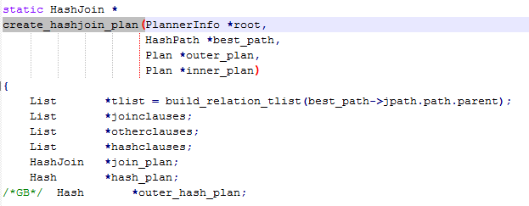
Createplan changes

Slide 4
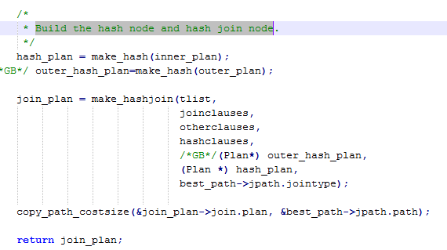
Createplan changes

Slide 5

Execnodes.h changes

Slide 6
