Slide 1
Lab 9
11/11/2014

Slide 2
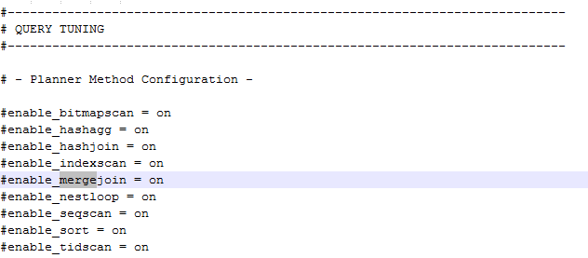
Disable other Joins in conf
To be edited in postgresql.conf found in database directory.

Slide 3
nodeHashJoin
Methods to be changed
  ExecHashJoin
  ExecInitHashJoin
  ExecEndHashJoin
  ExecHashJoinOuterGetTuple
  ExecHashJoinNewBatch
  ExecReScanHashJoin

Slide 4

ExecInitHashJoin
Instead of plan make the node to Hash type
Create another hash node for inner node or rename hashNode to innerNode

Slide 5

ExecInitHashJoin
outerNode is also of type hash so add conversion
specifier code for the same

Slide 6
ExecInitHashJoin
Add state code outerplanstate
Initialize InnerTupleSlot

Slide 7



ExecInitHashJoin
Use hashstate and slot to initialize OuterTupleSlot using outerPlanState
Set slot description for InnerTupleSlot
Set state of inner and outer hash tables to Null

Slide 8

ExecInitHashJoin
Initialize values for inner and outer hash table
Set the finish bool to false for both inner and outer
Set outerPlanState to lclauses

Slide 9
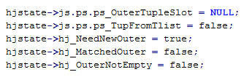
ExecInitHashJoin
Set innertuple slot to null
Set book NeedNewInner to true
Comment outerNotEmpty
Set probing_inner variable to 0

Slide 10
ExecEndHashJoin
Observe for changes related to inner tuple
ExecClearTuple for InnerTuple

Slide 11
ExecHashJoinOuterGetTuple
Need to pass the inner tuple pointer
ExecHashJoinNewBatch
Need to pass the inner tuple pointer wherever necessary

Slide 12
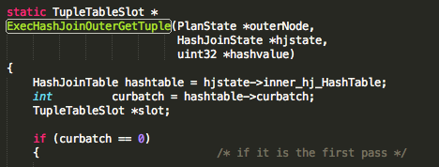

Slide 13
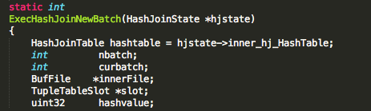
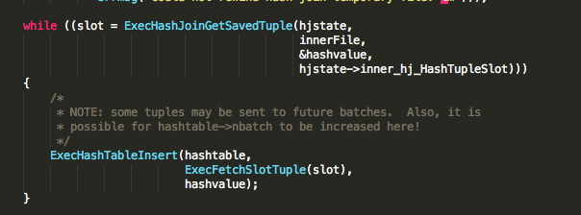

Slide 14
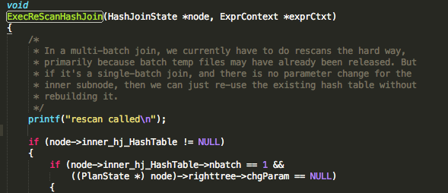
ExecReScanHashJoin

Slide 15
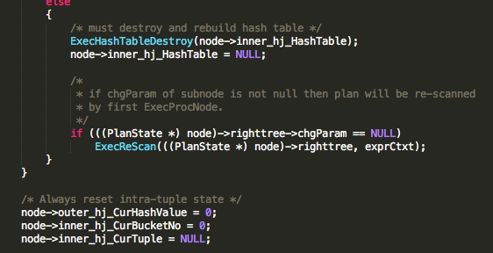

Slide 16
nodeHashJoin
Methods to be changed
  ExecHashJoin
  ExecInitHashJoin
  ExecEndHashJoin
  ExecHashJoinOuterGetTuple
  ExecHashJoinNewBatch
  ExecReScanHashJoin
  ExecHashJoinGetTuple

Slide 17
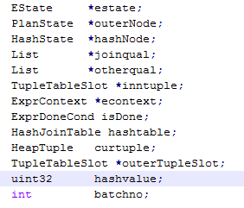
ExecHashJoin
Instead of using PlanState for outernode make it HashState
For each declare a variable for inner/outer table

Slide 18


ExecHashJoin
Declare a variable for inner/outer table

Slide 19
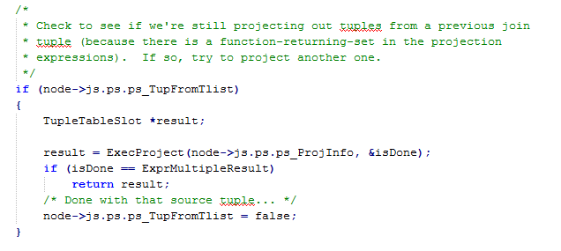
ExecHashJoin
Comment this section

Slide 20

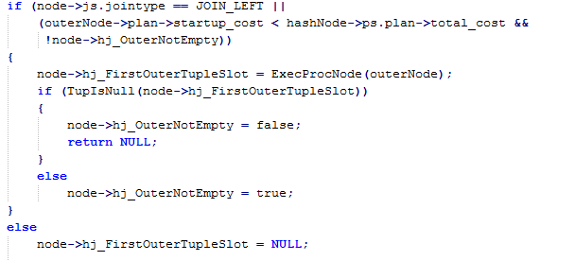
ExecHashJoin
Check if both inner and outer tables are NULL
No need to check join type.
Comment this section

Slide 21
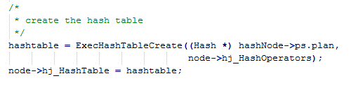

ExecHashJoin
Create both inner and outer hash tables
Assign hashnode with respective hashtables.
2. Don’t have to do MultiExecProcNode. Comment it out.

Slide 22
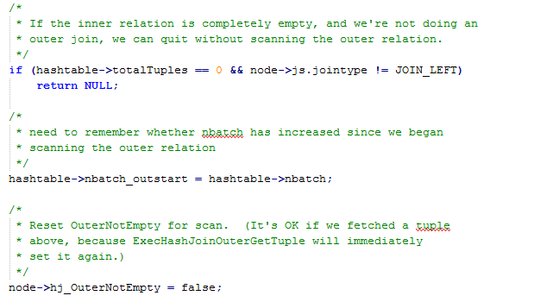
ExecHashJoin
Comment this section

Slide 23
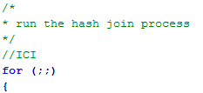
ExecHashJoin
Main code for hash join goes inside this for loop. Comment the code until scanhashbucket is selected.

Slide 24
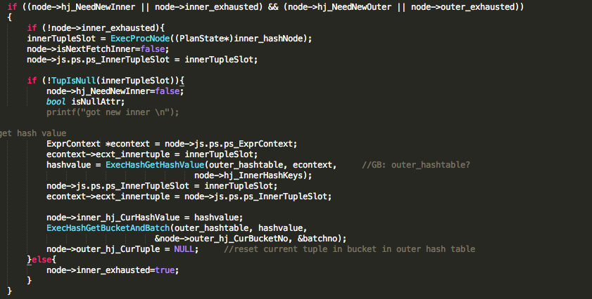
ExecHashJoin

Slide 25
ExecHashJoin
Once done check if both inner and outer nodes are finished
Hash tables are loaded. Now scan the hash buckets

Slide 26
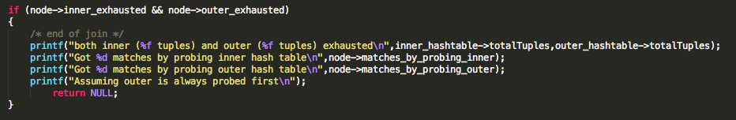

Slide 27
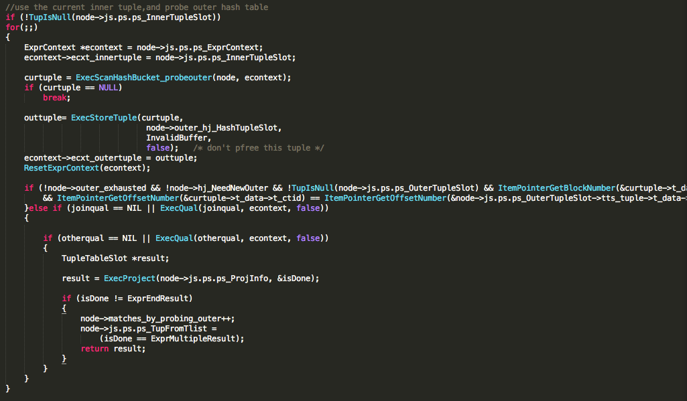
ExecHashJoin

Slide 28
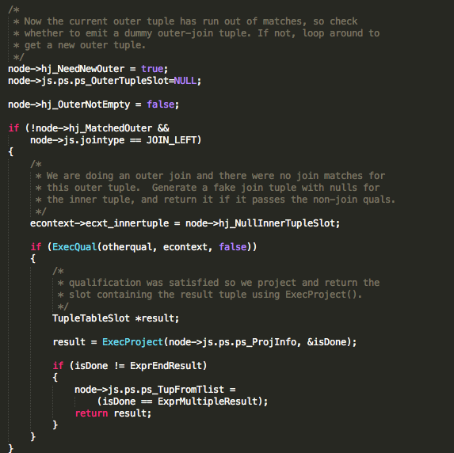
ExecHashJoin

