Slide 1
Lab – 8
11/04/2014

Slide 2
Last date to submit project Dec 2nd
Nov 18th submit part of project
createPlan.c
Execnodes.h
nodeHash.c

Slide 3
Disabling use of Multiple Batches
Present implementation
Hybrid hash join
Tuples from inner / outer are considered in batches

Slide 4
Changes in nodeHash.c
Modify ExecHash
Disable Batches
Implement ExecScanHashBucket for both Inner and Outer

Slide 5
ExecHash
Remove the present error message
It should have the same code as MultiExecHash

Slide 6
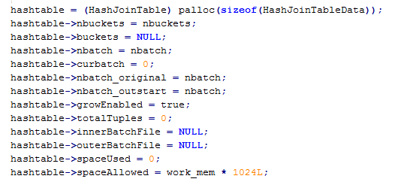
Where to disable?
nodeHash.c
ExecHashTableCreate

Slide 7

Changes to scanhashbucket
Present implementation
Two functions : one for probing inner and other for outer
Returns HeapTuple

Slide 8
Changes to scanhashbucket
Need only one method for scannning both hash tables
Return HashTuple instead of HeapTuple
Check for type of hash table in the method : whether its inner or outer.

Slide 9
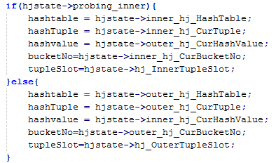
Sample Implementation Code

