Slide 1
Standard Input/Ouput in C
10/23/2013

Slide 2
Stdio.h
Each source file that refers to a input/output library function must contain
#include <stdio.h>
When the name is bracketed by < and > a search is made for the header in a standard set of places
On Unix systems, typically in the directory /usr/include

Slide 3
Sample Example
#include <stdio.h>
#include <ctype.h>
int main()
{
int c;
while ((c = getchar()) != EOF)
{
putchar(tolower(c));
}
return 0;
}

Slide 4
Formatted Output - printf
int printf(char *format, arg1, arg2, ...);
printf converts, formats, and prints its arguments on the standard output under control of the format.
It returns the number of characters printed.
printf("x = %d, y = %d\n", x, y);

Slide 5
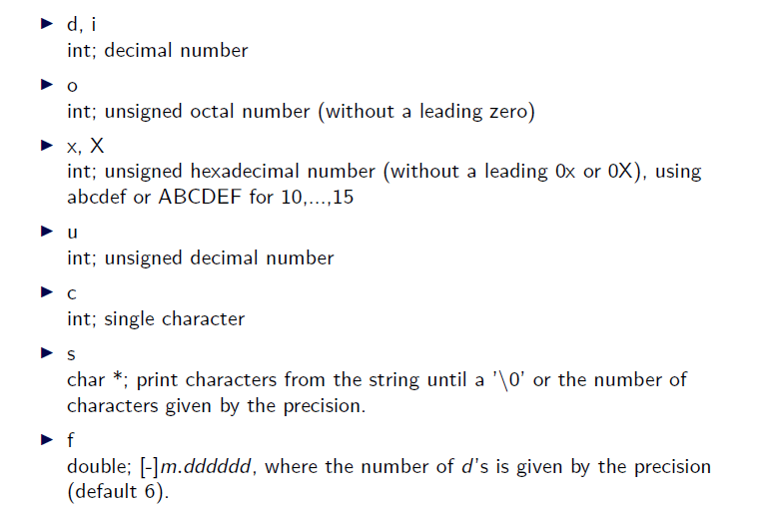
Basic printf Conversions

Slide 6
What can go wrong?
printf(s);
char *s = "My name is %s";
printf(s); // equivalent to printf("My name is %s");
printf("%s", s); // safe

Slide 7
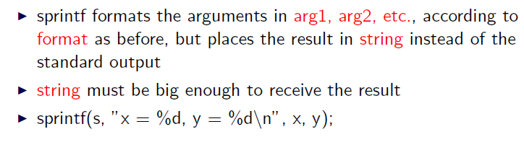
Print to String
int sprintf(char *string, char *format, arg1, arg2, ...);

Slide 8
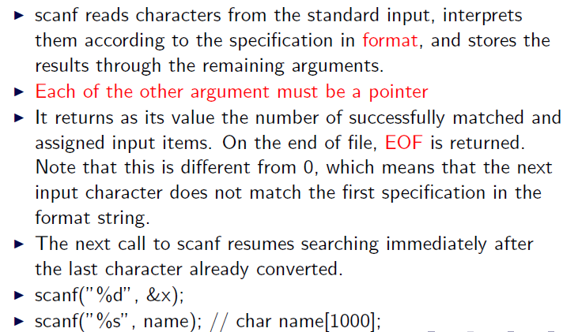
Formatted Input - scanf
int scanf(char *format, ...);

Slide 9
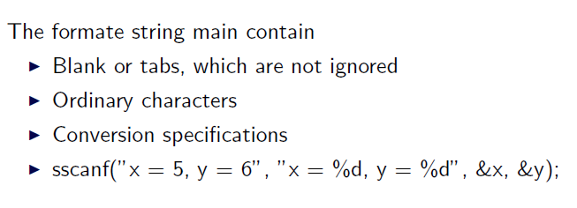
Read from a String
int sscanf(char *string, char *format, arg1, arg2, ...);

Slide 10
Example
#include <stdio.h>
int main()
{
double sum, v;
while (scanf("%lf", &v) == 1)
{
printf("\t%.2f\n", sum += v);
}
return 0;
}

Slide 11
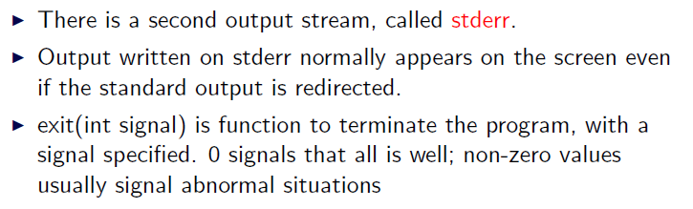
Error Handling – stderr and exit

Slide 12
Example
#include <stdio.h>
#include <stdlib.h>
main()
{
char *p = (char *) malloc(50 * sizeof(char));
if (p == NULL)
{
fprintf(stderr, "Not enough memory!\n");
exit(1);
}
// do something
exit(0);
}

