Slide 1
Functions, Pointers, Structures
Keerthi Nelaturu

Slide 2
Functions
Also called as subroutines or procedures
Return statement
Example:
double power(double val, unsigned pow)
{
double ret_val = 1.0;
unsigned i;
for(i = 0; i < pow; i++)
ret_val *= val;
return(ret_val);
}
Calling a Function: result = power(3, 4);

Slide 3
Steps to use a function
Declaration
Definition
Call

Slide 4
Rules to remember
Function cannot be declared in another function
Order of function declaration doesn’t matter when calling them
A function can be called any number of times
Any function can be called from any other even main

Slide 5
Functions
Example of a function without return value:
void error_line(int line)
{
fprintf(stderr, "Error in input data: line %d\n", line);
}
Note: void is optional

Slide 6
Scope of Function Variables
Local variables
  Local scope, store in the call stack
Static variables
  Local scope, single and statically allocated
Global variables
  Accessible in every scope

Slide 7
Modifying function arguments
We cannot do direct manipulation of arguments of function
Value passed is just a copy or local variable
Can be done by passing address of the variable – Pointers!!!!

Slide 8
Pointers
Address of any variable will be represented by using ‘&’
Ex: &I
Declaration of pointer:
int *pi = &I;
De-referencing a pointer:
j = *pi;

Slide 9
Pointers Example
fiddle(int x, int *y)
{
printf(" Starting fiddle: x = %d, y = %d\n", x, *y);
x ++;
(*y)++;
printf("Finishing fiddle: x = %d, y = %d\n", x, *y); }

Slide 10
Pointers Example
main()
{
int i = 0;
int j = 0;
printf(" Starting main : i = %d, j = %d\n", i, j); printf("Calling fiddle now\n");
fiddle(i, &j);
printf("Returned from fiddle\n");
printf("Finishing main : i = %d, j = %d\n", i, j);
}

Slide 11
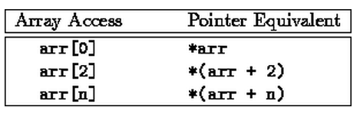
Arrays and Pointers
Arrays and Pointers are related
Array is a pointer to the 0th element of the Array.
We can modify values of an array in a function

Slide 12
Recursive Functions
A function which calls itself
Used when evaluating mathematical functions
Example: Linked lists or binary trees

Slide 13
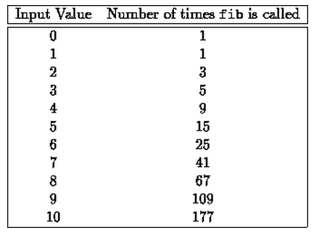
Recursive Function Example
Fibonacci Series

Slide 14
Recursive Function Example
int fib(int num)
/* Fibonacci value of a number */
{
switch(num)
{
case 0: return(0);
break;
case 1: return(1);
break;
default: /* Including recursive calls */
return(fib(num - 1) + fib(num - 2));
break;
} }

Slide 15
Structures in C
Collection of variables
Each variable can be of different type
It can use other structures, arrays and pointers as members
Definition of Structures:
typedef struct
{
char name[64];
char course[128];
int age;
int year;
} student;
Declaraion of Structure:
student st_rec;

Slide 16
Structures in C
Accessing a structure
st_rec.name
Usage:
Complex variables
Multi-dimensional space points
Arrays of structures
Fields including pointers to its own types

