Slide 1
File Input/Output
2014/10/07

Slide 2
What you will learn?
Create
Open
Close

Slide 3
File
Sequence of bytes – binary and text
Opening a file
- FILE *fopen(const char * filename,
const char * mode);

Slide 4
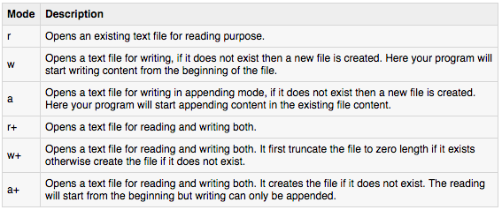
Modes
"rb", "wb", "ab", "rb+", "r+b", "wb+", "w+b", "ab+", "a+b"

Slide 5
Close
int fclose( FILE *fp );
Returns 0 on Successs
EOF for an error

Slide 6
Writing to a File
int fputc( int c, FILE *fp );
int fputs( const char *s, FILE *fp );

Slide 7
Sample program
#include <stdio.h>
main()
{
FILE *fp;
fp = fopen("/tmp/test.txt", "w+");
fprintf(fp, "This is testing for fprintf...\n");
fputs("This is testing for fputs...\n", fp);
fclose(fp);
}

Slide 8
Reading from a File
int fgetc( FILE * fp );
char *fgets( char *buf, int n, FILE *fp );

Slide 9
Sample Program
#include <stdio.h>
main()
{
FILE *fp;
char buff[255];
fp = fopen("/tmp/test.txt", "r");
fscanf(fp, "%s", buff);
printf("1 : %s\n", buff );
fgets(buff, 255, (FILE*)fp);
printf("2: %s\n", buff );
fgets(buff, 255, (FILE*)fp);
printf("3: %s\n", buff );
fclose(fp);
}

Slide 10
Binary I/O
size_t fread(void *ptr, size_t size_of_elements,
size_t number_of_elements, FILE *a_file);
size_t fwrite(const void *ptr, size_t size_of_elements,
size_t number_of_elements, FILE *a_file);

