Slide 1
Introduction to C Language
Keerthi Nelaturu
knela006@uottawa.ca
www.site.uottawa.ca/~knela006/

Slide 2
Quick inside into the language
Closely associated with UNIX system
System programming language
Stemmed up from Language BCPL
Supports data types, functions, control flow statements etc.

Slide 3
First C Program
Print “Hello, world”
#include <stdio.h>
main()
{
printf(“hello, world \n”);
}

Slide 4
More escape sequences
\n – Newline character
\t – Tab
\b – Backspace
\” – Double quote
\\ - Backslash

Slide 5
Comments in C
They start with “/*” and end with “*/”.
Ignored by the compiler
C compilers do not care about how a program looks, indentation and spacing.
Documentation of your program is always important! Makes it easy for people to read through.

Slide 6
Variables in C
Must be declared before they are used
C language is Case Sensitive
Cannot use keywords for variable names
Declaration of variable consists of :
  Type name
  List of variable names
  Terminator (;)
Ex: int fahr, celsius;
float lower, upper, step;

Slide 7
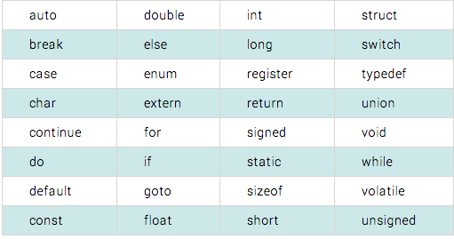
List of Keywords

Slide 8
Basic data types in C
int
float
char
short
long
double

Slide 9
Compiling and Running a C program
In Unix,
Command to compile:
gcc hello.c
Running a executable file
./a.out

Slide 10
Input/Output
Printf is the basic output function we use for displaying content in C
Syntax: printf(“%d %6.2f”, intvar1, floatvar2);
Scanf is the function we use to get user input.
Syntax: scanf(“%d%f”,&test1,&test2);

Slide 11
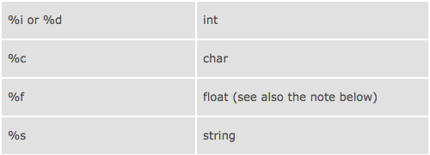
Format Specifier

Slide 12
Operators
Arithmetic Operator : +, -, *, /, %
Assignment Operators: +=, -= etc
Relational and Logical Operators: >, >=, <, <=, ==, !=, &&, ||
Always check for the order of precedence when evaluating an expression with operators in it.
Type conversions: From narrower to wider.
int to float – Correct
float to int – wrong
Check the texbook for table on precedence of all operators.

Slide 13
Increment / Decrement Operators
Increment : ++ (post & pre)
Decrement: -- (post & pre)
Ex: n++ - will increments n after the value is used
++n – will increment n before the value is used
Increment and Decrement operators can only be applied to variables not expressions

Slide 14
Bitwise Operators
Six operators for bit manipulation in C
& - bitwise AND
| - bitwise inclusive OR
^ - bitwise exclusive OR
<< - left shift
>> - right shift
~ - one’s complement (unary)
Conditional Expression: exp1 ? Exp2 : exp3;

Slide 15
Constants
#define MAXLINE 1000
char esc = ‘\\`;
int i = 0;
int limit = MAXLINE +1;
float aFloat = 1.0e-5;
const double e = 2.7856;

Slide 16
Control Flow
Else if
If-Else
Switch
switch (expression)
{
case const-expr: statement break;
default: statements
}

Slide 17
Control Flow (cont’d)
do-while
while
For
Goto!
for ( …) {
if (disaster)
goto error;
}
error:
printf(“bad programming!”);

