Slide 1
Laboratory - 8
Keerthi Nelaturu
(knela006@uottawa.ca)
Url: site.uottawa.ca/~knela006

Slide 2
Agenda
Java I/O
IO Exceptions
Formatting
PlayListManager application

Slide 3
Java I/O
Package to refer : java.io and java.nio (for advanced concepts – Not discussed in this session)
Java I/O – helps in reading and writing various forms of data

Slide 4
Java I/O (Contd..)
Stream – Sequence of data
Two types of tasks on streams
  Input - Reading data from console/any form
  Output – Writing data to console/any form
Two types of Streams
  Character
  Byte (Not discussed )
Access Modes – Read, Write, Direct

Slide 5
Java I/O (Contd..)
Character Streams
Java stores character values in Unicode convention
Character stream I/O converts this formal to/from local character set.
All classes descended from Reader and Writer
Two classes for File I/O – FileReader and FileWriter

Slide 6
Character streams are “wrappers” for byte streams
Takes byte stream assistance for Physical I/O
FileReader uses FileInputStream
FileWriter uses FileOutputStream

Slide 7
Two abstract classes with methods for input and output
  InputStream
  OutputStream
Byte to character bridge streams
  InputStreamReader
  OutputStreamWriter

Slide 8
InputStream
Read()
Read(byte[] b)
  Reads some number of bytes from the input stream and stores them into the buffer array b. The number of bytes actually read is returned as an integer
Close()
System.in – input stream associated with keyboard
Note: InputStream is an abstract class it is never instantiated

Slide 9
OutputStream
Write(byte[] b) – writes b.length of array bytes to output stream
Flush()
Close()
System.out – output stream associated with console
Note: OutputStream is an abstract class it is never instantiated

Slide 10
Demo
Reading from a file - Demo
Reading from a keyboard - Demo

Slide 11
Buffered Reader
Until now its Unbuffered I/O
Direct access
Buffered streams read/write data into a memory area known as buffer
BufferedReader in = new BufferedReader(
new InputStreamReader(
new FileInputStream("data") ) );
String s = in.readLine();
Demo

Slide 12
Exception
IOException - Signals some error when dealing with I/O operations
FileNotFoundException by FileInputStream
Finally clause
If the JVM exits while the try or catch code is being executed, then the finally block may not execute.

Slide 13
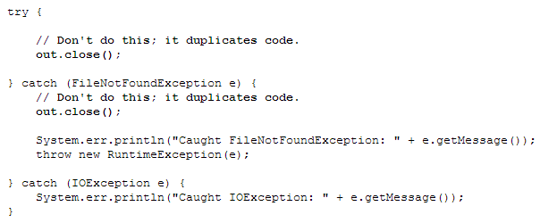
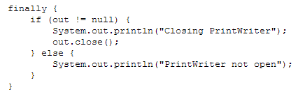

Slide 14
Formatting
Java.text.format
  DateFormat
  Number Format
  Decimal Format - to control leading and trailing zeros, prefixes, suffixes, decimal seperators
Demo

