Slide 1
Lab-12
Keerthi Nelaturu

Slide 2
BitList
Stores bit values in Linked List
Has to be stored in right to left order
Example : 101011
1
1
0
1
0
1

Slide 3
BitList - Implementation
public BitList( String s )
Creates list of bits
String S must contain ONLY 0’s and 1’s
  Illegal argument exception otherwise
Need to create empty list if S is empty
No trimming of trailing 0’s

Slide 4
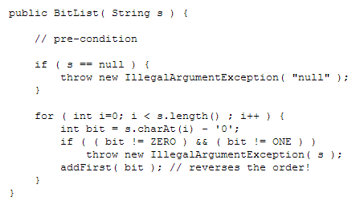
BitList - Implementation

Slide 5
BitList - Complement
Should return BitList of same length
Check for empty list
Reverse ‘1’ to ‘0’ & ‘0’ to ‘1’
1
1
0
1
0
0
0
1
1
0
1
0

Slide 6
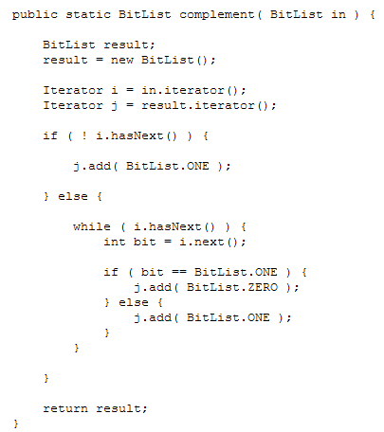
BitList - Complement

Slide 7
BitList - or
BitList – a | BitList – b | Result
1 | 1 | 1
1 | 0 | 0
0 | 1 | 0
0 | 0 | 0

Slide 8
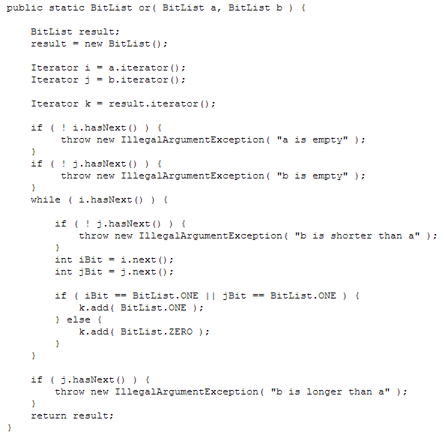
BitList-or

Slide 9
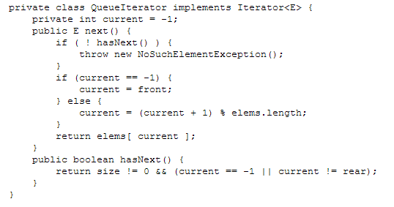

CircularQueue using Iterator <E>

Slide 10
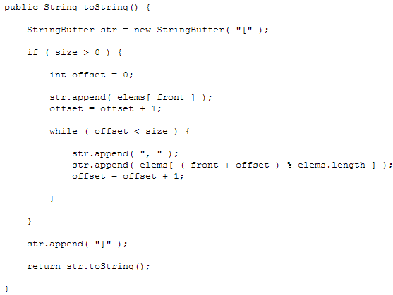
CircularQueue using Iterator <E>

Slide 11
LinkedList – remove(int from, int to)
Returns another list
New list contains the elements removed and in the same order
Nodes in the list are doubly linked and circular

Slide 12
LinkedList – remove(int from, int to)

