Slide 1
Lab - 11
Keerthi Nelaturu

Slide 2
Ordered Structure
Using Doubly linked list
All elements in the list are arranged in an order
Implement the Ordered Structure interface
Methods :
Add
Get
Remove
Merge
Size

Slide 3
OrderedList Class
Create a class OrderedList implement OrderedStructure interface
Add another nested static class Node
Node is an element in the Doubly Linked List
Tail
Head
Node
Node
Value
Of type Comparable

Slide 4
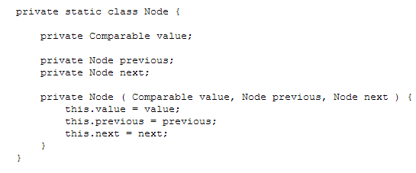
Node

Slide 5
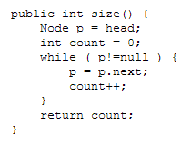
Size

Slide 6
Add
Conditions to consider :
Check for null value passed in the parameter
Check for empty list
Check if the first element in the list is greater than equal to value passed
There is one node which is greater than value passed

Slide 7
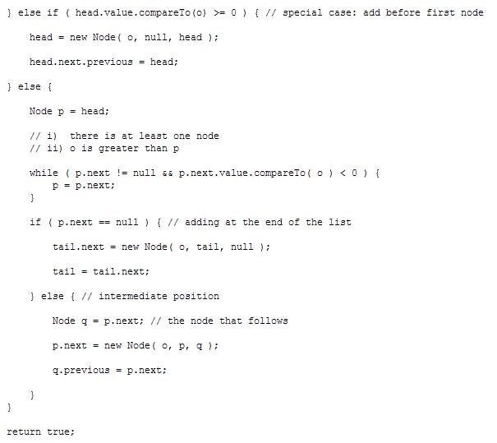
Add

Slide 8
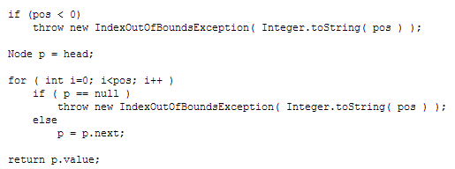
Get (pos)

Slide 9
Remove (pos)
Three cases to consider
If the position is less than 0 throw exception
If position is 0
Intermediate node

Slide 10
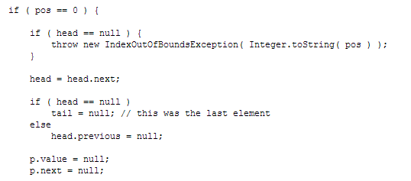
Position is 0

Slide 11
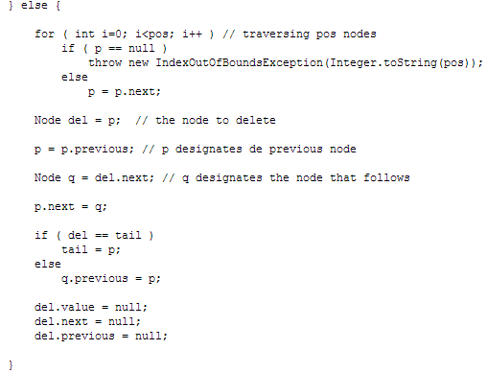
Intermediate position

Slide 12
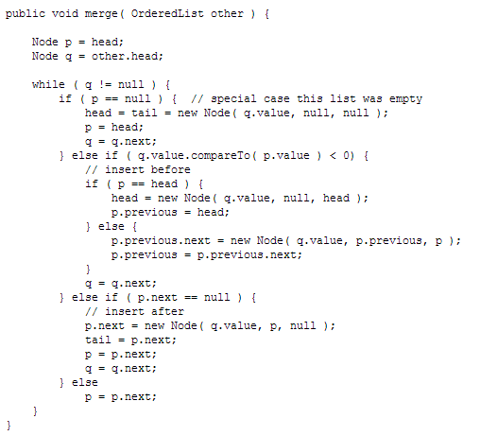
Merge another List

