Slide 1
Lab 10
Keerthi Nelaturu

Slide 2
What is a Crawler?
Keeps track of all the and web pages
Mainly used to help search engines
Searches a web page for links until there are none to find.
Example : www.google.ca

Slide 3
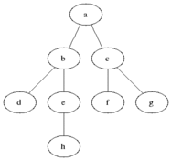

Breadth First Search

Slide 4
Crawler Implementation - HTML
Checks for the URL pattern
Gets the content of the page
Important Methods :
hasMoreUrls
nextUrl

Slide 5
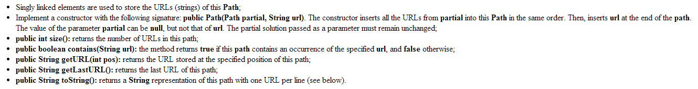
Crawler Implementation - Path
Queue used in BFS algorithm uses Path to keep track of the URL’s.

Slide 6
Crawler Implementation - Crawler
Implements BFS using Linked Queue.
Uses Path class to store all partial solutions
Important Methods:
isValid
Solve – BFS in this method

