Slide 1
Outline
Introduction
Background
Distributed Database Design
Database Integration
  Schema Matching
  Schema Mapping
Semantic Data Control
Distributed Query Processing
Multimedia Query Processing
Distributed Transaction Management
Data Replication
Parallel Database Systems
Distributed Object DBMS
Peer-to-Peer Data Management
Web Data Management
Current Issues

Slide 2
Problem Definition & Integration Alternatives
Given existing databases with their Local Conceptual Schemas (LCSs), how to integrate the LCSs into a Global Conceptual Schema (GCS)
  GCS is also called mediated schema
Bottom-up design process
Integration alternatives:
  Physical integration
    Source databases integrated and the integrated database is materialized
    Data warehouses
    Enterprise Application Integration (EAI)
  Logical integration
    Global conceptual schema is virtual and not materialized
    Enterprise Information Integration (EII)

Slide 3
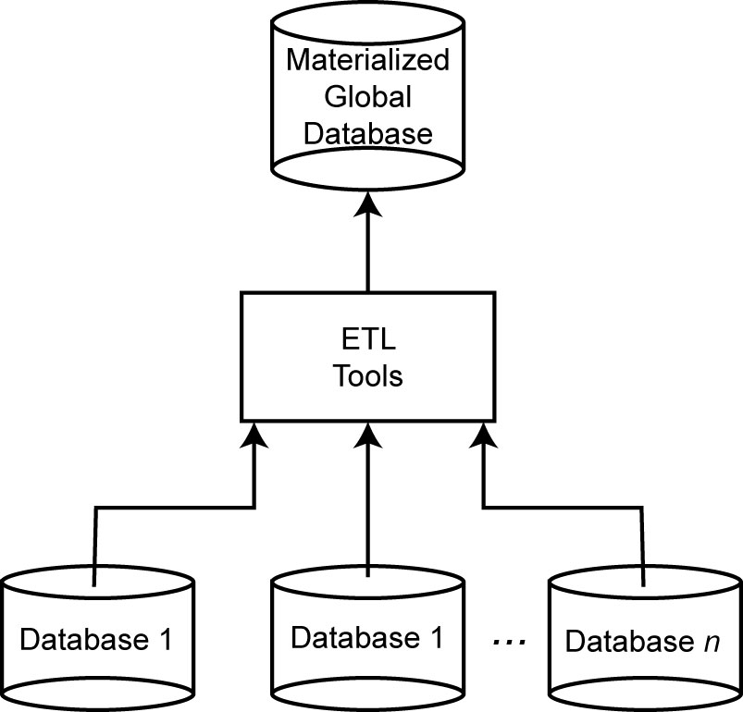
Data Warehouse Approach

Slide 4
Bottom-up Design
GCS (also called mediated schema) is defined first
  Map LCSs to this schema
  As in data warehouses
GCS is defined as an integration of parts of LCSs
  Generate GCS and map LCSs to this GCS

Slide 5
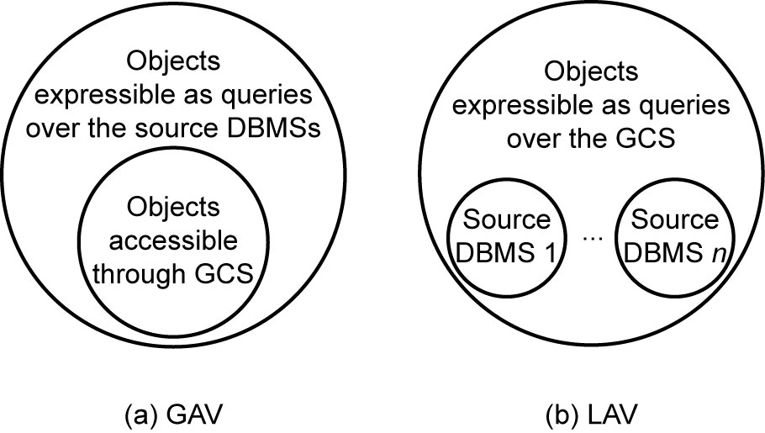
GCS/LCS Relationship
Local-as-view
  The GCS definition is assumed to exist, and each LCS is treated as a view definition over it
Global-as-view
  The GCS is defined as a set of views over the LCSs

Slide 6
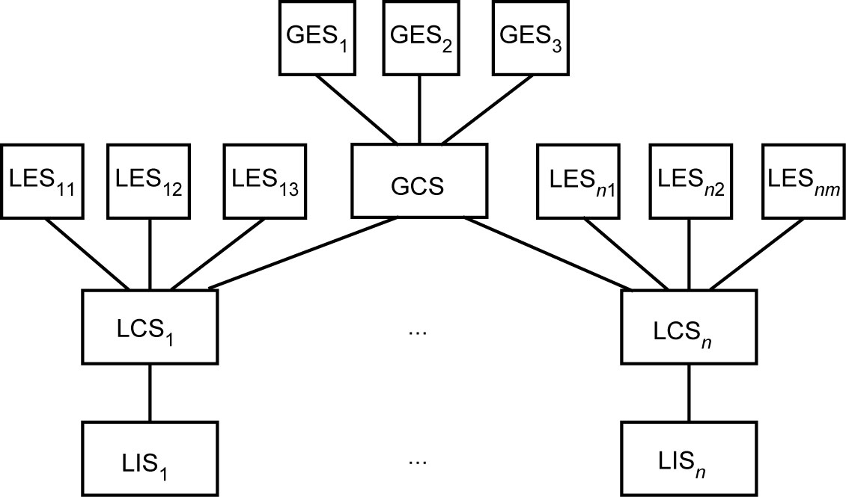
Recall Data-Centered Architecture

Slide 7
Database Integration Issues
Schema translation
  Component database schemas translated to a common intermediate canonical representation
Schema generation
  Intermediate schemas are used to create a global conceptual schema

Slide 8
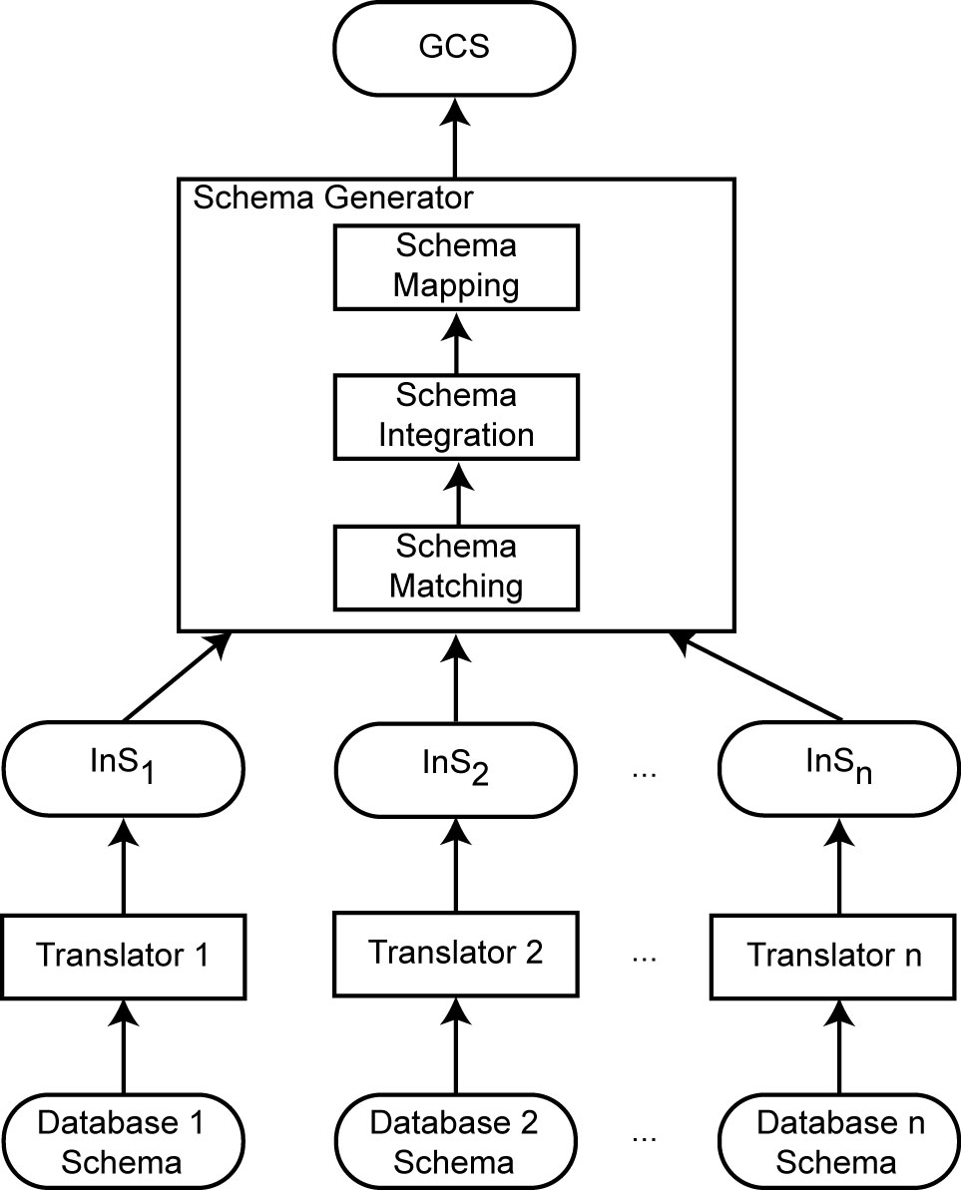
Database Integration Process

Slide 9
Schema Translation
What is the canonical data model?
  Relational
  Entity-relationship
    DIKE
  Object-oriented
    ARTEMIS
  Graph-oriented
    DIPE, TranScm, COMA, Cupid
    Preferable with emergence of XML
    No common graph formalism
Mapping algorithms
  These are well-known

Slide 10
Schema Generation
Schema matching
  Finding the correspondences between multiple schemas
Schema integration
  Creation of the GCS (or mediated schema) using the correspondences
Schema mapping
  How to map data from local databases to the GCS
Important: sometimes the GCS is defined first and schema matching and schema mapping is done against this target GCS

Slide 11
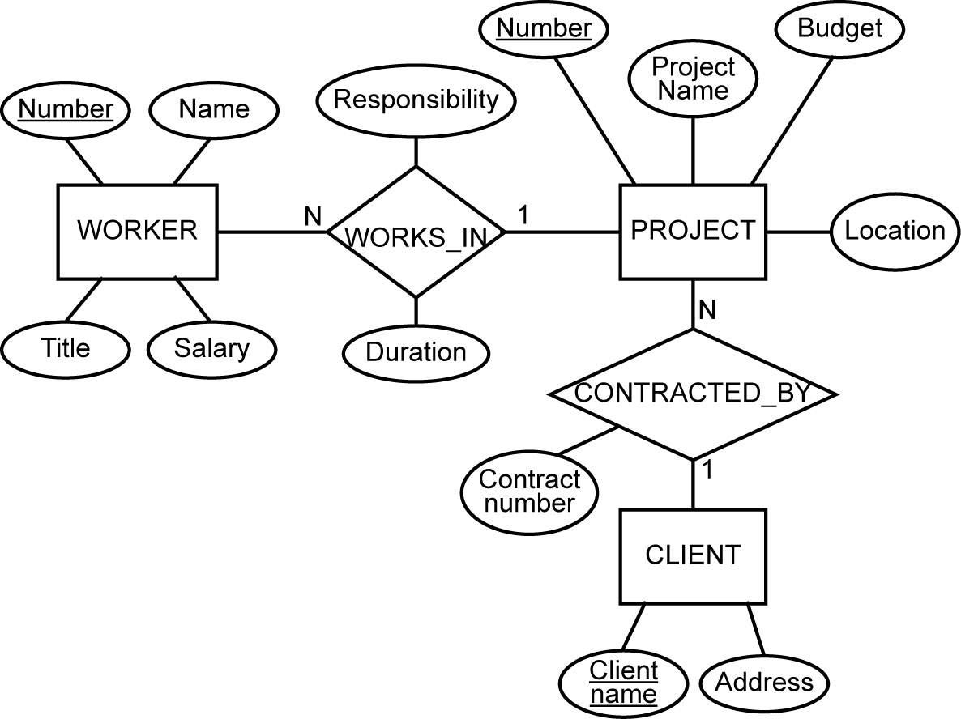
Running Example
E-R Model
Relational
EMP(ENO, ENAME, TITLE)
PROJ(PNO, PNAME, BUDGET, LOC, CNAME)
ASG(ENO, PNO, RESP, DUR)
PAY(TITLE, SAL)

Slide 12
Schema Matching
Complications in automatizing this step: schema heterogeneity
Schema heterogeneity
  Structural heterogeneity
    Type conflicts: attribute vs. entity
    Dependency conflicts: different relationship modes (e.g., 1-to-1 vs. N-to-1)
    Key conflicts: different keys selected in different schemas
    Behavioral conflicts: different modeling mechanisms
  Semantic heterogeneity
    More important and harder to deal with
    Synonyms, homonyms, hypernyms (Solved using ontologies)
    Different ontologies: how to match schema element across ontologies?
    Imprecise wording: ambiguity

Slide 13
Schema Matching (cont’d)
Other complications
  Insufficient schema and instance information
  Unavailability of schema documentation
  Subjectivity of matching
Issues that affect schema matching
  Schema versus instance matching: is the element part of the schema or is it part of the instance?
  Element versus structure level matching: should the structural relationship between elements mater?
  Matching cardinality: 1-to-N or N-to-N matching?

Slide 14
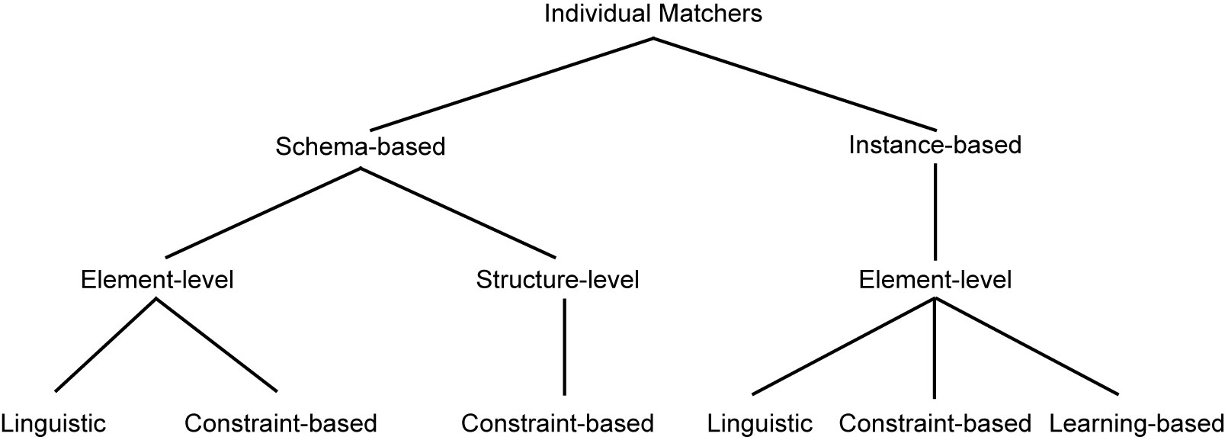
Schema Matching Approaches

Slide 15
Linguistic Schema Matching
Use element names and other textual information (textual descriptions, annotations)
May use external sources (e.g., Thesauri)
〈SC1.element-1 ≈ SC2.element-2, p,s〉
  Element-1 in schema SC1 is similar to element-2 in schema SC2 if predicate p holds with a similarity value of s
Schema level
  Deal with names of schema elements
  Handle cases such as synonyms, homonyms, hypernyms, data type similarities
Instance level
  Focus on information retrieval techniques (e.g., word frequencies, key terms)
  “Deduce” similarities from these

Slide 16
Linguistic Matchers
Use a set of linguistic (terminological) rules
Basic rules can be hand-crafted or may be discovered from outside sources (e.g., WordNet)
Predicate p and similarity value s
  hand-crafted ⇒ specified,
  discovered ⇒ may be computed or specified by an expert after discovery
Examples
  〈uppercase names ≈ lower case names, true, 1.0〉
  〈uppercase names ≈ capitalized names, true, 1.0〉
  〈capitalized names ≈ lower case names, true, 1.0〉
  〈DB1.ASG ≈ DB2.WORKS_IN, true, 0.8〉

Slide 17
Automatic Discovery of Name Similarities
Affixes
  Common prefixes and suffixes between two element name strings
N-grams
  Comparing how many substrings of length n are common between the two name strings
Edit distance
  Number of character modifications (additions, deletions, insertions) that needs to be performed to convert one string into the other
Soundex code
  Phonetic similarity between names based on their soundex codes
Also look at data types
  Data type similarity may suggest stronger relationship than the computed similarity using these methods or to differentiate between multiple strings with same value

Slide 18
N-gram Example
3-grams of string “Responsibility” are the following:
    Res  sib
    ibi  esp
    bip  spo
    ili  pon
    lit  ons
    ity  nsi
3-grams of string “Resp” are
  Res
  esp
3-gram similarity: 2/12 = 0.17

Slide 19
Edit Distance Example
Again consider “Responsibility” and “Resp”
To convert “Responsibility” to “Resp”
  Delete characters “o”, “n”, “s”, “i”, “b”, “i”, “l”, “i”, “t”, “y”
To convert “Resp” to “Responsibility”
  Add characters “o”, “n”, “s”, “i”, “b”, “i”, “l”, “i”, “t”, “y”
The number of edit operations required is 10
Similarity is 1 − (10/14) = 0.29

Slide 20
Constraint-based Matchers
Data always have constraints – use them
  Data type information
  Value ranges
  …
Examples
  RESP and RESPONSIBILITY: n-gram similarity = 0.17, edit distance similarity = 0.19 (low)
  If they come from the same domain, this may increase their similarity value
  ENO in relational, WORKER.NUMBER and PROJECT.NUMBER in E-R
  ENO and WORKER.NUMBER may have type INTEGER while PROJECT.NUMBER may have STRING

Slide 21
Constraint-based Structural Matching
If two schema elements are structurally similar, then there is a higher likelihood that they represent the same concept
Structural similarity:
  Same properties (attributes)
  “Neighborhood” similarity
    Using graph representation
    The set of nodes that can be reached within a particular path length from a node are the neighbors of that node
    If two concepts (nodes) have similar set of neighbors, they are likely to represent the same concept

Slide 22
Learning-based Schema Matching
Use machine learning techniques to determine schema matches
Classification problem: classify concepts from various schemas into classes according to their similarity. Those that fall into the same class represent similar concepts
Similarity is defined according to features of data instances
Classification is “learned” from a training set:
  A learner (e.g., bayesian networks, neural nets, decision trees, etc) generates probabilistic knowledge which is then subsequently used to predict matches

Slide 23
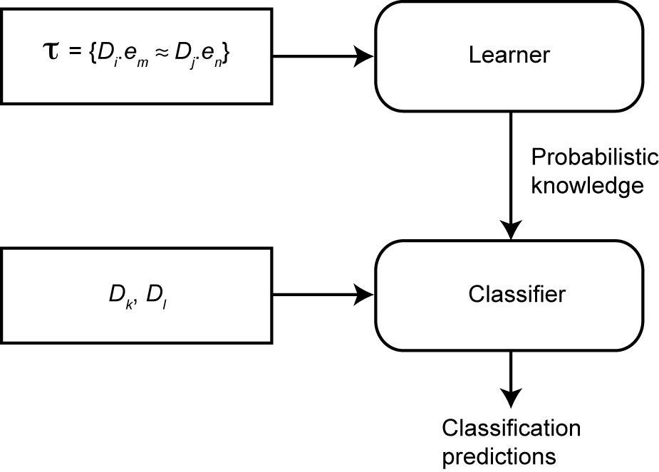
Learning-based Schema Matching

Slide 24
Combined Schema Matching Approaches
Use multiple matchers
  Each matcher focuses on one area (name, etc)
Meta-matcher integrates these into one prediction
Integration may be simple (take average of similarity values) or more complex (e.g., Fagin’s ranking aggregation functions)

Slide 25
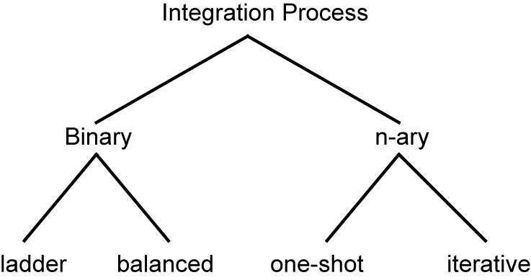
Schema Integration
Use the correspondences to create a GCS (schema integration)
  Necessary only if the GCS was not part of the matching step
Mainly a manual process, although rules can help

Slide 26
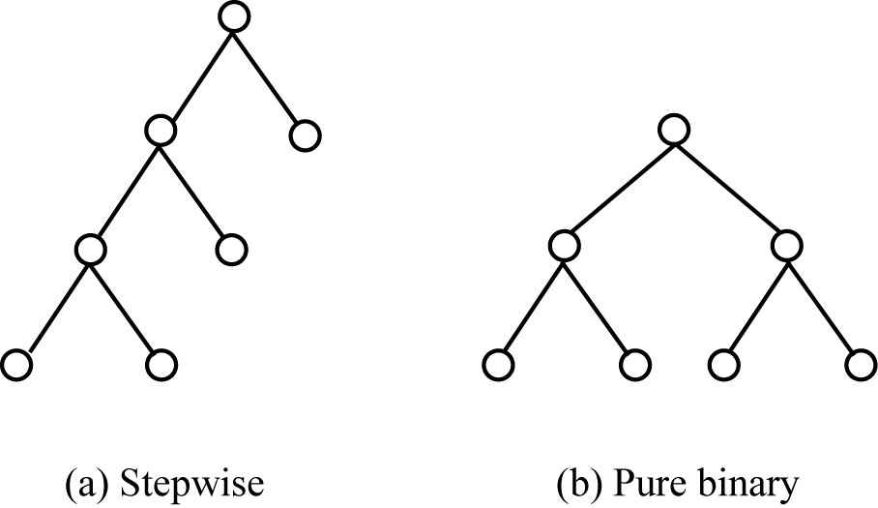
Binary Integration Methods

Slide 27
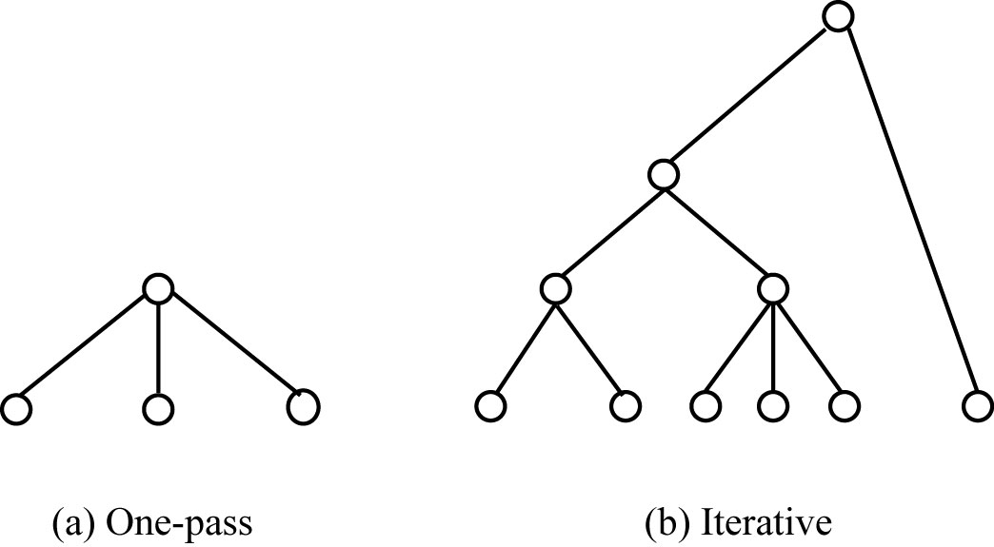
N-ary Integration Methods

Slide 28
Schema Mapping
Mapping data from each local database (source) to GCS (target) while preserving semantic consistency as defined in both source and target.
Data warehouses ⇒ actual translation
Data integration systems ⇒ discover mappings that can be used in the query processing phase
Issues
  Mapping creation
  Mapping maintenance

Slide 29
Mapping Creation
Given
  A source LCS
  A target GCS
  A set of value correspondences discovered during schema matching phase
Produce a set of queries that, when executed, will create GCS data instances from the source data.
We are looking, for each T_{k}, a query Q_{k} that is defined on a (possibly proper) subset of the relations in S such that, when executed, will generate data for T_{k} from the source relations

Slide 30
Mapping Creation Algorithm
General idea:
Consider each T_{k} in turn. Divide V_{k} into subsets such that each specifies one possible way that values of T_{k} can be computed.
Each can be mapped to a query that, when executed, would generate some of T_{k}’s data.
Union of these queries gives

