Slide 1
The Year the Internet
Fought Back
Professor Michael Geist
Canada Research Chair in Internet and E-commerce Law
University of Ottawa, Faculty of Law

Slide 2
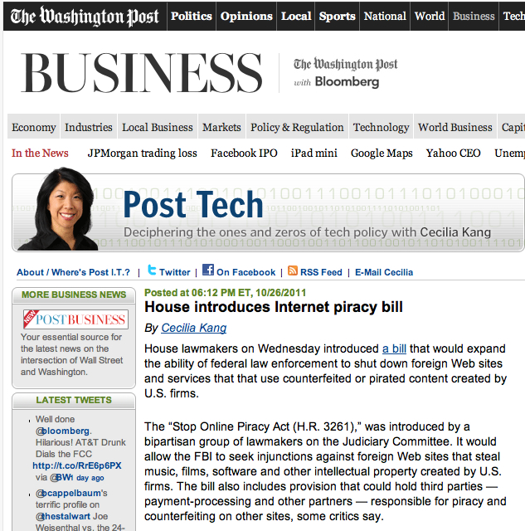

Slide 3
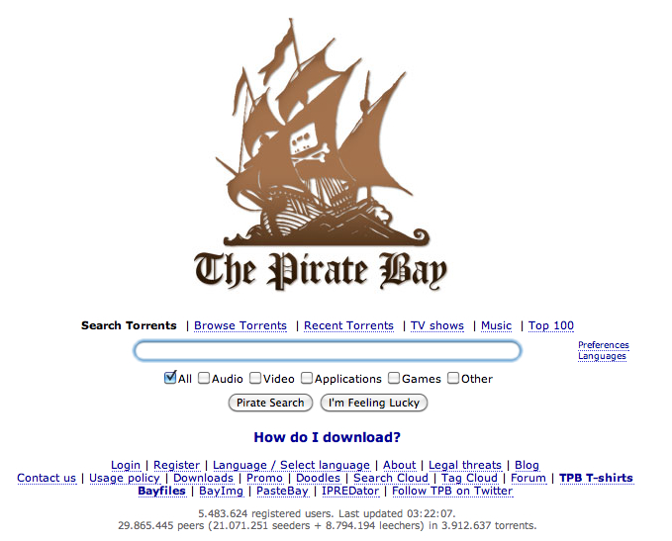

Slide 4
Domain Name System
Website Blocking
Payment Intermediaries
Ad Networks
Circumvention Technologies

Slide 5
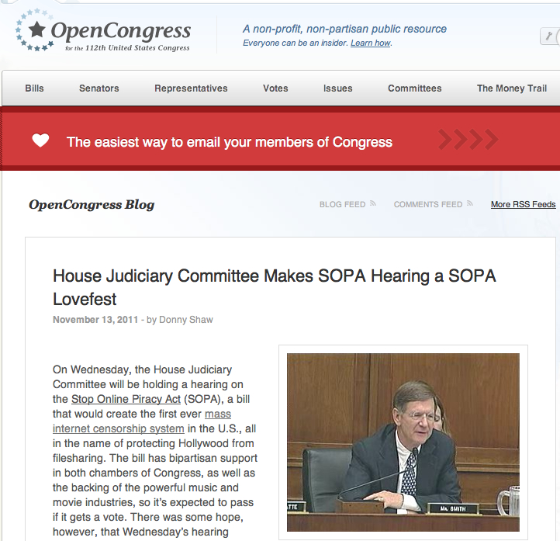

Slide 6
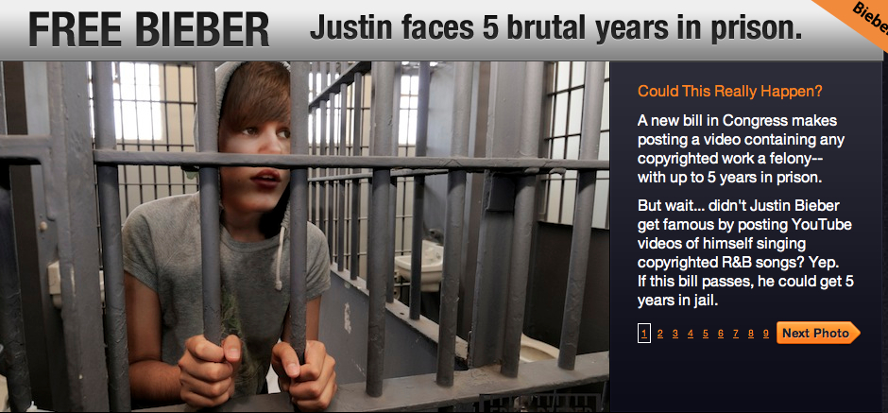

Slide 7
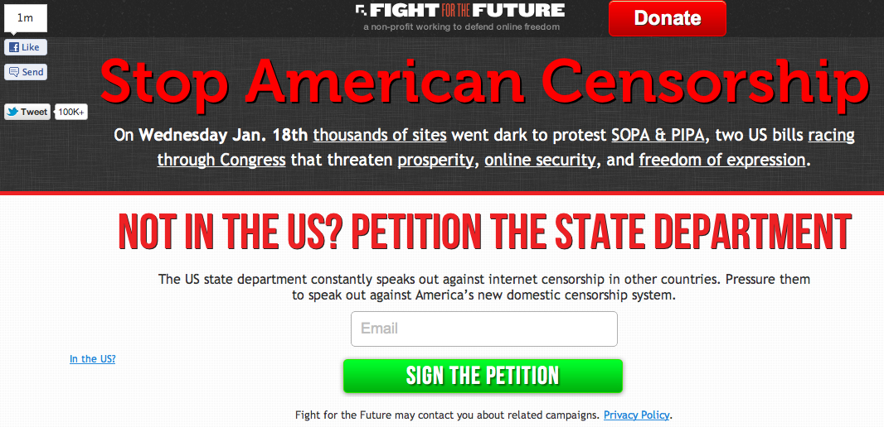

Slide 8
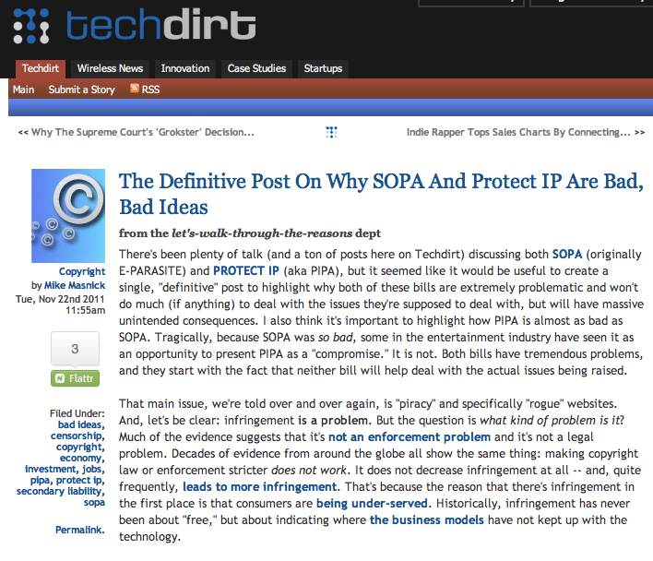

Slide 9
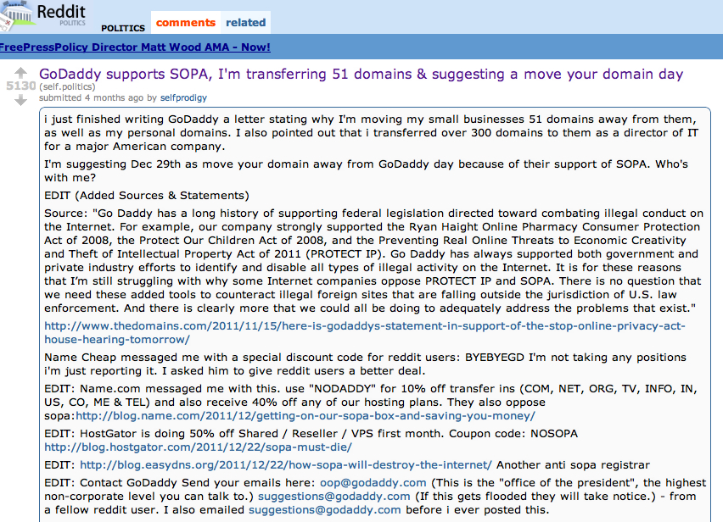

Slide 10
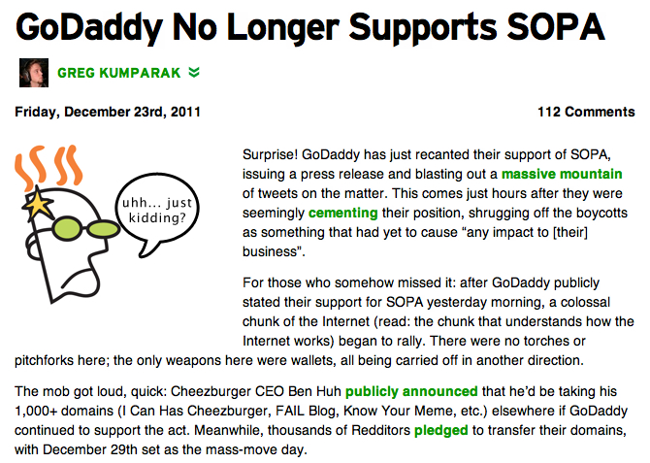

Slide 11
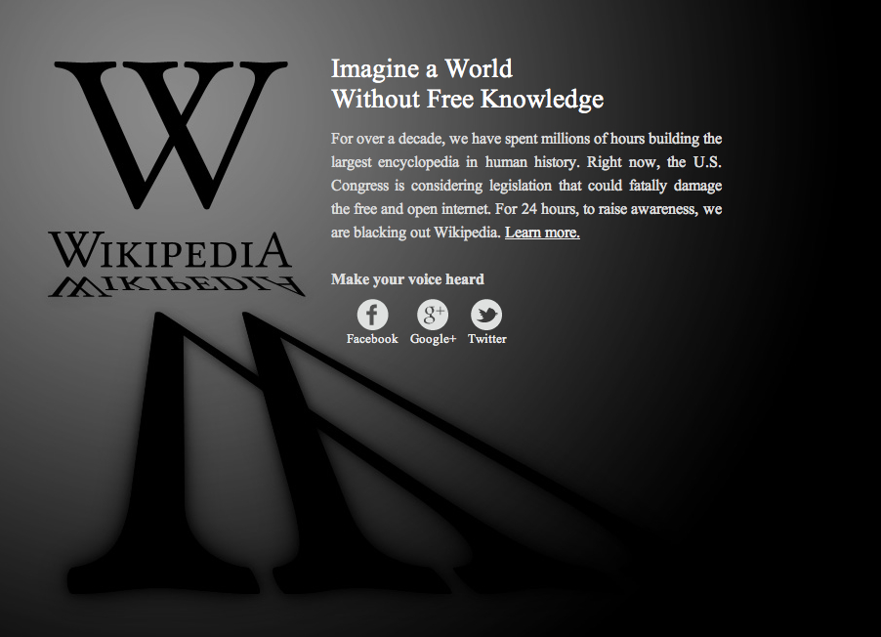

Slide 12
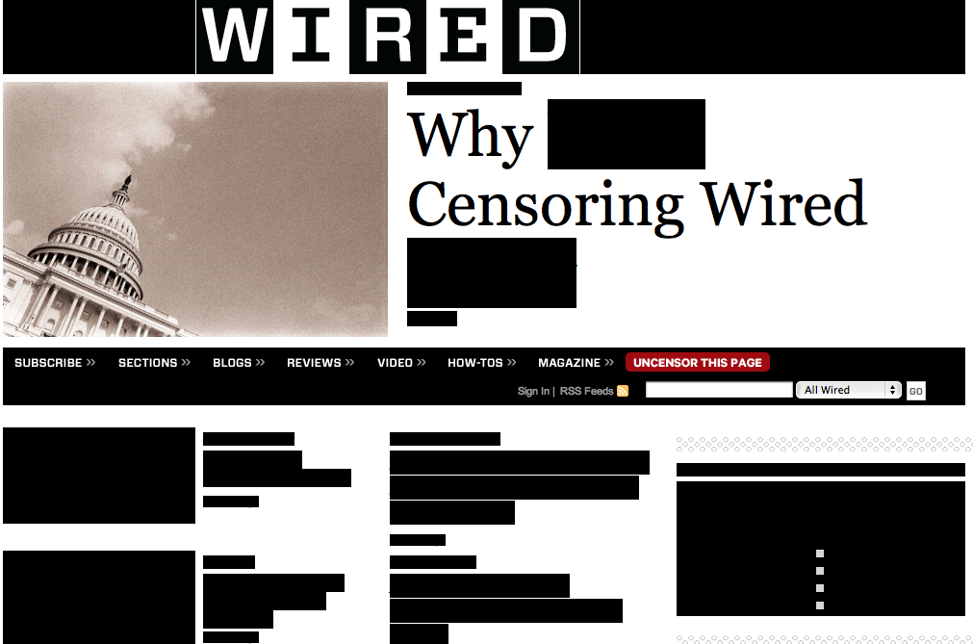

Slide 13
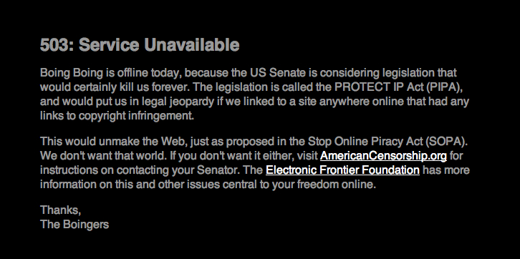

Slide 14
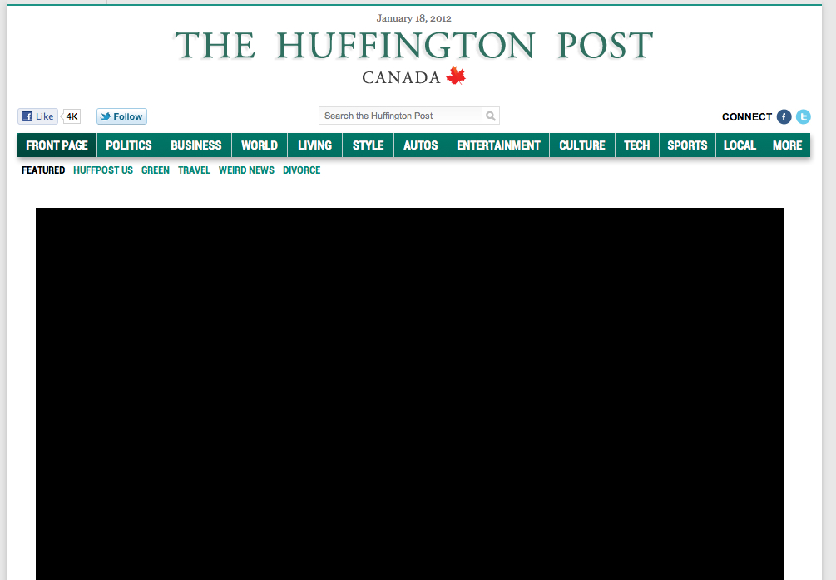

Slide 15
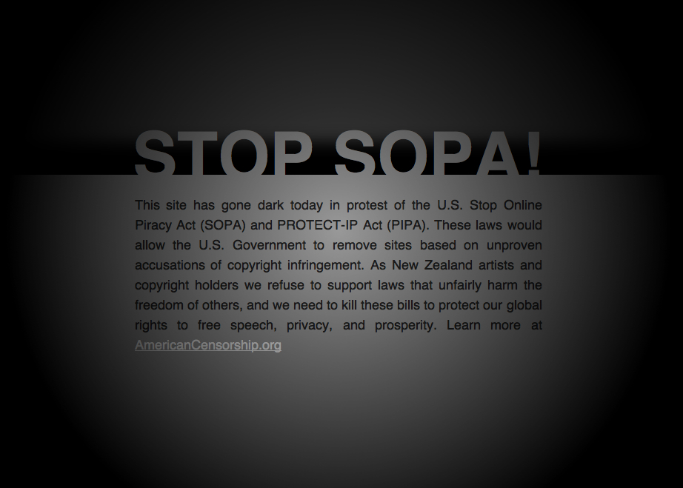

Slide 16
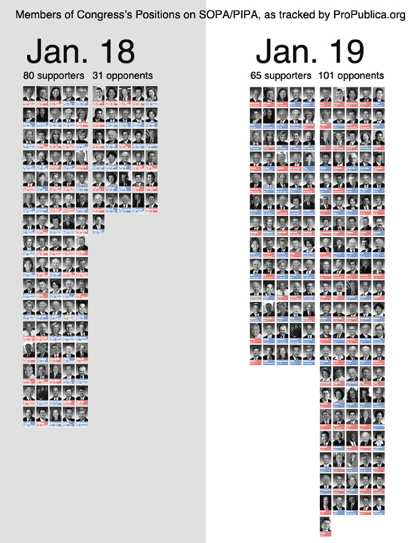

Slide 17
“SOPA Story”

Slide 18
What just happened?

Slide 19
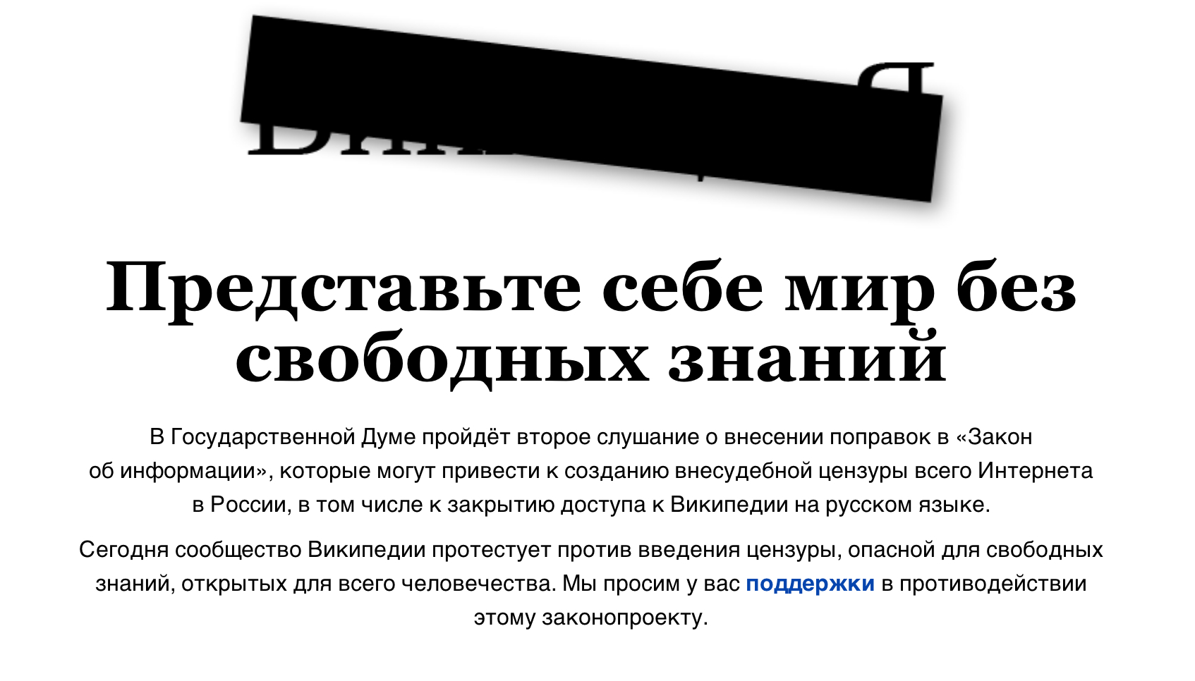

Slide 20
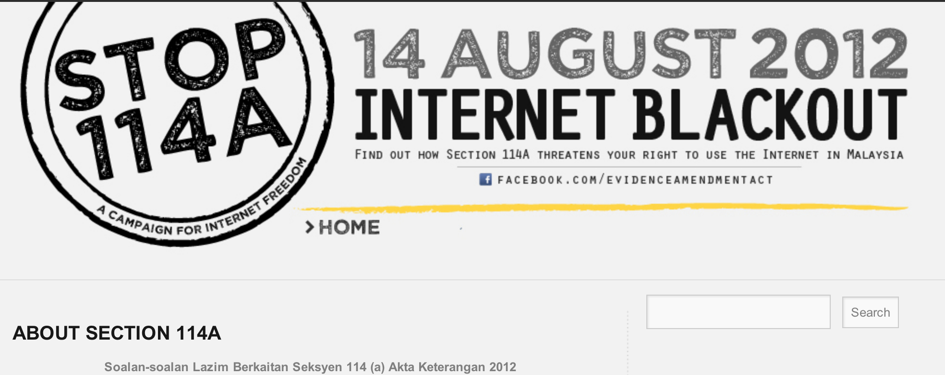

Slide 21
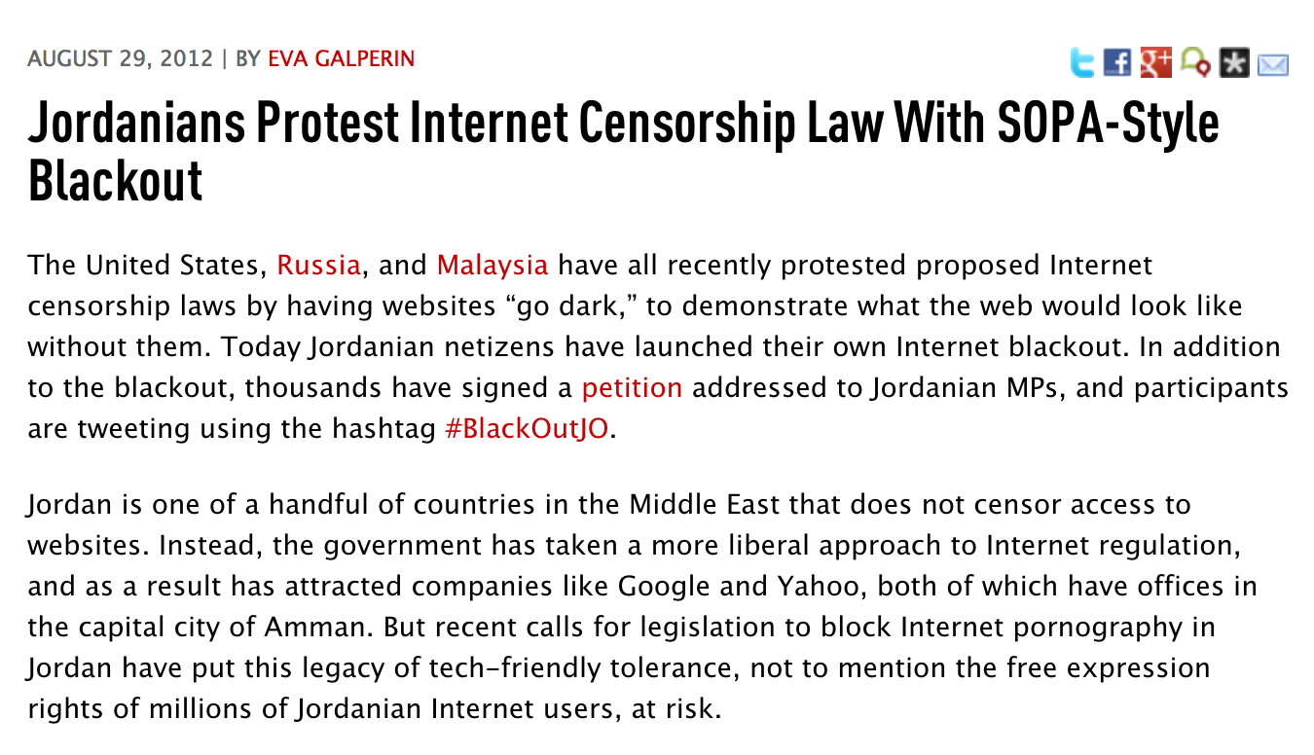

Slide 22
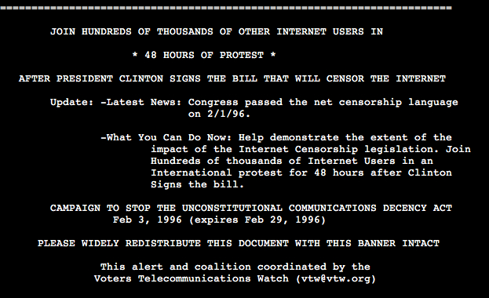

Slide 23
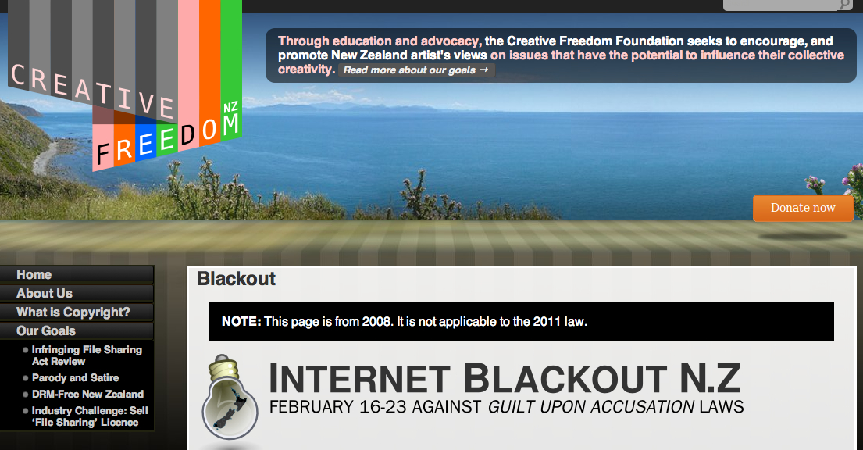

Slide 24
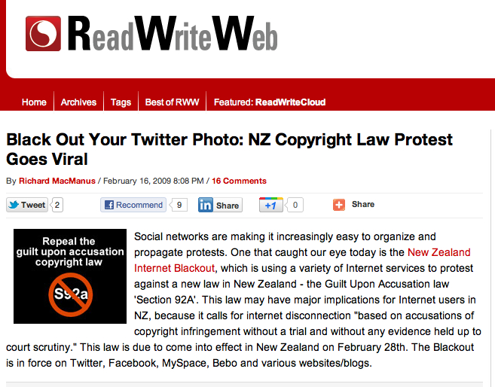

Slide 25
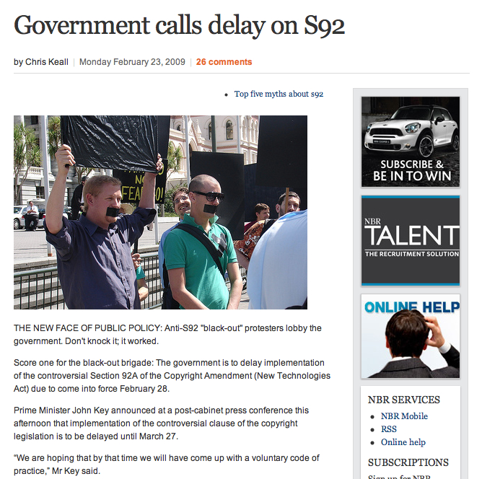

Slide 26
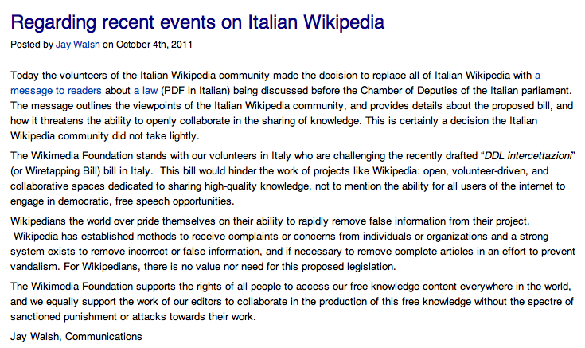

Slide 27
unthinkable

Slide 28
thinkable

Slide 29
unorganized Internet users don’t..

Slide 30
stop international treaties

Slide 31
stop legislation

Slide 32
stop regulation

Slide 33
major policies

Slide 34
or do they…

Slide 35
ACTA

Slide 36
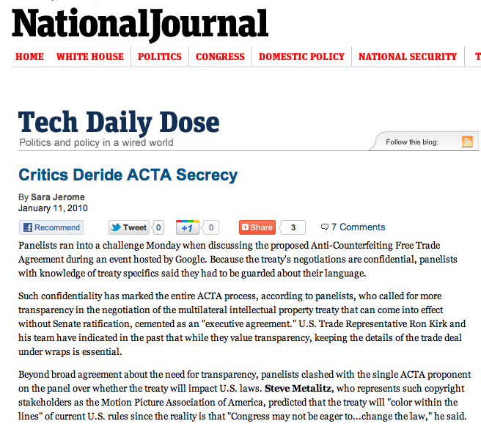

Slide 37
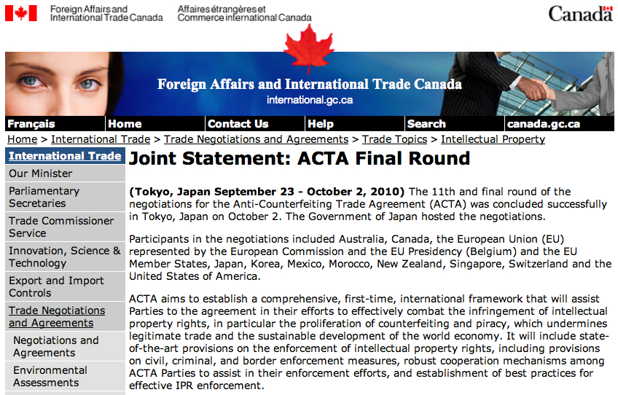

Slide 38
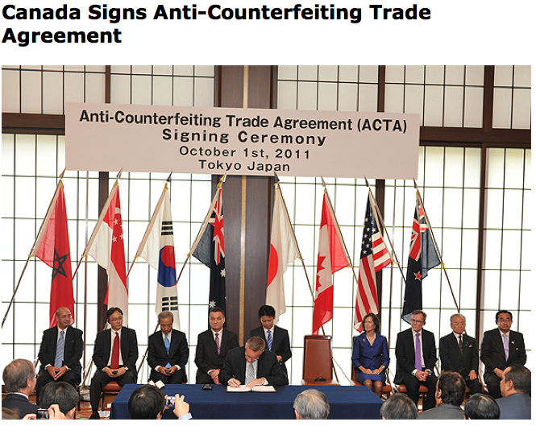

Slide 39
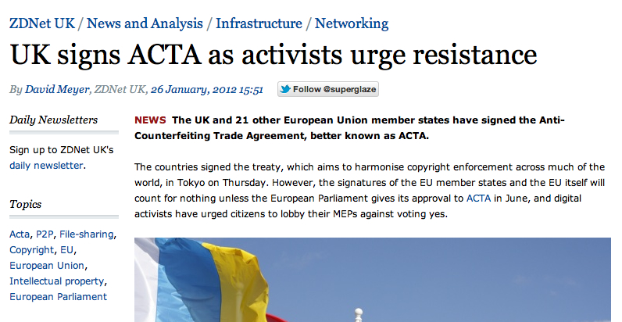

Slide 40
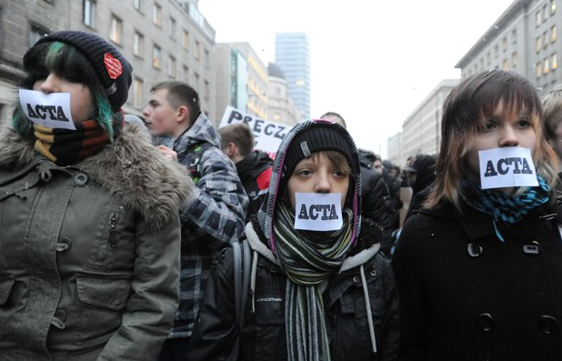

Slide 41
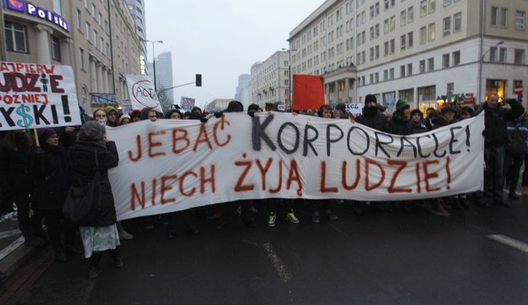

Slide 42
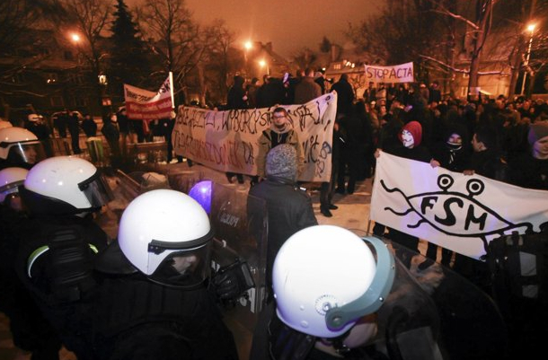

Slide 43
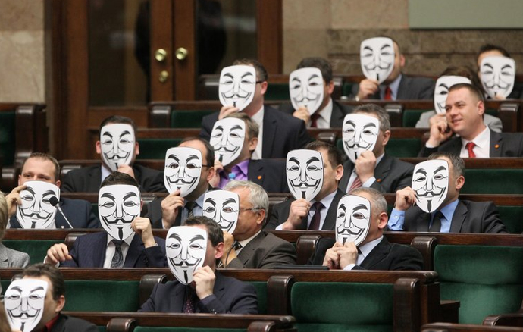

Slide 44
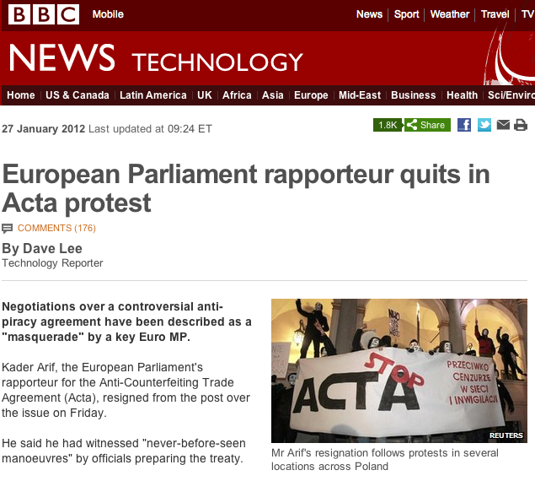

Slide 45
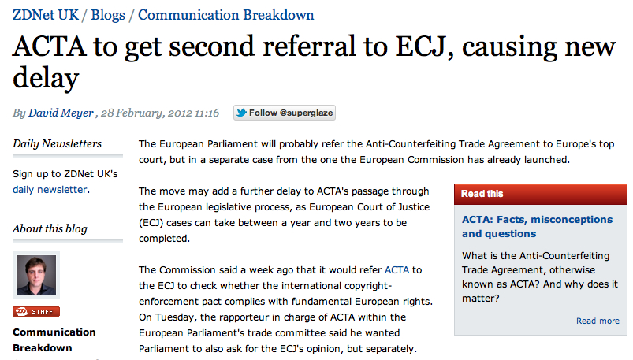

Slide 46
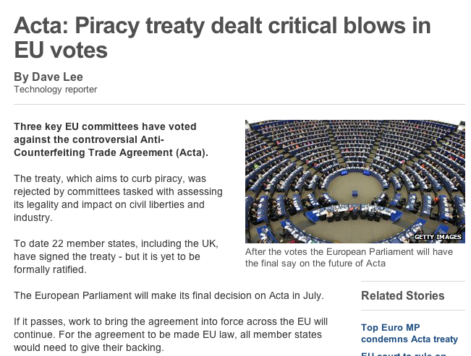

Slide 47
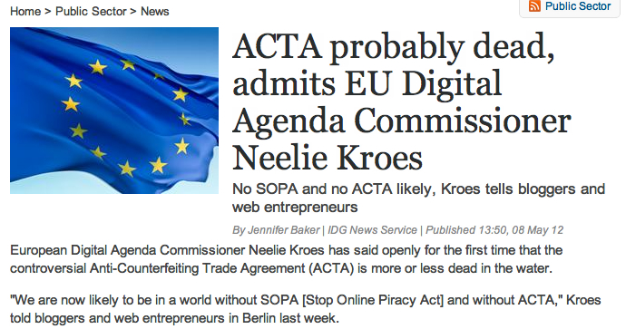

Slide 48
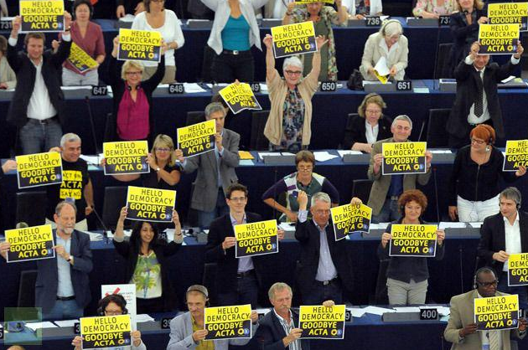

Slide 49
C-30

Slide 50
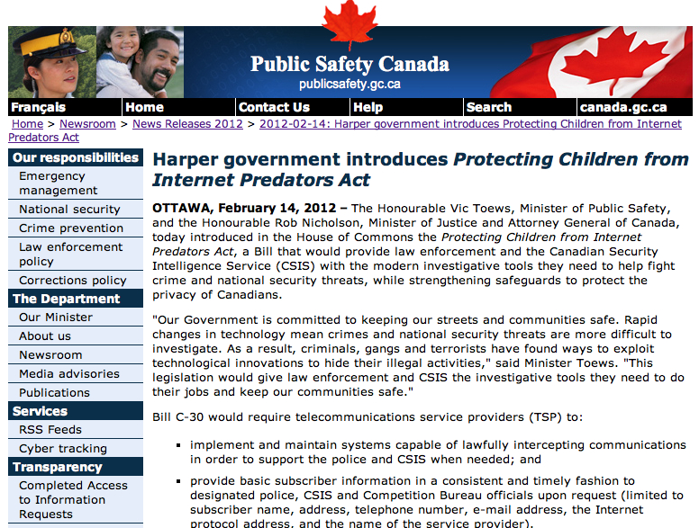

Slide 51
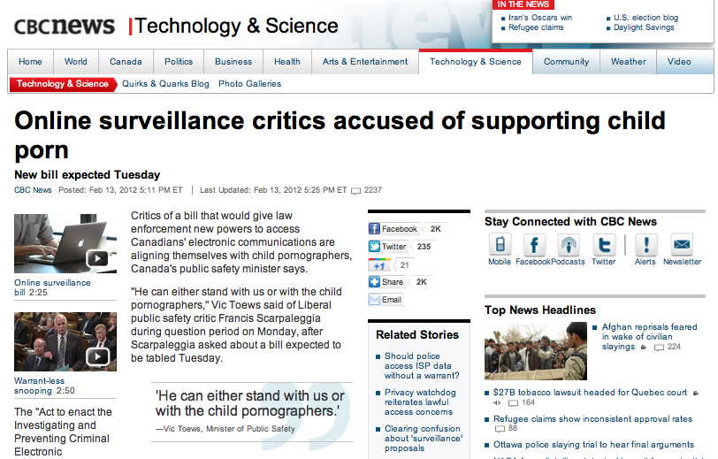

Slide 52
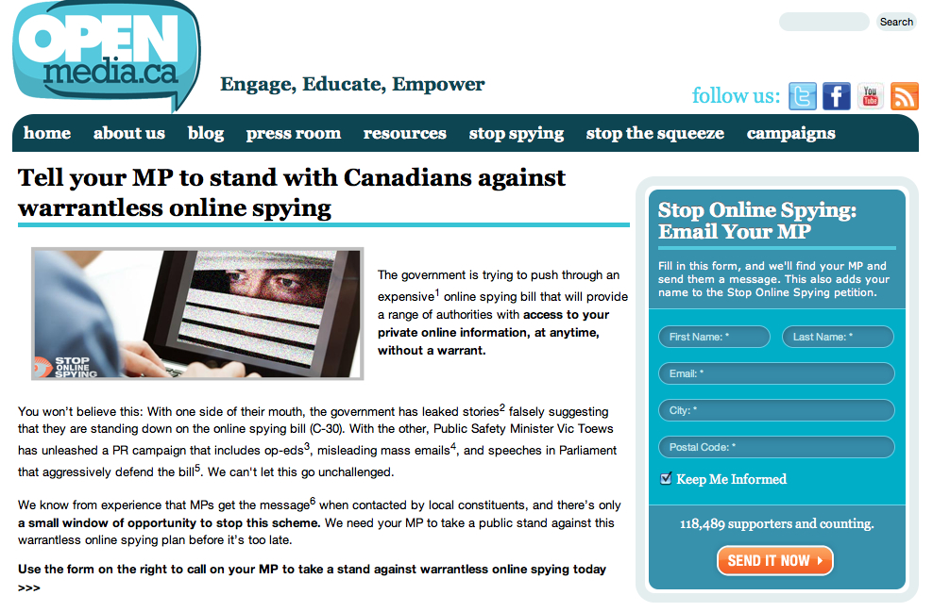

Slide 53
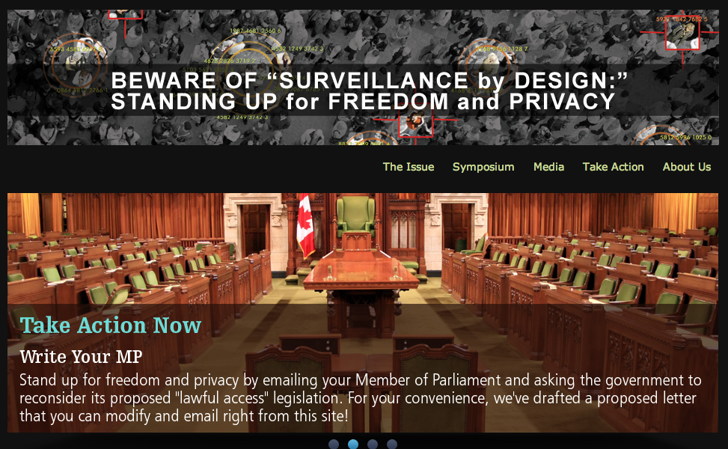

Slide 54
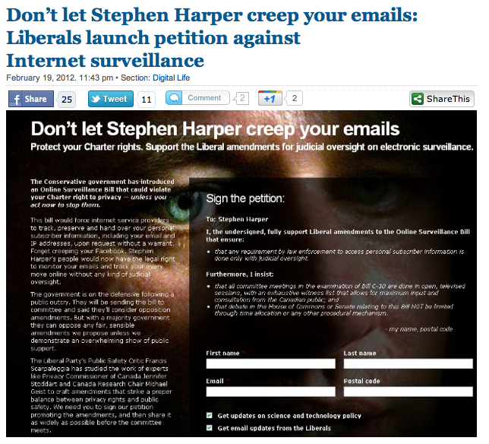

Slide 55
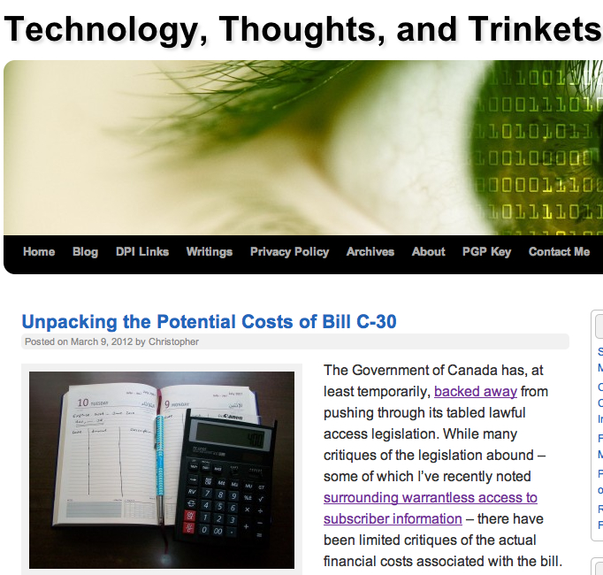

Slide 56
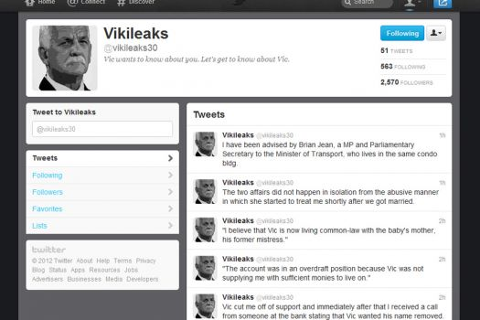

Slide 57
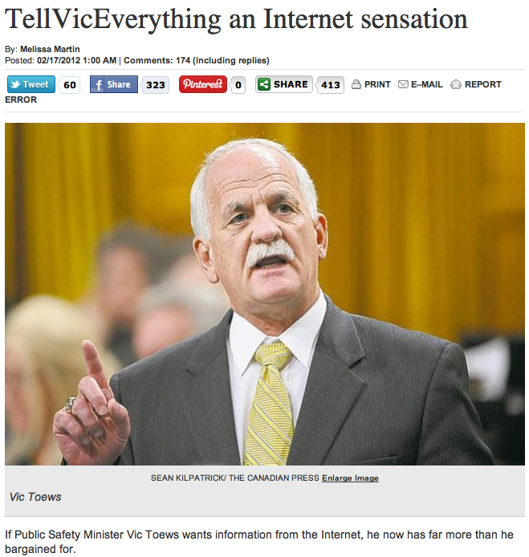

Slide 58
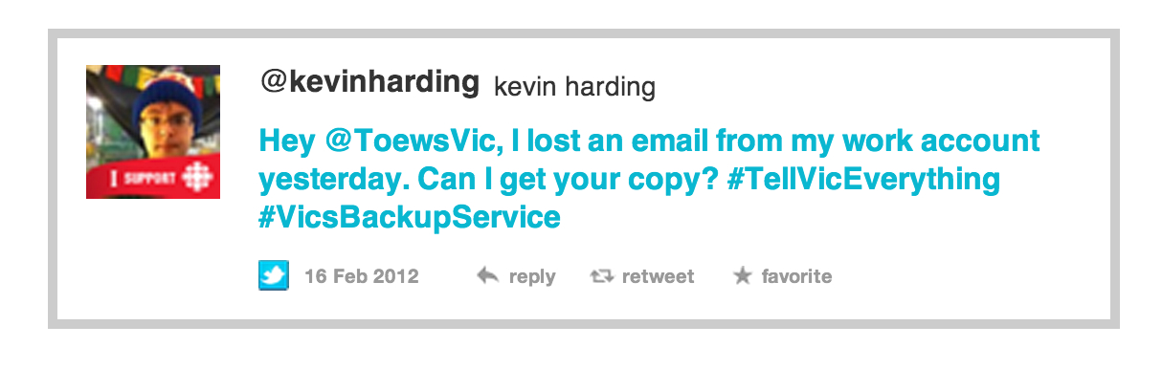

Slide 59
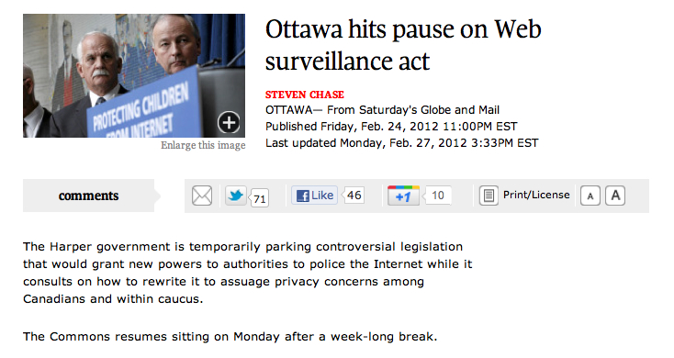

Slide 60
CRTC

Slide 61
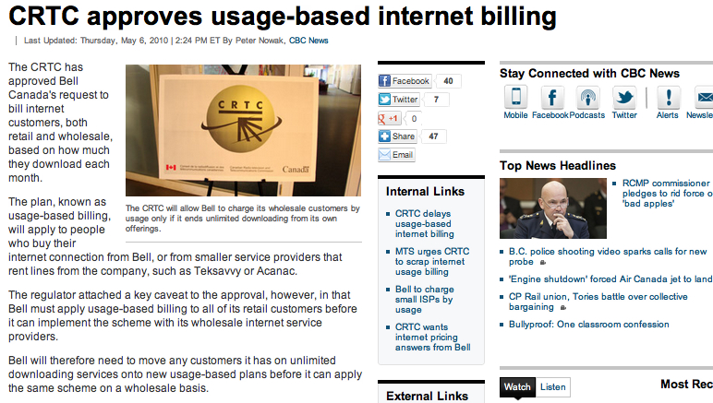

Slide 62
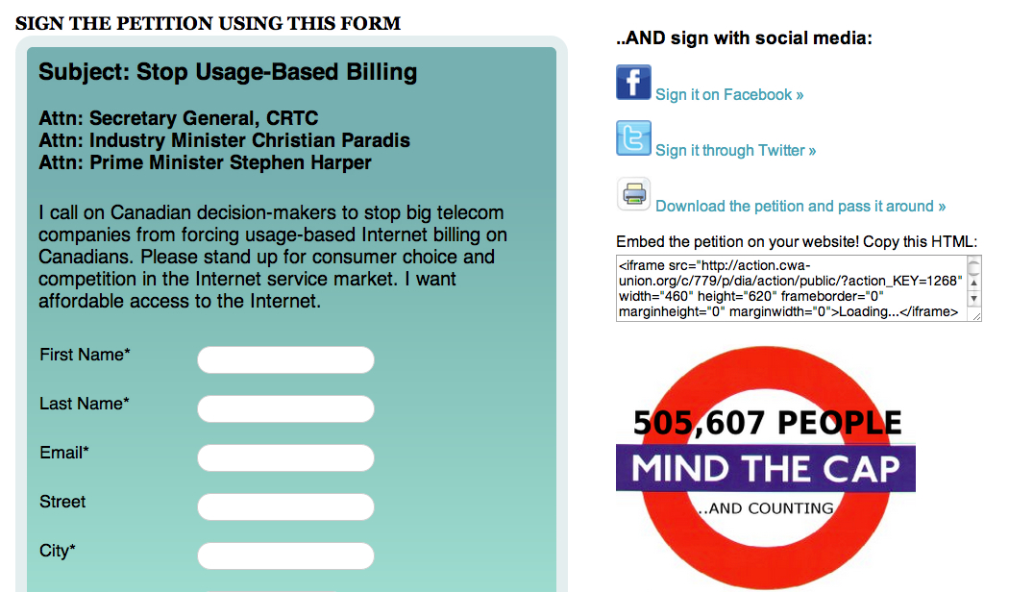

Slide 63
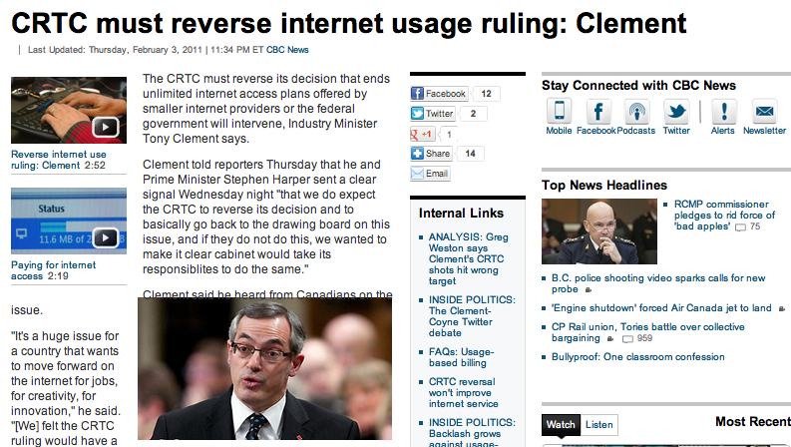

Slide 64
Copyright

Slide 65
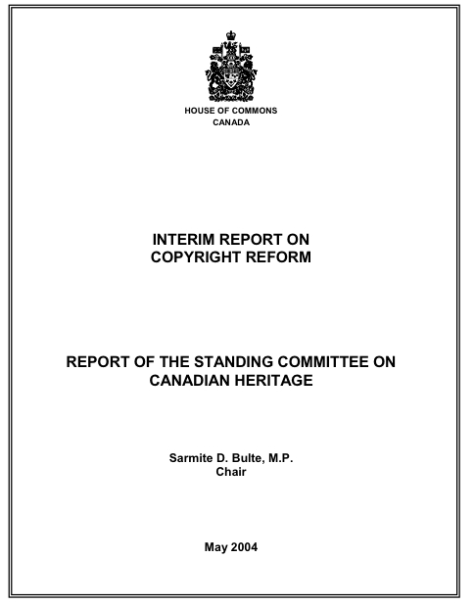

Slide 66
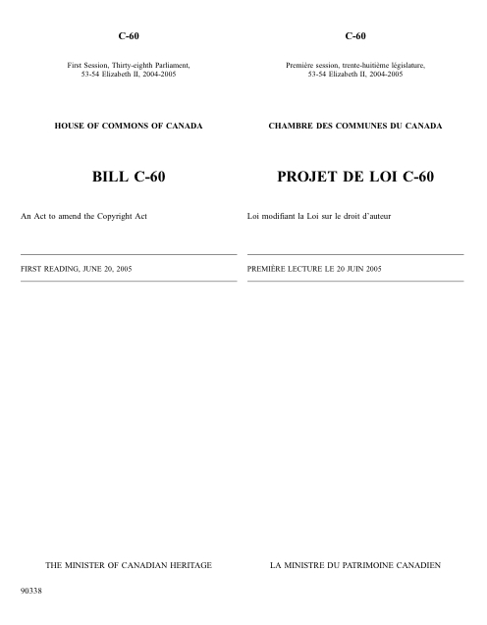

Slide 67
Issue | 2005 (C-60)
Fair Dealing | No
Consumer Exceptions (time shifting, format shifting, backup copies) | No
Internet Exceptions (Internet content, user generated content exception) | No
Statutory Damages Reform | No
Digital Locks | Yes
Internet Service Provider Safe Harbour | Yes

Slide 68


Slide 69


Slide 70


Slide 71


Slide 72




Slide 73




Slide 74





Slide 75



Slide 76


Slide 77
Issue | 2005 (C-60) | 2008 (C-61)
Fair Dealing | No | No
Consumer Exceptions (time shifting, format shifting, backup copies) | No | No
Internet Exceptions (Internet content, user generated content exception) | No | No
Statutory Damages Reform | No | Minor
Digital Locks | Yes | Yes
Internet Service Provider Safe Harbour | Yes | Yes

Slide 78


Slide 79


Slide 80


Slide 81


Slide 82


Slide 83


Slide 84


Slide 85


Slide 86


Slide 87


Slide 88


Slide 89


Slide 90


Slide 91

http://www.youtube.com/watch?v=03IhHeZwJuM

Slide 92


Slide 93


Slide 94


Slide 95
Issue | 2005 (C-60) | 2008 (C-61) | 2010 (C-32)
Fair Dealing | No | No | Yes
Consumer Exceptions (time shifting, format shifting, backup copies) | No | No | Yes
Internet Exceptions (Internet content, user generated content exception) | No | No | Yes
Statutory Damages Reform | No | Minor | Yes
Digital Locks | Yes | Yes | Yes
Internet Service Provider Safe Harbour | Yes | Yes | Yes

Slide 96
What just happened?

Slide 97
<1>
influence

Slide 98
<2>
distributed

Slide 99
<3>
undisciplined

Slide 100
<4>
non-expert

Slide 101
<5>
evolutionary

Slide 102
<6>
didn’t “just happen”

Slide 103
@mgeist

