Slide 1
Development Of Artificial Intelligence
Weizhe Liang 8136867
Xiaoxin Zhou 7957115

Slide 2
Contents
What is the (History, Context, and Subject of the problem)
Why is the problem important? (Significance)
Who is the problem important to, who has complained about it? (Humanity)
How many customers is the problem important to? (Most)

Slide 3
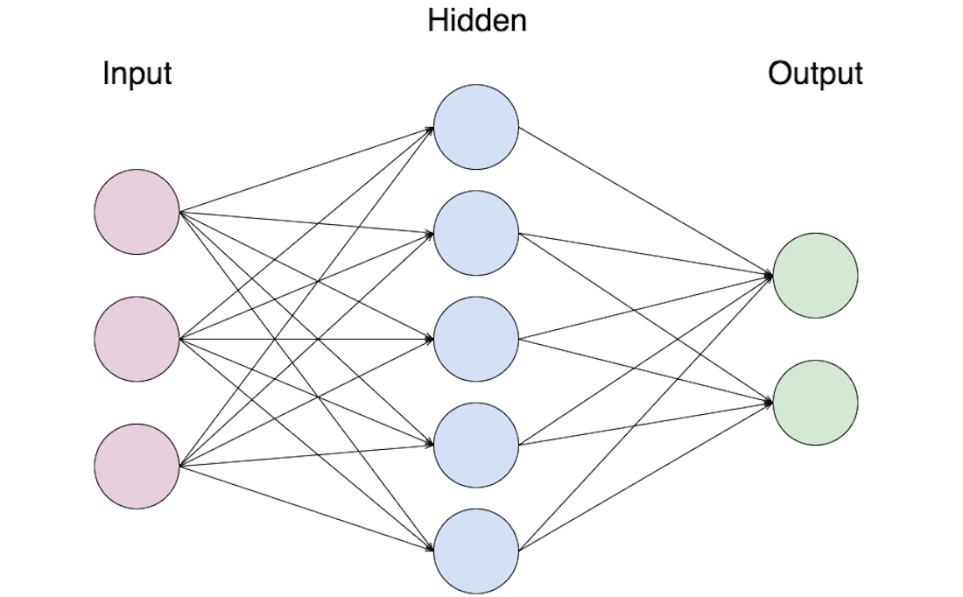
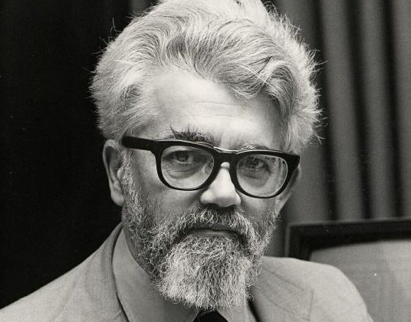
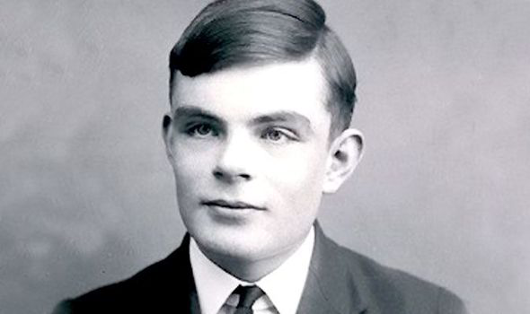
What & Who
Father of AI
Turing Test
1950
1955
1959
Notes:
Turing Test: developed an idea for a test to see if machines (computers) had the ability to think. comprised of three participants; a computer, a human, and another human who poses questions to the other two.The respondents would send their answers to the interrogator in a neutral fashion, through a teletype device for example. The test was designed in such a way that the interrogator would have to determine which respondent was the machine by finding errors in the conversation logic. The computer respondent always told the truth but the human respondent could lie in order to appear human. The general idea is that if the interrogator cannot tell which respondent is the computer, the computer is said to have passed the Turing Test.
John : The cognitive scientist coined the term in his 1955 proposal for the 1956 Dartmouth Conference, the first artificial intelligence conference. In 1958 he created the Lisp computer language, which became the standard AI programming language and continues to be used today, it also paved the way for voice recognition technology, including Siri,

Slide 4
Process on building a Neural Network
Define the problems ( what kind of pattern can be applicable for your dataset )
Data clean up
Build the network
Train and test ( cross validation , sampling data)
  Gradient Approach
More iteration or change the network

Slide 5
Why?
Engineering
  New solution for solving problems
  Non-repetitive based machine
  Scaling with data, eg. www
Humanity
  Labor-class; experience based
  Effectiveness
  Resource utilization, eg. Self-driving car

Slide 6
Conclusion
How many…customers
AI is a solution not a terminator
Seems overwhelming on beginning

Slide 7


