Slide 1
Biomedical Engineering:
Biohacking
Michael Qi
Nicholas Morin
Notes:
Props - RFID
Poll the audience
Tell short story (if time permits)
Short video
Perform an actual demo or application and have a random audienc

Slide 2
What exactly is
Biomedical Engineering?
?
The bridge between engineering and medicine by combining aspects of both disciplines.

Slide 3
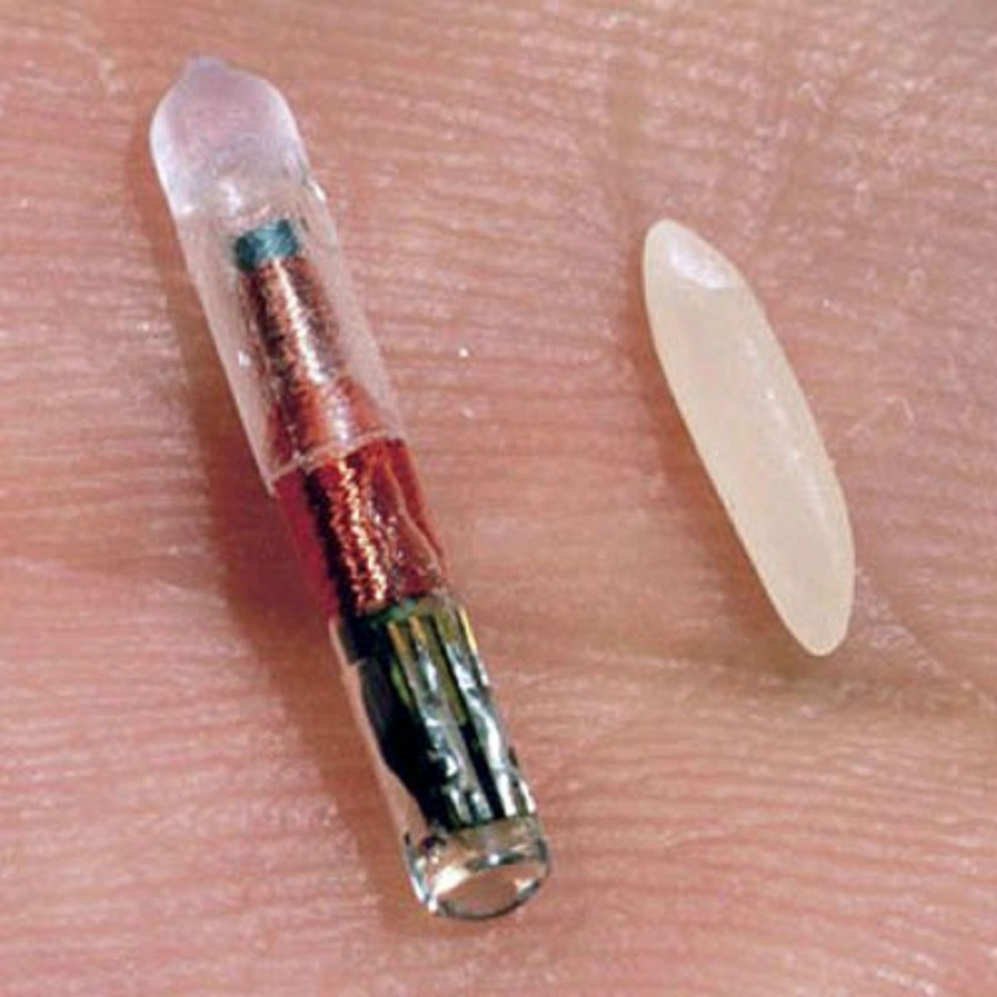
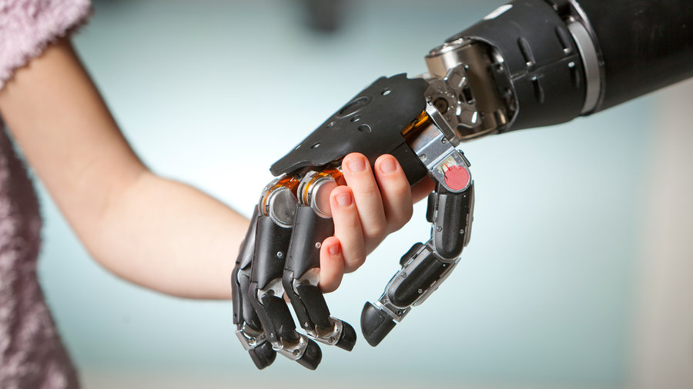
Current Biomedical engineering research
Prosthesis is a major topic in biomedical engineering (limbs, eyes, hearing aids, bionics)
Tissue engineering (skin, bones and small organs)
RFID and Microchip implants
Notes:
Ok so did you give you some quick context and background.
Biomedical engineering has over 10 sub fields but here are a few of the major ones currently undergoing cutting edge R & D
Many people arent aware but prosthesis development is a large part of Biomed engineering
A lot of reserac is dedicated to developing limbs that will be connected to nerves and the brain so movement is contable as well as feeling
Tissue engineering is another, artificial bones, skin, and small organs. For example artificial hips and knees.
And third, RFID and Micro chip implanted under the scin to track animals and in possibly even grandma and grandpa with alzeihmers or and dimentia or little kid incase they become lost or kidnaped. Not only can we use these chips to track them but we can also monitor vital signs, for example those with diabeties or even those susceptible to strockes. Pretty interesting right.
Now before I go to the next slide

Slide 4
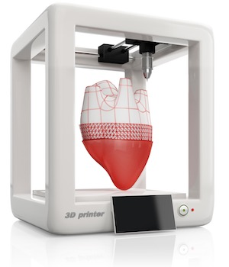
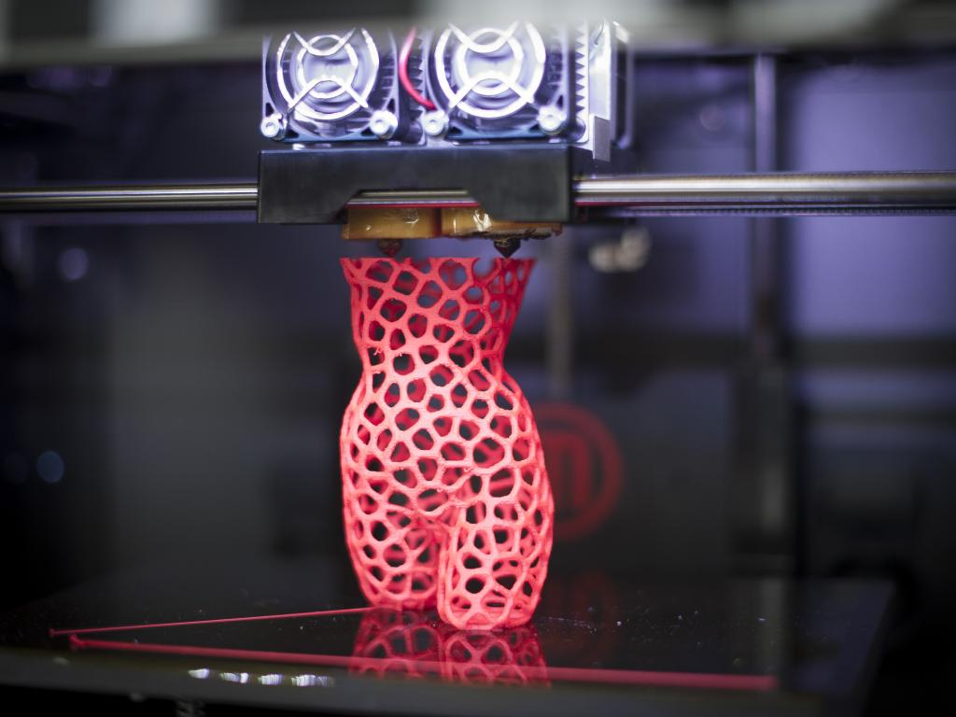
Current Biomedical engineering research
(continued)
Ongoing research on Organ 3D printing…
Bringing us towards a world without the Organ Donor List
Experts say within the next 10 years
Notes:
Before I go to the next slide, by raise of hands, who here knows someone whos had an organ transplant or organ surgery?
OK, most of you, now who here in this room has personally had organ related surgery (if someone raises there hand, ask them if they mind sharing)
Here is a good segway to this slide.
Now imagine world where instead of having an organ removed, they simply replace it with a new one.
This is the future of biomed engineering, 3D printed organs, according to experts, will be possible in 10 years. Very exciting.

Slide 5
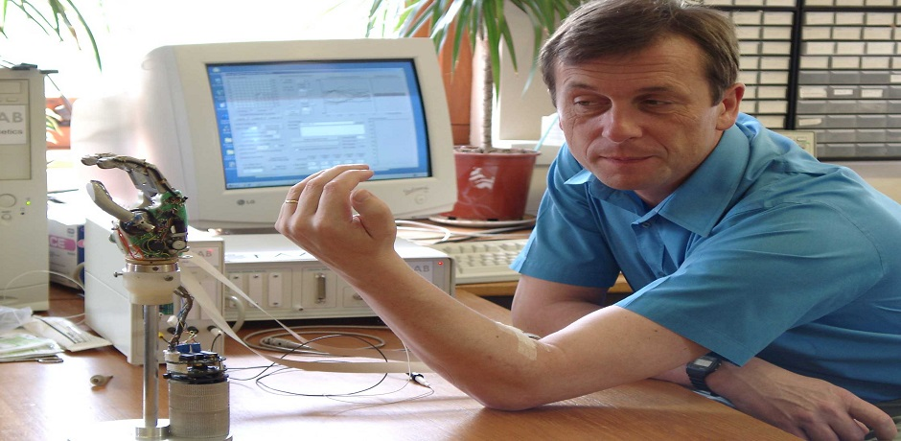
The Cyborg Project
Dr. Warwick, Coventry University
Pioneer of modern bionics
Started with RFID → controlling a mechanical hand

Slide 6

To what levels?
German biohacker: Lepht Anonym
Surgically implanted magnets into her fingertips
Able to feel magnetic fields

Slide 7
“Since doctors won’t help her, she does it in her own apartment, sterilizing her equipment … with vodka.
“Good anesthetic is largely impossible to buy, so she screams a little, and sometimes passes out. But it’s worth it, for what’s on the other side.”
(Borland, 2010)

Slide 8

Problem: Bio-Hacking
!
Frank Abagnale: Cybernetic Crime at the FBI
https://youtu.be/vsMydMDi3rI?t=3557
Notes:
Props - RFID (bring a chip)
Poll the audience (about pacemaker?)
Tell short story (if time permits)
Short video
Draw something on the board

Slide 9

Problem (continued)
More technology in the human body means more risk
Security breaches
Tracking people who have RFID implants or other electronic devices.
Notes:
The more integrated we become with technology inherently means more risks of being compromised.
Electronic security is a large industry and that industrys is about to get bigger once we start converging out human bodies with electronic devices.
Like I mentioned RFID chips are used to track pets and other animals and soon for little Timmy if he gets kidnaped. Now what happens if these tracking devices fall into the wrong hands? This is the problem. The implants become used for exactly the reason they are tryng to avoid!

Slide 10
What can we do?
Not a whole lot at the moment...
As the engineers of tomorrow we need to be aware of the risks and mitigate them
Ensure laws and regulations follow suit. It will be our duty to educate these officials.
Notes:
Mention that theres a good chance that some of us in this room will be in some way contributing to the biomedical engineering directly or indirectly

Slide 11


Questions???
Notes:
I think we should keep these 2

