Slide 1
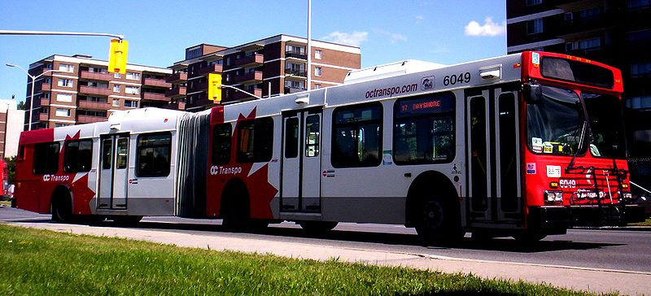
Transport layer in ad hoc and sensor network
Wireless Ad-Hoc Networking (ELG7178F)
Breeson Francis
December 5th 2011

Slide 2
Outline
Introduction to TCP
TCP Mechanisms
Problems in TCP
Approaches
References

Slide 3
Introduction to TCP
TCP is a connection based protocol
    3 way Hand-shake
TCP is a reliable protocol
    achieved by means of retransmissions
TCP enables data to be received in an ordered way
End-to-end semantics
    Acknowledgements sent to TCP sender to confirm delivery of data received by TCP receiver
    Ack for data sent only after data has reached receiver
TCP detects data duplication
TCP provides flow and congestion control

Slide 4
Introduction to TCP (ctnd)
TCP Client/Server Connection
Client
Server
TCP SYN
TCP SYN/ACK
Connection
setup
TCP ACK
HTTP request
HTTP response
Data
transmission
HTTP response
FIN
ACK
FIN
Connection
Termination
ACK

Slide 5
TCP Mechanisms
Sliding Window
Slow Start
    Is triggered at the beginning of connection or when a timeout(RTO) occurs
    Congestion window (cwnd) is set to 1. cwnd is decided by sender, based on network conditions
    cwnd is increased exponentially
    Slow start ends when cwnd reaches ssthresh, congestion avoidance then onwards
Offered Window (advertised by receiver)
1
2
3
4
5
6
7
8
9
10
11
12
13
14
15
16
17
18
19
20
Sent and ack received
Sent, not acked
Can’t send until window moves
Usable window
Transport Layer in ad-hoc and sensor networks

Slide 6
TCP Mechanisms (ctnd)
Congestion Avoidance
    Uses congestion window (cwnd) for flow control
    Additive increase (at most 1 segment for each RTT)
    Multiplicative decrease, cwnd set to 1/2 of its value when congestion loss occurs
    Sender can send up to minimum of advertised window and cwnd
Congestion
avoidance
Slow start threshold
  ssthresh = maximum of { min(cwnd,receiver’s advertised window)/2 and 2 segment size }
Slow start

Slide 7
TCP Mechanisms (ctnd)
Fast Retransmission and Fast Recovery
    Fast retransmit occurs when a packet is lost, but latter packets get through
    When 3 or more dupacks are received, send the missing segment immediately
    Start congestion avoidance(Fast Recovery)
    Set cwnd to ssthresh(half the current cwnd) plus no. of dupacks times segment size

Slide 8
Problems in Wireless Networks
High bit error rate
    Packets can be lost due to “noise”
Unpredictability/Variability
    Difficult to estimate time-out, RTT, bandwidth
    Increased collision due to hidden terminal
Hand-Offs
    Mobile users switch base stations
Multipath Routing
    Multiple paths lead to significant amount of out-of-order packets, which in turn generates duplicate acks
Long connections have poor performance
    Multi-hop connections have less throughput due to inherent fading properties of wireless channels

Slide 9
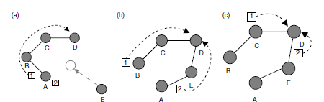
Problems in Wireless Networks
Route Instability
    Leads to OOO packets

Slide 10
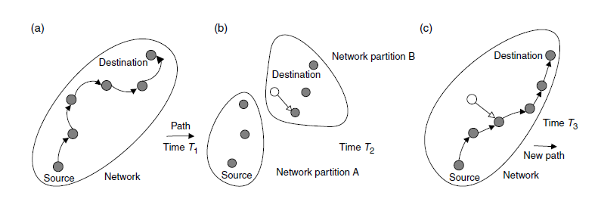
Problems in Wireless Networks
Network Partitioning
    Exponential back off of TCP’s RTO mechanism
    RTO doubled after every timeout
    Periods of inactivity even when the network is connected

Slide 11
Approaches
Link level mechanisms
Split connection approach
TCP-Aware link layer
Explicit notification
Feedback based scheme
Ad-hoc Transport Protocol (ATP)

Slide 12
Approaches
Link level mechanisms
  Forward Error Correction (FEC)
    Can be used to correct small number of errors
    Correctable errors hidden from TCP sender
    Applied in situations where retransmissions are costly or impossible
    FEC incurs overhead where there are no errors

Slide 13
Approaches
Link level mechanisms
  Link Level Retransmission
    Retransmit a packet at link level if error detected
    Retransmission overhead incurred only if error occurs, unlike FEC
TCP connection
application
application
application
transport
transport
transport
network
network
rxmt
network
link
link
link
physical
physical
physical
FH
BS
MH
wireless

Slide 14
Approaches
Link level mechanisms
  Link Level Retransmission
    Hides wireless losses from TCP
    Link layer modifications required at both ends of wireless link
    TCP need not be modified, although TCP timeout should be large enough to accommodate link level retransmissions
    Out of Order (OOO) packet delivery, which may in turn trigger Fast Retransmit

Slide 15
Approaches
Split Connection Approach
    End-to-end TCP connection is broken into wired part and wireless part
    Connection between mobile host(MH) and fixed host(FH) through base station(BS) is split into 2 TCP connections
FH-MH = FH-BS + BS-MH
Fixed Host
Wired Network
Mobile Host
Access Point
(Base Station)
Standard TCP
Wireless TCP

Slide 16
Approaches
Split Connection Approach
    Split connection results in independent flow/error control, packet size, timeouts at each part
    Optimized TCP protocol can be introduced in the wireless segment
TCP connection
TCP connection
application
application
rxmt
application
transport
transport
transport
network
network
network
link
link
link
physical
physical
physical
FH
BS
MH
wireless

Slide 17
Approaches
Split Connection Approach
    Loss of end-to-end semantics, an acknowledgement to a sender does not any longer mean that the intended receiver really got the packet
    Higher latency due to buffering at base station
    During hand-offs BSs should do state transfer along with the buffers, thereby increase hand-off latency. BS Failure results in loss of data.
    Buffers tend to get full due to slower wireless link
Access Point (BS1)
Fixed Host
Mobile Host
Wired Network
State Transfer
Access Point (BS2)

Slide 18
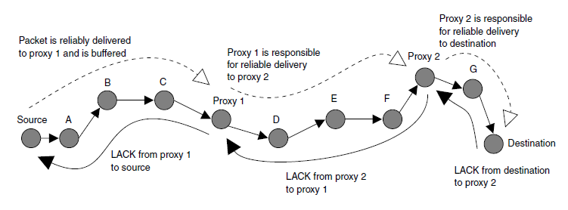
Approaches
Split Connection in multihop wireless network
    Many short TCP connections between proxies along the connection

Slide 19
Approaches
Split Connection in multihop wireless network
    Proxies buffer packets from the previous proxy or the source and acknowledges their receipt with Local Acknowledgements(LACKs) .
    Any dropped packets are recovered from the most recent proxy but not from the source.
    Enhance parallelism. Reduce bandwidth consumption on retransmission.
    Optimal frequency of proxy placement is not clear.

Slide 20
Approaches
TCP Aware Link Layer
    Retains local recovery of Split Connection approach and link level retransmission
    Improves on split connection
      end-to-end semantics retained
      soft state at base station, instead of hard state
TCP connection
application
application
application
transport
transport
transport
network
network
rxmt
network
link
link
link
physical
physical
physical
FH
BS
MH
wireless

Slide 21
Approaches
TCP Aware Link Layer
    Buffers data at BS for link layer retransmission
    When dupacks received by BS from MH, retransmit on wireless link, if present in buffer. Hides wireless losses from sender
    Prevents fast retransmit at sender TCP by dropping dupacks at BS
    Requires modification at BS only
    Link layer at base station needs to be TCP-aware
    Not useful if TCP headers are encrypted (IPsec)
    Cannot be used if TCP data and TCP acks traverse different paths (both do not go through the same base station)

Slide 22
Approaches
Explicit Notification
  Explicit Loss Notification (MH is TCP Sender)
    Wireless link first on the path from sender to receiver
    The base station keeps track of holes in the packet sequence received from the sender
    When a dupack is received from the receiver, the base station compares the dupack sequence number with the recorded holes, an ELN bit is set in the dupack
    When sender receives dupack with ELN set, it retransmits packet, but does not reduce congestion window
Record
hole at 2
MH
4
3
2
1
BS
4
3
1
FH
wireless
1
1
1
1
Dupack with ELN set

Slide 23
Approaches
Explicit Notification
  Explicit Loss Notification (MH is TCP Receiver)
    Caches TCP sequence numbers at base station, similar to Snoop. But does not cache data packets, unlike Snoop.
    Duplicate acks are tagged with ELN bit before being forwarded to sender if sequence number for the lost packet is cached at the base station
Sequence numbers
cached at base station
39
38
37
39
38
37
FH
BS
MH
37
37
Dupack with ELN

Slide 24
Approaches
Feedback based scheme in multihop wireless network
    Intermediate MH detects mobility of next MH along the path to destination
    Triggers Route Failure Notification(RFN) to source
    Each intermediate MH validates RFN and propagates to the source
    On receiving RFN, source
      Stops sending further packets
      Freezes all its timers
      Stores Window size and packets to be sent
S
B
C
D
A
RFN
RFN

Slide 25
Approaches
Feedback based scheme in multihop wireless network
    Source remains in the snoozed state until it receives Route Re-establishment(RRN) message
    A RRN is generated either by the node which generated RFN or an intermediate node which learned a new route to destination
    Source starts from the frozen state rather than restarting
S
B
C
D
A
RRN
E
F

Slide 26
Approaches
Feedback based scheme in multihop wireless network
    TCP has to be modified
    Requires support from intermediate nodes
    Requires support from underlying routing protocol

Slide 27
Approaches
Ad-hoc Transport Protocol (ATP)
    A Rate-based Transport Layer Protocol
    Feedback from intermediate nodes on path failure, queuing delay, periodic feedback on rate
    Rate based transmission
      Entirely rate-controlled(no window concept)
      Evenly distribute transmissions over time(reduce burstiness)
    Decoupling of congestion control and reliability
    Does not require the arrival of ACKs to clock out segment
    Does not employ cumulative ACKs but solely relies on periodic SACK to identify losses

Slide 28
Approaches
Ad-hoc Transport Protocol (ATP)
    Estimates rate accurately
    Reduce traffic on the reverse path
    Recover more than one lost segment at a time
    Incompatibility problem
    Require the assistance from the intermediate nodes
    Fastest possible time to detect and recover packet lost is 1 second

Slide 29
Conclusions
Scheme | Sender Support | Receiver Support | Intermediate Node Support | Routing Protocol Support
FEC | No | No | Link Level | No
Link Level Retransmission | No | No | Link Level | No
Split Connection | No | No | Transport Level | No
TCP Aware Link Level Retransmission | No | No | Transport Level | No
Explicit Loss Notification | Yes | No | Transport Level | No
Feedback Mechanism | Yes | No | Yes | Yes
ATP | Yes | Yes | Yes | Yes

Slide 30
Questions
While it takes three segments to establish a TCP connection, it takes four to terminate a connection. Why?
Ans. This is caused by TCP's half-close. Since a TCP connection is full-duplex (that is, data can be flowing in each direction independent of the other direction), each direction must be shut down independently. The rule is that either end can send a FIN when it is done sending data. When a TCP receives a FIN, it must notify the application that the other end has terminated that direction of data flow. The sending of a FIN is normally the result of the application issuing a close.

Slide 31
Questions
TCP sends a segment at 12:31:58. It receives the acknowledgement at 12:32:03. What is the new value of RTT if the previous RTT was four seconds?
(RTT = α * previous RTT + (1- α) current RTT and α = 90 % )
Ans. Current RTT = 5 seconds
previous RTT = 4 seconds
New RTT = 0.9 * 4 + (1 – 0.9) * 5
= 4.1 seconds

Slide 32
Questions
While accessing www.uOttawa.ca from a rogers connection it was observed that the bandwidth obtained was 120,000 bits/sec with a 128 ms delay, whereas the over wind mobile it was observed to be 33,000 bits/sec with a delay of 500 ms. Wind mobile customer is facing issues of frequent disconnections and extreme slowness. On debugging it was found out that the problem is with TCP window sizing. Find out what is the window size that should be set in order for the wind customer to access properly. Also find out the probable window size for the rogers customer?
(Capacity(bits) = bandwidth (bits/sec) * round-trip time (sec))

Slide 33
Questions
Ans. Capacity(bits) = bandwidth (bits/sec) * round-trip time (sec))
For wind customer:
Capacity = 33000 bits/sec * 500 ms
= 2062 bytes
For Rogers customer:
Capacity = 120000 bits/sec * 128 ms
= 1920 bytes
Window size for wind connection should be set to at least 2062 bytes and for rogers is at least 1920 bytes.

Slide 34
References
Prasanthi. S, Sang-Hwa Chung, “An Efficient Algorithm for the Performance of TCP over Multi-hop Wireless Mesh Networks”, Seventh International Conference on Information Technology 2010.
Chengdi Lai, Ka-Cheong Leung, Victor O.K. Li, “Enhancing Wireless TCP: A Serialized-Timer Approach”, IEEE INFOCOM 2010.
K. Chandran, S. Raghunathan, S. Venkatesan, R. Prakash, "A Feedback-based Scheme for Improving TCP Performance in Ad Hoc Wireless Networks", IEEE Personal Communications Magazine.
K. Sundaresan, V. Anantharaman, H.-Y. Hsieh, R. Sivakumar, "ATP: A Reliable Transport Protocol for Ad-hoc Networks", in Proc. of MobiHoc, 2003.
Nitin H. Vaidya, “TCP for Wireless and Mobile Hosts”.
Syed Natif Nawaz, Joseph Toney, “Protocols for Improving Performance of TCP over Wireless Links”.
Baruch Awerbuch, Dr. Amitabh Mishra, “Transport Layer for Mobile Ad hoc Networks”.
Ivan Stojmenovic, “Handbook of Wireless Networking and Mobile Computing”.
Azzedine Boukerche, “Handbook of Algorithms for wireless networking and mobile networking”.
Behrouz A. Forouzan, “TCP/IP Protocol Suite”.
W. Richard Stevens, “TCP/IP Illustrated Volume 1: The Protocols “ .

Slide 35
bfran097@uottawa.ca
Presenter
Class
Thank You
Thank You
THE END
Anytime !

