Slide 1

Medium Access Control Protocol for Wireless Sensor Network
Carleton University
Presented by:
Mohamed Ajal
majal@connect.carleton.ca

Slide 2
Topics of Discussion
Introduction
Power consumption in WSN’s
Wireless MAC protocols
Differences and Constraints
Attributes to WSN
Wireless Sensor network MAC protocols
Summary

Slide 3
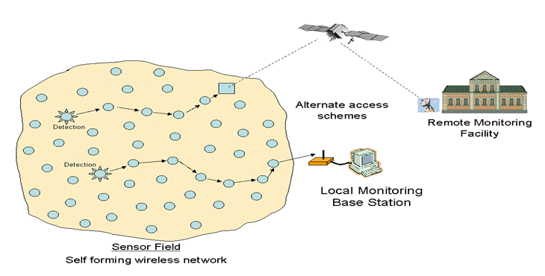
Introduction
Wireless Sensor Network?
It’s a collection of devices “ sensor nodes”
They are small, inexpensive, with constrained power
They are organized in a cooperative network
They communicate wirelessly
in multi hop routing
Heavily deployment
Changing network topology

Slide 4
Introduction ( Cont. )
Component and Schematic of Node
Processor.
Memory.
RF Radio.
Power Source.
Sensor.
GPS
Power
Signal
Processor
Processing And Decision Making
Wireless Transmitter/ Receiver
Sensors
Control

Slide 5
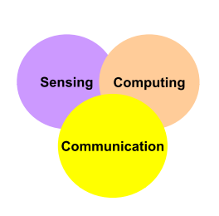
Introduction ( Cont. )
Goal of Wireless Sensor Network
Collect data at regular intervals.
Then transform data into an electrical signal.
Finally, send the signals to the sink or the base nod.
Types of Wireless Sensor Network
Temperature sensor.
Light sensor.
Sound sensor.
Vibration Sensor.

Slide 6
Introduction ( Cont. )
Communication pattern:
Broadcast : Base station transmits message to all its immediate neighbors.
Converge cast : a group of sensors communicates to a specific sensor
Local gossip: a sensor node sends a message to its neighboring nodes within a range.

Slide 7
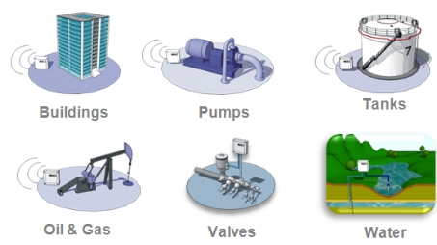
Introduction ( Cont. )
Applications of Wireless Sensor Network
Global scale
Battle field
Factories
Buildings
Homes
bodies

Slide 8
Power consumption in WSN’s
The power consumption in WSN’s is one of the biggest challenges because:
Sensors have a limited source of power and it’s hard to replace or recharge “ e.g sensors in the battle field, sensors in a large forest.. Etc”.

Slide 9
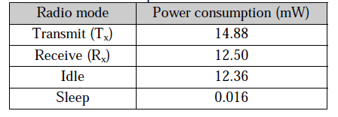
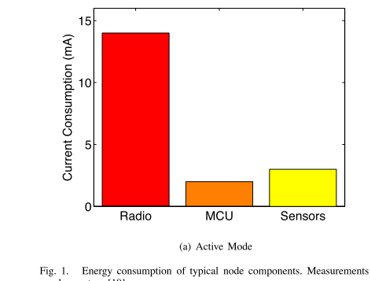
Power consumption in WSN’s
Energy consumption
of typical node
components.
Source: MAC Essentials for Wireless Sensor Networks

Slide 10
Sources of power consumption in WSN’s
1- useful power consumption:
Transmitting or receiving data.
Processing queries requests.
Forwarding queries and data to the neighbours.

Slide 11
Source of power consumption in WSN’s ( Cont. )
2- wasteful power consumption:
Idle listening to the channel “ waiting for possible traffic”.
Retransmitting because of collision: “ e.g two packets arrived at the same time at the same sensor”
Overhearing: when a sensor received a packet doesn’t belong it”.
Generating and handling control packets.

Slide 12
Power consumption in WSN’s
How to minimize the energy consumption of sensor nodes while meeting the application requirements?
Use Protocols that aim mainly to increase the sleep periods as much as possible
Sleep
Reception
Transmission
Idle

Slide 13
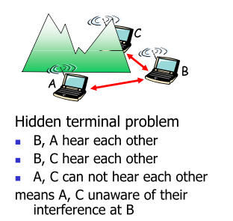
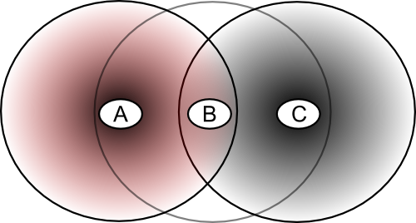
Another problem in Wireless Network
Hidden/Exposed terminal problem

Slide 14
Wireless MAC Protocols
Conventional of MAC Protocols
CSMA
CSMA/CA
IEEE 802.11

Slide 15
Wireless MAC Protocols (Cont.)
1- CSMA :
Non Persistent: if the device detects activity on the channel, it performs a back off by waiting before attempting to transmit.
P- Persistent: if it detects activity on the channel, it continuous to sense the channel instead of delaying.
CSMA requires devices to remain in the receive state when not transmitting
Disadvantages: the transceiver consumes energy too quickly.

Slide 16
Wireless MAC Protocols (Cont.)
2- CSMA/CA :
Control messages were introduced such as ( RTS and CTS) to reserve the channel
The source first performs CSMA algorithm
If it determines appropriate time for transmission, it sends RTS
Then, the destination responds with CTS
Disadvantages: it might still have some collision in RTS

Slide 17
Wireless MAC Protocols (Cont.)
3-IEEE 802.11 :
Infrastructure mode :devices communicate through a central entity called an access point (AP) using the point coordination function (PCF),
Ad hoc mode: devices communicate with each other directly using the distributed coordination function (DCF)
Both the PCF and DCF use a channel access mechanism similar to CSMA/CA and use acknowledgments for reliability.
In addition to physical carrier sensing, IEEE 802.11 devices perform virtual carrier sensing “ NAV”

Slide 18
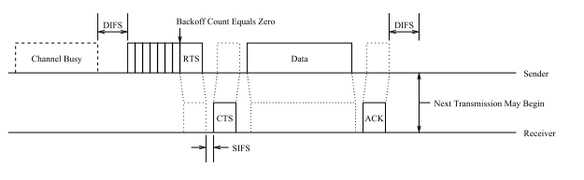
Wireless MAC Protocols (Cont.)
Disadvantages:
IEEE 802.11 devices consume large amounts of energy due to the high percentage of time spent listening without receiving messages
802.11 Data Transfer

Slide 19
Differences and Constraints
Traditional MAC protocol provides:
High throughput
Low latency
Fairness
Mobility But : have little consideration for energy
Improved MAC protocol provides:
Best performance of smallest amount of energy

Slide 20
Attributes to Wireless Sensor Networks
The following attributes should be taken in WSN
Energy conservation
Scalability and adaptively
throughput
Fairness
Latency
MAC protocol must achieve
Establish communication link between the sensor nodes
To share the communication medium fairly and efficiently
primary goal
less important

Slide 21
Wireless Sensor Network MAC protocols
Medium Access Control
Unscheduled MAC
Scheduled MAC

Slide 22
Unscheduled MAC protocols ( Cont. )
1- Unscheduled MAC:
Strategy:
Before sending a message, a sensor listens to the medium. If it’s busy, wait a random time then retry again and if it’s free then it will send the message.

Slide 23
Unscheduled MAC protocols ( Cont. )
Advantages:
It can adapt for changes “ in the node density, traffic load or the topology” better than scheduled protocol.
The sensors don’t have to be synchronized together.
Disadvantages:
It’s worst than scheduled MAC protocols from the power saving perspective, since all sensors listen to the channel.

Slide 24
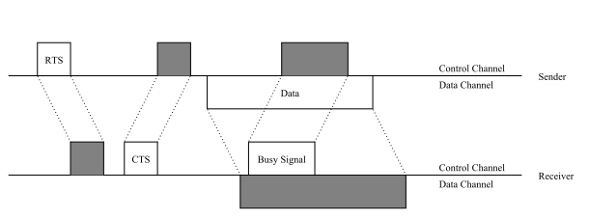
Unscheduled MAC protocols ( Cont. )
1.1- PAMAS: stands for Power Aware Multi-Access
Strategy : It uses multiple transceivers on each node
PAMAS Data Transfer

Slide 25
Unscheduled MAC protocols ( Cont. )
Advantages:
Prevent collision
Disadvantages:
Multiple radio requirement
Increase energy consumption
Increase device complexity and cost

Slide 26
Unscheduled MAC protocols ( Cont. )
1.2- STEM: stands for Sparse Topology and Energy Management
Strategy:
uses two different channels, the wakeup channel and the data channel,
requires two transceivers in each node
STEM duty cycle for single node

Slide 27
Unscheduled MAC protocols ( Cont. )
1.2.1- STEM-B:
Strategy : sensor nodes wakes a neighbour by transmitting a beacon
(no RTS/CTS )
advantages:
Lower Latency
Disadvantages:
More complex
High energy consumption

Slide 28
Unscheduled MAC protocols ( Cont. )
1.2.2- STEM-T:
Strategy : sensor nodes wakes a neighbour by transmitting a tone of
sufficient length that destination will have a high probability of sensing
Busy tone contains no destination address
Disadvantages:
  High latency
  Results in overhearing

Slide 29
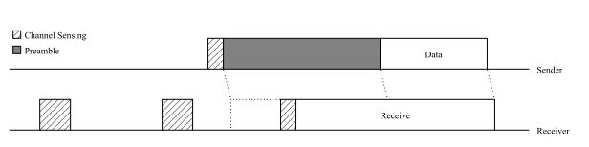
Unscheduled MAC protocols ( Cont. )
1.3- B-MAC:
Strategy :
It uses a tone to wake up sleeping neighbouring similar to STEM-T
It uses very long preambles for message transmission.
B-MAC Data Transfer

Slide 30
Unscheduled MAC protocols ( Cont. )
disadvantages:
B-MAC suffers from the overhearing problem
The long preamble dominates the energy usage.

Slide 31
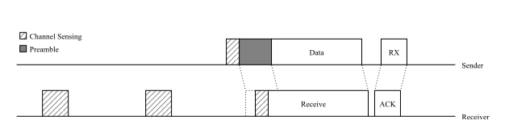
Unscheduled MAC protocols ( Cont. )
1.4- Wise MAC:
Strategy : it uses similar technique in B-MAC but it attempt to reduce the
energy consumption by having sensor nodes remember the sampling offset
of their neighbour
Wise MAC Data Transfer

Slide 32
Unscheduled MAC protocols ( Cont. )
advantages:
It decreases the amount of time a sensor node transmits preambles and the number of sensor nodes that overhear each message
Disadvantages:
the cost of an extra ﬁeld in the ACK messages and the memory required to store neighbor’s sampling oﬀsets.

Slide 33
WSN MAC protocols ( Cont. )
2- Scheduled MAC:
Strategy : it attempts to reduce the energy consumption by coordinating sensor nodes with a common schedule

Slide 34
scheduled MAC protocols ( Cont. )
Advantages:
Saving the power from being wasted by turning off the radio out the allocated time slot.
Limits the collision, idle listing, and overhearing
Disadvantages:
when sensor node enters net, must wait till they learn, some delay exist
Cost of increased messages
Not flexible to changes in sensor density or movements.
All sensors should be well synchronized.

Slide 35
scheduled MAC protocols ( Cont. )
2.1 - S-MAC:
Strategy :
the sensor node periodically goes to the fixed listen/sleep cycle.
A time frame in S-MAC is divided into two parts: one for a listening
session and the other for a sleeping session.

Slide 36
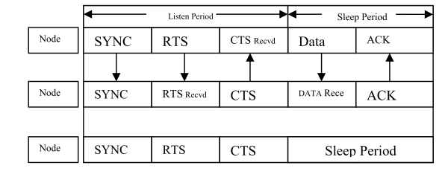
scheduled MAC protocols ( Cont. )
S-MAC Frame Format

Slide 37
scheduled MAC protocols ( Cont. )
Disadvantages:
energy is still wasted in this protocol during listen period as the sensor
will be awake even if there is no reception/transmission.

Slide 38
conclusion
Several MAC protocols has been introduced for both wireless network and wireless sensor networks
All WSN MAC protocols are designed with the goal to conserve energy
There is no generic best MAC protocol

Slide 39
[1] K. Kredo II, P. Mohapatra, “Medium Access Control in Wireless Sensor
Networks”, in 29 June 2006.
[2] A. Bachir, M. Dohler, T. Watteyne, and K. Leung, “ MAC Essentials for
Wireless Sensor Networks, “ in IEEE 2010.
[3] Salman Faiz Solehria, Sultanullah Jadoon, “ Medium Access Control
Protocol for Wireless Sensor Network – a Survey“, in IEEE 2010.
[4] K. LANGENDOEN , “MEDIUM ACCESS CONTROL IN WIRELESS SENSOR
NETWORKS“.
References

Slide 40
Questions?

Slide 41
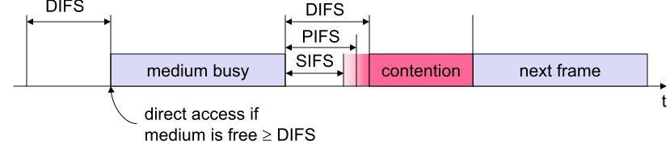
My questions (Q1)
Q1: Why IEEE 802.11 deﬁnes a SIFS shorter than a DIFS ?
ANS: SIFS (Short Inter Frame Spacing) has highest priority, for ACK, CTS, polling response while DIFS (Distributed Inter Frame Spacing) has lowest priority, for asynchronous data service. Having SIFS smaller than DIFS prevents ACK and important control packets from getting killed.
802.11 Data Transfer

Slide 42
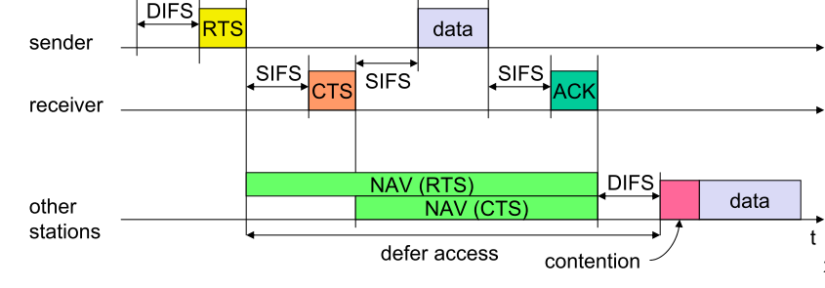
My questions (Q2)
Q2: Suppose a device uses an 802.11 MAC protocol to reserve the communication channel before transmitting. Suppose the device does sensing the channel and assumes the channel to be idle and wants to transmit 1000Bytes of data. Assume the transmission rate is 11 Mbps. Calculate the time required to transmit the frame and receive the Ack as function of SIFS and DIFS. Ignore the propagation delay and assume no bit error rate. The transmission rate = No. of bits/Transmission rate. Both a control frame and a frame without data is 32Bytes.
802.11 Data Transfer

Slide 43
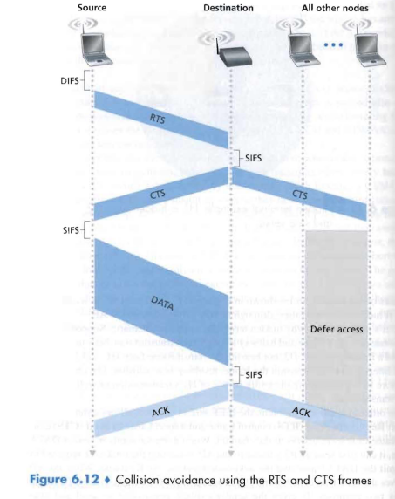
ANS: The time to transmit a control frame
= (8*32)bits/11Mbps=23µsec
The time to transmit the data frame
including the header
=(8*1000+8*32) bits/11Mbps=751µsec
The total time to transmit the frame and
receive the ACK
= DIFS+RTS+SIFS+CTS+SIFS+ data frame +SIFS+ACK
=DIFS+3SIFS+(3*23) µsec+751µsec
=DIFS+3SIFS+820µsec
My questions (Q2 cont.)
Collision avoidance using the RTS and CTS

Slide 44
Q3-a: True or false : Before an 802.11 station transmits a data frame , it must first send an RTS frame and receive a corresponding CTS frame?
Q3-b: Describe how the 802.11 protocol works?
My questions(Q3 )

Slide 45
ANS-a: False
My questions (Q3 cont.)
Collision avoidance using the RTS and CTS

Slide 46
ANS - b:
If initially the station senses the channel idle, it transmits its frame after a short period of time known as the Distributed Inter-frame Space (DIFS)
Otherwise, the station chooses a random backoff value and counts down this
value (NAV counter) when the channel is sensed idle. While the channel is sensed busy, the counter value “NAV” remains frozen.
3. When the counter reaches zero (note that this can only occur while the channel is sensed idle), the station transmits the entire frame and then waits for an acknowledgement.
My questions (Q3 cont.)

Slide 47
Thank you

