Slide 1
Sensor Placement In Sensor & Actuator networks
Presented by:
Anvesh Aluwala
aaluw006@uottawa.ca

Slide 2
Agenda
Introduction
Applications & Challenges
Problems and Sub-problems
Approaches for each sub problem
Conclusion
Questions

Slide 3
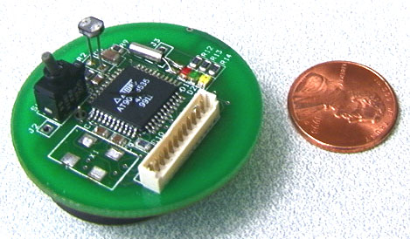
Introduction
What is WSAN?
Wireless Sensor and Actuator Networks
Contains a large number of self-sufficient nodes
Nodes have sensing capabilities, can perform simple computations and can communicate with each other[5]
Importance of Coverage in Sensor Networks
Coverage is the basis of a sensor network
It will be ideal if the sensor covers the right region designated to it…but due to many problems this is not fully satisfied

Slide 4
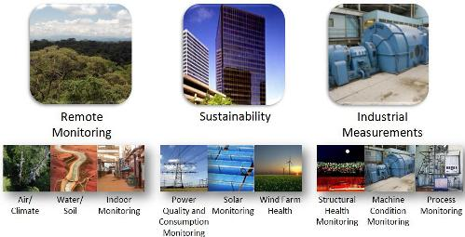
Applications & Challenges
Applications
Environmental monitoring - which involves monitoring air soil and water, condition based maintenance[2]
Habitat monitoring[2]
Military surveillance
Smart spaces…
Challenges
Ad hoc deployment
Dynamic changes…

Slide 5
Problem Statement
Movement Assisted Sensor Placement
In wireless sensor and actuator networks (WSAN), the impact on coverage from stochastic node dropping and unpredictable node failure, coupling with controlled node mobility, brings about the problem of movement-assisted sensor placement for coverage formation and improvement[1].
There are different ways to place sensors by exploiting node mobility in WSAN.
Sensors can be placed by mobile actuators.
If sensors have locomotion, then they can place themselves by intelligently changing their geographic location without others’ help.
Sub-problems[1]
Sensor placement by actuators
Coverage maintenance by actuators
Sensors self deployment
Sensor Relocation

Slide 6
Basic points…
Sensor placement by Actuators
Actuators serve as network installers for sensor deployment
They carry sensors along with them in ROI (Region Of Interest)
They deploy sensors at desired positions
Even in a case where ROI is bounded and where there are sufficient sensors, the problem is How to guide the actuators to explore entire ROI

Slide 7
Basic points (contd..)
Coverage maintenance by actuators
After initial sensor deployment, actuators can be used for further maintenance
They move and can drop new sensors in place of reported sensing holes
If actuators have no sensors in hand, then they have to first fetch spare sensors in the network and then proceed

Slide 8
Basic points (contd..)
Sensor self deployment
Sensor self-deployment takes place immediately after initial sensor dropping
To perform self-deployment, each sensor node needs to have locomotion
Sensor relocation
Even this process needs locomotion
Involves two tasks:
replacement discovery
replacement migration

Slide 9
Sensor placement by Actuators
Least Recently Visited Approach:
A single-actuator-based sensor placement algorithm
Assumes equal sensing and communication radii and guides actuator movement according to the suggestion of previously deployed sensors
The algorithm starts with an empty environment
At initiation, the actuator (robot) deploys a node at its current position
Each deployed sensor maintains a set of directions along which the robot can move away from it
Directions could follow a graph structure (e.g. tree), or could be pre-defined (e.g. four geographical directions)
It also assigns a weight, initially equal to 0, to each direction, indicating the number of times that direction was traversed by the actuator

Slide 10
Sensor placement by Actuators
Least Recently Visited Approach:
Every sensor recommends its locally least recently visited direction to the actuator by message when the actuator is in its communication range
The actuator travels a pre-defined distance in recommended direction
If, however, the chosen direction is obstructed, it will inform the recommender and ask for a new suggested direction
Whenever the actuator departs or arrives, its current sensor increases the weight of its going-direction /coming-direction
The actuator remains at a location for a pre-defined short period of time before its next movement
During this period, if it receives no sensor message, it will drop a new sensor in the environment

Slide 11
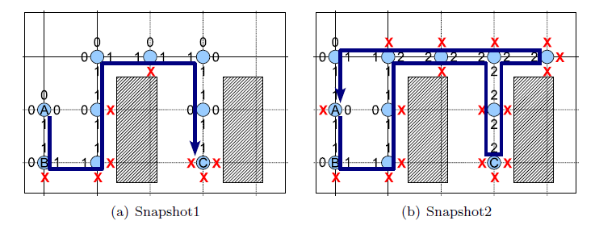
Least Recently Visited Approach
EXAMPLE
Picture taken from [1]
Pros and Cons:
Localized algorithm, hence fault tolerant
Not clear when the algorithm terminates, because actuator do not have global view and always receives a direction from the sensor.
It may terminate when it has no sensors left

Slide 12
Sensor placement by Actuators
Snake like Deployment Approach:
SLD uses a single mobile actuator to deploy static sensors at vertices of an equilateral triangle tessellation (TT) constructed over a bounded rectilinear ROI
The only actuator moves like a snake, starting from the upper-left corner of the ROI
It moves to the right along a horizontal line and drops sensors at separation √3r until it hits the boundary of the ROI or an obstacle.
Then it moves a distance of √3/2 r down to the next horizontal line, change its moving direction to the left, and proceed similarly.
‘r’ is the sensing range of the sensor

Slide 13
Sensor placement by Actuators
Snake like Deployment Approach:
The algorithm also attempts to avoid sensing holes hidden behind physical obstacles by allowing the actuator to break its regular movement pattern.
Specifically, the actuator checks, before its next movement step, whether there is any sensing hole in its vicinity in its coming direction.
If the answer is positive, it will change its moving direction toward that hole.
By this means, the actuator can move up and down, left and right along different lines, reducing the occurrence possibility of sensing holes.

Slide 14
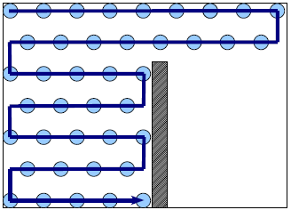
Snake like Deployment Approach
EXAMPLE
Picture taken from [1]
Pros and Cons:
Again when does the algorithm terminate?
No full coverage in case of above example
Once any obstruction it cannot cover the region across the wall

Slide 15
Voronoi diagram: Description
The Voronoi diagram of a collection of nodes partitions the space into polygons.
Every point in a given polygon is closer to the node in this polygon than to any other node.
Each sensor, represented by a number, is enclosed by a Voronoi polygon and these polygons together cover the target field.
The points inside one polygon are closer to the sensor inside this polygon than the sensors positioned elsewhere.
Thus, if this sensor cannot detect the expected phenomenon, no other sensor can detect it, and then each sensor is responsible for the sensing task in its Voronoi polygon.
In this way, each sensor can examine the coverage hole locally, and only needs to monitor a small area around it.
To construct the Voronoi polygon, each sensor only needs to know the existence of its Voronoi neighbors, which reduces the communication complexity.

Slide 16
Coverage Maintenance by Actuators
It has not yet been well studied how to repair/maintain coverage using actuators.
Existing solutions are straightforward application of clustering and flooding with huge message overhead.
They work under the assumption that actors are carrying sufficient spare sensors.
Cluster Based Approach
Addressed how to replace failed sensors in WSAN by presenting three straightforward actuator coordination protocols.

Slide 17
Coverage Maintenance by Actuators
Centralized protocol
An actuator is appointed as a central manager and responsible for handling node failure reports
The central controller broadcasts its location to all sensors and other actuators
It maintains the latest position of each actuator by listening to actuator location updates
Sensors monitor each other and report detected node failures to the central manager, which then dispatches closest actuators to replace failed sensors with their carried spare ones
First-come-first-serve basis for multiple requests
As an actuator moves to its assigned failure location, it keeps updating the central manager with its latest position

Slide 18
Coverage Maintenance by Actuators
Distributed protocol
The sensory field is partitioned into equal-sized sub-regions
Each actuator is assigned one and only one sub-region and required to handle regional node failure reports as manager
It is also responsible for sensor replacement in its own sub-region
The centralized algorithm is then run within each sub-region
Dynamic protocol
The sensory field is dynamically partitioned according to the current position of each robot
Specifically, each robot broadcasts its current location, sensors receiving messages from multiple robots rebroadcast only the one from closest robot
Finally, a Voronoi diagram is constructed based on hop count
Nodes report detected sensor failures to the creating actuators of their home Voronoi cells, which then move to replace the failed sensor with their carried spare ones
While moving, actuators broadcast their latest location to update the Voronoi diagram

Slide 19
Coverage Maintenance by Actuators
Perimeter Based Approach
In this solution, actuators are required to form a connected network
To obtain such a network, actuators can be densely dropped in a small region first and then spread by a vector-based self-deployment approach
Actuators locally construct a Gabriel over the actuator network.
When a sensor detects a sensing hole, which is represented by a geographic point, it sends a report to any one of the actuators by anycasting
The actuator receiving the report, which is not necessarily the closest one to the reporting sensor, routes a message toward the sensing hole through Greedy- Face-Greedy routing (GFG) protocol over the actuator network

Slide 20
Coverage Maintenance by Actuators
Perimeter Based Approach
Lack of destination information causes failure in routing process, hence the message will make a cycle around that sensing hole on Gabriel graph and stop at the actuator closest to it.
This actuator will take the responsibility to fill the reported sensing hole.

Slide 21
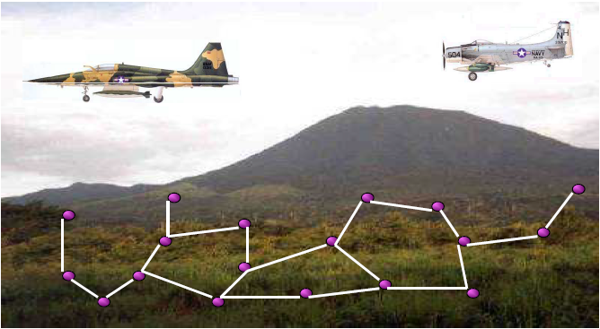
Sensor Self-Deployment: Motivation
Sensor dropping for aircrafts
Picture taken from [8]

Slide 22
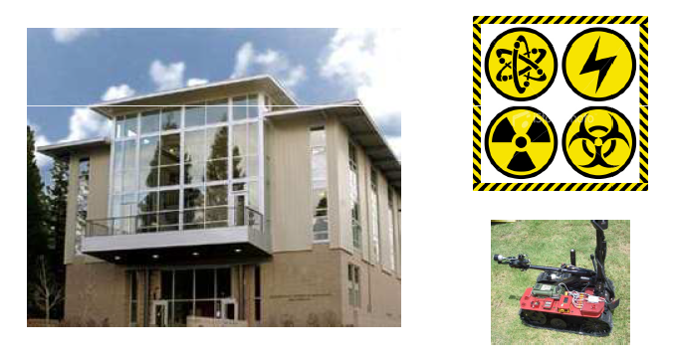
Sensor Self-Deployment: Motivation
Emergency environment monitoring
Picture taken from [8]

Slide 23
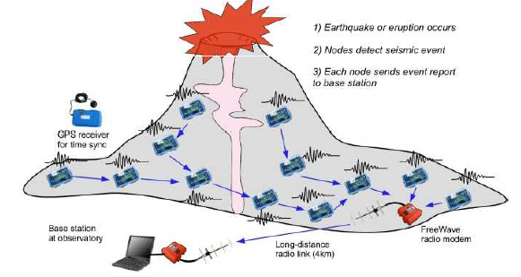
Sensor Self-Deployment: Motivation
Another emergency application
Picture taken from [8]

Slide 24
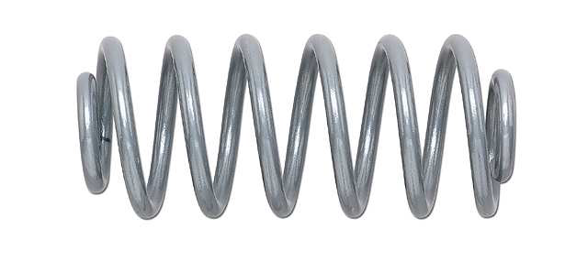
Sensor Self-Deployment
Virtual Forces: The Basics
Many different implementations of this technique have been proposed
The best known sensor self-deployment approach is probably the virtual force/vector based approach
Inspired by a variety of physical models, e.g. potential fields, molecules, electro-magnetic particles…
The core idea is the same. It is motivated by the attributes of electro-magnetic particles i.e. when two electro-magnetic particles are too close to each other, an expelling force pushes them apart

Slide 25
Sensor Self-Deployment
Virtual Force/Vector Based Approach
Assume d(si, sj) is the distance between sensor si and sensor sj
d.avg is the average distance between two sensors when the sensors are evenly distributed in the target area, which can be calculated beforehand since the target area and the number of sensors to be deployed are known
The virtual force between two sensors si and sj will push them to move (d.avg − d(si, sj))/2 away from each other.
In case one sensor covers its Voronoi polygon completely and should not move, the other sensor will be pushed d.avg − d(si, sj) away.
In summary, the virtual force will push the sensors d.avg away from each other if coverage hole exists in either of their Voronoi polygons.

Slide 26
Sensor Self-Deployment
Virtual Force/Vector Based Approach
In addition to the virtual forces generated by sensors, the field boundary also exert forces, denoted as Fb, to push sensors too close to the boundary inside.
Fb exerted on si will push it to move d.avg/2−db(si), where db(si) is the distance of si to the boundary.
Since d.avg is the average distance between sensors, d.avg/2 is the distance from the boundary to the sensors closest to it when sensors are evenly distributed.

Slide 27
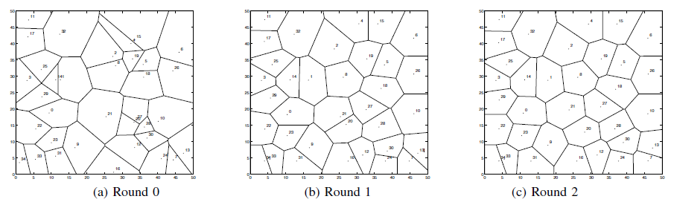
Snapshot execution of Vector based
Snapshots for vector based/virtual force approach
Picture taken from [3]

Slide 28
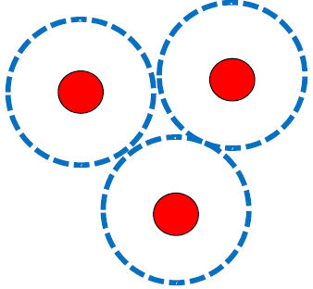
Vector based approach
EXAMPLE
Pros and Cons:
Enables nodes to make their deployment decision using solely their local knowledge
Sensors can not pass through closely placed obstacles due to their generated repulsive vector, resulting in sensing holes and coverage waste.

Slide 29
Sensor Self-Deployment
Voronoi Based Approach
The idea of Voronoi-based self-deployment is simple: sensors move to minimize their local uncovered areas (equivalently speaking, to maximize their sensing-effective areas) by aligning their sensing range with their Voronoi regions as much as possible.
Usually, this approach involves multiple rounds of alignment and terminates when no more gain can be achieved

Slide 30
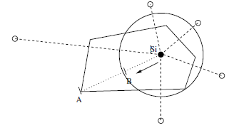
Voronoi based approach
Picture taken from [3]
Compared to the Vector based algorithm, VOR is a pull-based algorithm which pulls sensors to their local maximum coverage holes.
In VOR, if a sensor detects the existence of coverage holes, it will move toward its farthest Voronoi vertex
The small white circles represent si’s Voronoi neighbors and the large circle represents the sensing circle.
Point A is the farthest Voronoi vertex of si and d(A, si) is longer than the sensing range.
Sensor si moves along line siA to Point B, where d(A,B) is equal to the sensing range.
We limit the maximum moving distance to be at most half of the communication range

Slide 31
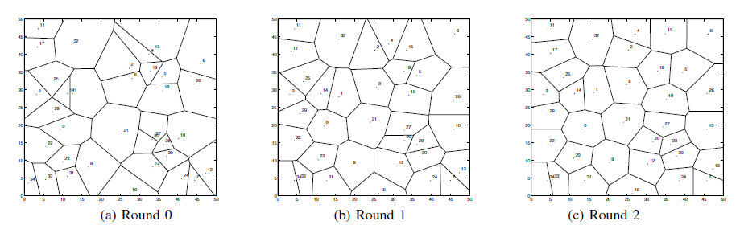
Voronoi based approach
EXAMPLE
Snapshot of voronoi based approach
Picture taken from [3]

Slide 32
Sensor Self-Deployment
Many other…[1]
Load-balancing approach:
The number of sensors in the regions of a partitioned sensor field is balanced through multiple rounds of scans
Stochastic approach:
Sensors spread out through random walk
Point-coverage approach:
The area coverage problem is converted to a point coverage problem over certain geographic graph
Incremental approach:
Sensors are deployed incrementally, i.e., one at a time, based on the information gathered from previously deployed sensors

Slide 33
Sensor Relocation
Mobile Sensor Migration
After a mobile sensor makes its decision for self-deployment or relocation, it will migrate from its current position to the target position.
Two ways: Direct way and Shifted manner.
In direct migration, the sensor simply moves all the way to the target location
In shifted migration, a multi-hop migration path is built from the sensor to the target location
Every sensor along this path shifts its position by one hop toward the target location.
The last sensor in the path moves to the target location.

Slide 34
Mobile Sensor Migration
EXAMPLE: shifted migration method…

Slide 35
Sensor Relocation
Two steps:
Replacement Discovery
Replacement Migration
To minimize energy consumption and response time, a replacement node should be a redundant sensor geographically closest to the failed node.
Thus replacement discovery is a distance-sensitive service discovery problem, where redundant sensors offers replacement service to failed sensors.
After replacement discovery, discovered replacement will be migrated to the position of failed sensor.

Slide 36
Sensor Relocation
Many service discovery have been proposed for wireless ad hoc networks. They can certainly be used to fulfill the replacement discovery problem
Some techniques such as location and data centric storage can also be adopted
By location service, redundant sensors update the network with their location and are searched when needed
By data centric storage, the location data of redundant sensors are stored somewhere in the network and retrieved by others
But, considering the resource constraints of sensors, a good solution should have low message overhead and constant per node storage load
Example approaches are Broadcast-based approach, Mesh-based approach, etc.

Slide 37
Conclusion
Stated the Movement Assisted Sensor Placement problem, also its sub problems
Different approaches for all the sub problems
Pros and cons for the approaches
There are even more approaches but there is no systematic study on them
Now-a-days Sensor self-deployment area is being researched more since it has more applications than others

Slide 38
References
[1] Amiya Nayak and Ivan Stojmenovic, “Wireless Sensor and Actuator Networks-Algorithms and protocols for Scalable Coordination and Data Communication”.
[2] Archana Bharathidasan and Vijay Anand Sai Ponduru, “Sensor Networks: An Overview”.
[3] Guiling Wang, Guohong Cao and Tom La Porta “Movement-Assisted Sensor Deployment”
[4] panda.ece.utk.edu/w/images/2/23/Sensordeployment.ppt “Optimal Self-placement of Heterogeneous Mobile Sensors in Sensor Networks.
[5] www.cs.berkeley.edu/~culler/cs252-s02/slides/lec08-wireless.ppt “Wireless Sensor Networks”
[6] www.site.uottawa.ca/~casteig/files/csi5140-shafagh-alikhani.ppt “Localization in Wireless Sensor Networks”
[7] Yi Zou, KrishnenduChakrabarty, ”Sensor Deployment and Target Localization Based on Virtual Forces” IEEE INFOCOM 2003
[8] Rafael Falcon, “Robotic Sensor Wireless Networks”

Slide 39
Questions
Question 1:
Consider Sensor placement by Actuators, In a snake like deployment approach if there is an obstacle in between as shown below. Whether full coverage is possible? If so Why(show with help of diagram)?
Ans: No.

Slide 40
Questions
Question 2:
In which way “shifted migration method” is better than “direct way” when we try to perform sensor relocation?
Ans: For better network lifetime
Shifted migration follows a multi-hop migration path, where every sensor involved shifts one position closer towards the target location. Since this method involves multiple nodes, it distributes energy consumption to all the nodes involved extending the network lifetime

Slide 41
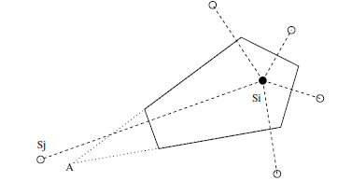
Questions
Question 3:
In case of Voronoi based approach, we limit the maximum moving distance for the sensor to be at most half of the communication range to avoid the situation shown below. Why?
Ans:
In above situation si is not aware of the existence of sj because of communication limitations, and its local view of Gp(si) (shown in the dotted line) is not correct (shown in the solid line).
Otherwise, if si moves toward point A and stops at a distance d(A,B) (sensing range), then si has obviously moved more than needed.

Slide 42
Thank You!

