Slide 1
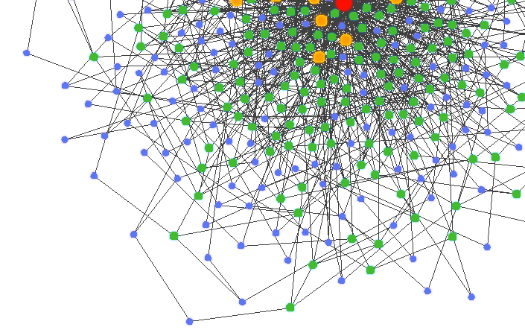

Security in Ad Hoc Networks

Slide 2
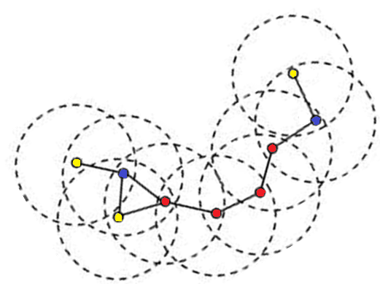
What is an Ad hoc network?
“…a collection of wireless mobile hosts forming a temporary network without the aid of any established infrastructure” [1]

Slide 3
Existing
Vulnerabilities
  Eavesdropping
  Altering
  Cheat on identities
  Overused
  Jammed
  Computing power and Energy

Slide 4

Why security is needed?
MANETS do not rely on fixed infrastructure
Essential for
  Packet forwarding
  Routing
Functions are carried out by available nodes
Misbehaving nodes

Slide 5
Security requirements
Authentication
Access Control
Confidentiality
Integrity
Privacy
Non-repudiation
Availability

Slide 6

Threats
Threats Using Modification
Threats Using Impersonation
Threats Using Fabrication
Misbehavior

Slide 7


Attacks
Active Passive
-bares energy cost -lack of cooperation
-damage other nodes -save battery life
-malicious -selfish

Slide 8
Routing protocols
Position-based approaches
Topology-based approaches
  Proactive routing (table driven)
  Reactive routing (on demand)
  Hybrid routing

Slide 9
Reactive routing
  Only discover routes to destinations on-demand
  Consume much less bandwidth but experience substantial delay
Proactive routing
  Classic routing strategies: link state, distance vector
  Keep track of routes to all possible destinations
  Changes in link connection updated periodically
  Minimal delay but substantial fraction of control information

Slide 10
DSR vs. AODV
Dynamic source routing (DSR)
  Source broadcasts RREQ through the network
  Intermediate nodes add its address to RREQ and continue broadcasting until RREP received
  Full path chosen by source and put into each packet sent
Ad hoc on-demand distance vector (AOVD)
  Hop-by-hop routing
  Source sends RREQ to neighbors
  Each neighbor does so until reach the destination
  Destination node sends RREP follow the reverse path
  Source doesn’t put whole path but only next hop addr in outgoing packets

Slide 11
ARIADNE
Proposed by Hu, Perrig and Johnson
Secure routing protocol based on DSR
Guarantees that target node of a route discovery process can authenticate the initiator
No intermediate node can remove a previous node in the node list in RREQ or RREP messages

Slide 12
ARAN
Proposed by Dahill, Levine, Royer and Shields
Detects and protects against malicious actions carried out by third party and peers
Introduces authentation, message integrity and non repudiation
Consists of preliminary certification process

Slide 13
CONFIDANT
Cooperation of Nodes, Fairness In Dynamic Ad-Hoc NeTworks
Designed as an extension to a routing protocol such as DSR
Another approach is Token based cooperation Enforcement Scheme

Slide 14
Cooperation Enforcement
Presented by Yang, Meng, and Lu
Reputation rating

Slide 15
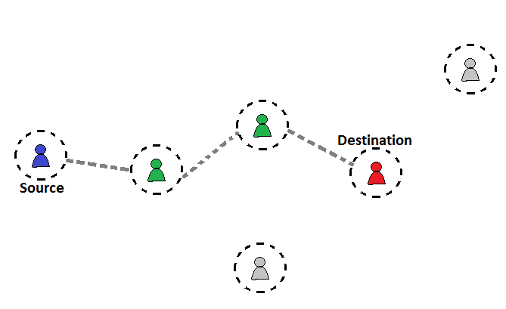


Slide 16
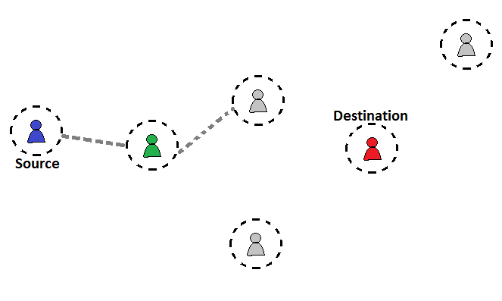


Slide 17
Nuglets
Packet Purse Model
-Source loads packet with nuglets
-forwarding node takes nuglet for forwarding
Packet Trade Model
- traded for nuglet

Slide 18
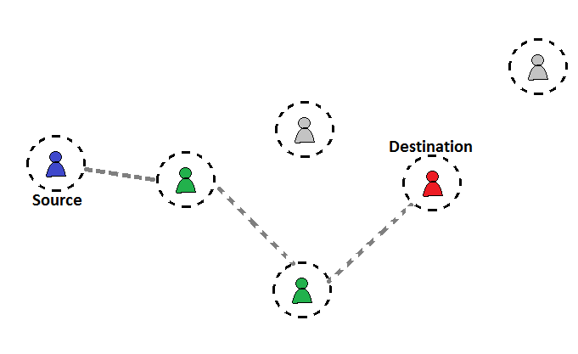


Slide 19

Token-Based Cooperation Enforcement
  Local neighbors monitor to detect misbehaving
  Expiration of tokens is based on the node behavior
  Token is renewed through multiple neighbors

Slide 20
Authentication and Public key infrastructure
Self-Organized Public-Key Management Based on PGP
Ubiquitous and Robust Authentication Services Based on Polynomial Secret Sharing

Slide 21
Security Mechanisms layer
Wired Equivalent Privacy (WEP)
Key Management
Authentication

Slide 22
Conclusion
Security in ad hoc networks has recently gained momentum in the research community
Due to the open nature of ad hoc networks and their lack of infrastructure
Security solutions for ad hoc networks have to cope with challenging environment including computational resources and lack of a fixed structure

Slide 23
Question1
How many kinds of attacks are there and what are they?
Answer:
Active Passive
-bares energy cost -lack of cooperation
-damage other nodes -save battery life
-malicious -selfish

Slide 24
Question2
What are the differences between DSR and AOVD?
Answer:
Dynamic source routing (DSR)
  Source broadcasts RREQ through the network
  Intermediate nodes add its address to RREQ and continue broadcasting until RREP received
  Full path chosen by source and put into each packet sent
Ad hoc on-demand distance vector (AOVD)
  Hop-by-hop routing
  Source sends RREQ to neighbors
  Each neighbor does so until reach the destination
  Destination node sends RREP follow the reverse path
  Source doesn’t put whole path but only next hop addr in outgoing packets

Slide 25
Question 3
What are Nuglets and why are they used? (as proposed in this presentation)
Answer: Packet Purse Model
-Source loads packet with nuglets
-forwarding node takes nuglet for forwarding
Packet Trade Model
- traded for nuglet

Slide 26



