Slide 1
Secure Routing in VANETs
CSI5148
Professor: Ivan Stojmenovic
Student: Antonio Prado

Slide 2
Outline
Introduction
  VANETs
  Security requirements
  Routing
Routing algorithms
Conclusions
Questions

Slide 3
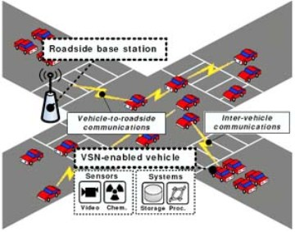
VANETs
Ad-hoc network between vehicles.
Nodes move in well-defined paths.
Highly dynamic version of MANETs.
Fig. from [4]

Slide 4
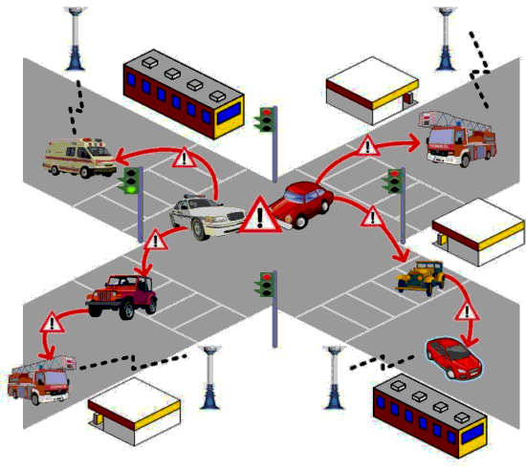
VANETs
Interesting types of data exchanged.
  Traffic/road conditions.
  Accidents/events.
  Commodity/entertainment.
Fig. from [3]

Slide 5
Security in VANETs
When data is compromised, the whole system suffers.
  Garbage in = garbage out.
The nature of VANETs could lead to malicious attacks.
  Predictable movement of nodes.
  High mobility of victim/attacker.
Adversaries could break the system.
  Data sinkholes.
  Feed false information.
  Sybil attacks.
  Flood the system.
Security measures must be taken to avoid malicious attacks on the system.

Slide 6
Security Requirements
Message authentication and integrity.
Message non-repudiation.
Node authentication.
Access control.
Message confidentiality.
Accountability.
Privacy protection.

Slide 7
Security Requirements
Reliable encryption/decryption device.
  Storing and safeguarding private keys.
Key/certificate generator.
  Third party (CA).
  Random number generators (shared secret keys).
GPS device.
Time synchronization.
  Free with GPS.
Infrastructure.
  Store and relay messages, group keys, etc.

Slide 8
Routing Requirements
Two major routing categories:
  ID based.
  Geography based.
Depending on the needs, each category has its advantages.
  ID methods are for sending data to an individual node.
  Geography methods are for sending data to a group of nodes.

Slide 9
Current Status
Most secure routing algorithms build on top of unsecure routing protocols.
  No routing protocol was originally built with security in mind.
  Any security advantage is a fortunate by-product of design.
Reactive protocols are preferred to proactive ones.
  On-demand instead of topology knowledge.
  e.g. AODV, ARIADNE, DSR.
Routing protocols tend to sacrifice privacy frequently.
  Notable exception: AODV.
Asymmetric encryption if preferred over symmetric encryption.

Slide 10
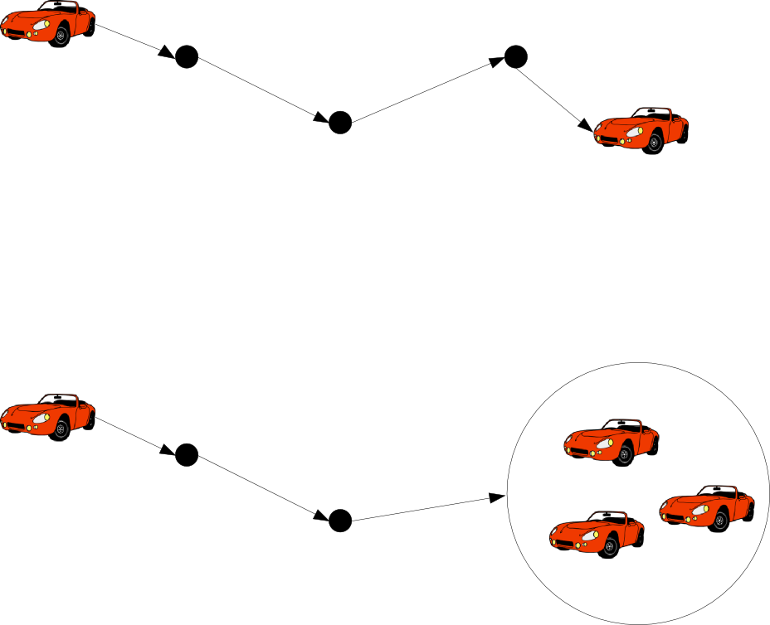
Secure Routing Algorithms
ID based
  Secure Routing Protocol (SRP)
  Secure Beaconing
Geographic
  PRISM
  Position-Based Routing

Slide 11
Secure Routing Protocol (SRP)
Extension to existing reactive protocols.
  e.g. AODV, DSR
Assumes secure link between two nodes already exists.
  e.g. create Shared Key using Public Keys of both sides.

Slide 12
Secure Routing Protocol (SRP)
Source S initiates route discovery.
RREQ identified by two parts.
  Query sequence #
  Random query ID
Calculate MAC from Source, Dest, RREQ ID, and Shared Key.
Destination T replies to query more than once to create multipath.
Intermediate relay nodes rank neighbours by frequency of queries received.
  High # of queries = low rank.

Slide 13
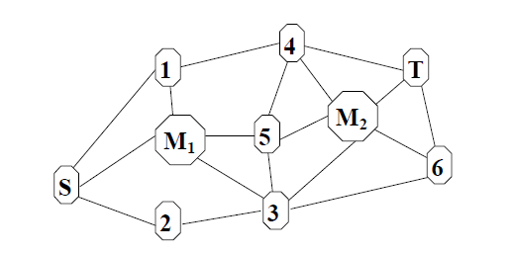
SRP
[1]Example topology: S wants to discover a route
to T in the presence of two malicious nodes, M1 and M2.

Slide 14
SRP
Example topology: S wants to discover a route
to T in the presence of two malicious nodes, M1 and M2.

Slide 15
SRP
Example topology: S wants to discover a route
to T in the presence of two malicious nodes, M1 and M2.

Slide 16
SRP
Example topology: S wants to discover a route
to T in the presence of two malicious nodes, M1 and M2.

Slide 17
Secure Routing Protocol (SRP)
Good:
  Deals with non-colluding malicious nodes.
  Prevents IP spoofing, ensures privacy.
Bad:
  Route cache poisoning renders efficient algorithms less efficient/effective.
  Colluding malicious nodes can "alter" topology (wormhole attack).

Slide 18
Secure Beaconing
Believes most communications are direct.
Not all beacons need to be encrypted.
  Tries to strike balance between security and efficiency.
Omitting Certificates and Certificate Verifications.
  Neighbour-based certificate omission (NbCO).
Omitting Signatures and Signature Verifications.
  Situation-based signing (SbS).

Slide 19
Secure Beaconing - NbCO
Send certificate to neighbours.

Slide 20
Secure Beaconing - NbCO
Send subsequent messages without certificate.

Slide 21
Secure Beaconing - NbCO
New neighbour arrives, receives encrypted message.

Slide 22
Secure Beaconing - NbCO
Send certificate to new neighbour.

Slide 23
Secure Beaconing - NbCO
Continue sending messages without certificates.

Slide 24
Secure Beaconing - SbS
Sign every nth beacon.
Every other (n-1) beacon is sent unsecured.
  Match data using movement prediction.
In critical situations, sign every message.

Slide 25
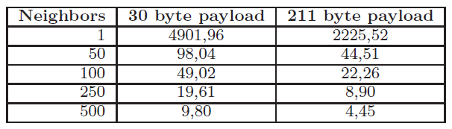
Secure Beaconing
Good:
  Saves bandwidth.
  Better data throughput.
Bad:
  Everything else?
    No privacy whatsoever.
    (NbCO) Some messages might be lost.
    (SbS) Critical situations mean exponential load on network.
Packet rates per node per second
(Table from [6])

Slide 26
PRISM
Use AODV to establish path.
  Destination is an area, not a node.
Use group signatures on both sides.
  Once link is established, create one-time-use secret key between parties .
Hit and miss approach.
  Is anybody there?
Ask a zone to reply.
  Set the maximum number of answers you want.

Slide 27
PRISM
Source broadcasts RREQ with destination location:
  DST-AREA = coordinates and perimeter.
  PK_tmp = Temporary public key.
  TS_src = Timestamp.
  Sign using Group signature GSIG_src.
Forwarders:
  Check if RREQ is valid and not duplicated.
  Check if RREP is related to cached RREQ hash.
  Forward towards area.
If in DST-AREA:
  Store RREQ for forensic analysis.
  Create secret key PK_ses between parties.
  Encrypt exact destination location.
  Send RREP.
  Sign using Group signature GSIG_dst.

Slide 28
PRISM
GSIG_src
DST-AREA
DST-AREA
PK_tmp
Data

Slide 29
PRISM
GSIG_src
DST-AREA
DST-AREA
PK_tmp
Data

Slide 30
PRISM
DST-AREA
GSIG_src
DST-POS
PK_ses
Data

Slide 31
PRISM
DST-AREA
GSIG_src
DST-POS
PK_ses
Data

Slide 32
PRISM

Slide 33
PRISM
Good:
  Preserves privacy.
  Avoids creation of pseudonyms (expensive).
Bad:
  Deals with rogue nodes reactively (TTP).
  Difficult to ensure that DST-AREA value has not been tampered with.
  Sybil attacks are easy.

Slide 34
Position-Based Routing
One way communication.
  Broadcasts.
Location table with ID and positions of nodes.
  Beaconing.
  Location service.
  Forwarding.
Location is plausible.
  Actual position is hard to obtain.
Two levels of encryption:
  End-to-end (Source ID, Position, data, etc).
  Hop-by-hop (Sender ID, Position, TTL).
Packets have a freshness range.
  TTL.
  Timestamps can apply timeout.

Slide 35
Position-Based Routing
On reception of a packet, a forwarding node:
  Verifies both the source and sender signatures.
  Updates the mutable field values and generates a new sender signature.
  Replaces the old signature with the new one.
  Re-forwards the packet.
The destination node verifies both the sender and source signatures.

Slide 36
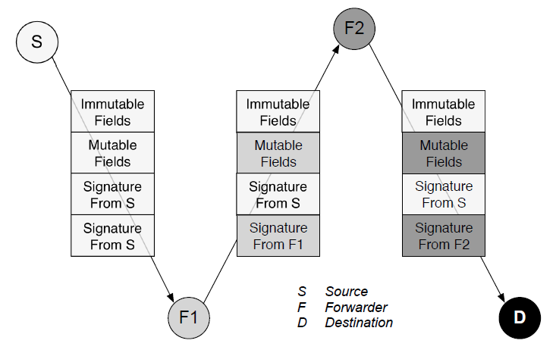
Position-Based Routing
Figure from [8]

Slide 37
Position-Based Routing
Good:
  Two levels of encryption.
  Broadcasts deter wormhole attacks.
Bad:
  Caching of location and certificates is a great loss of privacy.

Slide 38
Conclusion
Secure routing in VANETs still has a lot of ground to cover.
There is no routing algorithm that is designed to be secure and private from the start.
There is a need to strike a balance between privacy and security.

Slide 39
Bibliography
[1]P. Papadimitratos et al., “Secure Vehicular Communications: Design and Architecture,” IEEE Commun. Mag., Nov. 2008.
[2]Pietro Michiardi and Refik Molva, “Ad Hoc Networks Security”, ST Journal of System Research, 2003, volume 4
[3]Kari El Defrawy, Gene Tsudik , Sept 2011, “Security and Privacy in Location-based MANETs/VANETs ”
[4]Wired.com article, “Turning cars into wireless network nodes ” June 9, 2007 http://www.wired.com/beyond_the_beyond/2007/06/turning_cars_in/
[5]P. Papadimitratos, Z. Haas, “Secure Routing for Mobile Ad Hoc Networks”, in proceedings of CNDS 2002.
[6]Elmar Schoch, Frank Kargl, “On the Efficiency of Secure Beaconing in VANETs” WiSec’10, March 22–24, 2010
[7]Karim El Defrawy and Gene Tsudik, "PRISM: Privacy-friendly Routing In Suspicious MANETs (and VANETs)", The 2008 IEEE International Conference of Network Protocols (ICNP'08), October 19-22, 2008
[8]Charles Harsch, Andreas Festag, Panos Papadimitratos, “Secure Position-Based Routing for VANETs”, Vehicular Technology Conference, 2007. VTC-2007 Fall. 2007 IEEE 66th, Sept 30-Oct 3, 2007

Slide 40
Question 1
In the SRP protocol, the routing is done using a reactive protocol (e.g. AODV) in which the reply tries to create as many paths as possible in order to avoid disconnections. Forwarding node preference is by ranking, where ranking is inversely proportional to the number of queries posted. A higher query count gives a node a lower preference rank. Rank also gives you priority when forwarding.
Assume that a malicious node is always repeating a query. Using AODV, show the paths created by Source S when trying to talk to Destination T.

Slide 41
Question 1

Slide 42
Question 1
Solution

Slide 43
Question 1
Solution

Slide 44
Question 1
Solution

Slide 45
Question 1
Solution

Slide 46
Question 1
Solution

Slide 47
Question 2
In Position-Based Routing (PBR), the message data is encrypted end-to-end by the source (immutable) and the transmission data is encrypted hop-by-hop by the senders (mutable). Every time a message travels from a link, the TTL is updated and the mutable information is signed by the sender.
In the following graph, show the message changes. Assume H is the source, C the destination, TTL is 3, and that the message times out after 10 time units. In the graph, time costs are shown in the links.

Slide 48
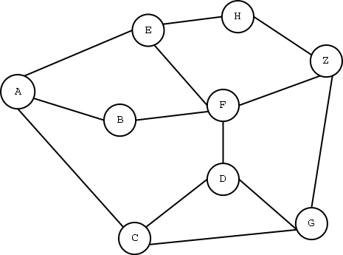
Question 2
Sig:H
TTL:3
TS: 0
2
2
9
3
1
2
2
5
4
2
1
3

Slide 49
Question 2
Sig:H
TTL:3
TS: 0
Sig:H
TTL:2
TS:2
Solution
2
2
9
3
Sig:H
TTL:2
TS:2
1
2
2
5
4
2
1
3

Slide 50
Question 2
Sig:H
TTL:3
TS: 0
Sig:H
TTL:2
TS:2
Solution
2
2
9
3
Sig:H
TTL:2
TS:2
Sig:E
TTL:1
TS:11
1
2
2
5
4
2
1
3
Sig:Z
TTL:1
TS:6

Slide 51
Question 2
Sig:H
TTL:3
TS: 0
Sig:H
TTL:2
TS:2
Solution
2
2
9
3
Sig:H
TTL:2
TS:2
Sig:E
TTL:1
TS:11
1
2
2
5
4
2
1
3
Sig:Z
TTL:1
TS:6
Sig:G
TTL:0
TS:9

Slide 52
Question 2
Sig:H
TTL:3
TS: 0
Sig:F
TTL:0
TS:7
Sig:H
TTL:2
TS:2
Sig:Z
TTL:1
TS:4
Solution
2
2
9
3
Sig:H
TTL:2
TS:2
Sig:E
TTL:1
TS:11
1
2
2
5
4
2
1
3
Sig:Z
TTL:1
TS:6
Sig:G
TTL:0
TS:9

Slide 53
Question 3
In the security beaconing family of protocols, the situation-based signing (SbS) method establishes that to save bandwidth, every beacon is signed only in critical situations, and every nth beacon is signed in normal situations. Give a short explanation of why this could be a bad strategy to save bandwidth.

Slide 54
Question 3
Solution:
  During critical scenarios, the network would be flooded by large packets from every observer, while staying sparsely used in normal situations. This could lead to starvation.
  Malicious nodes could monopolize network bandwidth by signing every message.

