Slide 1
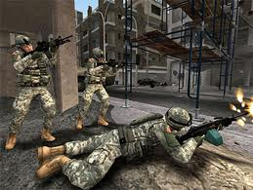

SECURITY IN SENSOR NETWORKS
BY
SASIKIRAN V.L. REDDY
STUDENT NO.6603240

Slide 2
OUTLINE
1.Introduction
2.Threats and Attacks
3.Protocols for Detection of Clone Attacks
3.1 Randomized Multicast(RM)
3.2 Line-Selected Multicast(LSM)
3.3 Randomized Efficient Distributed(RED)
4.Epidemic Data Survivability in Unattended WSNs
5.A Protocol for Securing Mobile Unattended WSNs
6. Secure Routing
7. Key Management
8.Cryptography
9.Conclusion
10.Questions

Slide 3
INTRODUCTION
Sensor networks have a large number of small sensor nodes with each consisting of some computing power, limited memory , various sensors with different communication capabilities.
WSNs are assumed to be operated in real time environment and depending on the application it may be necessary that wireless message exchange be secure.

Slide 4
CONSTRAINTS
1Kbps - 1Mbps,
3-100 Meters,
Transceiver
Limited Storage
Memory
Embedded
Processor
Slow Computations
Sensors
Battery
Limited Lifetime

Slide 5
NEED FOR SEPARATE SECURITY MECHANISMS
Due to various limitations ( memory, power, battery) existing security mechanisms are poor fit for this domain.
Threats to sensor networks are different from threats to mobile ad-hoc networks.
Traffic model in WSNs is many to one unlike in mobile ad-hoc models where it is many to many.
Sensor nodes are prone to failures due to harsh deployment environments.
Number of nodes in WSNs can be several orders of magnitude higher than the nodes in the ad-hoc network.
Sensor nodes may not have global identification.

Slide 6
THREATS AND ATTACKS
External Attacks:
Attackers can capture sensor nodes and reprogram them
Attackers can deploy nodes with larger computing resources such as laptops to attack sensor nodes
Internal Attacks:
Compromised nodes can steal secrets from encrypted data
Compromised nodes can report wrong information
Compromised nodes can report other nodes as compromised nodes.
Compromised nodes can breach routing by introducing many routing attacks.

Slide 7
Attacks
1.Denail Of Service(DOS)
Main aim is to exhaust the resources of the nodes by sending unnecessary packets
Some of the DOS attacks can be tampering, jamming,collision,exhausition,unfairness,blackholes etc.,
Methods to prevent DOS attacks –watchdog and reputation rating based scheme, Virtual Currency
2.Attacks on Information
Wireless communication is vulnerable to eavesdropping, information may be altered, spoofed, replayed or vanished
An attacker with high processing power and larger communication range (e.g., laptops) could attack several sensors at the same time to modify the actual information.

Slide 8
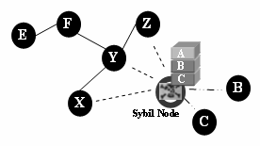
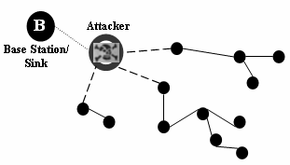
Attacks(Cont.)
3.Sybil Attack:
A node uses the identities of more than one node for attacking distributed storage, routing mechanism, resource allocation etc.,
Difficult to detect the sybil node, radio resource testing is used to detect sybil nodes
4.Blackhole Attack:
Node attracts all the traffic, once inserted between the communicating nodes, it can do any thing with the packets passing between them.
Picture from (2)
Picture from (2)

Slide 9
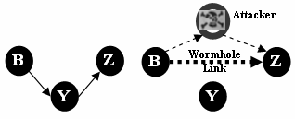
Attacks(Cont.)
5.Hello Flood Attack
Attacker with high transmission power sends hello packets to various sensor nodes persuading that the attacker is the neighbor . As a result victim nodes tries to send the packets through the attacker
6.Wormhole Attack
Attacker tunnels the message recorded at one location of the network to another location to make a fake that these two parts are very close
Efficient authentication protocols can
be used to detect the attack.
Picture from (2)

Slide 10
Attacks(Cont.)
7.Node Replication Attack(Clone Attack)
Adversary captures nodes, acquires all the information stored inside .Therefore it may replicate the nodes and deploy them in the network.
Can be detected using the Randomized multicast , Line Selected Multicast and RED protocols
RED is highly efficient as for communications , memory and computations and has an improved detection probability compared to other distributed protocols

Slide 11
Detection Of Clone Attacks
Centralized protocols to detect a clone have a single point of failure and high communication cost
Local protocols do not detect replicated nodes that are distributed in different parts of the network.
Randomized multicast(RM) , Line-Selected Multicast(LSM) and Randomized ,Efficient and Distributed(RED) are self healing protocols which detects clones and exclude them from the network.
General idea of all the above protocols is to distribute the location information to randomly selected nodes and the node that detects the existence of a node in two different locations is called a witness

Slide 12
Detection Of Clone Attacks-RM
When a node announces its location information , each of its neighbors sends digitally signed copy of the location information to randomly selected nodes with a probability p.
If each neighbor selects O(n) destinations, at least one node will receive a pair of not coherent location claims which is the witness.
Birthday Paradox implies location claims from a cloned node and its clone will collide with high probability
High probability of detection of a clone
Decentralized and randomized
High communication costs (O(n) hops per node )

Slide 13
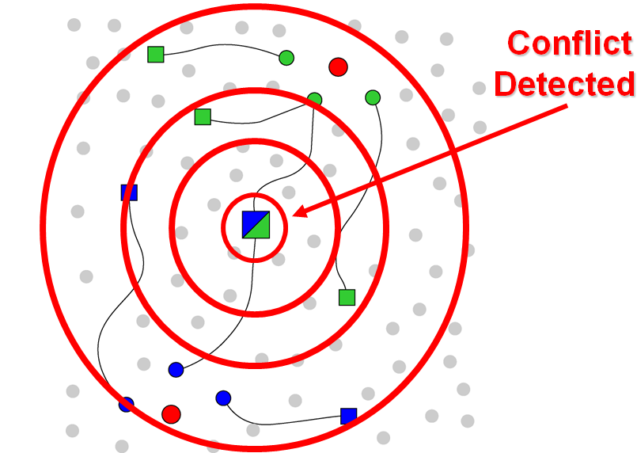
Detection Of Clone Attacks-RM

Slide 14
Detection Of Clone Attacks-LSM
In LSM when a node announces its location, every neighbor checks the signature in the claim and then with probability p forwards it to g>1 randomly selected destination nodes
The location claim has to pass through several intermediate nodes and each node checks for the conflict and forwards the location claim towards the destination
Node replication is detected by the node at the intersection of the two paths
Decentralized and randomized
High probability of intersection of two randomly drawn lines in a plane
O(√n) signature verifications should be done and O(√n) location claims must be stored in memory which is impractical in real networks with thousands of nodes

Slide 15
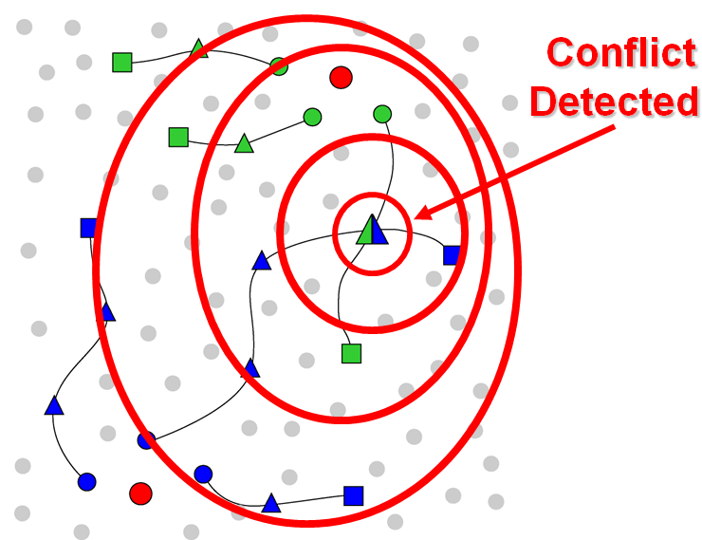
Detection Of Clone Attacks-LSM

Slide 16
Detection Of Clone Attacks-RED
Randomized, Efficient, Distributed (RED) is similar to RM in principle but witness is chosen pseudo randomly based on a network-wide seed.
Every run of the protocol consists of 2 steps
Step 1:A random value is broadcasted among all the nodes
Step 2:
Each node broadcasts its ID and location to its neighbors
Each neighbor forwards the claim to a set of g>=1 (With probability p)
Pseudo random function takes the input ID, rand and g
Every node in the path (from claiming node to the witness
destination) forwards the message to its neighbour nearest to
the destination and signature verification is done only at the
destination.

Slide 17
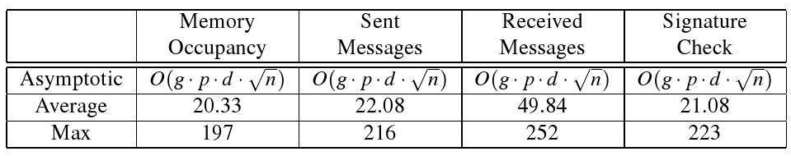
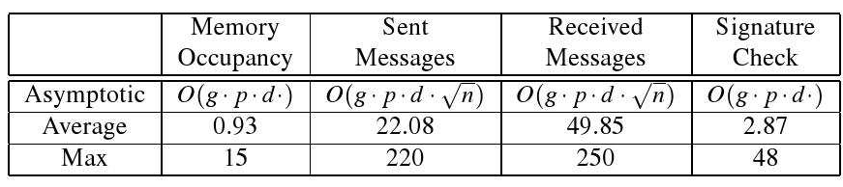
LSM vs RED
N=1000,g=1,p=0.1
LSM
RED
Data from (5)

Slide 18
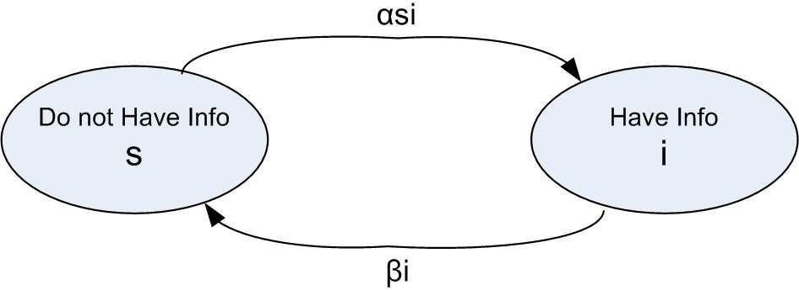
Epidemic Data Survivability in Unattended WSNs
UWSNs are needed because sink cannot be present in the cases where sensors are deployed in hostile environments.
Data survivability in UWSNs depends on the replication rate of the data and flooding should be avoided due to sensor resource constraints
Controlled data replication can be achieved from the epidemic model SIS( Susceptible – Infected – Susceptible)
Picture from (4)

Slide 19
Epidemic Data Survivability in Unattended WSNs (Cont.)
When a nodes receives the data, it is said to be infected and when an adversary tries to wipe the data, it moves back to the susceptible state.
Sink captures the data as soon as a node in its range gets the infected.
The goal of the adversary is to wipe the data such that the data does not reach the sink.
Time is partitioned into rounds and in each round sensors with a replication approach tries to preserve the information and the attacker will try to compromise them with a final target to completely erase the information.

Slide 20
Epidemic Data Survivability in Unattended WSNs (Cont.)
Main aim of the model is to minimize the value of alpha(rate at which nodes are infected with data) preserving the data survivability and avoid the flooding of data in the network
Selecting a maximum value for alpha such that alpha>beta(rate at which nodes move back to the susceptible state) is not a good choice because it floods the network and selecting a minimum value of alpha such that alpha>beta is also not a good choice
A method of bounded difference is used to choose the lower bound on the data survivability.

Slide 21
Securing Mobile Unattended WSNs
In unattended WSN there is no real time communication with the sink , data collection is performed sporadically
Goal: To provide intrusion resilience with out the aid of any trusted third parties
Security is based entirely on the Hash function and the pseudo random number generator which is used to generate the key for encryption, we say that the sensor is secure in a particular round iff the adversary cannot compute the key generated by PRNG.
Mobility Models:
Random Jump(RJ): Speed is set such that sensor reaches the deployment area in one round
Random Waypoint(RP): Speed is set such that sensor cover a distance no greater than m in one round

Slide 22
Securing Mobile Unattended WSNs(Cont.)
Protocol:
Main idea is that any sensor that either has never compromised or regained security after compromise can act as a source of secure randomness to its peers
At any round , sensors can be partitioned into three disjoint sets :
Green: Either has never compromised or compromised
and regained security, any green sensors can help its
immediate neighbors to regain security
Red: Currently compromised sensors that is located with
in the range of the adversary. Green peers cannot help
the Red ones to regain security
Yellow: Sensors that has been compromised and has moved out
of the range of the adversary. An yellow sensor can become Green if
it receives the random value from the Green sensor

Slide 23
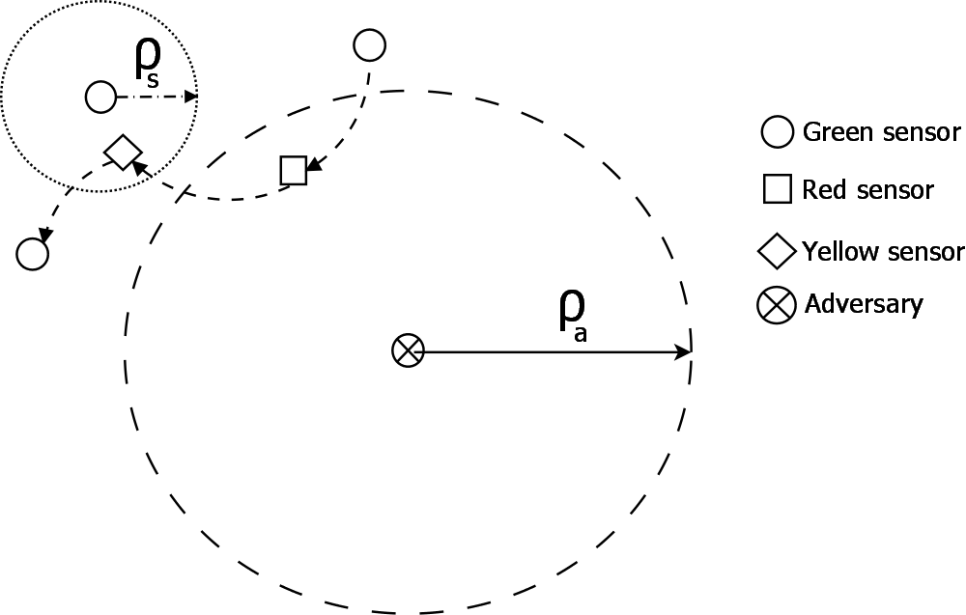
Securing Mobile Unattended WSNs(Cont.)
As shown below , when a green sensor enters into the range of a adversary ,it gets compromised and becomes a Red sensor .
Since the sensors are mobile , when a Red sensors moves out of the range of adversary in the next round, it becomes Yellow and an Yellow sensor with the help of a Green sensor can turn into a Green sensor.
Picture from (4)

Slide 24
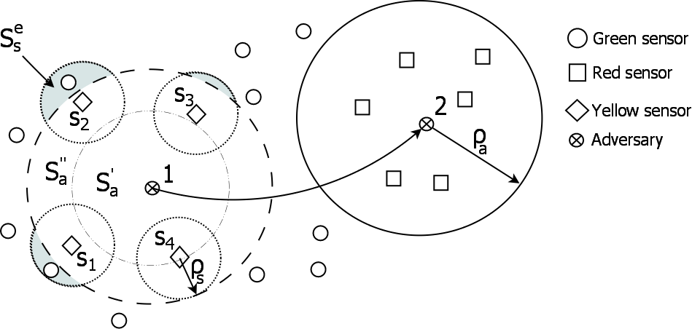
Securing Mobile Unattended WSNs(Cont.)
Static sensors provide worst healing ratio if the same protocol is used.
S1,s2,s3 and s4 becomes yellow after adversary moves from position 1 to 2, s1 and s2 heal they both have a green neighbor, s3 and s4 does not heal as it has no green neighbor
Picture from (4)

Slide 25
Secure Routing
Multipath Routing: In a network where there are only small number of compromised nodes multipath routing schemes provide more reliable routing but communication overhead is more
Reputation Based Schemes: This scheme requires neighbor nodes cooperation to control credit ,reputation. Main idea is that next hop in the routing is chosen based on link reliability and node reputation
Broadcast Authentication: uTesla ,broadcast authentication protocol divides time into intervals of equal duration and assigns each time slot a corresponding key.
Secure Routing Defense Against Attacks: PRSA (path redundancy based secure algorithm) uses alternate routing paths for each data transmission call to overcome the sensor network attack.

Slide 26
Key Management
1.Key Pre-Distribution Schemes:
Sensor nodes store some initial keys before deployment which are used to setup secure communication after deployment. This method is used in networks that have limited resources.
Probability Schemes: Randomly preload each node with a
subset of keys from a global key pool before deployment
such that there exists one or more common keys
between intermediate nodes
Deterministic Schemes: Any two intermediate nodes share one
or more pre distribution keys. The sharing of keys is done
during the interval secure time

Slide 27
Key Management(Cont.)
2.Hybrid Cryptography Schemes: An hybrid cryptographic
scheme uses public key computations in the base station
side and symmetric key computation in the sensor side
3.Key Management In hierarchy Networks: Key Distribution
Center(KDC) maintains a key tree that will be used for
key updates and distribution ,every sensor only store its
keys on its key path that is from the leaf node up to the
root.

Slide 28

Cryptography
Asymmetric key encryption are too expensive in terms of computation and energy cost
Symmetric key encryption is better in terms of speed and low energy cost but it is difficult to deploy and manage
Rijndael is suitable cipher when considering security and energy efficiency and MISTY1is good considering storage and energy efficiency
Among asymmetric key encryption techniques SKIPJACK is reasonable and Diffie-Hellman is respectable

Slide 29
Conclusion
Cryptography Selection is fundamental to provide good security services, most approaches adopt symmetric key cryptography by introducing complex key management techniques
Although more secure schemes are available to limit the effects of attacks ,attack detections are still needed .
There are some secure routing protocols for ad-hoc networks but figuring out how to use them in sensor networks still need some work.
Most secure routing protocols assume that sensors are stationary and it is highly needed to study secure routing protocols for mobile WSNs.
Most security mechanisms assume that the base station is secure and robust however ,in some environments base station may be easily attacked

Slide 30
References
1.Xiangqian Chen, Kia Makki, Kang Yen, and Niki Pissinou: “Sensor Network Security: A Survey, ” IEEE COMMUNICATIONS SURVEYS & TUTORIALS, VOL. 11, NO. 2, SECOND QUARTER 2009
2.Al-Sakib Khan Pathan , Hyung-Woo Lee, Choong Seon Hong : “Security in Wireless Sensor Networks: Issues and Challenges,” Advanced Communication Technology 2006,ICACT 2006. The 8th International Conference
3.Roberto Di Pietro, Nino Vincenzo Verde :“Epidemic Data Survivability in Unattended Wireless Sensor Networks,” Proceedings of the fourth ACM conference on Wireless network security ,2011
4.Roberto Di Pietro , Gabriele Oligeri , Claudio Soriente , Gene Tsudik: “Securing Mobile Unattended WSNs against a Mobile Adversary,” 2010 29th IEEE International Symposium on Reliable Distributed Systems
5.Mauro Conti, Roberto Di Pietro, Luigi V. Mancini, and Alessandro Mei: ” Distributed Detection of Clone Attacks in Wireless Sensor Networks,” IEEE TRANSACTIONS ON DEPEDABLE AND SECURE COMPUTING ,2010

Slide 31

Questions?

Slide 32
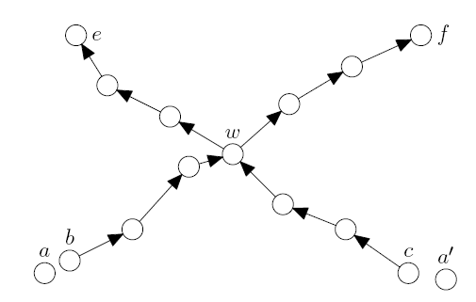
Question 1
What are the overheads caused by Line-Selected Multicast (LSM) protocol for detecting clone attacks and how are they eliminated using Randomized ,Efficient and Distributed (RED) protocol.
Figure from 5

Slide 33
Question 1(Cont.)
Ans:
Overheads caused by LSM:
1.Memory Overhead-claim messages should be saved
in all the intermediate nodes on the route to
the destination.
2.Computation Overhead-Signature verification
should be done at all the intermediate nodes
RED:
1.RED doesn’t have a memory overhead as the claim
messages will be saved only at the destination.
2.In RED signature verification is done by the neighbors
and the destination nodes only .

Slide 34
Question 2
Assume that the sensors in the network are all static and adversary is mobile. Adversary is in position p1 at round r-1 and jumps to position p2 at round r. All the sensors that were red at round r-1 become yellow at round r .
Green: Either has never compromised or compromised and regained security
Red: Currently compromised sensors that is located with in the range of the adversary
Yellow: Sensors that has been compromised and has moved out of the range of the adversary.
Which type of sensors have worst healing ratio ,static or mobile? and why?
In the following network which nodes can heal?

Slide 35
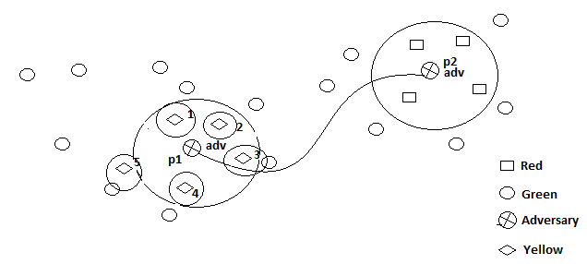
Question 2 (Cont.)
Ans. Static sensors have the worst healing effect .If the sensors are mobile ,they jump in each round so that the probability that they can meet a green sensor is high but in static sensor ,once a sensor is compromised, it cannot be healed if there is no green sensor in its range.
Nodes 1,2,3,4 and 5 gets compromised and nodes 3 and 5 can heal as they have a green neighbor.

Slide 36
Question 3
What are the security constraints in a WSN and why do we need separate security mechanisms for sensor networks?
Ans:
Constraints:
1.Low Transmission Power
2.Limited Memory
3.Limited Battery Life Time
4.Slow Computations
Need for a Separate Security Mechanism
1.Various Limitations
2.Threats are different from ad-hoc networks
3.Harsh Deployment Environments
4.Number of nodes are very high

Slide 37
THANK YOU
Email:svepa045@uottawa.ca

