Slide 1

ROUTING IN VANETs
SAMEERA SIDDIQUI
PhD STUDENT
UNIVERSITY OF OTTAWA

Slide 2
Outline
Introduction
Problems in Routing Procedures
Classification Of Routing Protocols
Taxonomy of Previous Literature
Objective of the Project
FROMR----Path Recovery Protocol (2010)
PCR------Optimal Hop Selection (2010)
XORi-----Optimal Hop Selection (2011)
Mobicast—Optimal Hop Selection (2010)
Conclusions and Observations
References
Questions

Slide 3
Introduction
VANETs : They are distributed, self-organized communication networks formed by vehicles.
Why need routing for VANETs ? : High Mobility and frequent network disconnection and merging.
Application Areas:
  Traffic Safety
  Traffic Management Solutions
  Comfort and Entertainment application (Delay Tolerant Applications)

Slide 4
Problems in Routing Procedures
WHICH NODE TO SEND DATA TO? : Optimal Hop Selection For Message Forwarding
WHAT TO DO WHEN A CHOSEN LINK BREAKS DOWN? : Fast Link Recovery

Slide 5
Classification of Routing Protocols
Routing protocols are classified based on:
  Topology based or Position (geographical) based
  Beacon or Non- Beacon
  Multipath or Single Path
  1D or 2D
  Highways or City Roads
  Large Scale Routing or Small Scale Routing
  Localized or Generalized

Slide 6
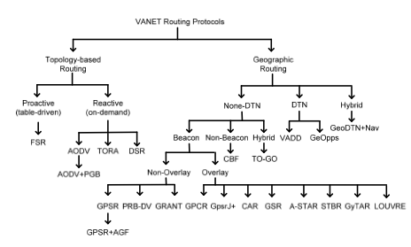
Taxonomy of Previous Literature

Slide 7
Objective of the Project
To Present A Survey of Recently Reported Routing Protocols with emphasis on the two problem areas :
  Optimal Hop Selection &
  Link Recovery
Following protocols are chosen for the Presentation:
Protocol | Problem Area | Classification
FROMR | Link Recovery | Multipath, Localized, 1D, Beacons
PCR | Optimal Hop Selection | Generalized, City Roads, Beacons,2D
XORi | Optimal Hop Selection | Single path, Localized, 1D, Beacon
Mobicast | Optimal Hop Selection | Single path, Carriers, 1D, Beaconless

Slide 8
FROMR: Fast Recovery On-Demand Multipath Routing Protocol
CHARACTERISTICS:
  Multipath routing based Fast Recovery Protocol
  Concentrates on rapidly building alternate path when the original path is broken
  FROMR Extends AODV which is a single path algorithm to find multiple paths
Assumptions:
  GPS
  Periodic beacons
  Grid Leaders

Slide 9
FROMR : Fast Recovery Protocol
Four Main Parts:
  Route Discovery
  Route Selection
  Route Recovery
  Grid Leader Selection

Slide 10
FROMR : Fast Recovery Protocol
Route Discovery:
  Source initiates by sending RREQ
  Vehicle receives RREQ :
    Creates or Updates the route to previous hop
    Rebroadcast RREQ to neighbouring nodes
  When receives another copy of same RREQ:
    Record in table to form alternate reverse path
    Do not forward the RREQ again.
  When the destination vehicle receives several RREQ from different hops, it generates reply message RREP to each request and sends by unicasting.
  Finally, the RREP reach the source and we have multiple paths between the source and destination.

Slide 11
FROMR: Fast Recovery Protocol
RREQ
RREP

Slide 12
FROMR : Fast Recovery Protocol
Route Selection:
  Best next hop : shortest arrival time of RREPs.
Route Recovery: Vehicle Identifies Broken Link
Deletes all corresponding links from the routing table
If the deletion causes a path breakage -> missing next hop is only downstream node for a path to destination.
Send RERR to upstream node.

Slide 13
FROMR : Path Recovery Protocol
Vehicle gets RERR: Checks Alternate Path Available
YES
Alternate Path Applied ; RERR discarded
NO
Reforwards RERR to reverse path

Slide 14
FROMR : Example
Consider Path S-B-A-F-E-D
E-D broken
Error Message RERR sent E-> B & F, F->A, A->B
Alternate Path S-B-C-D
F
RERR
A
S
RERR
RERR
RERR
E
B
D
C

Slide 15
FROMR : Fast Recovery Protocol
Grid Leader Selection:
“Who is the Leader?”
Reply within predetermined Time
Joins the Group as a Normal Vehicle
No Reply within predetermined Time
I am the Leader

Slide 16
FROMR : Fast Recovery Protocol
When a Grid Leader discovers itself is going to leave the grid ; passes on the leadership to the vehicle closest to the center of the grid by unicasting the message to the vehicle.
You are the leader now!!!

Slide 17
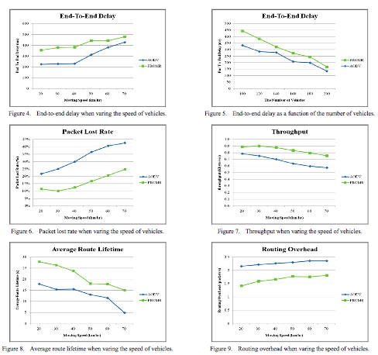
FROMR : Simulation Results
Compared:
  End to End Delay
  Packet Loss Rate
  Throughput
  Average Lifetime
  Routing Overhead
Delay is more as
only GL forwards
the packet

Slide 18
PCR : Position and Connectivity Based Routing
CHARACTERISTICS:
  PCR selects route with optimal connectivity to improve packet delivery rate
  Predict and Overpass is used to reduce average hop count and hence average delay
Assumptions:
  GPS
  Vehicles communicate within LOS

Slide 19
PCR : Optimal Hop Selection
PCR
Greedy Forwarding
Perimeter Forwarding

Slide 20
PCR : Optimal Hop Selection
Greedy Forwarding :
  “ Junction Nodes First”
  If a vehicle on intersection ; Forward directly to it
  No Junction Nodes; Forwards to the node closest to destination
  Junction node after receiving data chooses which road segment to forward data to and then send the data to the node closest to the destination on that road segment

Slide 21
PCR : Optimal Hop Selection
Predict and Overpass:
  If The Destination Is In Neighbourhood; Forwards Directly
  Otherwise Check The Neighbour List.

Slide 22
PCR : Optimal Hop Selection
Predict and Overpass
Junction Node -> predict the road segment its going to forward data to; if it’s the extension of current road segment; forward data itself saving one hop ; otherwise forwards it to junction node.
No Juction Nodes: Forward According To Greedy
No Neighbour closest to Destination Than Itself ; Enters Perimter Mode

Slide 23
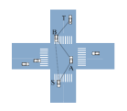

PCR : Optimal Hop Selection

Slide 24
PCR: Optimal Hop Selection
Perimeter Mode:
  Only Junction Nodes switches to Perimeter Mode
  Ordinary Nodes forwards data on the same road segment
  Perimeter Forwarding is done by Right Hand Rule.
  Still Use Predict and Overpass with only difference that prediction is done by Right Hand Rule.
  Junction Nodes keep checking the distance from the destination mode and switches back to Greedy when distance requirement is fulfilled.

Slide 25
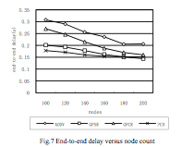
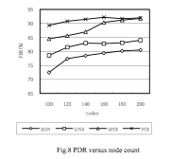
PCR : Simulation Results
Compared:
  Against multiple protocols
  End to End Delay and
  Packet Delivery Rate is compared
  Performance decrements with
  increase in number of nodes

Slide 26
XORi: Optimal Hop Selection
CHARACTERISTICS:
  Presents a XOR-based routing protocol for VANETs first time in literature.
  Similar to Topology based protocols
  Routing mechanism is blinded in the sense that it only uses the information related to the identifiers of the nodes, independent of any other metric.
Assumption:
  Applicable in high mobility conditions: VANETs on highway

Slide 27
XORi: Optimal Hop Selection
Assigns n-bit identifier to each node.
Routing principle :
  Calculate the distance a b
  Store in a routing table based on identifiers
  Forward to the node such that the distance between the current and destination node is minimized.
To Summarize; two conditions should be met:
  Forward to the node that minimizes:
    R= argmin {d (y,z)} --------(1)
  Store the neighbour b in bucket β_{n-1-I} given by the highest i that satisfies:
    d(a,b) div 2^{i} =1, 0<i<n-1---(2)

Slide 28
XORi : Optimal Hop Selection
Constructing the Table:
  Consider n=4, a=1001, b=1010 ;the distance d(a,b) =0011 and i= 1 ; β = 2
Routing Table Of the Node 1001 using n=4 bits
β₀ | β₁ | β₂ | β₃
0000 | 1100 | 1010 | 1000
0010 | 1101
0100

Slide 29
XORi: Optimal Hop Selection
Discovering Process
Active Search: Send Query To Physical Neighbours
Passive Search: Send Query about Neighbours of Neighbours

Slide 30
XORi: Optimal Hop Selection
Node sends queries only to BGL.
Node send queries to all nodes if no BGL has been chosen yet.
BGL Selection Rules:
  When N is unstable ; it doesn’t select a BGL (stability is defined as exchange of beacon messages between nodes for a predefined time)
  When none of N’s neighbour have a BGL, N selects that node as BGL which is closest to it and has biggest stability value.
  N selects itself as BGL when it is selected as BGL by another node
  If there is an immediate neighbour which is already a BGL ; N also joins the group.

Slide 31



XORi Simulation Results
Packet Delivery Ratio
End-to-End Delay
Average Path Length
Compared:
  Against XOR, OLSR, AODV & DSR
  Performance is comparable to
  AODV, DSR outperforms XOR in
  most cases but OLSR outshines
  XORi in most cases.

Slide 32
Mobicast: Optimal Hop Selection
CHARACTERISTICS:
  Carry and Forward technique is implemented
  All vehicles located in a geographic zone created with the message initiation must get the message in a specific time duration
  Although a Geo-Casting based protocol is reviewed as claimed to be a routing based protocol.
Assumptions:
  GPS
  Highway scenario
  Applicable to comfort applications only

Slide 33
Mobicast: Optimal Hop Selection
Important Definitions:
  V_{e} : Event Vehicle -> which initiates the message
  m_{t} : Mobicast message
  ZOR (Zone of Relevance) : Given an event vehicle V_{e} and a constrained delay time λ, ZOR_{t} is a static elliptical region determined by V_{e} at time t, such that any vehicle V_{j} present in the zone at the time of message initiation must successfully receive the message m_{t} from V_{e} before time t+λ
  ZOF (Zone of Forwarding): Given a V_{e}, ZOF_{t+i} is a geographical region determined at each time t+i, where i=0, 1,….i such that each vehicle V_{j} has the responsibility of carrying and forwarding the mobicast message m_{t}, where V_{j} is located in the ZOF_{t+i.} ZOF is divided into front and rear subzones according to the position of V_{e}

Slide 34
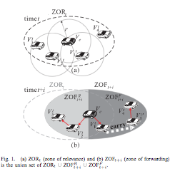
Mobicast : Optimal Hop Selection

Slide 35
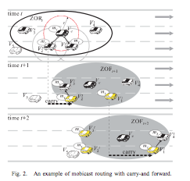
Mobicast : Optimal Hop Selection

Slide 36
Mobicast: Optimal Hop Selection
m_{t Delivery Techniques}
Multi-hop Forwarding
Carry –And-Forward

Slide 37
Mobicast: Optimal Hop Selection
Multicast Routing Protocol
ZOR_{t} Creation Phase
ZOF_{t+i} Estimation Phase
Message Dissemination Phase

Slide 38
Mobicast: Optimal Hop Selection
ZOR_{t} Creation Phase:
  V_{e} announces ZOR_{t} which is determined by requirement of comfort application and width of lane.
  Velocity of V_{e} is recorded and applied to define the borders of ZOF_{t+I}
  V_{e} broadcast the mobicast control packet P_{m} with all the necessary header information.
  The ZOF_{t+i} estimation phase is executed next.

Slide 39
Mobicast: Optimal Hop Selection
ZOF_{t+i} Estimation Phase:
  To know the necessary of receiving m_{t}, V_{j} checks whether it has appeared in ZOR_{t} at time t if V_{j} receives a packet P_{m}
  V_{j} compares its location with V_{e} to know if it is located in either ZOF^{R}_{t+i} or ZOF^{F}_{t+i} because ZOF_{t+i} is split by V_{e}’s location
  ZOF^{R}_{t+i} is created to deliver m_{t} to all the vehicles behind V_{e} at each time t+i by estimating velocities.
  ZOF^{F}_{t+i} is created to deliver m_{t} to all the vehicles in front of V_{e} at each time t+i by estimating velocities.
  Protocol proceeds to message dissemination phase.

Slide 40
Mobicast : Optimal Hop Selection
Message Dissemination Phase:
  Message is delivered using multihop technique if the vehicle is in immediate neighborhood :ZOR_{t}+ZOF^{F}_{t+i} or ZOR_{t}+ ZOF^{R}_{t+I}
  Message is delivered using carry and forward if the vehicle is in far neighborhood: ZOR_{t} but outside ZOF^{R}_{t+i} or in ZOF^{F}_{t+i} but outside ZOR_{t}
  Message is dropped if vehicle is outside ZOF_{t+i}

Slide 41
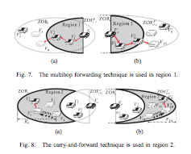
Mobicast: Optimal Hop Selection

Slide 42
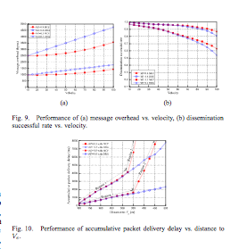
Mobicast : Simulation Results
Message Overhead
Dissemination
Success Rate
Accumulative Packet
Delivery Delay
Compared to DRG:
In general, an improved
performance is observed
due to the fact that both
Multihop and CF are used.

Slide 43
Conclusions
FROMR:
  Compared only against AODV not any other multipath protocol
  Grid Leader Switching Procedure is not clearly defined
  Route Discovery Procedures can be improved by including vehicle moving parameters to the route selection.
PCR:
  Gives better result when node density is lower but gets worse when node density increases.

Slide 44
Conclusion
XORi :
  Seems complicated to implement as might require additional hardware.
  Overcome the limitations of most protocols that store information and active routes or about every addressable node in the network.
Mobicast :
  Can only be used in comfort applications
  Implementation should be very specific as any deviation might result in protocol’s failure.

Slide 45
Observations
It was observed that:
  In general, most of recent work uses greedy forwarding techniques
  Localized control through Clusters was also quite evident
  Carry-Store- and Forward protocols have also been reported in literature but all CSF and CF techniques suffers from delay and hence are not suitable for implementable in delay sensitive scenarios.

Slide 46
Concisely
Project successfully accomplishes a comprehensive study of routing protocols in VANETs for the problem areas identified as:
  Optimal Hop Selection and
  Fast Recovery of Broken Link

Slide 47
References
Cheng-Shiun Wu; Shuo-Cheng Hu; Chih-Shun Hsu; “ Design of Fast restoration multipath routing in VANETs “,IEEE –International Computer Symposium ( ICS), pp 73-78, 2010.
Lin Lei; Xiao Xiaoqiang; Xu Ming; Wei Liqi; “ PCR-a Postion-and-Connectivity-Based Routing Protocol for VANETs”, 7th International Conference on Ubiquitous Intelligence & Computing and 7th International Conference on Autonomic & Trusted Computing (UIC/ATC),pp.469-473, 2010.
Yuh-Shyan Chen; Yun-Wei Lin; Sing-Ling Lee; “ A mobicast routing protocol with carry-and –forward in vehicular ad-hoc networks”, 5th International ICST Conference on Communications and Networking in China (CHINACOM), pp 1-5 , 2010.
Oliveira, R.; Garridot, A.; Pasquini, R.; Liu, M.; Bernardo, L.; Dinis, R.; Pinto, P.; “ Towards the use of XOR-Based Routing Protocols in Vehicular Ad Hoc Networks “ , IEEE 73rd Vehicular Technology Conference (VTC Spring) pp 1-6, 2011.
Kevin C. Lee, Uichin Lee, Mario Gerla, “ Survey of Routing Protocols in Vehicular AdHoc Netorks”, www.cs.ucla.edu/~kclee/RoutingBookChapterKLULMario.pdf
Ivan Stojmenovic, Yousef-Awwad Daraghmi, Chen-Wei Yi, “ A Taxonomy Of Data Communication Protocols For Vehicular Ad Hoc Networks “ provided by Professor.

Slide 48
Questions

Slide 49
OK Then Questions!!

Slide 50
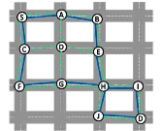
Proposed Question # 1
FROMR is the path recovery protocol which form
multiple links between the nodes and is indicated
by green dashed lines whereas blue lines indicate
another single path protocol. Consider the path
S-A-B-E-H-I-D. In case link (E-H) is broken,
Compare the way both FROMR and single path
protocol would behave?
What is the alternate path formed b/w S & D using
FROMR?
Both will issue error message RERR at node E. For the single path this message traverse back all the way to S before an alternate path can be found. In case of FROMR, the RERR message issued at E will be routed to D and B. D would found an alternate path through G and discard the error message. B would bounce it reverse to A which would forward it to alternate node D.
Hence the new path S-A-D-G-H-I-D is readily established using FROMR.

Slide 51
Proposed Question # 2
XORi protocol assigns a
unique binary identifier to
each car depending on N which
is number of bits. It then
computes the routing table by
performing XOR on each car
with reference to every other
Car. Using XORi, Compute the
routing table of A using
identifiers at Time t, t+1, t+2
A=100
110
001
101
010
Time | β₀ | β₁ | β₂
t | 001 | 110
t+1 | 010 |  | 101
t+2 | 011 | 111
111
011

Slide 52
Proposed Question# 3
Mobicast is the routing protocol that works on
carry and forward technique. In the picture, the
relationship between ZOR and ZOF is given.
Explain with reference to change in time and the
procedure of data delivery in each time frame.
ZOR is a static region and ZOF is constantly
moving with V_{e} so with time the width of region 1
is decreasing . The data would be delivered using
multihop as long as vehicle is in Region 1 and
switches to Carry and Forward as it exits region 1.
Region1
ZOR_{t}
ZOF^{F}
ZOF^{R}
Region 1
ZOR_{t}
ZOF^{R}
ZOF^{F}
ZOR_{t}
Region 1
ZOF^{R} ZOF^{F}
t+1 t+2 t+4

