Slide 1
Multi Retransmission Route Discovery Schemes for Adhoc Wireless Networks.
By Okundaye Izegbuwa Alice (100846820)
Carleton University
iokunday@connect.carleton.ca

Slide 2
Contents
Introduction
Brief History
Problem with Conventional methods
Proposed Solution
Algorithms
Analysis of algorithms using predefined options
Results and Conclusion
Future Work
References
Questions.

Slide 3
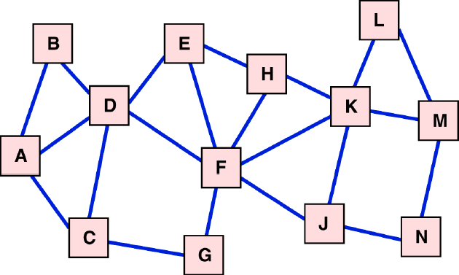
Introduction
An Adhoc network is a collection of nodes which communicate and do not need any preconfigured communication infrastructure.
Route discovery in Adhoc network is a process of creating a route from the source to a destination.
It usually involves a Route request RREQ and a Route reply RREP packet being sent between source and destination to select a configured route.
How can I send a message to node M?

Slide 4
Brief History
AODV and DSR are the most predominantly used reactive routing protocols for ad-hoc networks.
- They shall be used for the purpose of this analysis.
All existing Route Discovery Schemes apply retransmission of Route Requests and Route replies only once.

Slide 5
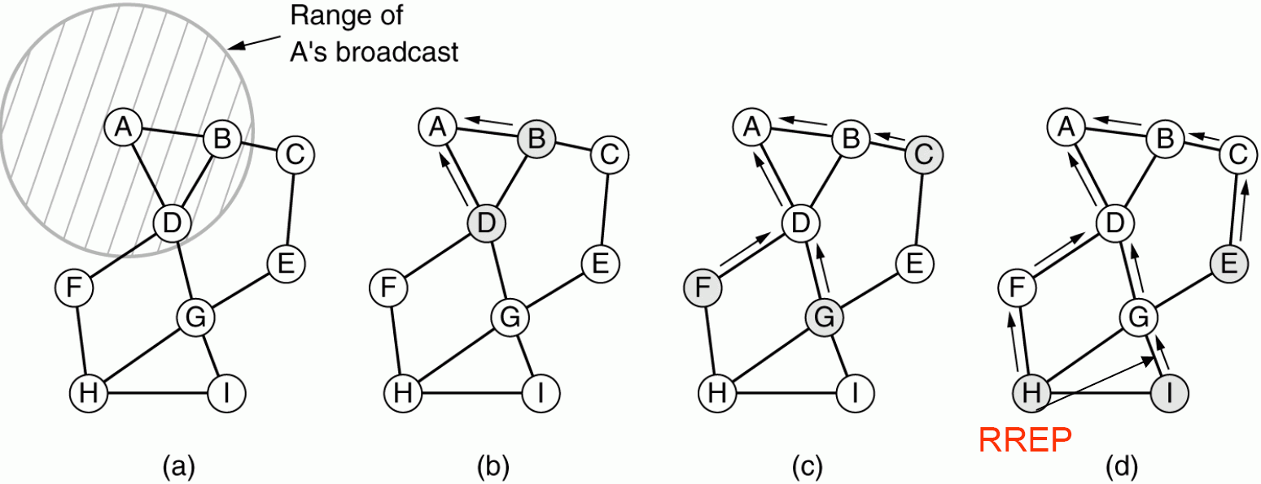
AODV
Diagram from [NB]
Path from Source A – Destination I, A broadcasts the RREQ
When its neighbor that is not the intended destination re-broadcasts a
RREQ, it sets up a reverse path pointing towards the source.
When the intended destination receives a Route Request, it replies by
sending a Route Reply RREP.
Route Reply travels along the reverse path set-up when RREQ
was forwarded.

Slide 6
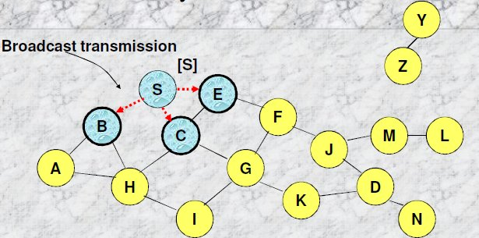
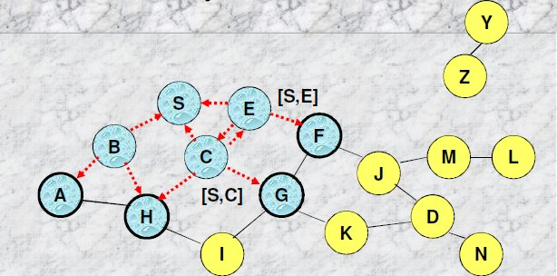
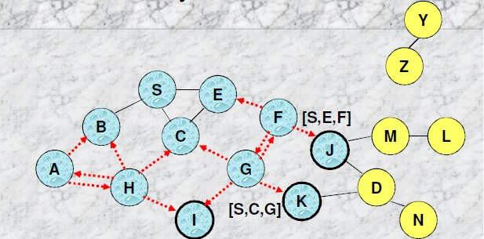
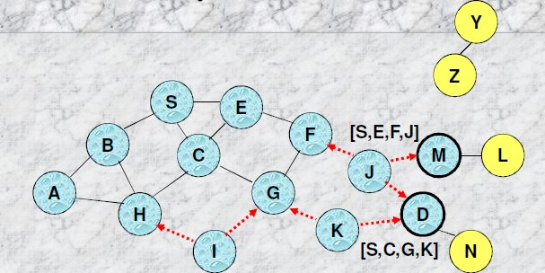
DSR
Diagram from [TK]
Route Discovery from Node S to D, Source node S floods(RREQ)
Each node appends own identifier when forwarding RREQ
Destination D on receiving the first RREQ, sends a RREP
RREP is sent on a route obtained by reversing the route appended to received RREQ
RREP includes the route from S to D on which RREQ was received by node D

Slide 7
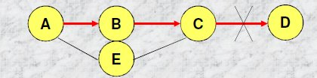
Problem with conventional method
A distant neighbor may accidentally receive the only route discovery message and happily use it to announce a new route, even though in reality it cannot provide service for traffic.
Retransmitting once means than a neighbor with the best path to the destination might be missed, hence finding the optimal route is not guaranteed.
Diagram from [TK]

Slide 8
Proposed Solution
To effectively overcome the issues stated, a proposed solution will be to retransmit the RREQ and RREP more than once.
This will most likely find better routes, and may find distant neighbors, thus increasing the success rate of route discovery
Two different Algorithms for RREQ have been proposed and will be compared with the conventional route discovery scheme using the same metrics and conditions.

Slide 9
Algorithms
n- Retransmission (nR)
Once a node decides to transmit a RREQ, it will do so exactly “n” times.
When n = 1
this becomes equivalent to the traditional route discovery schemes. We shall call this “1R”
n- Retransmission c- Reception(ncRR)
When a node discovers that it is not the destination, it retransmits the Route request to its neighbors “n” times or till its number of received copies of the RREQ reaches “c” (c ≥ 2).
Introducing the variable “c” helps control overhead, as nodes can stop retransmitting as soon as “c” number of RReq are heard .

Slide 10
example
In the case of “12RR”, Node will make one retransmission, or will make no retransmission at all, if while waiting for its own retransmission to occur it receives two copies of RREQ from neighbors.
For n3RR,
node will retransmit at most n times, until two or more copies of the same RREQ are received from neighbors.
When c>>>>>>>
ncRR ≡ nR

Slide 11
The previous algorithms can be further combined with options based on route discovery and route reply decisions.
Route Discovery Options.
R1: The sender retransmits only upon receiving the first copy of received RREQ. When a route discovery message is received again, it is simply ignored.
[1R, R1] is equivalent to the traditional terms of handling RREQ.
R+: If a node receives a route request with a better cumulative cost upon arrival, it will retransmit once again.
In R+ the same node may decide to send RREQ upon receiving any route with better cost.

Slide 12
If we have [1R, R+]
then one retransmission is sent each time
If we have [nR, R+]
then n retransmissions are made each time a better route is found to the same destination.
In nR and ncRR if the current best route has not finished retransmitting “n” times and a route with a better cost is found then the counter “n” restarts with R+.
Combining the options, we can define new algorithms
[nR, R1] = nR1
[nR, R+] = nR+
[ncRR, R1] = ncRR1
[ncRR, R+] = ncRR+

Slide 13
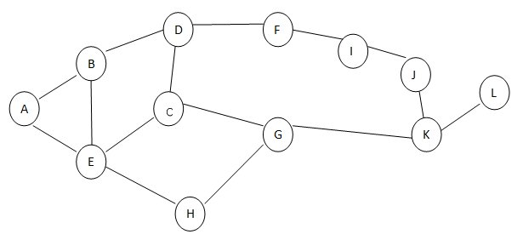

nR+ Diagram

Slide 14
Route Reply Options
The destination node might receive multiple copies of the same RREQ bearing different path information.
In conventional route discovery schemes a destination node responds to every route request packet received.
This may cause more overhead
The two options are then as follows:
B*: The destination node replies all received RREQs with RREP
B+: The destination nodes replies back the first time and any time the measured value of path metric is better than previously received ones.

Slide 15
An RREP packet is sent back to the source node using the reverse path of the RREQ
There are three options for the way a RREP is processed by nodes on the reply path.
A1: Each node transmits the RREP exactly once, if any failure happens, process is stopped
A3: Each node transmits the RREP once, if no transmission is heard from its neighbor, it retransmits two more times.

Slide 16
Analysis of algorithms using the predefined options
Goal: To prove that nR and ncRR are superior to 1R, using the different predetermined options.
Metrics used for the observations include
Average EHC( expected hop count) which is the expected hop count to send an actual message over the link.
Success Rate
Message Overhead during Route discovery
The simulation was run in MATLAB using 200nodes and the average node degree d is tested for d = 6,8,10,16,20,24,32,40, which simulate a network from sparse to dense.

Slide 17
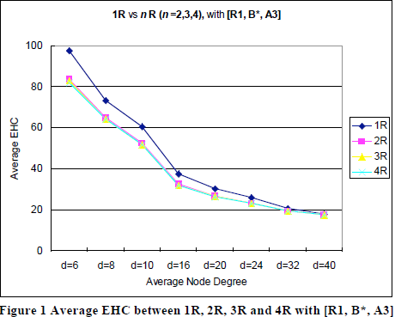
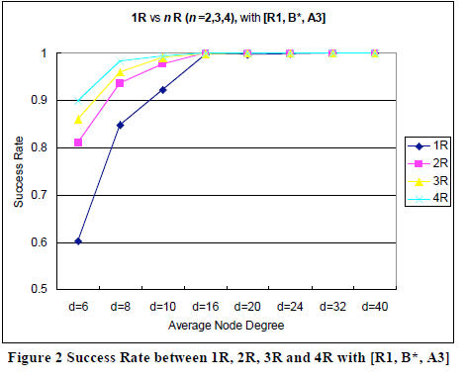
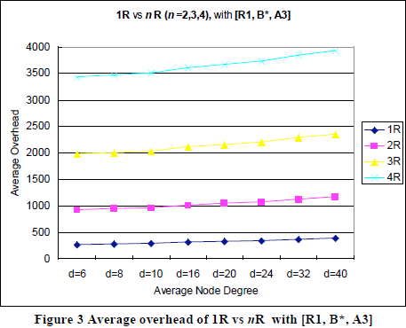
First analysis will be to get the best value for “n” we will compare 1R and nR for when n= 2, 3, 4.
Using options R1, B* and A3.

Slide 18
Figure 1 shows that the average EHC decreases as the average network degree “d” increases, smaller EHC means a better route.
We see that transmitting the packets more than twice does not lower EHC any further.
In Figure 2, Success rate is improved by up to 58% in low density networks in high density networks transmitting more than once does not help.
In Figure 3 The message overhead rises significantly with the increase of n or d.
The best value of “n” in nR appears to be 2, however the message overhead is almost tripled compared to n1, ncRR is simulated using n=2 to see if the overhead is decreased.

Slide 19
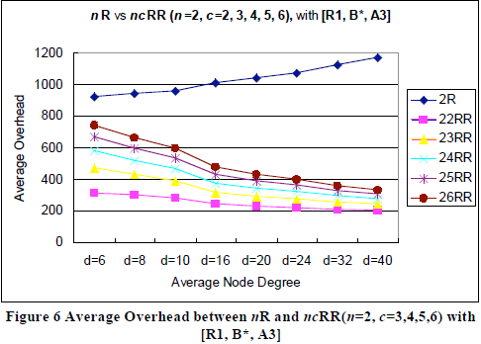
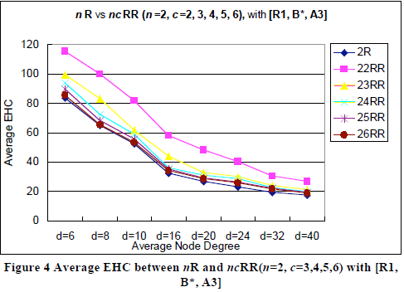
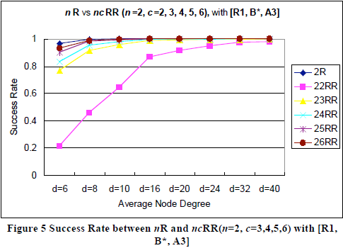
Secondly we compare nR and ncRR using n = 2 and
c = (3,4,5,6) with options R1, B* and A3.

Slide 20
Figure 4 and 5 shows that the average EHC is slightly lower in 2R than in 2cRR especially in low density networks, however from c≥3 and d≥16 the EHC and success rate become the same.
Figure 6 shows that overhead is greatly reduced by 19.6% ~ 79.2% depending on the network density.
This is a great improvement from the 2R algorithm
Overall the ncRR scheme has the best trade off between quality of route, success rate and message overhead when n = 2 and c = 3 or 4

Slide 21
The options R1 and R+ are compared and R+ is found to have a better EHC lowered by 7.6% to 18.1%, and also a better success rate rising from 2.6% to 19.6% in low density networks .
The options B* and B+ are also simulated against each other and B*is found to be more effective as it yields a higher success rate even though their EHC appear to be equal.
The option A1 and A3 are also compared, A1 slightly raises the average EHC compared to A3.

Slide 22
Results and Conclusion
ncRR is seen to find better routes than nR and 1R, when n = 2 and c =4
Using Options R+, B* and A3 provided optimal Route discovery and improved the average EHC with about 0.9%~31% and raised success rate with about 58%.
The proposed route discovery scheme is superior to the existing ones.

Slide 23
Future Work
It is possible to have a counter based retransmission based on only a single parameter.
In nCB, node is retransmitting RREQ until a total number of n own or retransmission from neighbors is heard.
1CB means no retransmission at all, since one cop of the message was already received.
2CB mode will make one retransmission or no retransmission if while waiting to retransmit it receives a copy of the RREQ from a neighbor.
The implication of this is left for Future work.

Slide 24
References
[JSK] X. Jin, Stojmenovic I., T. Kunz, “Multi-retransmission router discovery schemes for ad hoc wireless networks with a realistic physical layer” 2009.
[SNK] I. Stojmenovic, A. Nayak, and J. Kuruvila. Design guidelines for routing protcols in ad ´hoc and sensor networks with a realistic physical layer. IEEE Communications Magazine, March 2005
[NB] Niels Olof Bouvin, Mobile P2P Systems & Recap (Based in part on a talk by Lars Michael Kristensen)11November 2005
[TK] Thomas Kunz, Adhoc Networks, SCE Carleton University January 2011.

Slide 25
Question1
What is the stated problem with the conventional route discovery method?
What was the solution proposed for this problem?
What goal did the proposed solution achieve?

Slide 26
Answer 1
(a) The convention route discovery method using the process of retransmitting the RREQ and RREP messages only once during route discovery, an implication of this is that , a distant neighbor may accidentally receive the only route discovery message and happily use it to announce a new route, even though in reality it cannot provide service for traffic and also retransmitting once means than a neighbor with the best path to the destination might be missed, hence finding the optimal route is not guaranteed.
The proposed solution is to retransmit the route request and route reply messages more than once.
Retransmitting more than once produced an increase success rate in optimal routes discovery with less overhead.

Slide 27
Question2
Explain the ncRR Algorithm

Slide 28
Answer 2
ncRR stands for n- Retransmission Reception, it is the second Algorithm proposed in the multiple retransmission route discovery scheme, it introduces a counter “c”
When a node discovers that it is not the destination, it retransmits the Route request to its neighbors “n” times or till its number of received copies of the RREQ reaches “c” (c ≥ 2).
Introducing the variable “c” helps control overhead, as nodes can stop retransmitting as soon as “c” number of RReq are heard from their 1-hop neighbors.

Slide 29
Question3
State the difference between the following Route Discovery and Route Reply Options
R1 and R+
B* and B+
A1 and A3

Slide 30
Answer3
R1 and R+ :
In R1, The sender retransmits only upon receiving the first copy of received RREQ. When a route discovery message is received again, it is simply ignored. While in R+ , if the same node receives a route request with a better cumulative cost upon arrival, it will retransmit once again.
B* and B+ :
In B*, The destination node replies all received RREQs with RREP, while in B+: The destination nodes replies back the first time and any other time the measured value of path metric is better than previously received ones.
A1 and A3 :
In A1, each node on the reply path transmits the RREP exactly once, if any failure happens the process is stopped, while in A3, Each node transmits the RREP once, if no transmission is heard from its neighbor, it retransmits two more times.

Slide 31
THANKYOU FOR LISTENING.

