Slide 1
Middleware for Sensor networks
By
Salma Ahmed
Student No. 5836385

Slide 2
Outline
Introduction to Wireless Sensor networks
Applications of Wireless Sensor networks
Middleware for WSN
Middleware Challenges for WSN
Middleware Approaches for WSN
Comparison between Middleware Approaches
Mires- A Message oriented Middleware approach
Conclusion
References
Proposed questions

Slide 3
Introduction of Wireless Sensor Network
Wireless Sensor Network is a form of ad-hoc network consisting of large number of heterogeneous tiny sensors with communication, processing and storage capabilities to monitor physical or environmental conditions such as temperature, sound, vibration & pressure.

Slide 4
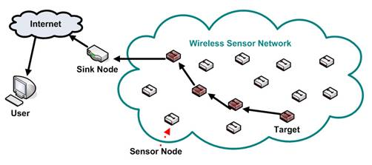
WSN architecture
A network is formed by hundred to thousand of sensor nodes.
Sensor nodes are responsible for collecting environmental information and sending it towards a sink node, which receives the information gathered by the network and delivers it to the end-user.

Slide 5
Applications of Wireless Sensor Networks
Area Monitoring
- Air pollution monitoring, greenhouse monitoring, landslide monitoring
Industrial monitoring
- Machine health monitoring
Military applications
- battlefield surveillance, target detection, biological & nuclear attack detection
Environmental Surveillance
- forest fire detection, flood detection
Medical monitoring
- drug administration, monitor human physiological data
Structural monitoring

Slide 6
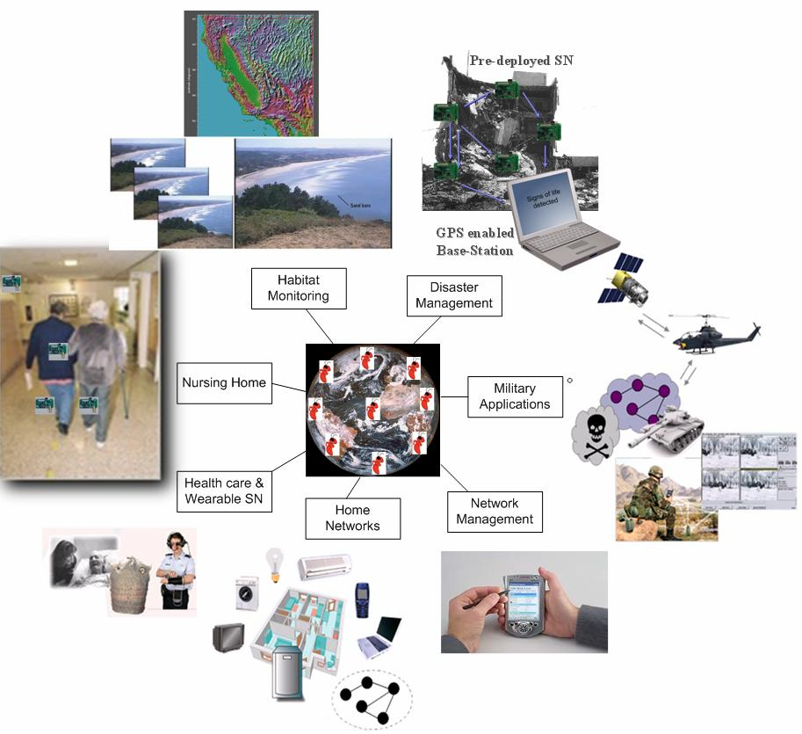

Slide 7
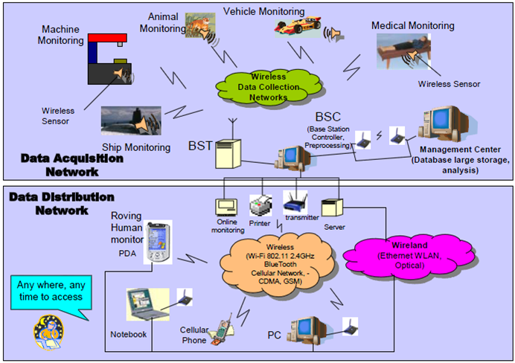

Slide 8
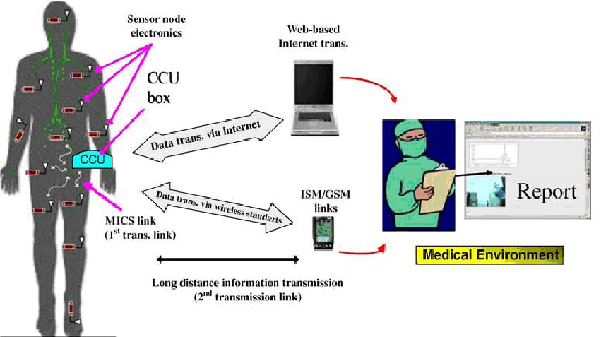
Medical Monitoring

Slide 9
Middleware for WSN
What is it?
It is a software infrastructure that glues together the networking hardware, operating system, network stacks and applications. It sits between the operating system and the application domain.
Purpose
Supports the development, maintenance, deployment and execution of sensing based applications.
Facilitates scalability, interoperability, deployment & development of applications.
Middleware Provides
Standardized system services to diverse applications.
A runtime environment that can support and coordinate multiple applications.
Mechanisms to achieve adaptive and efficient utilization of system resources.

Slide 10
Middleware Challenges for WSN
Challenges of middleware arises due to changing environments, wireless access & energy limitations.
Limited power and resources
- Due to the advent of microelectronics, miniaturized devices are increasing which possesses limited energy & memory (e.g. CPU & memory).
- Middleware should provide mechanisms for efficient processor & memory use while enabling lower-power communication and prolong sensor node lifetime(e.g. Cougar)
Heterogeneity
- Middleware should provide low-level programming models to bridge the gap between hardware technology’s raw potentials and necessary board activities such as reconfiguration, execution & communication.
- Middleware has to support system mechanisms interfacing various types of hardware & networks (e.g. TinyDB, Mires)

Slide 11
Scalability, mobility & dynamic network topology
- Middleware for sensor networks must be scalable enough in terms of no. of nodes, no. of users etc. to operate over long period of time.
- Middleware should maintain performance and robust operation while network changes dynamically.
Real world integration
- WSN applications are real time oriented where the environment is always changing including time and space.
- Middleware should provide real time services to adapt to the changes and provide consistent data.
Application knowledge
- WSN middleware have limited resource availability and therefore it cannot support variety of applications across the network.
- Middleware should integrate application knowledge into the services provided.
Adaptability
- Middleware for sensor networks must support algorithms that have adaptive performance.

Slide 12
Data centricity
- In WSN, the user application is not interested in the identity of the node but the data it produces. In a case where a set of nodes is deployed to produce the same kind of data, the application is not concerned which node of the set has supplied the data, but the data itself is the center of attention in data-centric networking.
- Middleware should support data-centricity by providing data-centric routing and querying within the network.
Configuration and Maintainability
- Sensor nodes are initially deployed for long periods of time, application might have to reconfigure them or assign them a new task.
- Hence middleware should be able to make simple and low-cost software updates and maintenance necessary to sensor nodes.
QoS Support
- WSN middleware should support various QoS features- response time, bandwidth allocation for ensuring reliability, detecting/reporting events, coverage and deployment, information and tracking accuracy.

Slide 13
Data Aggregation
- Network generates data redundancy which leads to communication cost being higher than computational cost.
- Middleware should be able to aggregate data to eliminate redundancy & minimize the no. of transmission to sink.
Security
- Middleware should concentrate on integrating security aspects to the application from the very first stage of development in order to achieve security requirements such as confidentiality, authentication, integrity, freshness & availability.
Abstraction Support
- Sensors have different hardware platforms, hiding this information to offer a homogeneous and holistic view of the network is a challenge for middleware for WSN.
Data Fusion
- Data collected by various sensor nodes have to be merged to form easily understandable format or report . Now communicating this information to task issuer( i.e. PDA, Laptop, Cell phone etc.) is another major challenge.

Slide 14
Middleware Approaches for WSN
Database Approach
In this approach the entire sensor network is viewed as a database, giving a chance to the applications to query the network using SQL languages for extracting the data.
Pros:
It provides a way for simple and easy communication scheme between users & network.
Cons:
It lacks time space relations between events. Real time applications are not supported, only approximate results are provided.

Slide 15
Example:
SINA (System Information Networking Architecture)
SINA allows sensor applications to query the network, get the results back from & eventually monitor changes in the network.
SINA constitutes three functional components:
1. Hierarchical clustering: Grouping nodes into clusters.
2. Attribute-based naming: it replaces the standard id-based naming .
3. Location awareness: GPS is used to know the physical location of the nodes.
In SINA, network is a collection of datasheets, containing attributes for each sensor node.
SQTL & SQL-like language can be used to query the database.

Slide 16
Modular Approach
Application is decomposed into tiny modules.
Pros: Simple software updates are needed which saves a lot of energy since more energy is consumed in sending data than processing it.
Cons: It possess increased overhead.
Example: Impala
Impala supports modularity of sensor applications, application correctness & adaptability. Adaptability is achieved using parameter-based adaptation and device-based adaptation.
Impala can handle issues like adaptability, software updates, energy efficiency & security but it lacks behind in hardware heterogeneity & QoS issues.
Impala is designed for ZebraNet where wildlife monitoring can be done.

Slide 17
Application driven Approach
In this approach the application is given more power in controlling the network by the use of an architecture which reaches the network protocol stack; therefore the programmers can tune the network according to the application’s need.
Pros:
- Application is scalable.
- Application will control network operations management thus providing QoS advantage.
Cons:
- Lacks support for OS & hardware heterogeneity.
- Doesn’t address mobility issues.

Slide 18
Example: MiLAN
In order to maximize application lifetime MiLAN receives a description of application requirements, monitors network conditions & optimizes sensor and network configurations.
To fulfill these requirements applications represent their requirements to MiLAN through specialized graphs which contains state-based changes in application needs.
By using this information MiLAN can control the network and also the sensors too for meeting the application QoS, energy efficiency & also the lifetime of the application.

Slide 19
Virtual Machine Approach
The system contains Virtual machine, interpreters and mobile agents. It allows programmers to write applications in separate, small modules.
Pros: Energy consumption & resource use are minimized.
Cons: Experiences high overhead that the instructions introduce.
Example:
Mate
Mate is built upon TinyOS
Its programs are broken up into capsules of upto 24 instructions which benefits large programs to be easily injected into the network.
It mainly focuses on how to overcome the constraints such as limited bandwidth & other network parameters.
Mate avoids message buffering & large storage.

Slide 20
Tuple Space Approach
This approach is similar to database approach, in that it provides a similar form of “shared memory” model, in which queries can be submitted to the sensor network as if the data was stored in a centralized repository.
Example: TinyLIME
Built over TinyOS, based on LIME.
It follows an abstraction model based on shared tuple space which supports data aggregation.
It has three main components:
1. Lime Integration component
2. Mote interface
3. Mote-level subsystem
No built in security support & does not support adaptability or scalability either.

Slide 21
Message oriented Approach
The asynchronous model provided by this approach and the decoupling between consumers & producers made it suitable for networks where node failures are common.
Example: Mires
It implements publish/subscribe paradigm in WSN.
Built upon TinyOS.
Implements data aggregation.
By implementing publish/subscribe & data aggregation, Mires proved its energy- efficiency for sensor applications.
Does not support Security & QoS.

Slide 22
Comparison between Middleware approaches
Table 1 . Comparison of middleware designed for WSN [ Masri et al, 2007]
The table shows different challenges met by the middleware approaches
where Y denotes supported
Y- denotes partially supported
N denotes not supported

Slide 23
Challenges met | SINA | Mires | MiLAN | TinyLIME | Impala | Mate
Data-Centricity | Y | Y | Y | Y | N | N
Energy & Resource Management | Y | Y | Y | Y | Y | Y
In-Network Processing (Data Aggregation) | Y | Y | N | N | N | N
QoS Support | N | N | Y | N | N | N
Application Knowledge | N | N | Y | N | N | N
Scalability | Y | Y | Y | N | Y | Y
Dynamic Net. Topology & Robustness | Y | N | N | Y | Y | Y
Adaptability | N | N | Y | N | Y | N
Configurability & Maintainability | N | N | N | N | Y | Y
Real World Integration | Y | N | Y | Y | Y | Y
Security | N | N | N | N | Y | Y
Heterogeneity | N | Y- | Y- | Y- | Y- | Y-
Comparison of middleware designed for WSN

Slide 24
Mires – Message oriented Middleware
Mires middleware addresses the implementation of publish/subscribe communication for wireless sensor network applications.
Traditional request/response approach is not suitable for event-driven communication model. Publish/subscribe approach is used to query and extract data from the network.

Slide 25
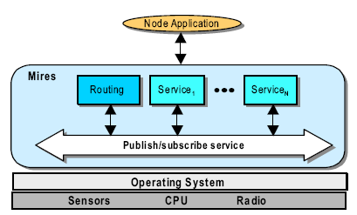
Figure 1: Mire’s Architecture [Souto et al, 2004]
Starting from bottom to top,
Hardware of sensor network
- micro controller unit
- sensors
- radio transceiver
Operating System
Mires
- Publish/ subscribe service
- Routing component
- Additional services
Node or User Application

Slide 26
The main component in Mires architecture is the
publish /subscribe
- intermediates the communication between middleware services.
- Advertising the topics provided by the local application.
- Maintaining the list of topics subscribed by the node application.
- Publishing messages.
Routing component
Multi- hop routing algorithm is used in order to transmit messages received from the network towards the sink node.

Slide 27
Types of notification events:
i. topicArrival :
This event signals that the node application has submitted data collected from sensors.
ii. stateArrival:
Signals that the data is collected from the network instead of sensors.
iii. topicSetupArrival:
is the subscribed message broadcasted from the user application. It contains both a list of subscribed topics and configuration information for the services.

Slide 28
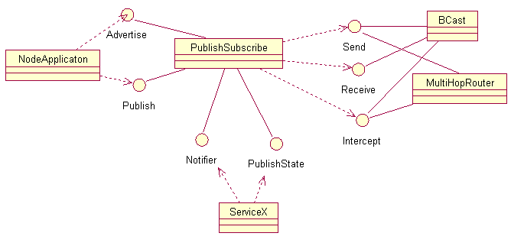
Publish/subscribe service
Figure 2 : Publish/subscribe class diagram [Souto et al,2004]
PublishSubscribe component provides both the Advertise and Publish interfaces to node application. And also PublishState and Notifier interfaces to ServiceX.

Slide 29
PublishState interface defines the command used by ServiceX to publish their processing results.
PublishSubscribe service uses three interfaces (Send, Receive, Intercept) that are implemented by the Bcast and MultiHopRouter communication components.
The MultiHopRouter component is responsible for establishing routing heirarchy towards the sink node.
The Bcast component is responsible to broadcast setup information across the network.

Slide 30
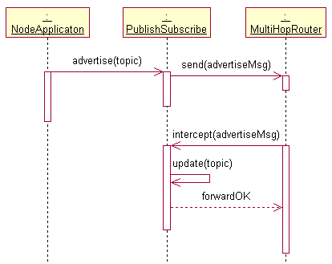
Advertisement Phase
Node application advertises to the
PublishSubscribe service its
capability of sensing data.
PublishSubscribe service sends the
advertised message to the network
via Multihop router.
Interactions are shown in the
bottom part of the figure where a
advertiseMsg arrives at the node
- Intercept
- Update
- Forward
Figure 3: Topic advertisement sequence diagram[ Souto et al,2004]

Slide 31
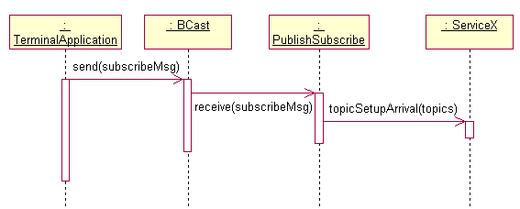
Subscribe phase
User application sends
subscribeMsg to all nodes in
the network.
Each node that receives
subscribeMsg, the Bcast
component signals a receive
event.
Finally PublishSubscribe
component extracts the
information from the message
& signals the topicSetupArrival
event to notify the ServiceX
component.
Figure 4: Topic Subscription Sequence Diagram[Souto et al,2004]

Slide 32
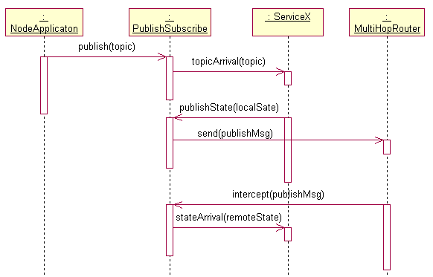
Publish & Process data
Node application collects
data from the node’s sensors
& sends it to the
PublishSubscribe component.
PublishSubscribe component
notifies other services
through topicArrival event.
Next, the service invokes the
publishState command to
PublishSubscribe component,
by providing its processing
results.
[cont.]
Figure5: Data publishing sequence diagram [Souto et al,2004]

Slide 33
PublishSubscribe sends the publishMsg to the network using MultiHopRouter component.
Finally, the MultiHopRouter intercepts publishMsg and sends it to PublishSubscribe.
PublishSubscribe extracts information & notifies other services by signalling the stateArrival event.

Slide 34
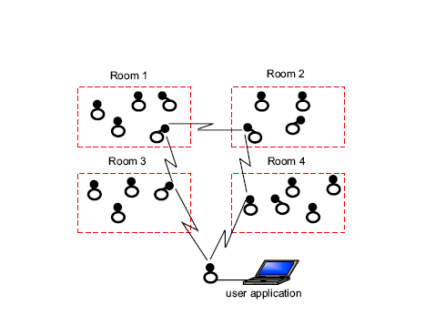
An Environment Monitoring Application
Figure 6: Sensor nodes distributed in rooms[ Souto et al,2004]
Sensor nodes are capable of monitoring variables such as temperature, humidity, sound & luminosity.
The sensors are grouped in rooms forming clusters.
Each room has a cluster head which communicates with the sink node.
Each node inside a cluster integrates the information by using some aggregation technique & reports the results to the cluster head.
Sink receives the data from cluster heads and spreads it to the network.

Slide 35
Aggregation Service
Data aggregation is needed in environment monitoring applications to reduce the no. of message transmissions, latency and power consumption in the network.
Aggregation is performed in each sensor node.
Aggregation service uses aggregation function and stop criteria as the configuration parameters.
Aggregation function includes
- suppression
- min
- max
-average

Slide 36
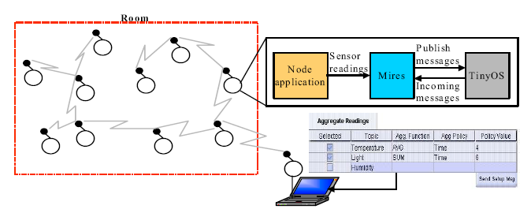
Application Example
Figure 7: Graphical User Interface Example[Souto et al,2004]
Figure shows user application & its interaction with middleware architecture.

Slide 37
In this example the user is interested in receiving data about temperature every four minutes & luminosity every six minutes.
The user application needs to inform Mires only which topics( temperature, luminosity or humidity) it is interested in.
The middleware receives this configuration message (topics, function and aggregation policies) and sends the requested data back to the user application.
In this way Mires makes the control and communication of the sensors readings.

Slide 38
Conclusion
WSN technology will enhance our daily lives in future. They are too complicated to be handled directly by end-users hence middleware approach is used.
Since WSN present some peculiarities not found in traditional networks, middleware have then to obey to certain design principles to be suitable for the sensor networks environment.
The comparison between middleware approaches shows that most of the approaches have dealt with the energy consumption, limited resources issue and the scalability issues, but didn’t support QoS and Security issues.
Work is needed to be done in middleware especially in the QoS support issue.

Slide 39
References
Hadim, S. and Mohamed, N., “Middleware: Middleware Challenges and Approaches for Wireless Sensor Networks”. IEEE Computer Society Vol.7, No.3; March 2006.
Masri, W. and Mammeri, Z., “Middleware for Wireless Sensor Networks: A Comparative Analysis ”. In the proceedings of IFIP International Conference on Network and Parallel Computing, 2007.
Molla, M.M and Ahamed S.I ., “ A Survey of Middleware for Sensor Network and Challenges”. In the proceedings of International Conference on Parallel Processing Workshops, 2006.
Masri, W. and Mammeri, Z., “ Middleware for Wireless Sensor Networks: Approaches, Challenges and Projects”. In the proceedings of International Conference on Signal Processing and Communications, pp 24-27, November 2007.
Rahman, A., “ Middleware for wireless sensor networks: Challenges and Approaches”. In Seminar on Internetworking, April 2009.
Souto, E., Guimaraes, G., “ A Message-Oriented Middleware for Sensor Networks”. In the proceedings of 2nd International Workshop on Middleware for Pervasive and Adhoc Computing, October 2004.

Slide 40
Thank You!!!

Slide 41
Questions
Q1. Compare two middleware approaches Impala & Mires with respect to what challenges they meet.
Ans. Impala based on Modular middleware approach supports Energy & resource management, scalability, Dynamic Network topology & Robustness, Adaptability, configurability & maintainability, real world integration and security.
Mires a message oriented approach supports Data centricity, Energy & Resource Management, In-network processing, Scalability.
They both partially supports Heterogeneity.But none of them supports QoS & Application knowledge issues.
Hence we can conclude that Impala is better than Mires.

Slide 42
Q2.. Describe the role of each component in Publish/subscribe class diagram.
Figure: Publish/subscribe class diagram [Souto et al,2004]

Slide 43
Ans.
Roles:
Node Application: Node application advertises to the PublishSubscribe service its capability of sending data related to a certain topic.
PublishSubscribe: It intermediates the communication between middleware services, maintains a list of topics provided by node application & it is also responsible for publishing messages.
ServiceX: By using the two interfaces ( Notifier & ServiceX), this component allows the addition of services to Mires.
Bcast: It is responsible to broadcast setup information across the network.
MultiHoprouter: It is responsible for establishing routing hierarchy towards the sink node.

Slide 44
Q3. Describe how publish & process data scheme in a network works?
Figure: Data publishing sequence diagram [Souto et al,2004]

Slide 45
Ans.
The node application periodically collects readings from node’s sensors and sends it to the PublishSubscribe component via publish command.
PublishSubscribe component uses topicArrival event to notify other services.
In the next phase, service invokes publishState command to PublishSubscribe component by passing its processing results. Then, PublishSubscribe sends PublishMsg to the network using MultiHopRouter component.
Finally, in the third phase, the MultiHopRouter signals an intercept event containing the PublishMsg to PublishSubscribe component. The publishSubscribe component extracts the information from message & notifies other services by signalling the stateArrival event.

