Slide 1

LOCALIZATION IN SENSOR NETWORKS
Joshua Tom-Jack
jtomj044@uottawa.ca

Slide 2

OUTLINE
Introduction
Application Areas
Localization Methods
Conclusion
Questions
Sources

Slide 3
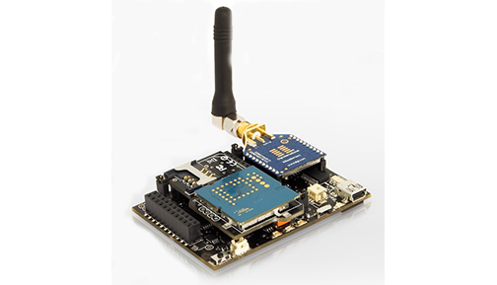
SENSOR NETWORKS
Sensor networks consists of a large number of nodes densely distributed over a region of interest and have wireless connectivity.
Sensor Network Node

Slide 4
APPLICATION AREAS
Countless Applications in many different fields, including:
Environmental monitoring
Seismic Activity detection; Planetary monitoring
Industrial monitoring and control
High-precision agriculture
Healthcare and Medical Research
Homeland Security and Military applications
New emerging areas.

Slide 5
LOCALIZATION
In Wireless Sensor Networks, sensor nodes that are deployed into the environment do not have prior knowledge of their location. The problem of determining the node’s location (position) is referred to as localization.

Slide 6
GOAL
To determine the information available to a node whose location is unknown
Methods that this information can be used to derive the location

Slide 7
PROBLEM STATEMENT
Regular Assumptions
Large number of nodes
Random deployment in a given area
Known transmission range for all nodes
Static/not very dynamic networks
Question
What are the geographical positions of the nodes?

Slide 8
A possible solution?
Usage of Global Positioning System (GPS) devices
Not a feasible solution for wireless sensor networks:
High cost of the device (value/energy/computation power/space)
Unavailability/poor precision of the service in special environments(indoors, underground etc)
Conclusion: other approaches need to be developed and deployed

Slide 9
CLASSIFICATION OF LOCALIZATION METHODS
Range-based
Received Signal Strength Indicator (RSSI)
Time of Arrival (ToA)
Time Difference of Arrival (TDoA)
Angle of Arrival (AoA)
Range-Free
Local Techniques
Hop-Counting Techniques
Notes:
Range based usually single hop……Range free…multihop

Slide 10
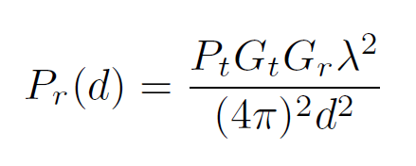
RANGE BASED DISTANCE ESTIMATION
Received Signal Strength (RSS) techniques measure the power of the signal at the receiver. Based on the known transmit power, the respective propagation loss can be calculated. Theoretical or empirical models are used to translate this loss into a distance estimate. This method has been used mainly for RF signals.
Friis Free Space Equation
Note: The Friis space equation above does not consider losses

Slide 11
RANGE BASED DISTANCE ESTIMATION
Time based methods (ToA, TDoA) record the time-of-arrival (ToA) or time-difference-of-arrival (TDoA).The propagation time can be directly translated into distance, based on the known signal propagation speed. These methods can be applied to many different signals, such as RF, acoustic, infrared and ultrasound.
Angle-of-Arrival (AoA) systems estimate the angle at which signals are received and use simple geometric relationships to calculate node positions.

Slide 12
Anchor Nodes Method
Anchor Nodes: These are nodes that know their coordinates a priori and are used to calculate global coordinates in Anchor-based systems
  Determine the distance between unknown and anchor nodes
  (Sum-dist, DV-hop and Euclidean)
  Derive the position of each node from its anchor distances
  (Lateration and Min-max)
  Refine the node positions using information about the range to, and positions of neighbouring nodes

Slide 13
Calculating Distance to Anchor Nodes
There are three algorithms
Sum-dist (DV-Distance)
DV-Hop
Euclidean
Anchors flood the network with their position

Slide 14
Sum-dist
Determines distance to the anchors by simply adding the ranges encountered at each hop during the network flooding.
Example:
**shortest path range
B
10
8
X
6
C
7
8
A
A: 8
B: 10+6 = 16
C: 7+8+6 = 21

Slide 15
DV-Hop
Determines distance to the anchors by counting the average number of hops.
Multiply with the average hop distance
Example:
Number of hops between anchors and
Nodes are computed
Average hop distance is estimated
Position is computed via lateration
A-B: 15
3 hops
3
B
avg hop: 5
1
4
2
1
3
2
C
1
4
1
2
A

Slide 16
DV-Hop
B
20m
30m
C
A
50m
Average hop distance for
A: (30+50)/(3+4) = 11.4m
B: (30+20)/(3+2) = 10m
C: (50+20)/(4+2) = 11.7m

Slide 17
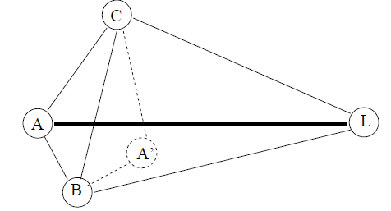
Euclidean
This scheme works by propagating the true Euclidean distance to the anchor node(L)
If accurate distance measurements are available, nodes can estimate exact distances to anchors
Notes:
Euclidean distance is the "ordinary" distance between two points that one would measure with a ruler

Slide 18
Determining Position
Lateration (Trilateration and Multi-lateration)
Triangulation
Min-Max

Slide 19
LATERATION
Trilateration
Given:
Three points with known positions
Distances to all three of them
Position can be determined by intersecting three circles centred in the points with radius the known distances
Mulitilateration
B
B
A
A
C
C
A
A
A
B
B
B
C
C
C

Slide 20
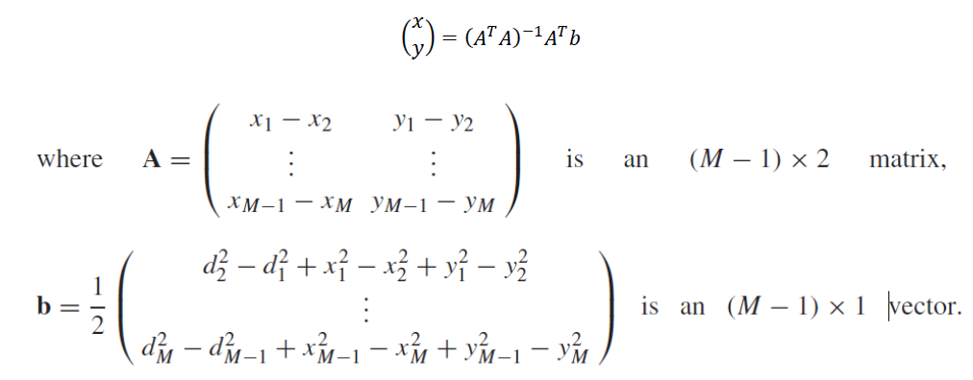
LATERATION
The (x,y) coordinates of a node can be found by solving the matrix equation. M is the number of anchor nodes.
M. Bolic, D. Simplot-Ryl, I. Stojmenovic (2010) “RFID Systems: Research Trends and Challenges” Pg 399-401. John Wiley and Sons Ltd.

Slide 21
TRIANGULATION
Triangulation is used when the direction of the node instead of the distance is estimated, as in Angle of Arrival (AoA) systems. The node positions are calculated by using the trigonometry laws of sine and cosine.
θ3
θ2
θ1

Slide 22
Min-Max
Distance to anchors determines a bounding box
Center of box estimates node position
The main idea is to construct a bounding box for each anchor using its position and distance estimate, and then to determine the intersection of these boxes. The position of the node is set to the centre of the intersection box.
C
A
B
Notes:
Note that the estimated position by Min–max is close to the true position computed through Lateration

Slide 23
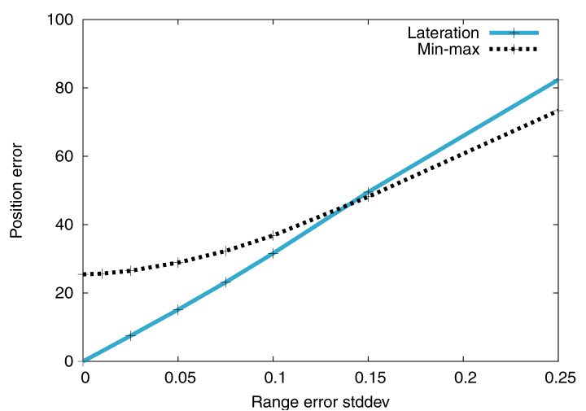
COMPARISON: DISTANCE ERROR
Sensitivity to deviations on the range measurements by the Min-max and Lateration algorithms
Notes:
when noise is introduced in the range measurements, the two algorithms (Min-max and Lateration) show different behavior. Figure shows the sensitivity of Lateration and Min-max when standard deviation percentage was varied from 0 to 0.25.

Slide 24
CONCLUSION
Localization is an essential service in wireless sensor networks
In this presentation, the main idea of localization was described
Anchor node based localization systems main strong point is that it is a completely distributed protocol. Its weakest point is that the number of needed anchors should be large for a good result.
Lateration is capable of obtaining very accurate positions but that is very sensitive to the accuracy of the distance estimates. Min-max is more robust, but is sensitive to the placement of anchors.

Slide 25

QUESTIONS

Slide 26
QUESTION 1
What are the main steps in calculating node position using anchor nodes?
Answer
  Determine the distance between unknown and anchor nodes
  (Sum-dist, DV-hop and Euclidean)
  Derive the position of each node from its anchor distances
  (Lateration and Min-max)

Slide 27
QUESTION 2
Assume node X gets its average hop distance from B, what are its estimate distances to all the anchors (A,B,C) using DV-Hop propagation method
[Hint: avg. hop distance = Σ(dist. to anchors)/Σ(number of hops) ]
B
75m
Answer
avg. hop dist. for B: (40+75)/(2+5)= 16.42
Estimated Distances
A: 16.42 x 3(hops) = 49.26m
B: 16.42 x 2(hops) = 32.84m
C: 16.42 x 3(hops) = 49.26m
C
40m
X
A
100m

Slide 28
QUESTION 3
Using lateration method, illustrate how all nodes in the following diagram can be localized in 3 steps
(To obtain localization a node has to have at least 3 neighbors with known position)
F
E
B
D
A
C
Answer
F
F
F
1
2
3
E
E
E
B
B
B
D
A
D
A
D
A
C
C
C

Slide 29


Slide 30
Sources
K. Langendoen and N. Reijers “Distributed Localization in Wireless Sensor Networks: A Quantitative Comparison” Computer Networks Vol. 43 Issue 4 Pg 500—518. 2003
Moaveni-Nejad, K. and Li, X.-Y. Path Exposure, Target Location, Classification and Tracking in Sensor Networks, in Handbook of Sensor Networks: Algorithms and Architectures (ed I. Stojmenović), John Wiley & Sons, Inc. 2005
D. Niculescu and B. Nath, “Ad hoc positioning system (APS),” in Proceedings of GLOBECOMM, November 2001.
R. Severino and M. Alves “On a Test-bed Application for the ART-WiSe Framework” Technical Report, November 2006 www.hurray.isep.ipp.pt website visited November 15, 2011
Boukerche, E. F. Nakamura and A.A.F. Loureiro “Algorithms For Wireless Sensor Networks: Present And Future” in Algorithms and Protocols for Wireless Sensor Networks, John Wiley & Sons Inc. 2009
L. Hu, and D. Evans, “Localization for Mobile Sensor Networks,” in Proceeding of Tenth Annual International Conference on Mobile Computing and Networking (MobiCom 2004), October 2004
A. Savvides, H. Park, M.Srivastava, “The bits and flops of the N-hop multilateration primitive for node localization problems”, in First ACM International Workshop on Wireless Sensor Networks and Application
(WSNA), Atlanta, GA, 2002, pp. 112-121.

