Slide 1
Fault Tolerance in
Wireless Sensor Networks
Balaaji Tirouvengadam
btirouve@uottawa.ca

Slide 2
Outline
Introduction
  FT , WSN
Stages in forming WSN
FT Algorithms for different stages
Summary
Questions

Slide 3
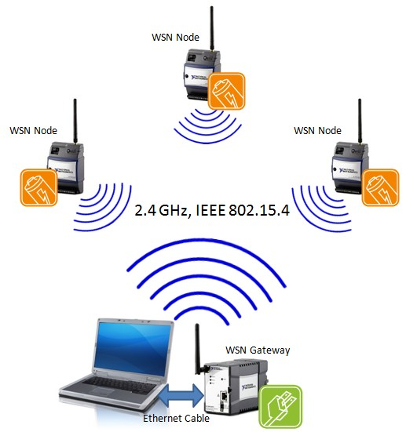
Introduction
Wireless Sensor Networks
  Application specific
Fault Tolerance
  Ensures Reliability
Why FT in WSN
  Failure is part of the system
    Limited power, harsh environment …
    Malicious
FT parameter – varies with its applications

Slide 4
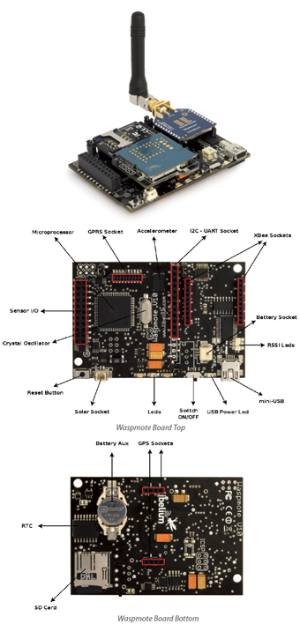
Faults in Sensor Networks
Fault Types
  Hardware Faults
  Software Faults
    Application
    Middleware
  Communication Link Faults

Slide 5

Fault Detection
  Self Diagnosis
    e.g. Battery depletion
  Cooperative Diagnosis
    e.g. Failure in communication link
Fault Recovery
  Uses the redundant element (common practice)
    E.g. Memory, link, secondary power source etc.,
    Deploying redundant sensing nodes
    Multipath routing – for k path, the system is k-1 fault tolerable

Slide 6
Stages in forming WSN
Node Placement
Topology Control
Target / Event detection
Data Aggregation

Slide 7
Node placement
More crucial for immobile nodes
Determines the system
  Robustness
  Efficiency & performance
Architecture
  Flat network
  Two tier

Slide 8
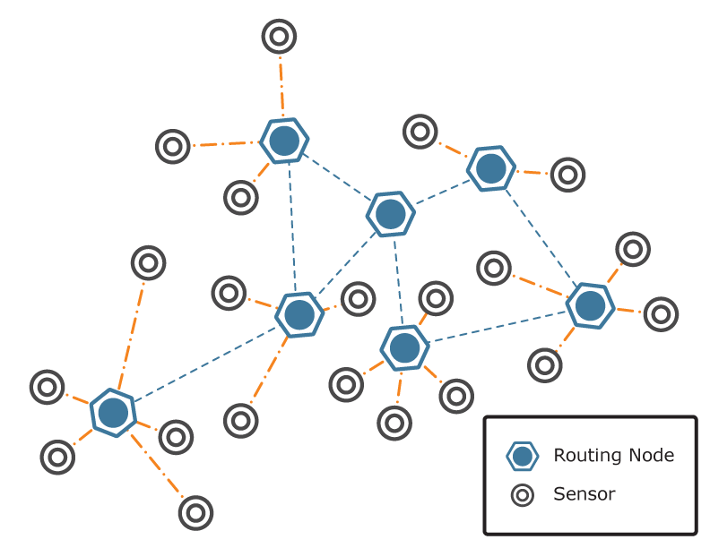
FT – Node placement(1)
Two tier network architecture
  Sensor → Relay Nodes → Sink
  Relay Nodes (RN)
    Should be fault tolerant
    Form the back bone of the WSN
    There should be at least 2 disjoint path between two RN
    Minimum RN will be chosen to keep the network k-connected
  Each sensor connects to at least one RN
  Sensor does only sensing, routing / data forwarding is done by RN → Increases Sensors operational life

Slide 9
Topology Control
Node Placement is not always the final solution
Topology Control is must to maintain the fault tolerance of the system

Slide 10
FT – Topology Control (1)
An algorithm is proposed by Yong Chen et al. in [3]
A CDS graph is constructed for a system
CDS forms the backbone network
For each node in CDS, it adds the neighbour of the node to the backbone to meet required vertex connectivity
Power on/off model is applied to the so formed model
Redundant nodes in the backbone goes to sleep mode, thus maintaining k-vertex connection
Fair rotation among active and sleep nodes
So any point of time k-vertex connection is maintain thereby allows the system to work even if (k-1) node fails

Slide 11
FT – Topology control (2)
A FT TC algorithm was proposed for heterogeneous network by M. Cardei et al. in [4]
Heterogeneous network ?
  WSN with mixed hardware capabilities
  Some nodes are more powerful than other nodes
    Super Nodes (SN)
    More communication range, higher power …
  Their model Assumes SN ←→ SN is highly reliable
  They address only sensor to sensor & sensor to SN

Slide 12
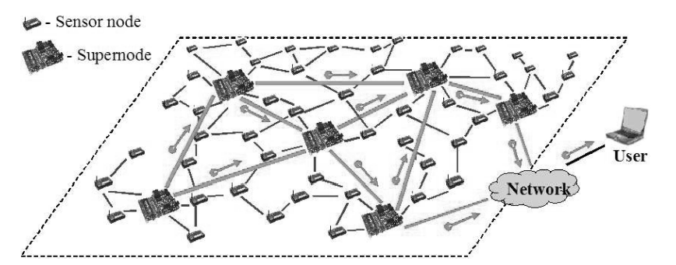
Heterogeneous Network (WSN)
[4]

Slide 13
M. Cardei et al. constructed a reduced graph with directed edges for the system
The proposed 3 algorithm which can be applied on top of the derived reduced graph
For simplicity, only one algorithm is discussed here.
Minimum Weight-Based Anycast Topology Control [4]
  There are k-vertex disjoint path between a given vertex and any other vertex in the subgraph
  the sum of the weight of the selected edges is minimized.

Slide 14
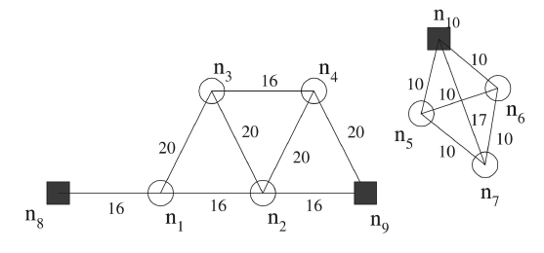
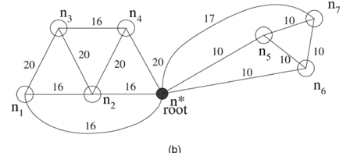
FT TC (2) – Reduced Graph
In Figure
  square : SN
  circle : sensor
SN can communicate each other, so can be merged to one node : root node
[4]

Slide 15
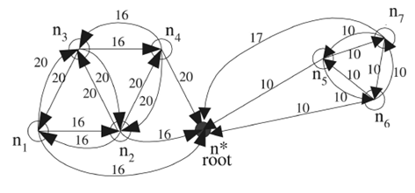
Rules for adding directions to the edges
  Edge between sensor
    replaced with bidirectional edge with same weightage
  Edge between sensor and root node
    Replaced with unidirectional edge towards root node
    Only the edge to the closest SN is kept
[4]

Slide 16
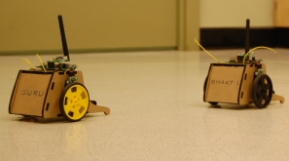
FT – Topology Control (3)
Shantanu Das et al. proposed a FT topology control approach in [5]
  This can be employed in networks which has limited mobility to the sensor nodes
The intention of the author
  To remove all critical nodes
    Single point of failure
  To make the network bi-connected
    More fault tolerant
    Sub graphs are interconnected by two nodes

Slide 17
P-hop sub graph
  In the given sub graph any node can reach any other node within p hops
P-hop critical node
  A node which make the P-hop sub graph disconnect on its failure
Bi-connected network
  Not even one p-hop critical node
  All critical nodes → non critical nodes
    Asks two of its neighbour node to move closer to each other to establish a redundant link
    This movement can break an existing link

Slide 18
Three possibilities can exists in a network
  Critical node with
    No critical neighbour ( all its neighbour are non critical nodes)
    One critical neighbour
    More than one critical neighbour

Slide 19
Critical node with no critical neighbour – 1/2
6
2
1
3
7
4
5
8

Slide 20
Critical node with no critical neighbour – 2/2
2
1
3
7
4
5
8

Slide 21
Critical node with no critical neighbour:
  The critical node identifies the two disconnected sub graph
  Chooses one node from each graph such a way that those two nodes can move closer to establish a new link
  The neighbour node are chosen such a way that the existing links are not much disturbed (some case disconnection of some non critical node cannot be avoided)
  Since the two nodes make another path, the critical node will now become non critical

Slide 22
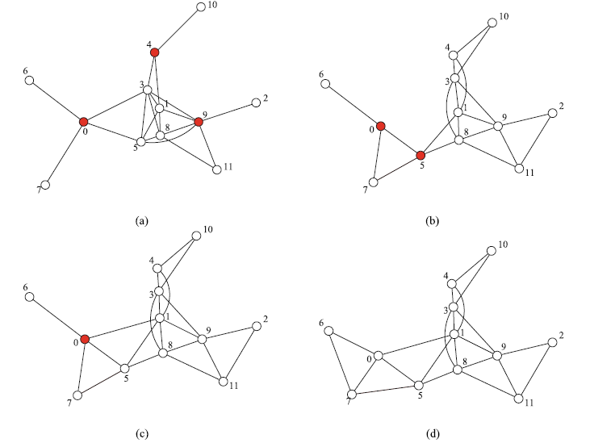
Example showing node movement causing disconnection

Slide 23
Critical node with one critical neighbour – 1/3
3
2
5
8
1
7
4
6

Slide 24
Critical node with one critical neighbour – 2/3
3
2
5
8
1
4
7
6

Slide 25
Critical node with one critical neighbour – 3/3
3
2
5
8
1
4
7
6

Slide 26
Critical node with one critical neighbour:
  Critical node with larger node id is chosen first
    It will try to relocate its non critical node to establish a link
  Now the critical node with higher node id will become non critical
  Repeat above process till critical node with no critical neighbour case is reached.

Slide 27
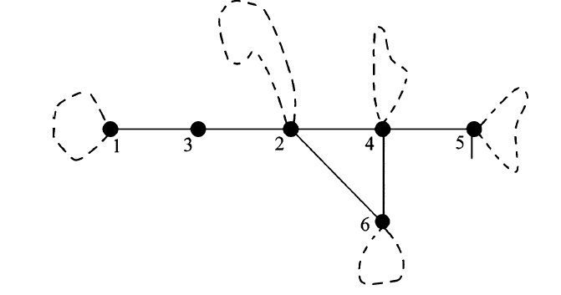
Critical node with several critical neighbour:
Critical node
  Available – if it has a non critical neighbour
  Non available – if it does no have any non critical node
Critical head
  Critical node with higher node value among available critical node
Pairwise merging strategy
  Critical head dominates pair merging and selects one of its critical neighbour to pair with it.
Critical nodes
1 (3 is unavailable), 5, 6
Pair : (1.3) (5,4) (6,4)
Dominated node : 1, 5, 6
The steps are repeated

Slide 28
FT – Target / Event Detection
The assumption is that in a dense sensor network
  The event region will be shared by many sensors
  The data among the sensors are collected and compared to derive a decision.
  The faulty sensor reading will be masked by the majority of non faulty sensors
There are many techniques used in literatures
  Calculating the median for a group of sensors
  Calculating the failure probability of a node to decide on its future decision correctness

Slide 29
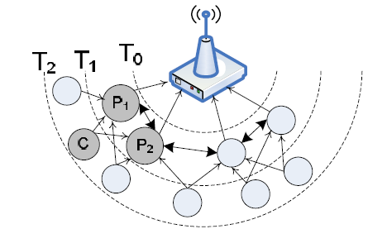
FT – Data Aggregation
Reliable aggregation in Track Topology
Edges : Primary, backup & side edge
The back up node just listens
Each message is attached with a bit vector, informing about faulty links
Backup node aggregates the received data along with its on seeing a error bit from the side edge

Slide 30
Summary
Fault Tolerance is very crucial for sensor networks
Many algorithms have been proposed in literature addressing the FT issues
Few of FT algorithms were discussed

Slide 31
Question #1
Construct a reduced graph and show the directed edges in it using the following figure
Note: The black square represents the super nodes, which can communicate each other with high reliability (a message sent to any super node is considered that all other SN will receive it)

Slide 32
Answer #1
Reduced Graph
Directed reduced graph

Slide 33
Question #2
The below shown figure is 2-hop network with 4 and 5 as its critical nodes, Assume the nodes can be moved, use node mobility to remove node criticality and derive a bi-connected network (Note: critical node id with higher value will dominate the lower value, assume the node mobility is not breaking any of the existing connection)
3
2
5
8
1
7
4
6

Slide 34
Answer #2
Moved nodes : 7 and 1
3
2
5
8
1
4
7
6

Slide 35
Question #3
Describe the steps involved in converting critical node into non critical node, when a critical node has several critical nodes as its neighbour

Slide 36
Answer #3
Identify the Available and non available critical nodes
Critical nodes with higher node id than its neighbouring available critical node will declare itself as Critical head
Critical head pairs up with its neighbour critical node and dominates the pair to remove criticality

Slide 37
References
[1] “Guide to Wireless Sensor Networks”, Chapter 10 Fault-Tolerant Algorithms/Protocols in Wireless Sensor Networks, Hai Liu, Amiya Nayak, and Ivan Stojmenovi´c
[2] J.L. Brediny, E.D. Demainez, M.T. Hajiaghayiz, and D. Rus, “Deploying Sensor Networks with Guaranteed Capacity and Fault Tolerance,” MobiHoc 2005, urbana-champaign, IL, 2005
[3] Y. Chen, and S.H. Son, “A Fault Tolerant Topology Control in Wireless Sensor Networks,” Proceedings of the ACS/IEEE 2005 International Conference on Computer Systems and Applications, 2005
[4] M. Cardei, S. Yang, and J. Wu, “Algorithms for Fault-Tolerant Topology in Heterogeneous Wireless Sensor Networks,” IEEE Transactions on Parallel and Distributed Systems, vol. 19,no. 4, pp. 545–558, 2008
[5] S. Das, H. Liu, A. Kamath, A. Nayak, and I. Stojmenovic, “Localized Movement Control for Fault Tolerance of Mobile Robot Networks,” The First IFIP International Conference on Wireless Sensor and Actor Networks (WSAN 2007), Albacete, Spain, 24–26 Sept. 2007
[6] S. Gobriel, S. Khattab, D. Mosse, J. Brustoloni, and R. Melhem, “Fault Tolerant Aggregation in Sensor Networks Using Corrective Actions,” Third Annual IEEE Communications Society on Sensor and Ad Hoc Communications and Networks, vol. 2, pp. 595–604, 2006

Slide 38

Thank you !!!

