Slide 1

Data Aggregation In Wireless Sensor Networks
Dave McKenney

Slide 2
Presentation Outline
Introduction
Algorithms/Approaches
  Tiny Aggregation (TAG)
  Synopsis Diffusion (SD)
  Tributaries and Deltas (TD)
  OPAG
  Exact Top-K (EXTOK)
  Histogram Incremental Update (HIU)
  Distributed Data Cube
Conclusion

Slide 3
Introduction
What is data aggregation?
Why is it important?
Notes:
May want to create an overall data measurement over thousands of sensors
E.G.: Want to know average speed in a traffic network, highest temperature in a chemical storage facility
Nieve method: Send all data to a sink, have it process data
Aggregation method: Use in-network processing and synchronization to decrease amount of data sent
Important: Affects the amount of energy used, which affects the network lifetime
NetLogo Demo

Slide 4
Aggregation Concerns
Energy vs. Latency vs. Accuracy
Notes:
Energy -> Decreasing energy increases network life (in general)
Latency -> Decreasing energy may increase latency (which may be very important)
Accuracy -> With decreased accuracy requirements, energy can usually be reduced
Not necessarily a linear or static relationship, depends on aggregation strategy

Slide 5
Tiny Aggregation (TAG)¹
Maintain tree structure
Aggregate at internal nodes
[1] S. Madden, M. J. Franklin, J. M. Hellerstein, and W. Hong, “Tag: a tiny aggregation service for ad-hoc sensor networks,” ACM SIGOPS Operating Systems Review, vol. 36, no. SI, pp. 131–146, 2002.
Notes:
One of the original WSN aggregation works
Tree rooted at sink

Slide 6
Max – No Aggregation
Total Messages: 0
5
7
4
8
3
1
9

Slide 7
Max – No Aggregation
Total Messages: 1
5
Numbers: [5]
Max
Max
7
4
8
3
1
9
Notes:
Note, not 2 messages as wireless sends to all neighbours

Slide 8
Max – No Aggregation
Total Messages: 5
5
Numbers: [5,7,4]
7
4
7
4
Max
Max
Max
Max
8
3
1
9

Slide 9
Max – No Aggregation
Total Messages: 9
5
Numbers: [5,7,4,8,9]
8
9
7
4
8
9
8
3
1
9

Slide 10
Max – No Aggregation
Total Messages: 13
5
Numbers: [5,7,4,8,9,3,1]
Max: 9
3
1
7
4
3
1
8
3
1
9
Notes:
Found max in tree with 13 messages
Majority of which are sent by 7 and 4 nodes

Slide 11
Max – With TAG
Total Messages: 0
5
7
4
8
3
1
9

Slide 12
Max – With TAG
Total Messages: 1
5
Max
Max
7
4
8
3
1
9

Slide 13
Max – With TAG
Total Messages: 3
5
7
4
Max
Max
Max
Max
8
3
1
9

Slide 14
Max – With TAG
Total Messages: 7
5
[7,8,3]
7
4
[4,1,9]
8
3
1
9
8
3
1
9

Slide 15
Max – With TAG
Total Messages: 9
5
8
9
[7,8,3]
7
4
[4,1,9]
8
3
1
9

Slide 16
Max – With TAG
Total Messages: 9 (vs. 13)
5
[5,8,9]
Max: 9
7
4
8
3
1
9
Notes:
Less than 70% of the messages required, even in this simple example.
Very important as communication cost can be dominating factor in wireless communication.
The problem is: how to synchronize these transfers – can’t wait forever on a child that may not be responding.

Slide 17
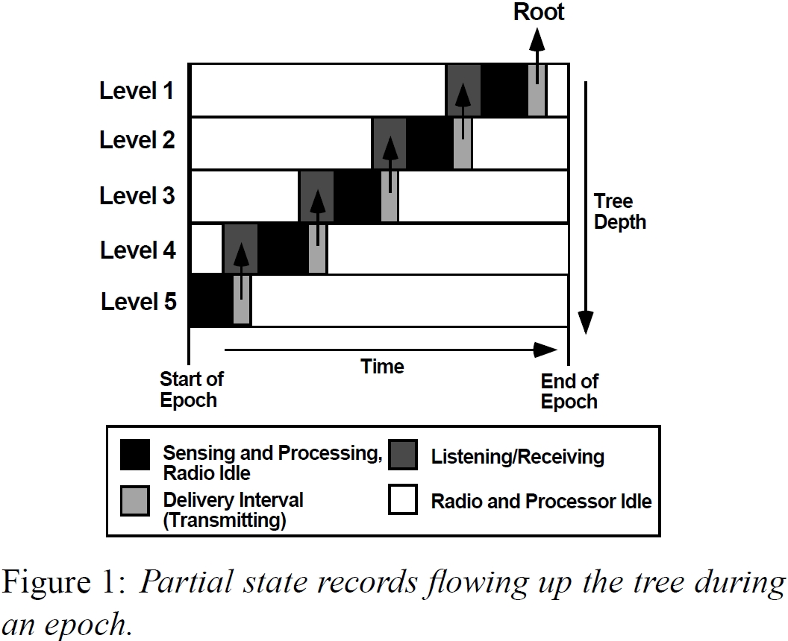
‘Global’ Synchronization
Notes:
Time divided into epochs – one measurement per sensor per epoch
Each node is listening for a specified time, sending in a specified time
Interval length = epoch_length / tree depth (easily calculated from information available during tree construction)
Note: Nodes may be in low-energy states for a large proportion of time
Figure:

Slide 18
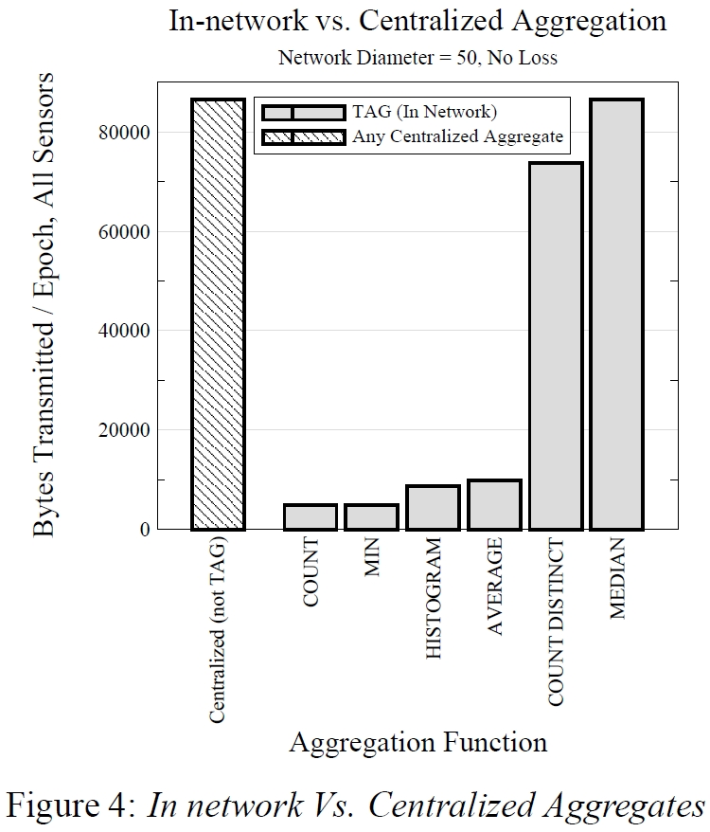
TAG Results
Notes:
Median requires all values to be sent to sink

Slide 19
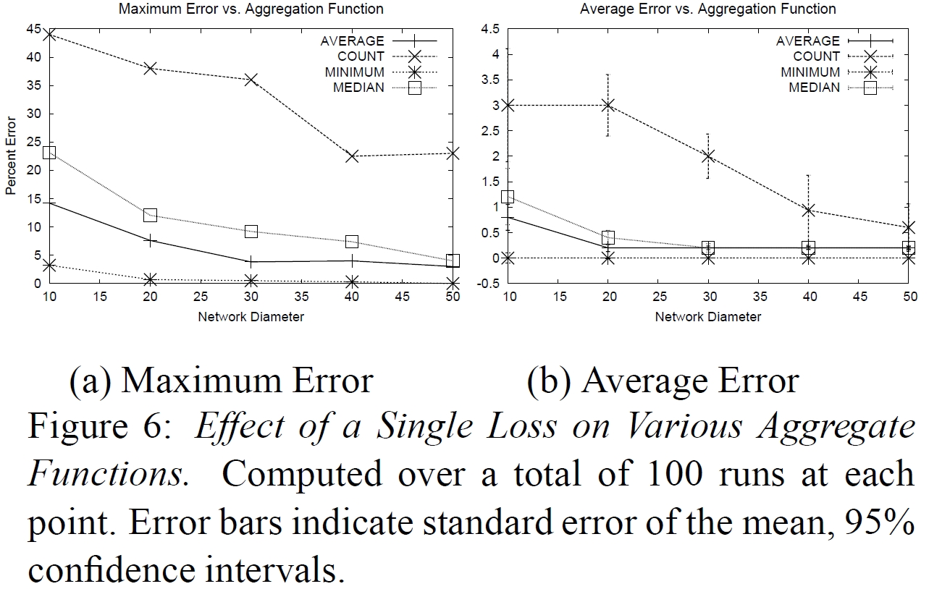
TAG Results
Notes:
Single loss results in entire subtree being lost
Note low error for high network diameters
They don’t mention, though, that as network size increases, node loss will increase proportionally.

Slide 20
TAG Summary
Advantages | Disadvantages
Zero estimation error Energy efficient (vs. centralized) | Vulnerable to node loss Must maintain tree structure Increased latency

Slide 21
Synopsis Diffusion (SD)²
Multipath routing
How to handle duplicate information
  Order and Duplicate Insensitive (ODI) Aggregation
  Example: Count - Flajolet and Martin [3]
  Introduces approximation error
[2] S. Nath, P. B. Gibbons, S. Seshan, and Z. R. Anderson, “Synopsis diffusion for robust aggregation in sensor networks,” in Proceedings of the 2nd international conference on Embedded networked sensor systems, 2004, pp. 250–262.
[3] P. Flajolet and G. Nigel Martin, “Probabilistic counting algorithms for data base applications,” Journal of Computer and System Sciences, vol. 31, no. 2, pp. 182–209, 1985.
Notes:
Tree aggregation is susceptible to node loss
Multipath routing is more robust -> increased redundancy

Slide 22
SD Structure/Routing
Ring 1
Ring 3
Ring 2
Notes:
Organize nodes into rings
Node is in ring i if it is i hops from the sink
Nodes broadcast data, received by all nodes in range with ring > sending ring
Note that still only one transmission is sent by each node, as in TAG

Slide 23
SD Structure/Routing
Ring 1
Ring 3
Ring 2

Slide 24
SD Structure/Routing
Ring 1
Ring 3
Ring 2

Slide 25
SD Structure/Routing
Ring 1
Ring 3
Ring 2
Notes:
We can see, more robust than TAG
If one intermediary node fails, information is still maintained

Slide 26
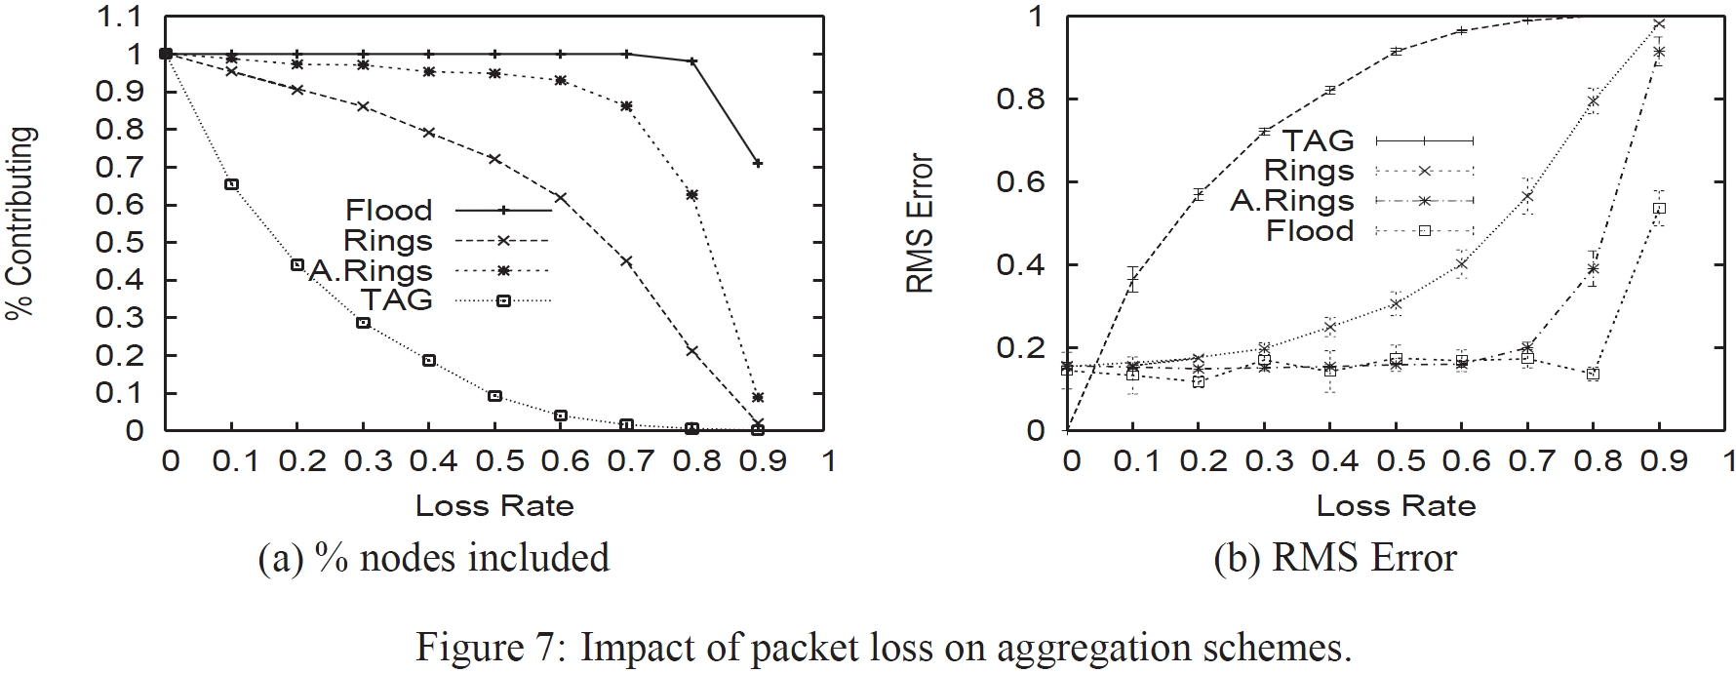
SD Results
Notes:
Compared using SUM aggregate
Loss Rate = Probability that packet is dropped
TAG % contributing drops significantly faster than Rings and A.Rings
TAG Error increases significantly faster

Slide 27
SD Summary
Advantages | Disadvantages
More robust than TAG | Approximation error Increased message size
Notes:
Robust due to multipath routing
Decreased overhead as tree structure does not need maintained
Energy efficient – still 1 transmission per node in both directions
Increased message size required using fusion algorithm

Slide 28
Tributaries & Deltas (TD)⁴
Combine TAG and SD approaches
M-Node
T-Node
[4] A. Manjhi, S. Nath, and P. B. Gibbons, “Tributaries and deltas: efficient and robust aggregation in sensor network streams,” in Proceedings of the 2005 ACM SIGMOD international conference on Management of data, 2005, pp. 287–298.
Notes:
Low loss rates: Use tree -> zero approx error, shorter msg size
High loss rates: Use multipath -> robustness
M-Node: Use SD algorithm for increases robustness, accept information from any node in a lower level
T-Node: Use TAG algorithm, accept information from only children in aggregation tree
Black edges: TAG edges
Gold edges: Additional edges for increased robustness

Slide 29
TD-Coarse vs. TD
Nodes change based on percent contributing
  Expand when % < threshold, decrease if % > threshold
TD-Coarse
  Expand: Switch all possible T nodes to M nodes
  Decrease: Switch all possible M nodes to T nodes
TD
  Expand: Switch any T node below M node with percentage contributing < threshold
  Decrease: Switch M nodes to T node if percent contributing > threshold
Notes:
TD-Coarse: Adapts quickly, but cannot address different failure rates in different regions
TD: Adapts slightly slower, but can handle various failure rates across a number of regions
Interesting: Algorithm varies size of delta (multipath) and tributary (tree) dynamically based on percentage contributing
NetLogo demonstration

Slide 30
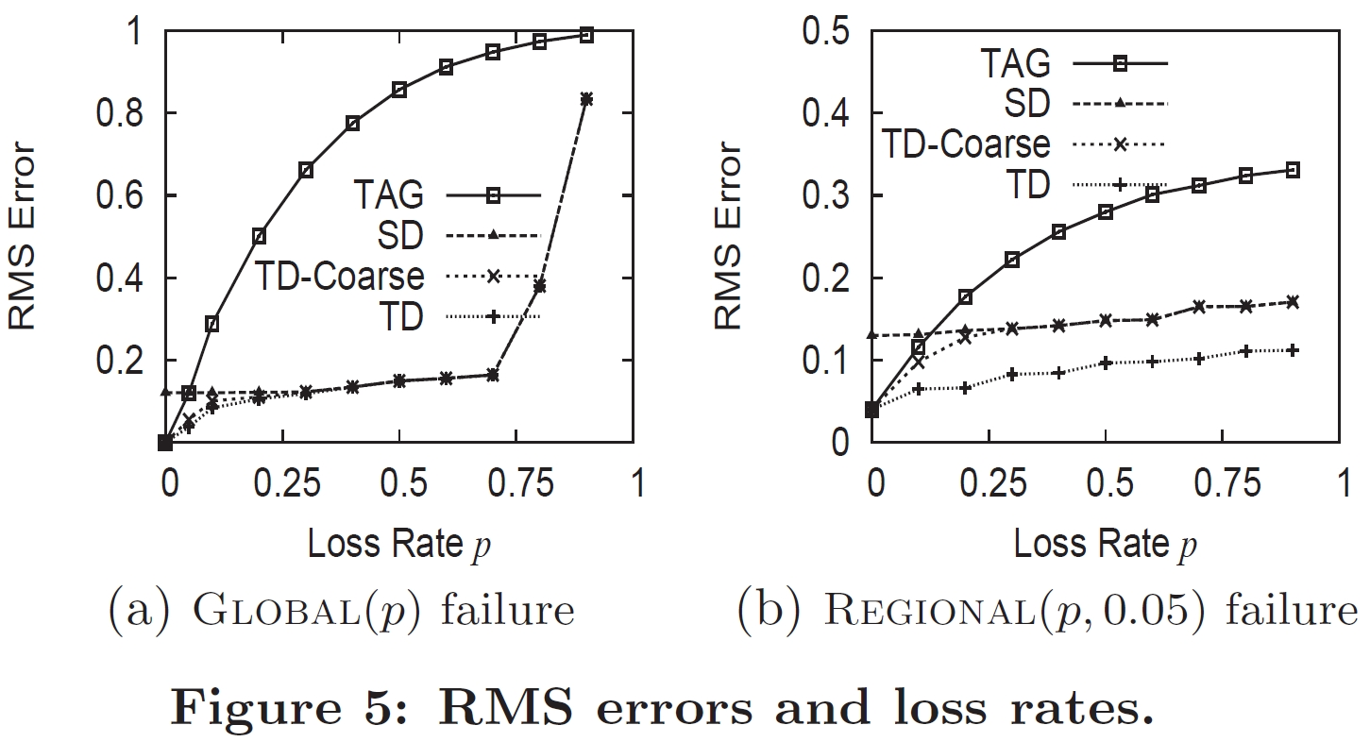
TD Results
Notes:
Sum Aggregate
TD Approach adapts every 10 epochs
90% contributing threshold
Global: All nodes have loss rate of p
Regional: 1 quadrant with loss rate p, others with 0.05
With global: TD never results in more error than min of TAG/SD
Regional: TD has less error than TAG/SD
Because TD can change part of network with high loss to SD, while eliminating estimation error is low-loss areas.

Slide 31
TD Summary
Advantages | Disadvantages
Adapts to network state Increased robustness (vs. TAG) Lower estimation error (vs. SD) Lower error than SD or TAG | Increased overhead (switching nodes) Requires network node count
Notes:
Overhead – must maintain delta/tributary size
Total network nodes – needed for computation of percentage contributing

Slide 32
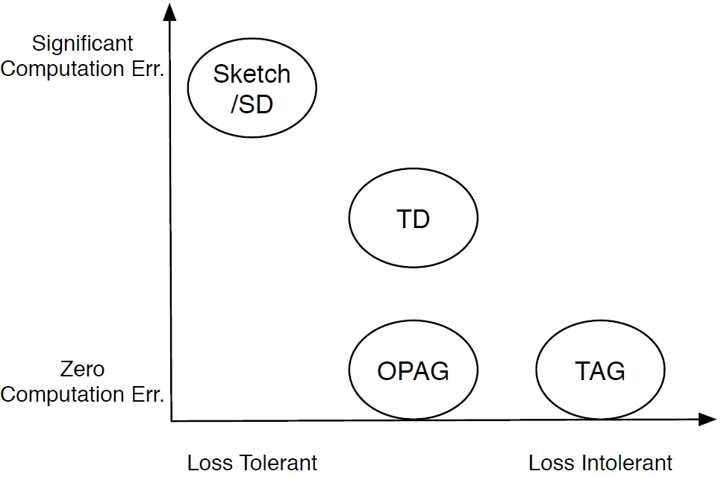
OPAG⁵
[5] Z. Chen and K. G. Shin, “OPAG: Opportunistic Data Aggregation in Wireless Sensor Networks,” in 2008 Real-Time Systems Symposium, 2008, pp. 345-354.

Slide 33
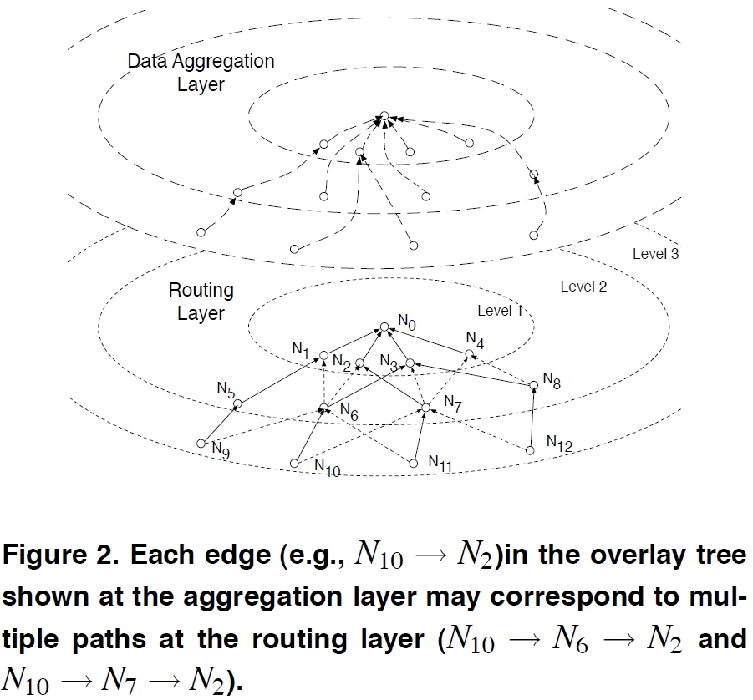
OPAG Layers
Notes:
DAN Node multi-hops aways
DAN List maintained by nodes (id, level, probability, neighbours)
Increased overhead
DAN selected to maximize probabity that info will be delivered.

Slide 34
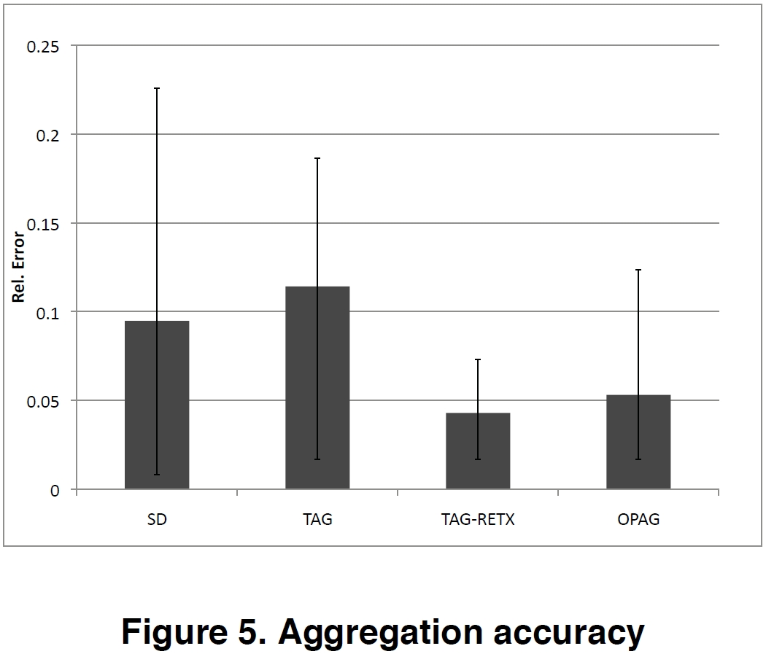
OPAG Results

Slide 35
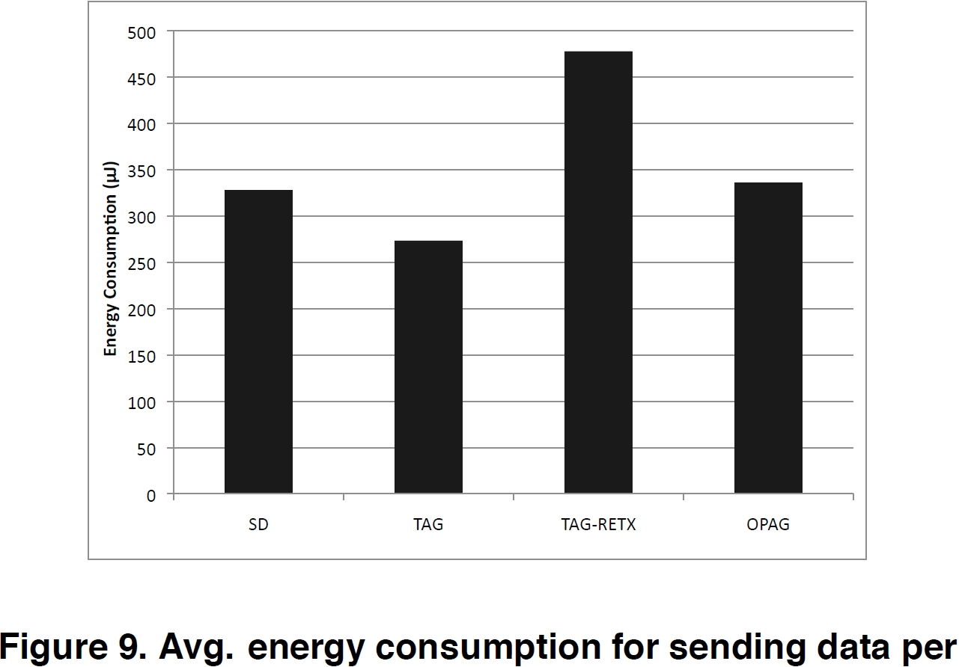
OPAG Results

Slide 36
OPAG Summary
Advantages | Disadvantages
Increased robustness (vs. TAG) | Increased overhead
Notes:
Arguably decreased error

Slide 37
Exact Top-k⁶
Find the top most k elements in the WSN
TAG
  Full update every epoch
FILA
  Uses filters → approximations
Exact Top-k
  Exact result
  Partial updates
[6] B. Malhotra, M. A. Nascimento, and I. Nikolaidis, “Exact top-k queries in wireless sensor networks,” IEEE Transactions on Knowledge and Data Engineering, vol. 23, no. 10, pp. 1513-1525, 2010.
Notes:
FILA Filter: Top-k last time is most likely top-k this time
Filter – if value has not changed to a value outside the filter range, do not send update
Top-k could change within their filter range (Which may be large) with no update to top-k results

Slide 38
Exact Top-k Example
5
Top-2
Top-2
7
4
8
3
1
9

Slide 39
Exact Top-k Example
5
[7]
7
4
[4]
Top-2
Top-2
Top-2
Top-2
8
3
1
9

Slide 40
Exact Top-k Example
5
[7,8,3]
7
4
[4,1,9]
8
3
1
9
8
3
1
9

Slide 41
Exact Top-k Example
Top-2: [8,9]
α: 8
5
[5,7,8,4,9]
7,8
4,9
[7,8,3]
7
4
[4,1,9]
8
3
1
9

Slide 42
Exact Top-k Example
Top-2: [8,9]
α: 8
5
TM-Node
8
8
F-Node
7
4
8
8
8
8
8
3
1
9
Notes:
TM-Node – required to update on every change as it may affect the Top-k
F-Node – only updates if value exceeds alpha

Slide 43
Exact Top-k Example
Top-2: [8,9]
α: 8
5
TM-Node
F-Node
7
7
4→7
8
5
2
9
3→5
1→2
Notes:
No updates required!

Slide 44
Exact Top-k Example
Top-2: [9,10]
α: 9
5
TM-Node
10
F-Node
7
10
7→10
8
5
2
9
Notes:
No updates required!

Slide 45
Exact Top-k Example
Top-2: [9,10]
α: 9
5
TM-Node
9
9
F-Node
7
10
9
9
9
9
8
3
1
9

Slide 46
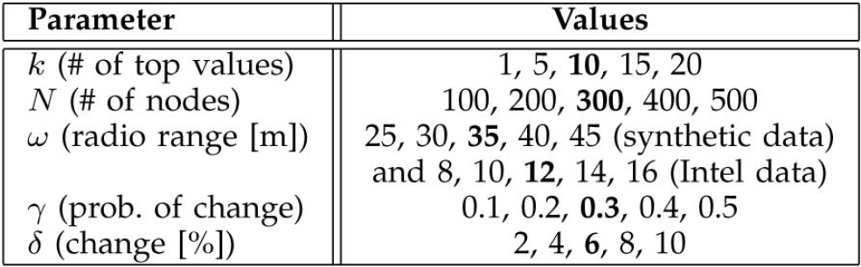
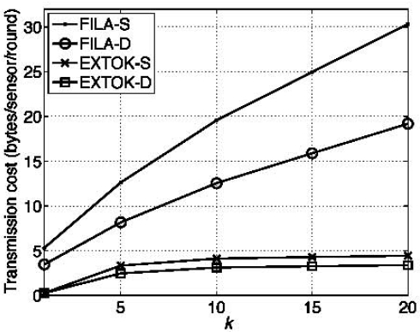
Exact Top-k Results
Notes:
Exact top-k scales with top k better
FILA requires an extra filter for every k
Similar results found for other parameters tested

Slide 47
Exact Top-k Summary
Advantages | Disadvantages
Provides exact answer Requires only partial update | Unaware if a top-k node dies

Slide 48
HIU Algorithm⁷
TAG Histogram requires complete update
Histogram Incremental Update (HIU)
  Sensors update if value leaves previous bin
  Nodes store value and previous partial state
  Update message – the change in bin count
[0,1,2,2,1] → [1,1,1,1,1] = [1,0,-1,-1,0]
  Updates may negate each other
[7] K. Ammar and M. A. Nascimento, “Histogram and other aggregate queries in wireless sensor networks,” in Proc. of SSDBM, 2011, pp. 1-12.

Slide 49
HIU Example
5
Bins: 0-1, 2-3, 4-5
4
2
[0,1,0]
[0,1,0]
[1,0,0]
[1,0,0]
3
3
0
1
[0,1,0]
[0,1,0]
[1,0,0]
[1,0,0]

Slide 50
HIU Example
5
Bins: 0-1, 2-3, 4-5
[0,0,1]
+ [0,1,0]
[0,1,0]
= [0,2,1]
[1,0,0]
+ [1,0,0]
[0,1,0]
= [2,1,0]
4
2
[0,1,0]
[0,1,0]
[1,0,0]
[1,0,0]
3
3
0
1
[0,1,0]
[0,1,0]
[1,0,0]
[1,0,0]

Slide 51
HIU Example
5
Bins: 0-1, 2-3, 4-5
[0,2,1] + [2,1,0] + [0,0,1] = [2,3,2]
[0,2,1]
[2,1,0]
4
2
[0,2,1]
[2,1,0]
3
3
0
1
[0,1,0]
[0,1,0]
[1,0,0]
[1,0,0]

Slide 52
HIU Example
5
Bins: 0-1, 2-3, 4-5
[2,3,2]
4
2
[0,2,1]
[2,1,0]
3
3
0
1
[0,1,0]
[0,1,0]
[1,0,0]
[1,0,0]

Slide 53
HIU Example
5
Bins: 0-1, 2-3, 4-5
[2,3,2]
4
2
[0,2,1]
[2,1,0]
1
3→1
4
3→4
0→1
1
1→2
2
[0,1,0]→[1,0,0]
[0,1,0]→[0,0,1]
[1,0,0]→[1,0,0]
[1,0,0]→[0,1,0]

Slide 54
HIU Example
5
Bins: 0-1, 2-3, 4-5
[2,3,2]
4
2
[0,2,1]
[2,1,0]
[1,-1,0]
[0,-1,1]
[-1,1,0]
1
3→1
4
3→4
0→1
1
1→2
2
[0,1,0]→[1,0,0]
[0,1,0]→[0,0,1]
[1,0,0]→[1,0,0]
[1,0,0]→[0,1,0]
Notes:
NOTE: One leaf does not update as value did not change

Slide 55
HIU Example
5
Bins: 0-1, 2-3, 4-5
[2,3,2]
[1,-1,0]
+ [0,-1,1]
= [1,-2,1]
4
2
[-1,1,0]
[1,-1,0]
[0,-1,1]
[-1,1,0]
1
3→1
4
3→4
0→1
1
1→2
2
[0,1,0]→[1,0,0]
[0,1,0]→[0,0,1]
[1,0,0]→[1,0,0]
[1,0,0]→[0,1,0]

Slide 56
HIU Example
5
Bins: 0-1, 2-3, 4-5
[2,3,2] + [1,-2,1] + [-1,1,0] = [2,2,3]
[1,-2,1]
[-1,1,0]
[1,-1,0]
+ [0,-1,1]
= [1,-2,1]
4
2
[-1,1,0]
[1,-1,0]
[0,-1,1]
[-1,1,0]
1
3→1
4
3→4
0→1
1
1→2
2
[1,0,0]
[0,0,1]
[1,0,0]
[0,1,0]

Slide 57
HIU Example
5
Bins: 0-1, 2-3, 4-5
[2,2,3]
Cancellation = No Update Required
[-1,1,0]
+ [1,-1,0]
= [0,0,0]
4
2
[1,0,2]
[-1,1,0]
[1,-1,0]
1
4
1→2
2
2→1
1
[1,0,0]
[0,0,1]
[1,0,0]→[0,1,0]
[0,1,0]→[1,0,0]

Slide 58
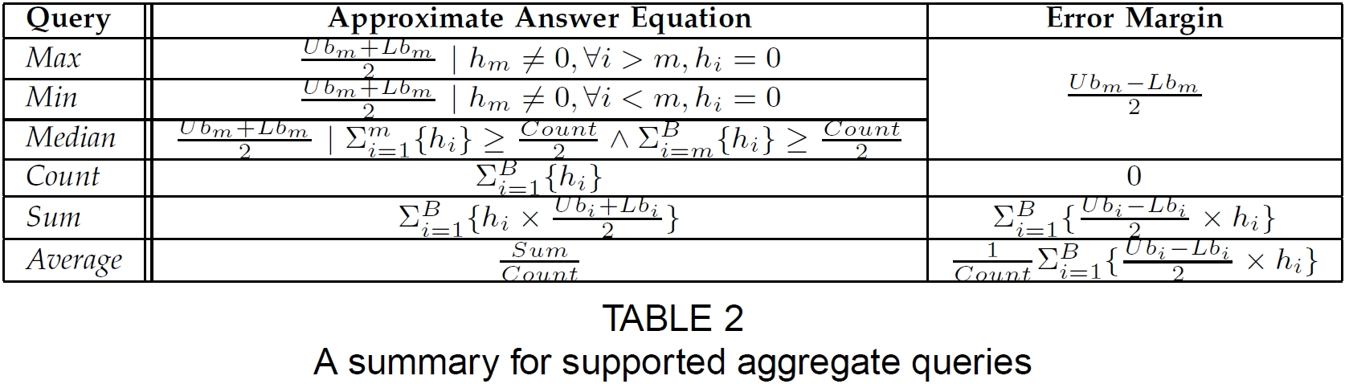
Other Aggregates
Other aggregates can be estimated
Notes:
Increasing number of bins increases accuracy, but also energy

Slide 59
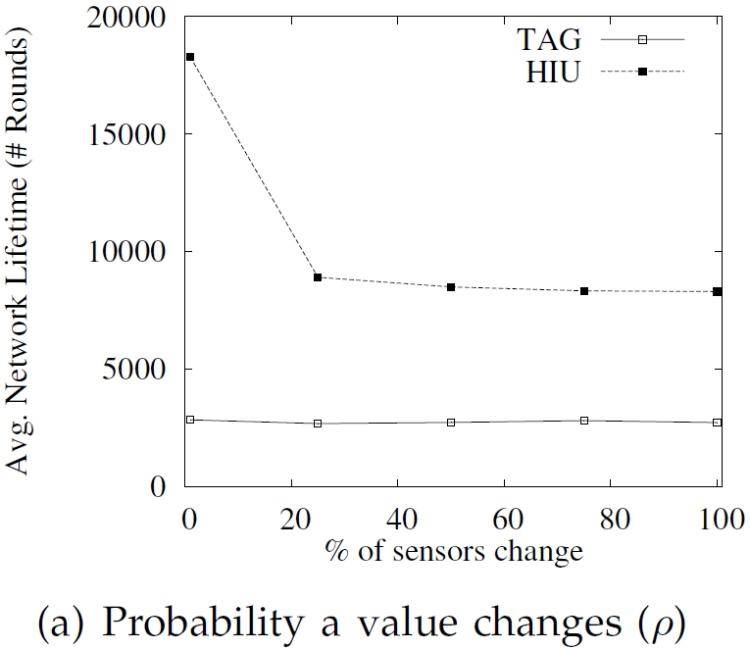
HIU Results

Slide 60
HIU Summary
Advantages | Disadvantages
Partial updates Possible cancellations Estimate other aggregates | |Partial State| = |Histogram|
Notes:
State size – would be advantageous to send only updated fields

Slide 61
Fast and Simultaneous
Multi-Region Aggregation⁸
Solutions so far are for single values
  Aims for multiple simultaneous aggregates
Assumes (questionably) a grid topology
  See [8] and [9] for details
Uses distributed data cube
  Idea taken from database systems
[8] D. Wu and M. H. Wong, “Fast and simultaneous data aggregation over multiple regions in wireless sensor networks,” Systems, Man, and Cybernetics, Part C: Applications and Reviews, IEEE Transactions on, vol. 41, no. 3, pp. 333-343, 2011.
[9] X. Li, Y. J. Kim, R. Govindan, and W. Hong, “Multi-dimensional range queries in sensor networks,” in Proceedings of the 1st international conference on Embedded networked sensor systems, 2003, pp. 63–75.

Slide 62
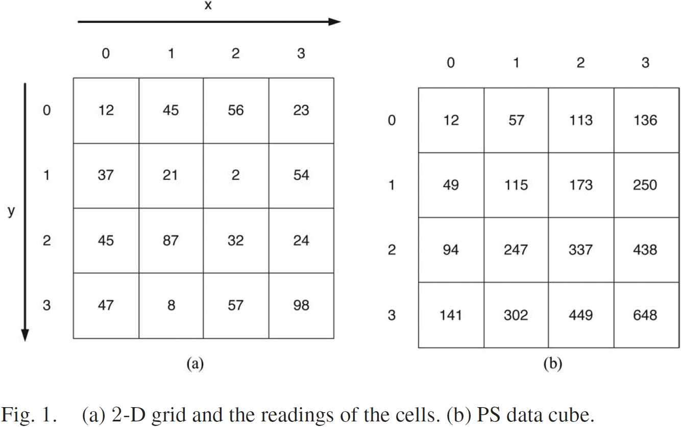
PS Cube Calculation
32 + 247 + 173 – 115 = 337

Slide 63
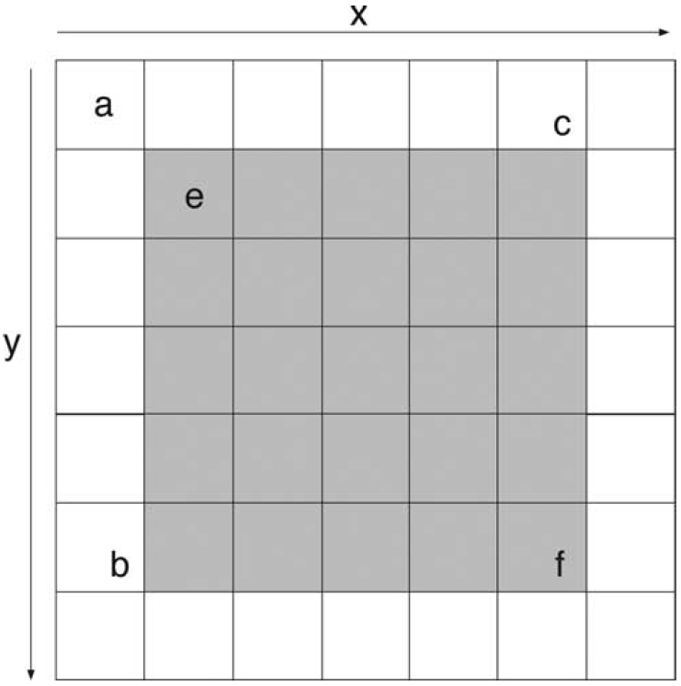
Region Definition (e:f)

Slide 64
Region Calculation (e:f)
Sum(e:f) = pSum(x_{f},y_{f}) – pSum(x_{e} – 1, y_{f}) – pSum(x_{f}, y_{e} – 1) + pSum(x_{e} – 1, y_{e} – 1)

Slide 65
Region Calculation (e:f)
Sum(e:f) = pSum(x_{f},y_{f}) – pSum(x_{e} – 1, y_{f}) – pSum(x_{f}, y_{e} – 1) + pSum(x_{e} – 1, y_{e} – 1)

Slide 66
Region Calculation (e:f)
Sum(e:f) = pSum(x_{f},y_{f}) – pSum(x_{e} – 1, y_{f}) – pSum(x_{f}, y_{e} – 1) + pSum(x_{e} – 1, y_{e} – 1)

Slide 67
Region Calculation (e:f)
Sum(e:f) = pSum(x_{f},y_{f}) – pSum(x_{e} – 1, y_{f}) – pSum(x_{f}, y_{e} – 1) + pSum(x_{e} – 1, y_{e} – 1)

Slide 68
Region Calculation (e:f)
Sum(e:f) = pSum(x_{f},y_{f}) – pSum(x_{e} – 1, y_{f}) – pSum(x_{f}, y_{e} – 1) + pSum(x_{e} – 1, y_{e} – 1)

Slide 69
Data Cube Summary
Advantages | Disadvantages
Theoretically fast queries Multiple simultaneous queries | Very limiting assumptions Increased overhead/latency No empirical comparison
Notes:
Data cube must be calculated at every epoch. This is doable in O(n) time, but still introduces latency.

Slide 70
Conclusion
A number of approaches, each with own tradeoffs
More details and works will be available in the report

Slide 71
Bibliography
[1] S. Madden, M. J. Franklin, J. M. Hellerstein, and W. Hong, “Tag: a tiny aggregation service for ad-hoc sensor networks,” ACM SIGOPS Operating Systems Review, vol. 36, no. SI, pp. 131–146, 2002.
[2] S. Nath, P. B. Gibbons, S. Seshan, and Z. R. Anderson, “Synopsis diffusion for robust aggregation in sensor networks,” in Proceedings of the 2nd international conference on Embedded networked sensor systems, 2004, pp. 250–262.
[3] P. Flajolet and G. Nigel Martin, “Probabilistic counting algorithms for data base applications,” Journal of Computer and System Sciences, vol. 31, no. 2, pp. 182–209, 1985.
[4] A. Manjhi, S. Nath, and P. B. Gibbons, “Tributaries and deltas: efficient and robust aggregation in sensor network streams,” in Proceedings of the 2005 ACM SIGMOD international conference on Management of data, 2005, pp. 287–298.
[5] Z. Chen and K. G. Shin, “OPAG: Opportunistic Data Aggregation in Wireless Sensor Networks,” in 2008 Real-Time Systems Symposium, 2008, pp. 345-354.
[6] B. Malhotra, M. A. Nascimento, and I. Nikolaidis, “Exact top-k queries in wireless sensor networks,” IEEE Transactions on Knowledge and Data Engineering, vol. 23, no. 10, pp. 1513-1525, 2010.
[7] K. Ammar and M. A. Nascimento, “Histogram and other aggregate queries in wireless sensor networks,” in Proc. of SSDBM, 2011, pp. 1-12.
[8] D. Wu and M. H. Wong, “Fast and simultaneous data aggregation over multiple regions in wireless sensor networks,” Systems, Man, and Cybernetics, Part C: Applications and Reviews, IEEE Transactions on, vol. 41, no. 3, pp. 333-343, 2011.
[9] X. Li, Y. J. Kim, R. Govindan, and W. Hong, “Multi-dimensional range queries in sensor networks,” in Proceedings of the 1st international conference on Embedded networked sensor systems, 2003, pp. 63–75.

Slide 72
Question #1
A prefix-sum (PS) cube is a cube (or grid in this case) in which an entry summarizes the aggregate sum of all values above and to the left of the grid entry. Using the prefix-sum values, a sum aggregate can then be easily calculated for a specified region using certain values bordering the defined region. Fill in the PS data-cube below and calculate the aggregate sum for the rectangular region (x=2,y=1):(x=3,y=3).

Slide 73
Question #1 - Answer
A prefix-sum (PS) cube is a cube (or grid in this case) in which an entry summarizes the aggregate sum of all values above and to the left of the grid entry. Using the prefix-sum values, a sum aggregate can then be easily calculated for a specified region using certain values bordering the defined region. Fill in the PS data-cube below and calculate the aggregate sum for the rectangular region (x=2,y=1):(x=3,y=3).
Sum(x=2,y=1:x=3,y=3) = 648 – 302 – 136 + 57 = 267

Slide 74
Question #2
Using the Histogram Incremental Update (HIU) aggregation algorithm, leaf nodes propagate changes in their local histogram by sending update messages to their parent (if required). These changes are locally aggregated at internal nodes and continuously moved up the tree until they reach the root node, which can then determine the overall network histogram. Show the update messages sent using the HIU algorithm if the values change as specified.
Bins: 0-1, 2-3, 4-5
5
4
2
3
3→1
3
3→4
2→1
2
1→2
1

Slide 75
Question #2 - Answer
Using the Histogram Incremental Update (HIU) aggregation algorithm, leaf nodes propagate changes in their local histogram by sending update messages to their parent (if required). These changes are locally aggregated at internal nodes and continuously moved up the tree until they reach the root node, which can then determine the overall network histogram. Show the update messages sent using the HIU algorithm if the values change as specified.
Bins: 0-1, 2-3, 4-5
5
Update messages in red.
[1,-2,1]
[1,-1,0]
+ [0,-1,1]
= [1,-2,1]
[-1,1,0]
+ [1,-1,0]
= [0,0,0]
4
2
[1,-1,0]
[0,-1,1]
[1,-1,0]
[-1,1,0]
3
3→1
3
3→4
2→1
2
1→2
1
[0,1,0]→[1,0,0]
[0,1,0]→[0,0,1]
[0,1,0]→[1,0,0]
[1,0,0]→[0,1,0]

Slide 76
Question #3
When calculating the EXACT top-k aggregate for a tree, temporal monitoring (TM) nodes are required to update the root every time their sensor value changes, while filtering (F) nodes are only required to send an update when they violate a filter value (essentially the same idea as a threshold). Identify the F and TM nodes in the tree on the left after top-2 is executed. Identify which nodes are required to send an update to the sink in the tree on the right.
5
5
7
4
7
7→9
4
4→6
8
3
1
9
8
3
1
9
3→7
9→10

Slide 77
Question #3 – Answer 1
When calculating the EXACT top-k aggregate for a tree, temporal monitoring (TM) nodes are required to update the root every time their sensor value changes, while filtering (F) nodes are only required to send an update when they violate a filter value (essentially the same idea as a threshold). Identify the F and TM nodes in the tree on the left after top-2 is executed. Identify which nodes are required to send an update to the sink in the tree on the right.
5
5
TM-Node
F-Node
7
4
7
7→9
4
4→6
8
3
1
9
8
3
1
9
3→7
9→10

Slide 78
Question #3 – Answer 2
When calculating the EXACT top-k aggregate for a tree, temporal monitoring (TM) nodes are required to update the root every time their sensor value changes, while filtering (F) nodes are only required to send an update when they violate a filter value (essentially the same idea as a threshold). Identify the F and TM nodes in the tree on the left after top-2 is executed. Identify which nodes are required to send an update to the sink in the tree on the right.
5
5
Updates
TM-Node
F-Node
7
4
7
7→9
4
4→6
8
3
1
9
8
3
1
9
3→7
9→10

Slide 79
Dave McKenney dmckenne@connect.carleton.ca
Thank you!

