Slide 1
Data Mining and Sensor Networks
(DMSNs)
Presented by Mohammed AlShammeri
University Of Ottawa
Fall 2011

Slide 2
Outline
Introduction | Area Objectives and Challenges | First Algorithm | Second Algorithm | Conclusion
Introduction
  Data Mining Background
  Data Mining and Sensor Networks Background
  Area Objectives
First Algorithm
  Online Mining in Sensor Networks
Second Algorithm
  Data Mining in Multi-Feature Sensor Networks
Conclusion
Questions
References

Slide 3
INTRODUCTION
Introduction | Area Objectives and Challenges | First Algorithm | Second Algorithm | Conclusion
Definitions
Data Mining: one of the process of extracting patterns from data
Data stream mining : is the process of extracting knowledge structures from continuous, rapid data
Multi-Feature Sensor Networks: sensor networks that report more than one Feature

Slide 4
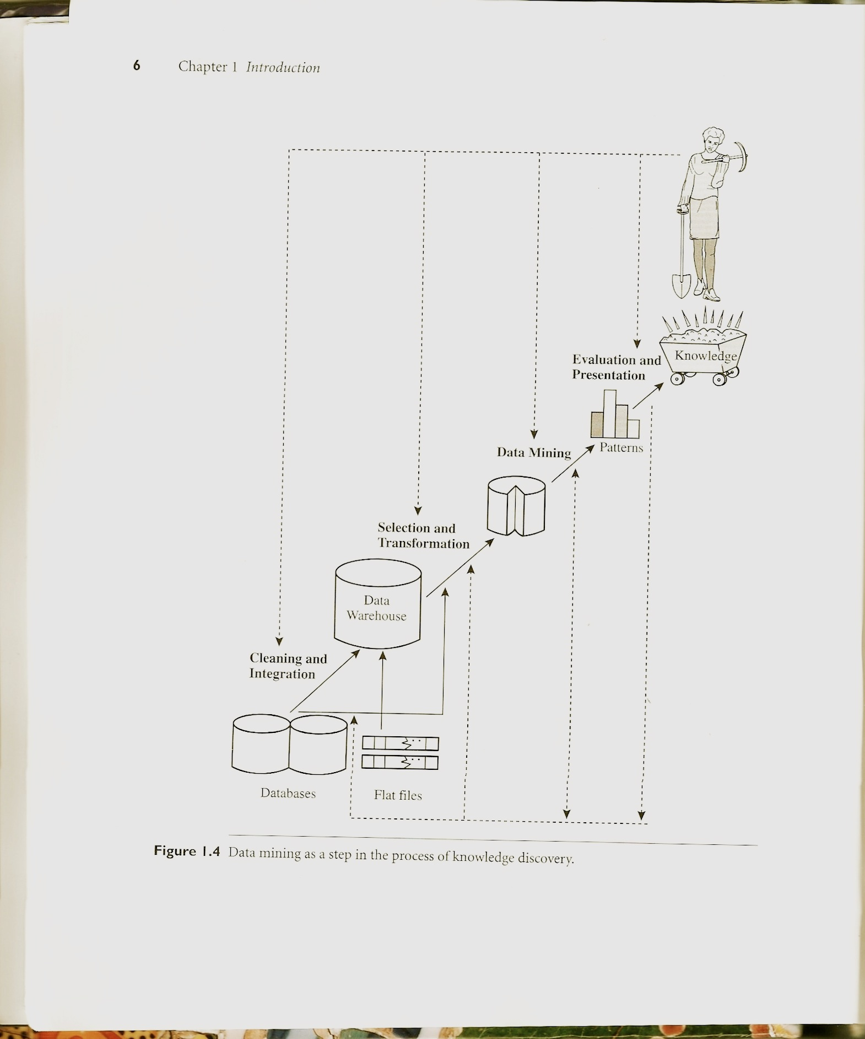
INTRODUCTION
Introduction | Area Objectives and Challenges | First Algorithm | Second Algorithm | Conclusion

Slide 5
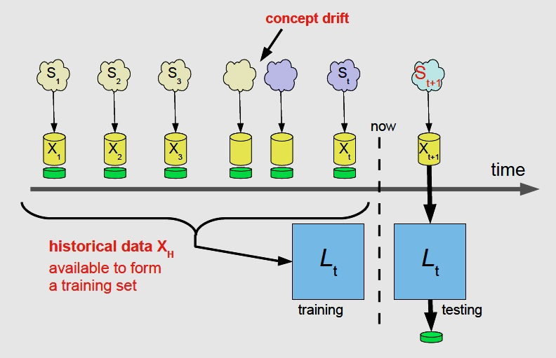
INTRODUCTION
Introduction | Area Objectives and Challenges | First Algorithm | Second Algorithm | Conclusion
1. Incoming Data
2. future prediction
4. model selection
and evaluation
3. learner

Slide 6
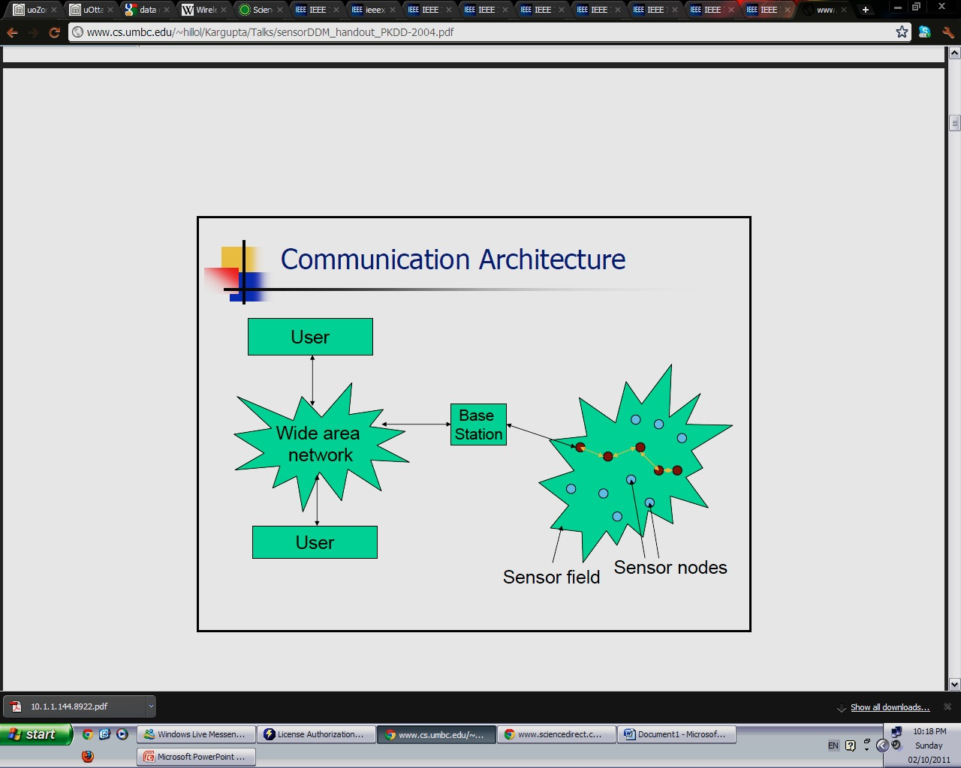
INTRODUCTION
Introduction | Area Objectives and Challenges | First Algorithm | Second Algorithm | Conclusion
3
2
1

Slide 7
Data Mining and Sensor Networks (DMSNs)
Introduction | Area Objectives and Challenges | First Algorithm | Second Algorithm | Conclusion
Area Motivation: Sensors can be deployed in large numbers in wide geographical areas to monitor, detect and report time-critical events. Consequently, wireless networks consisting of such sensors create exciting opportunities for large-scale, data-intensive measurement and surveillance applications.
Therefore: it is essential to mine the sensor readings for patterns in real time in order to make intelligent decisions promptly
Area Challenges :
Sensors have serious resource constraints including battery lifetime, , CPU capacity communication bandwidth and storage
sensor node mobility increases the complexity of sensor data
sensor data come in time-ordered streams over networks

Slide 8
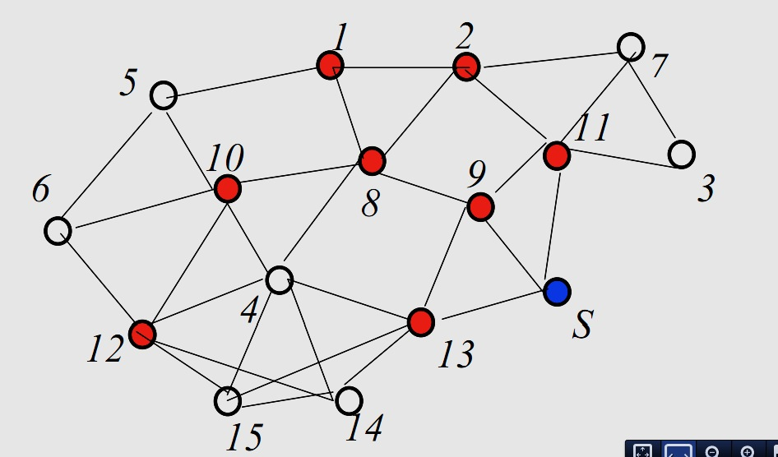
Data Mining and Sensor Networks (DMSNs) Example
Introduction | Area Objectives and Challenges | First Algorithm | Second Algorithm | Conclusion
Suppose we use neighbor elimination and dominating set,
Here we try to identify the dominating set to reduce the transmission and retransmission cost

Slide 9
Data Mining and Sensor Networks (DMSNs) Example Cont.
Introduction | Area Objectives and Challenges | First Algorithm | Second Algorithm | Conclusion

Slide 10
Data Mining and Sensor Networks (DMSNs) Example Cont.
Introduction | Area Objectives and Challenges | First Algorithm | Second Algorithm | Conclusion
Our focus in DMSNs on the data that sent by sensors

Slide 11
Online Mining in Sensor Networks (OMSNs)
Xiuli Ma¹, Dongqing Yang¹, Shiwei Tang¹, Qiong Luo², Dehui Zhang¹, Shuangfeng Li¹
Introduction | Area Objectives and Challenges | First Algorithm | Second Algorithm | Conclusion
Goal : processing as much data as possible in a decentralized fashion while keeping the communication, storage and computation cost low.
The authors propose three operations of online mining in sensor networks
detection of sensor data irregularities
clustering of sensor data
discovery of sensory attribute correlations
These mining operations are useful for practical applications and network management, because the patterns found can be used for both decision making in applications and system performance tuning.
Notes:
For example, irregularities in sensory data are of interest of monitoring applications. In addition, for this kind of applications, the communication cost can be reduced if only abnormal sensory values, as opposed to all values, need to be transmitted.

Slide 12
Online Mining in Sensor Networks (OMSNs)
Xiuli Ma¹, Dongqing Yang¹, Shiwei Tang¹, Qiong Luo², Dehui Zhang¹, Shuangfeng Li¹
Introduction | Area Objectives and Challenges | First Algorithm | Second Algorithm | Conclusion
Detection of Sensor Data Irregularities
Goal : The problem of irregularities detection is to find those sensory values that deviate significantly from the norm.
Motive : This problem is especially important in the sensor network setting because it can be used to identify abnormal or interesting events or faulty sensors.
We break this problem into two smaller problems.
detect irregular patterns of multiple sensory attributes
detect irregular sensory data of a single attribute with respect to time or space.
Notes:
The irregular multi-attribute pattern detection problem has the assumption that there are some normal patterns among multiple sensory attributes, which is true in some natural phenomena. Once these normal patterns are broken somewhere, the irregularity is detected and reported. Once these normal patterns are broken somewhere, the irregularity is detected and reported. In contrast, the irregular single-attribute sensor data detection problem examines the temporal and spatial characteristics of a sensor node and detects any irregularity in comparison with the node’s previous data or the data of the neighbor nodes.

Slide 13
Online Mining in Sensor Networks (OMSNs)
Xiuli Ma¹, Dongqing Yang¹, Shiwei Tang¹, Qiong Luo², Dehui Zhang¹, Shuangfeng Li¹
Introduction | Area Objectives and Challenges | First Algorithm | Second Algorithm | Conclusion
Detection of Irregular Patterns
The authors propose a new approach named pattern variation discovery to solve this problem.
There are four steps for pattern variation discovery approach
Selection of a reference frame
  This frame consists of the directions along which we want to look for irregularities among multiple sensory attributes
Definition of normal patterns
  This definition can be models of multiple sensory attributes or constraints among multiple attributes
Incremental maintenance of the normal patterns
  Whenever a sensor gets a new round of readings, the normal patterns are adjusted incrementally
Discovery of irregularity
  Whenever a normal pattern is broken at some point along the reference frame, an irregularity appears

Slide 14
Online Mining in Sensor Networks (OMSNs)
Xiuli Ma¹, Dongqing Yang¹, Shiwei Tang¹, Qiong Luo², Dehui Zhang¹, Shuangfeng Li¹
Introduction | Area Objectives and Challenges | First Algorithm | Second Algorithm | Conclusion
Detection of Irregular Sensor Data
temporal irregularities in sensor data
We build a model of the sensory data as the readings of a node come in
When some reading substantially affects the coefficients of the model, it is identified as an irregularity
With resource constraints of sensor nodes, we may need to approximate the distribution of data instead of maintaining all historical data
spatial irregularities in sensor data
we build a statistical model of readings of neighboring nodes
If some readings of a node differ from what the model anticipates based on the readings of the neighboring nodes, an irregularity is detected
In order to reduce resource consumption, we may define the neighboring nodes to be those only a single hop away on the network
As a node moves geographically, the parameters of its model is incrementally adjusted

Slide 15
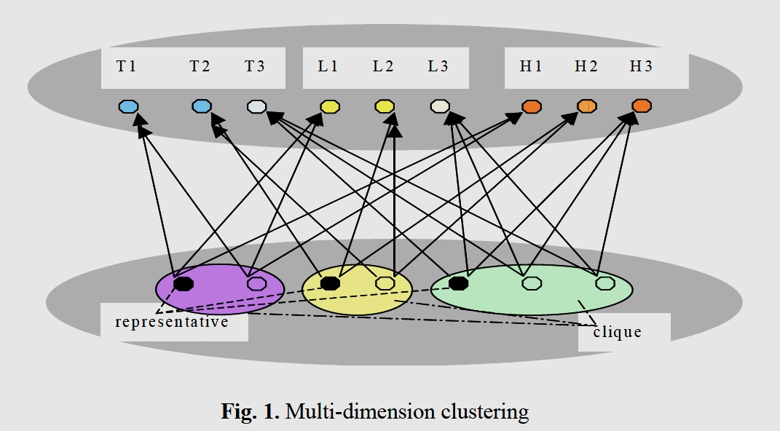
Online Mining in Sensor Networks (OMSNs)
Xiuli Ma¹, Dongqing Yang¹, Shiwei Tang¹, Qiong Luo², Dehui Zhang¹, Shuangfeng Li¹
Introduction | Area Objectives and Challenges | First Algorithm | Second Algorithm | Conclusion
Clustering of Sensor Data

Slide 16
Online Mining in Sensor Networks (OMSNs)
Xiuli Ma¹, Dongqing Yang¹, Shiwei Tang¹, Qiong Luo², Dehui Zhang¹, Shuangfeng Li¹
Introduction | Area Objectives and Challenges | First Algorithm | Second Algorithm | Conclusion
Clustering of Sensor Data
The authors propose a new approach named multi-dimensional clustering of sensor data
There are four steps for multi-dimensional clustering approach
cluster the sensor data along each sensor attribute separately
  All resulted clusters from a set of clusters, which we call the Cluster Set
construct a bipartite graph G with the Sensor Set (the set of sensor nodes) and the Cluster Set being the two vertex sets
  If some sensory attribute value of a sensor v belongs to cluster u, there is an edge pointing from v to u
  find all of the maximal complete bipartite sub-graphs, i.e., the maximal bipartite cliques of G
  Thèse cliques identify «which sensor nodes have similar sensory readings on which attributes »

Slide 17
Second Algorithm
Introduction | Area Objectives and Challenges | First Algorithm | Second Algorithm | Conclusion
Data Mining in Multi-Feature Sensor Networks
Rabie A. Ramadan
Problem Statement: Assume a sensor network with S sensors deployed across a certain monitored field A
Also, suppose :
  Each sensor node posses some kind of transmission medium that allows it to communicate directly with neighbouring nodes
  Sensor nodes are heterogeneous, with each sensor node could sense different data types
  Energy consumption is not uniform for all nodes: transmission power levels are not the same and so are computation power and sensing power
  Sensor nodes are left unattended after deployment, usually in inaccessible terrain or dangerous environments, leaving no choice for battery recharge
  Sensor nodes are assumed to have a enough storage to store some of their sensed data for limited period of time
Goal : Coming up with a suitable data mining framework for the multi-feature sensor networks. The framework is supposed to extend the sensor network lifetime.

Slide 18
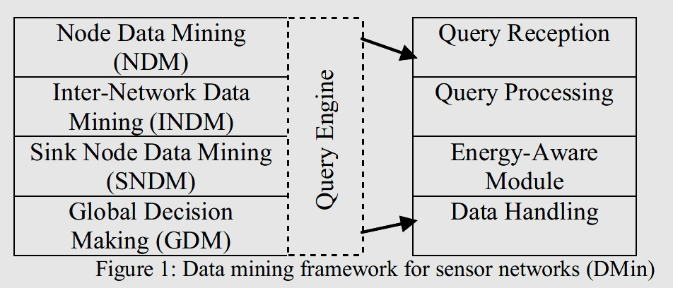
Data Mining in Multi-Feature Sensor Networks
Rabie A. Ramadan
Introduction | Area Objectives and Challenges | First Algorithm | Second Algorithm | Conclusion

Slide 19
Data Mining in Multi-Feature Sensor Networks
Rabie A. Ramadan
Introduction | Area Objectives and Challenges | First Algorithm | Second Algorithm | Conclusion
Node Data Mining Layer
Considers the data mining principles on the node itself
Every node have a piece of its own history for further analysis or sink node future query request
Use sliding window algorithm to reduce the transmitting
Each node compares the current sensed value to the previous value
If there is an important change, the node report. If not, keep the current value
if it exceeds a certain threshold, it sends to the sink node
report the new sensed value based on suddenly change
This will reduce the data transmitted over the network

Slide 20
Data Mining in Multi-Feature Sensor Networks
Rabie A. Ramadan
Introduction | Area Objectives and Challenges | First Algorithm | Second Algorithm | Conclusion
Inter-Network Data Mining Layer
an intermediate layer between the sink node and sensor nodes
This layer deals with the clustering of sensor nodes according to several criteria such as data similarity
clustering techniques identify cluster heads that are responsible of collecting information from their members

Slide 21
Data Mining in Multi-Feature Sensor Networks
Rabie A. Ramadan
Introduction | Area Objectives and Challenges | First Algorithm | Second Algorithm | Conclusion
The sink node data mining layer
applies a centralized data mining technique, after gathering all information from the cluster heads in the network
This centralized approach enables the sink node to have a global view of the entire network
This is where the Global Decision Making (GDM) layer comes to the play

Slide 22
Data Mining in Multi-Feature Sensor Networks
Rabie A. Ramadan
Introduction | Area Objectives and Challenges | First Algorithm | Second Algorithm | Conclusion
Global Decision Making (GDM) layer
GDM layer is separated from other layer to consider different applications requirements
separation also allows using different node/computer other than the sink node for decision making
the GDM layer includes the user specified queries

Slide 23
Data Mining in Multi-Feature Sensor Networks
Rabie A. Ramadan
Introduction | Area Objectives and Challenges | First Algorithm | Second Algorithm | Conclusion
Query Engine is an optional layer that is associated
with all of the framework layers. The query engine is required
for a query-based network where the sink node queries the
sensed data in the node

Slide 24
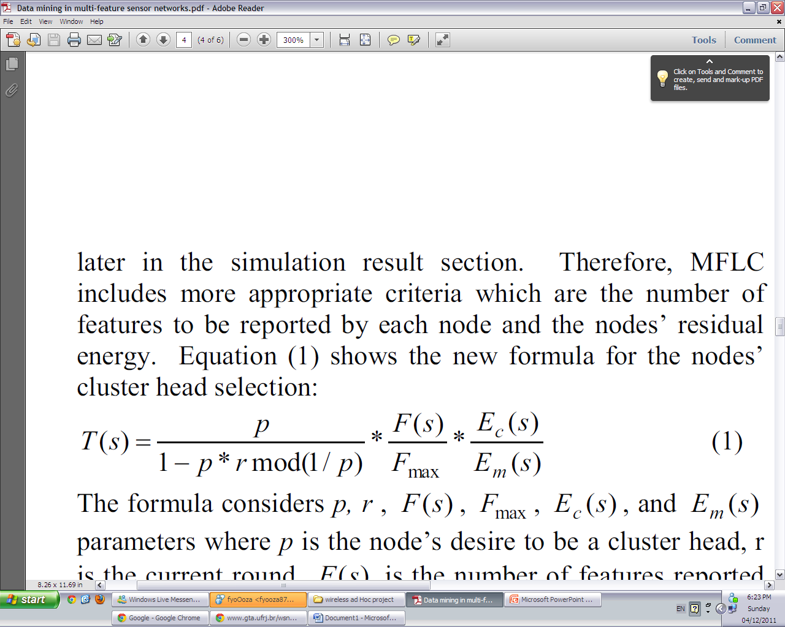
Data Mining in Multi-Feature Sensor Networks
Rabie A. Ramadan
Introduction | Area Objectives and Challenges | First Algorithm | Second Algorithm | Conclusion
MFLC Protocol
Step 1:
  The algorithm starts by the initialization phase where the sink node (SN) broadcasts its position and the maximum number of features expected to be reported from all nodes
  After nodes received the SN message, each node looks for its neighbours and fills its neighbours' list l
Step 2:
  nodes start working on the clustering where each node applies equation (1) and computes T(s)
Where p is the node’s desire to be a cluster head , r is the current round, F(s) is the number of features reported by node s, Fmax is the maximum features reported by the network, Ec(s) is node’s s residual energy, Em(s) is node’s initial energy

Slide 25
Data Mining in Multi-Feature Sensor Networks
Rabie A. Ramadan
Introduction | Area Objectives and Challenges | First Algorithm | Second Algorithm | Conclusion
MFLC Protocol
Step 2: Cont.
  At the same time, each node runs the random generator algorithm to generate a random number between 0 and 1
  Based on these two values, T(s) and the random number, the node decides to be a cluster head or not
  If a node decided to be a cluster head, it sets the CHparam to true and waits for a certain period of time to hear from other cluster heads (if any)
  If it hears from any other cluster head, it adds it to its CH-list for further usage
  If a node is not a cluster head, it decides to join one of its neighbour cluster heads based on the cluster heads residual energy
  Any node without a cluster head, it is forced to be a cluster head

Slide 26
Data Mining in Multi-Feature Sensor Networks
Rabie A. Ramadan
Introduction | Area Objectives and Challenges | First Algorithm | Second Algorithm | Conclusion
Step 3:
  Nodes start to report to their cluster heads using TDMA protocol (Time division multiple access (TDMA) is a channel access method for shared medium networks. It allows several users to share the same frequency channel by dividing the signal into different time slots.)
  The cluster heads applies an appropriate aggregation method such as the average on the received similar features and try to send the aggregated value(s) to the sink node
  A cluster head might not be directly connected to the sink node. Therefore, a multi-hop reporting must be used. We propose the cluster head to choose one of its neighbour cluster heads found in its CH-list with the highest residual energy to sent to
  However, the CH-list might be empty; thus, the cluster head has to select one of its neighbours that it does not belong to its cluster to report to
  If all of the neighbours belong to other clusters, it might select a node at random or based on the neighbours energy or number of features hoping that it will reach one of the other cluster heads
  Step 4: repeat until the network stop

Slide 27
INTRODUCTION
Conclusion
Introduction | Area Objectives and Challenges | First Algorithm | Second Algorithm | Conclusion
Online mining for sensor networks faces several new challenges :
Sensors have serious resource constraints including battery lifetime, communication bandwidth, CPU capacity and storage
sensor node mobility increases the complexity of sensor data because a sensor may be in a different neighborhood at any point of time
sensor data come in time-ordered streams over networks
Our goal is to process as much data as possible in a decentralized fashion while keeping the communication, storage and computation cost low

Slide 28
INTRODUCTION
References
Introduction | Area Objectives and Challenges | First Algorithm | Second Algorithm | Conclusion
Ramadan, R.A.; , "Data mining in multi-feature sensor networks," Computer Engineering & Systems, 2009. ICCES 2009. International Conference on , vol., no., pp.584-589, 14-16 Dec. 2009 doi: 10.1109/ICCES.2009.5383064
Ma, X., Yang, D., Tang, S., Luo, Q., Zhang, D., Li, S.: Online mining in sensor networks. In Jin, H., Gao, G.R., Xu, Z., Chen, H., eds.: NPC. Volume 3222 of Lecture Notes in Computer Science., Springer (2004) 544{550
Rodrigues, P.P., Gama, J.: Online prediction of streaming sensor data. In Joo Gama, J. Roure, J.S.A.R., ed.: Proceedings of the 3rd International Workshop on Knowledge Discovery from Data Streams (IWKDDS 2006), in conjunction with the 23rd International Conference on Machine Learning. (2006)
Yairi, T., Kato, Y., Hori, K.: Fault detection by mining association rules from house-keeping data. In: Proceedings of the 6th International Symposium on Artificial Intelligence, Robotics and Automation in Space. (2001)
Halatchev, M., Gruenwald, L.: Estimating missing values in related sensor data streams. In Haritsa, J.R., Vijayaraman, T.M., eds.: Proceedings of the 11th Inter-national Conference on Management of Data (COMAD '05), Computer Society of India (January 2005) 83{94

Slide 29
INTRODUCTION
Questions
Introduction | Area Objectives and Challenges | First Algorithm | Second Algorithm | Conclusion
Question 1
Apply the multi-dimensions clustering to determine which sensors data belong to sensor nodes. For each, construct a bipartite sup graph with sensor set. If some sensory attributes value of sensor v belongs to to cluster u, there is an edge pointing from v to u
Suppose the sensor network below measuring the weather temperature and humidity
Notes
each clique has a representative
T1 , T2 , H1 , H2
where T stands for temperature and H stands for humidity
hop

Slide 30
INTRODUCTION
Questions
Introduction | Area Objectives and Challenges | First Algorithm | Second Algorithm | Conclusion
Answer 1
Step 1
cluster the sensor data along each sensor attribute separately. which we call the Cluster Set
Step 2
construct a bipartite graph G with the Sensor Set (the set of sensor nodes) and the Cluster Set being the two vertex sets
H1
H2
T1
T2
hop

Slide 31
INTRODUCTION
Questions
Introduction | Area Objectives and Challenges | First Algorithm | Second Algorithm | Conclusion
Answer 1
Step 3
  If some sensory attribute value of a sensor v belongs to cluster u, there is an edge pointing from v to u
H1
H2
T1
T2
hop

Slide 32
INTRODUCTION
Questions
Introduction | Area Objectives and Challenges | First Algorithm | Second Algorithm | Conclusion
Answer 1
Step 3
  If some sensory attribute value of a sensor v belongs to cluster u, there is an edge pointing from v to u
  Since all sensor nodes in one clique are similar, we can select a representative node for each clique to work on behalf of its clique in order to save power consumption with a reduced accuracy of data
  This selection can be based the distance between the node and the base station
H1
H2
T1
T2
hop

Slide 33
INTRODUCTION
Questions
Introduction | Area Objectives and Challenges | First Algorithm | Second Algorithm | Conclusion
Question 2
3
6
2
7
Hop 1
Hop 2
1
8
5
4
9
Apply the data mining technique that proposed in Online mining in sensor networks on the scenario 1. The techniques is the detection of irregularities in sensor data by considering the neighboring nodes reading. If some readings of a node differ from the readings of the neighboring nodes, an irregularity is detected
scenario 1: suppose this network measure the temperature in area A at time t. suppose the readings were as fallows:
1= 17 , 2=17, 3= 17, 4=0 , 6=40, 7= 17, 8=17, 9=17, 5= 17
Your task is to identify which nodes have irregularities sensor data and list their neighboring nodes

Slide 34
INTRODUCTION
Questions
Introduction | Area Objectives and Challenges | First Algorithm | Second Algorithm | Conclusion
Answer 2
The nodes that have irregularities are 4, 6
Neighbors of 4 : 1,2,3
Neighbors of 4 : 5,7,8, 9

Slide 35
INTRODUCTION
Questions
Introduction | Area Objectives and Challenges | First Algorithm | Second Algorithm | Conclusion
Question 3
Suppose the fallowing network measure the temperature in area A at time t and the reading were: 1=15, 2= 15, 3= 15, 4=15 .At time t+1, the reading become: 1=15, 2= 15, 3= -10, 4=15
Use sliding window algorithm to reduce the transmission. Each node compares the current sensed value to the previous value If there is an important change, the node report. If not, keep the current value if it exceeds a certain threshold, it sends to the sink node. report the new sensed value based on suddenly change
Your task is to list the nodes that transmit before exceeds time threshold and after at time t+1
3
3
2
2
Hop 1
Hop 1
1
1
4
t
4
t+1

Slide 36
INTRODUCTION
Questions
Introduction | Area Objectives and Challenges | First Algorithm | Second Algorithm | Conclusion
Answer 3
The node that transmits before time end is 3
The nodes that transmits after time end are 1,2,4

Slide 37
Thanks for listening
Comments & Questions

