Slide 1
Cognitive Radio Networks
Nipun Nanda
nipunnanda@hotmail.ca

Slide 2
Outline
1.Introduction
2.Motivation
3.Cognitive Radio Network(CRN)
4.Categories of CRN
5. Challenges
6. Routing Schemes
7.References
8.Questions

Slide 3
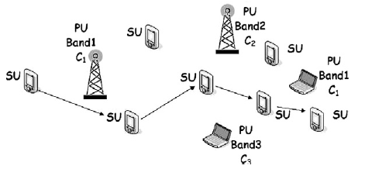
Introduction
The cognitive radio network are an intelligent multiuser wireless communication systems.
Cognitive radio networks (CRNs) are composed of cognitive, spectrum-agile devices capable of changing their configurations based on the spectral environment. This capability allows the reuse of portions of the spectrum temporarily vacated by licensed primary users.

Slide 4
Motivation
According to Federal Communication Commission, most of the assigned spectrum bands (licensed bands) are under-utilized while unlicensed spectrum bands are always crowded.
Current wireless networks are regulated by fixed spectrum assignment policy.
  Fixed Spectrum Assignment policy White Spaces
  Inefficient spectrum utilization

Slide 5
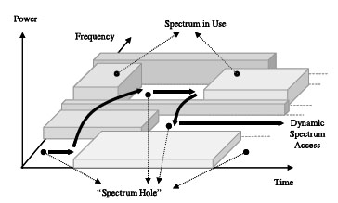
Motivation
Spectrum Hole/White Space: Spectrum hole or White space is a set of frequency bands that are currently unoccupied and available for use, which may be available only for a short while before it is reclaimed by a primary user.
Cognitive radio network is :
A new paradigm that provides the capability to share or use the spectrum in an opportunistic manner.

Slide 6
Cognitive Radio
Cognitive radio is a wireless communication system which is aware of the environment and its changes.
The ability to sense the unused spectrum (spectrum hole or white spaces).
The ability to receive and transmit at different frequency band which enables it to reconfigure its parameters and select the best band.

Slide 7
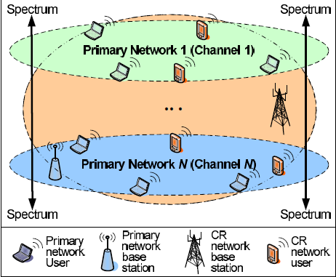
Cognitive Radio Network
CRN consists of: primary user (the license holder of a spectrum band) and secondary users (cognitive users).

Slide 8
CRN Components
Primary network
  Primary users(PU): Primary users have the license to operate in certain
  spectrum bands
  Primary base station: Controls the access of primary users to spectrum
Secondary network
  Secondary users(SU): Secondary users have no licensed bands assigned to
  them.
  Secondary base-station: A fixed infrastructure component with cognitive radio capabilities

Slide 9
Categories of CRNs
We classify them into three separate categories:
• Static Multihop CRNs
• Dynamic Multihop CRNs
• Opportunistic or highly dynamic Multihop CRNs
Based on the holding time of the exploited primary bands by the CR determine the routing solution to use.

Slide 10
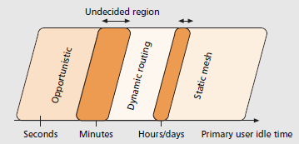
Categories of CRNs
Figure shows the primary band holding time and the three possible categories.
Choosing between a dynamic routing solution and an opportunistic approach is a hard decision to make

Slide 11
Challenges
The main challenges for routing information throughout multi-hop CRNs include:
Challenge 1 : the spectrum-awareness: Designing efficient routing solutions requires the spectrum management functionalities such that the routing module(s) can be continuously aware of the surrounding physical environment to take more accurate decisions.
Challenge 2 : the set up of ‘‘quality” routes: Refers to deciding the categories of CRN.
Challenge 3 : the route maintenance/reparation: The sudden appearance of a PU in a given location may result in unpredictable route failures. Thus effective signalling procedures are required to restore ‘‘broken” paths with minimal effect on the perceived quality.

Slide 12
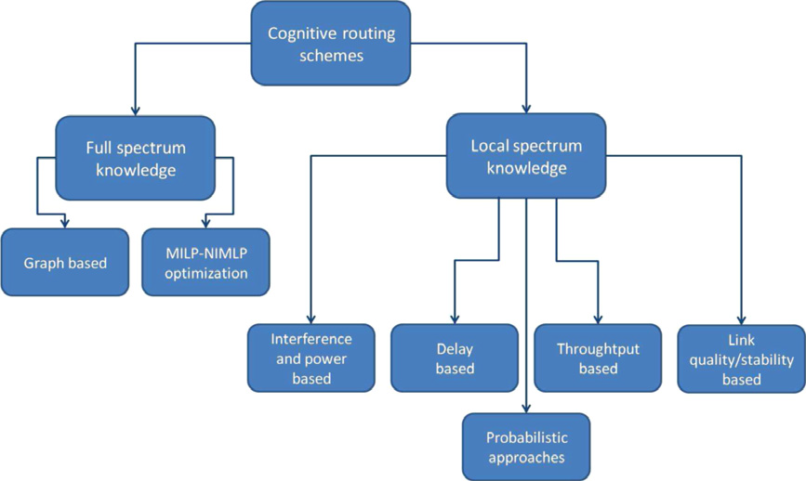
Routing Schemes
Keeping an eye on the aforementioned three main challenges various routing solutions can be discussed.
Classification of
routing schemes

Slide 13
Routing Schemes
Full Spectrum Knowledge: Spectrum occupancy map is available to the network nodes, or to a central control entity.
Network Layered Graph model[4]
Local Spectrum Knowledge: Information on spectrum availability is locally ‘‘constructed” at each SU .
Spectrum Aware Mesh Routing (SAMER)[5]

Slide 14
Graph-Based Routing Scheme
It consists of two phases:
Graph abstraction phase: Refers to the generation of a graph representing the physical network topology. The outcome of this phase is the graph structure G = (N, V, f(V)), where N is the number of nodes, V is the number of edges, and f(V) the function which allows to assign a weight to each edge of the graph.
Route calculation: Deals with defining/designing a path in the graph connecting source–destination pairs.

Slide 15
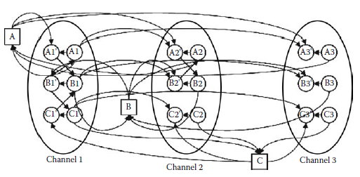
Layered Graph Model
Each layer corresponds to a channel.
N denote the number of channels (layers).
User device is represented as node A .
For each node ,N additional subnodes, A1,.., AN, Ai subnode in layer i .

Slide 16
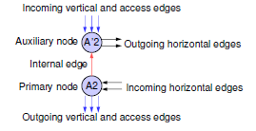
Layered Graph Model
The edges in the layered graph are classified into four types:
• Access edges: Connects a node to its subnodes, e.g., node A to subnode A1.
• Horizontal edges: Connect subnodes in the same layer.
• Vertical edges: Connect subnodes in different layers that are from the same
node.
• Internal edges :Connect a subnode to its auxiliary node.
Auxiliary subnode is A’i for each subnode Ai :
Used so that no node can take more than one
path when changing channels.

Slide 17
Layered Graph Model
Algorithm :Construction of layered graph edges
1) On each layer i, if there is a channel available between two potential neighboring nodes, A and B, then let (horizontal) edge (Ai,Bi) ∈ G.
2) If the number of free interfaces at node A is larger than 1, then for all Ai,Aj ∈ A, let (vertical) edge (Ai,Aj) ∈ G.
3) If the number of free interfaces at node A equals 1, then for any active subnode Ai ∈ A and any inactive subnode Aj ∈ A, let (vertical) edge (Ai,Aj) ∈ G.
4) For all active subnodes Ai,Aj ∈ A, let (vertical) edge (Ai,Aj) ∈ G.

Slide 18
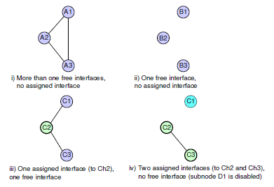
Layered Graph Model
Vertical edges in the layered graph

Slide 19
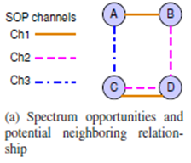
Layered Graph Model
A complete picture of the layered graph, including access, horizontal, vertical, and internal edges.
Topology formation for a network. Node A and C have 2 interfaces. Node B and D have 1 interface. The solid line indicates a data link established on the corresponding channel.

Slide 20
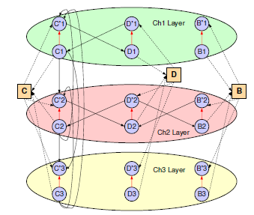
Layered Graph Model
Figure shows the constructed layered graph for the DSA network. For demonstration purpose, have excluded the edges corresponding to node A.

Slide 21
Layered Graph Model
Using the layered graph, finding a routing path between two nodes in a network becomes simply computing a shortest path in G, with appropriate edge costs.
Routing Path Computation
1.Sort all node pairs (source and destination) by some metric. This can be link capacity, traffic load, etc.
2.Pick a node pair or a destination. Compute a path between the selected node pair .

Slide 22
Conclusion
The proposed layered graph framework is useful to model channel assignment and routing in semi static multi-hop CRNs, where the topology variability dynamics is low.

Slide 23
Throughput-Based solutions
Spectrum Aware Mesh Routing (SAMER)
The design of SAMER is to utilize available spectrum blocks by routing data traffic over the paths with higher spectrum availability. For computing spectrum availability we use (path spectrum availability)PSA metric.
PSA’s goal is to capture:
1. Local spectrum availability: Spectrum availability at a node i depending on the number of available spectrum blocks at i.
2. Spectrum blocks quality depending on their bandwidth and loss rate.

Slide 24
SAMER
The PSA is expressed as the throughput between a pair of nodes (i, j) across a spectrum block b as:
Thr(i,j),b = Tf ,b ∙ Bw,b ∙(1 – ploss,b)
Bw,b = is the bandwidth
ploss,b = the loss probability of the spectrum block b.
Tf,b = is the fraction of time during which the node i is free to transmit and/or receive packets through a spectrum block b.
PSA across a for a path P is considered the minimum throughput for (i, j) ∈ P as this link

Slide 25
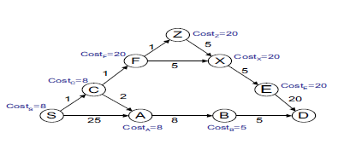
SAMER
Consider in figure the nodes execute SAMER routing protocol. In the example topology, the cost Costi for each node i is given . Source and destination nodes are S and D respectively. In case that the cost is the same for all the candidate forwarding paths, data is forwarded over the link of the smallest weight.

Slide 26
SAMER
In the first round, the algorithm has two candidate forwarding nodes C,A, and because link S−C is better, it will forward the packet to C.
In the second round, C has only one candidate, node A as CostF > 8. So the final path to the destination D, will be S −C −A−B −D.

Slide 27
Conclusion
SAMER is found to outperform the popular hop count metrics. Furthermore, SAMER avoids highly congested and unavailable links.

Slide 28
Routing Schemes
Classification of routing schemes.

Slide 29
References
V. Bhargavaand E. Hussain, ed., Cognitive Radio Networks, Springer-Verlag, 2007.
H. Khalife, N. Malouch, S. Fdida. Multihop cognitive radio networks: to route or not to route, IEEE NETWORK, vol. 23, no. 4, pp. 20–25, July/Aug. 2009.
M. Cesana, F. Cuomo, E. Ekici, Routing in cognitive radio networks: Challenges and solutions, Ad Hoc Networks, to appear.
C. Xin, B. Xie, C.-C. Shen, A novel layered graph model for topology formation and routing in dynamic spectrum access networks, in: First IEEE International Symposium on New Frontiers in Dynamic Spectrum Access Networks, DySPAN 2005, pp. 308–317.
I. Pefkianakis, S. Wong, S. Lu, SAMER: spectrum aware mesh routing in cognitive radio networks, in: 3rd IEEE Symposium on New Frontiers in Dynamic Spectrum Access Networks, DySPAN 2008, 2008, pp. 1–5, doi: 10.1109/DYSPAN.2008.90.

Slide 30
Questions
Question 1: What are the major Challenges in Multihop cognitive radio networks (CRNs) ?
Answer: The main challenges are:
Challenge 1: The spectrum-awareness
Challenge 2: The set up of ‘‘quality” routes
Challenge 3: The route maintenance/reparation

Slide 31
Questions
Question 2: Consider SAMER routing protocol. In the example topology except from the link weights, we present also the cost Costi for each node i . Source and destination nodes are S and D respectively. In case that the cost is the same for all the candidate forwarding paths, data is forwarded over the link of the smallest weight. Find the path from S to D.
Answer:
In the first round, the algorithm has two candidate forwarding nodes C,A and because link S−C is better, it will forward the packet to C.
In the second round, C has only one candidate, node A as CostF > 8.
So the final path to the destination D, will be S −C −A−B −D.

Slide 32
Questions
Question 3: Topology formation for a DSA network. Node A and C have 2 interfaces. Node B and D have 1 interface. The solid line indicates a data link established on the corresponding channel. Draw the Partial view of the layered graph that represents node B, C, and D using layered graph model. Also identify access, horizontal, vertical, and internal edges.

Slide 33
Questions
Answer: Partial view of the layered graph that represents node B, C, and D
Access edges: Dotted arrows
Internal edges: Red arrows
Horizontal edges: Solid arrows
connecting subnodes in the
same layer[like edges(C`1,D1),
(D`2,C2)....]
Vertical edges :Solid arrows
connecting subnodes in the
different layer[like edges(C1,C`2), (C1,C`3),(C3,C`2)....]

Slide 34
THANK YOU
.

