Slide 1
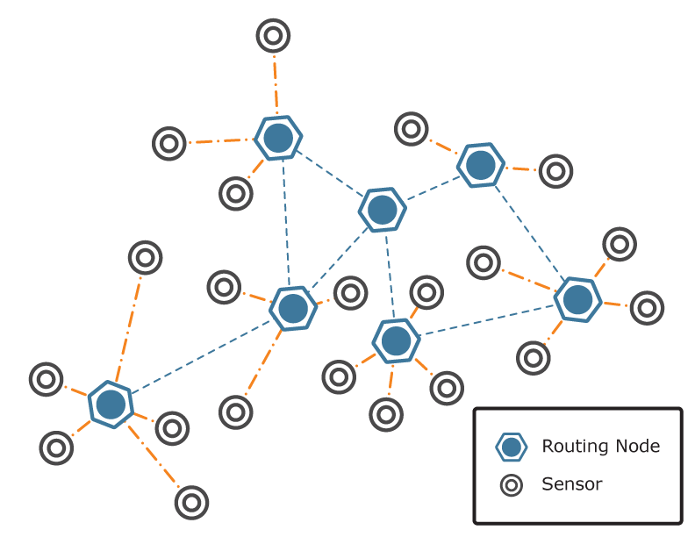
Embedded operating systems for sensor nodes
Hirdepal Singh Hunjan
6533352
hhunj057@uottawa.ca

Slide 2


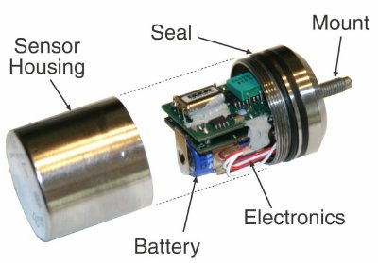
Introduction
Why Do Sensors Need Operating Systems?
General purpose device Sensor Single application device
For devices customized to a particular application, such as digital cameras or microwaves, it is much simpler to run the application code directly on the microcontroller. On the other hand, more general-purpose devices such as personal digital assistants (PDAs) use embedded versions of full-blown operating systems, such as Windows Mobile PocketPC OS to provide basic services that are common to multiple applications.
Sensor nodes fall somewhere in between the single-application devices that need no operating system, and the more capable, general-purpose devices with the resources to run a traditional embedded operating system. A sensor operating system provides a limited number of common services for application developers.

Slide 3
Common services carried on by EOS
Hardware management of sensors, radios, and I/O buses, and devices such as external flash
Task cordination
Power management
Adaptation to resource constraints
Networking

Slide 4
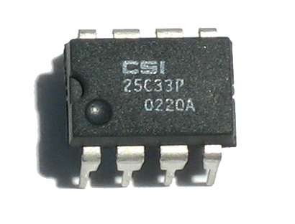
MICROSENSOR NODE HARDWARE
In developing operating systems for embedded micro sensor nodes, the chosen hardware has a direct effect on many aspects of the system design.
  Flash, SRAM, and EEPROM
In terms of both time and energy,
flash memory is inexpensive to read
but expensive to write, which makes
it well suited for program memory.
Flash memory is nonvolatile, so it retains data
when powered off.
The number of writes to a particular block is limited, as the blocks wear out over time.

Slide 5
SRAM is random access and is generally fast for reads and writes, but is volatile, consumes more energy than flash, and costs more.
SRAM does not wear out in the same fashion as flash memory.
For these reasons, SRAM is used in small quantities as data memory.
From an operating system perspective, EEPROM behaves similarly to flash:
It is nonvolatile,
Survives a limited number of writes,
May be slow to write.

Slide 6
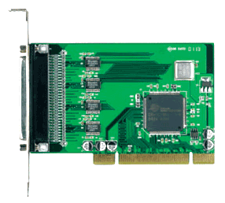
Peripheral Interfaces
Modern microcontrollers come with a number of peripheral interfaces, all integrated on the same chip with the CPU and memory.
Peripheral devices, such as the radio and sensors, connect to the microcontroller through one or more of these interfaces.
Common interfaces include
UART (universal asynchronous receiver transmitter),
SPI (serial peripheral interface),
I2C (inter-integrated circuit)

Slide 7
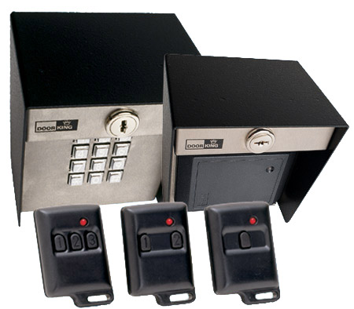
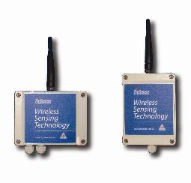
Radios
Radio-frequency (RF) devices may or may not
have a large impact on the performance
of a sensor operating system, depending on how
much of the RF protocol is handled in hardware.
Sensors
Sensors are difficult to characterize as a group, because
they come in such a wide variety. Sensors may be digital
or analog in nature, may or may not require significant
attention from the CPU, and may have power requirements ranging from insignificant to dominant.

Slide 8
PRINCIPLES OF SENSOR
OPERATING SYSTEM DESIGN
Managing Hardware
One of the primary hardware constraints on a typical microcontroller is the lack of a memory management unit (MMU).
Additionally, most sensor node controllers only have a single operating mode, whereas a typical processor has both user and supervisor modes.
This eliminates the distinction between executing kernel code and executing application code, so hardware management may be implemented as a library of function calls.
While these function calls can provide a clean, abstract interface to the hardware, they do not provide protection from users who access the hardware directly, either by accident or with malicious intent.
This lack of protection has implications for system reliability, debugging, coordination of multiple tasks, and security.

Slide 9
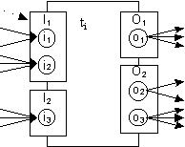
Task Coordination
Another major problem solved by the operating system
is that of coordination of multiple tasks.
This primarily consists of two sub-problems:
Scheduling
Synchronization.
The operating system must decide when to allocate the CPU to each
task, and it must provide mechanisms for the user to attain guarantees about execution order and mutual exclusion when necessary.
There are two costs associated with task management:
A small amount of CPU bandwidth (consumed by the kernel to make scheduling decisions and context switches)
A significant amount of memory.

Slide 10
Resource Constraints
Sensor nodes must operate under resource constraints that are not major concerns on PCs, or even on smaller embedded devices such as PDAs.
For example, the Mica2 node has only 4 kB of data memory (SRAM), 128 kB of program memory (flash), and an 8-bit, 7.3 MHz CPU.
Each of these limitations affects the design of sensor operating systems.
Data Memory
Program Memory
CPU Bandwidth

Slide 11
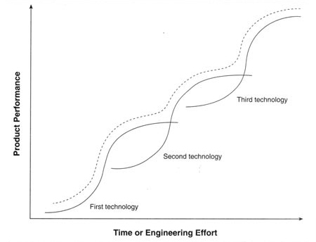
It has been argued that one should not design around these resource constraints, because the hardware is subject to Moore’s law and will have increased in capability by the time sensor networks are widely adopted.
The advances predicted by Moore’s law can be applied to lower the cost, rather than increase the capability of a sensor node.
An operating system that runs within tight resource constraints will always run on cheaper hardware, which can be economically deployed in larger
numbers.

Slide 12

Power Management
Power constraints on sensor nodes are severe. While Moore’s law applies to CPU speed and memory size, it does not apply to battery capacity.
Lifetime of a sensor node is increased primarily by reducing power consumption, rather than increasing supply.
Large-scale increases in node lifetime are obtained by
turning components off during times when they are
not needed. The “duty cycle” of a node is the fraction of
the time that the node’s high-power components are
active, and may be on the order of 1%.
This extends the lifetime of a node from several days to several months

Slide 13
Networking
The network stack is the primary application running on a sensor node.
while a typical sensor network packet might be only 32 bytes, 32 bytes is not that small compared to the total data memory available.
Since memory is so limited and the network may be the primary memory consumer, it is important to define cross-layer interfaces that avoid copying buffers.
It also may make sense to integrate network memory management closely with the operating system, to make maximum use of the data memory that is available.
Sensing
Calibrating sensors is an especially difficult problem in situ. Some approaches seek to provide distributed autocalibration to improve ease of in situ deployment and management while retaining the accuracy of sensor readings

Slide 14
FEATURES OF SENSOR OPERATING SYSTEMS
In order to be of practical use, sensor operating systems must include features that are uncommon in PC operating systems, or significantly different from their analogs in the PC world.
Dynamic Network Reprogramming
Two of the main features of wireless sensor networks are that they are unattended and long-lived.
Sensor networks could be installed in inaccessible and hostile environments that cannot be accessed easily. Even if the individual nodes are accessible, the scale of a network may be so large that manually accessing each node in the network is highly impractical.
Management of the network under such conditions is a daunting task, and a sensor node operating system should have features that enable network management to be handled remotely.

Slide 15
Dynamic network reprogramming is defined as the process of programming the sensor nodes by disseminating code over a multihop network
At present, there are two main techniques that may be used to reprogram a sensor network.
The first technique is to transmit the entire code image as raw binary data.
An alternative approach is to use a virtual machine (VM) on each node in the network

Slide 16
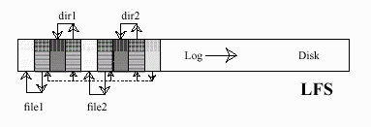
File System
It may not always be possible to transmit sensor data frequently , due to hardware failures, environmental conditions, and the presence of physical layer jamming.
Frequent transmissions over the radio are an expensive operation in terms of energy consumption.
Due to these factors, a sensor node must be able to store data locally over a long period of time while multiple sensor readings are collected.
A file system tailored for sensor nodes needs to take into consideration a multitude of resource constraints, and it should be optimized for the common operations and data types observed in a sensor network.
The three most commonly encountered data sources in a sensor network are
Configuration data (sampling rate, various thresholds, etc.)
Sequentially appended sensor data
Binary code images.

Slide 17
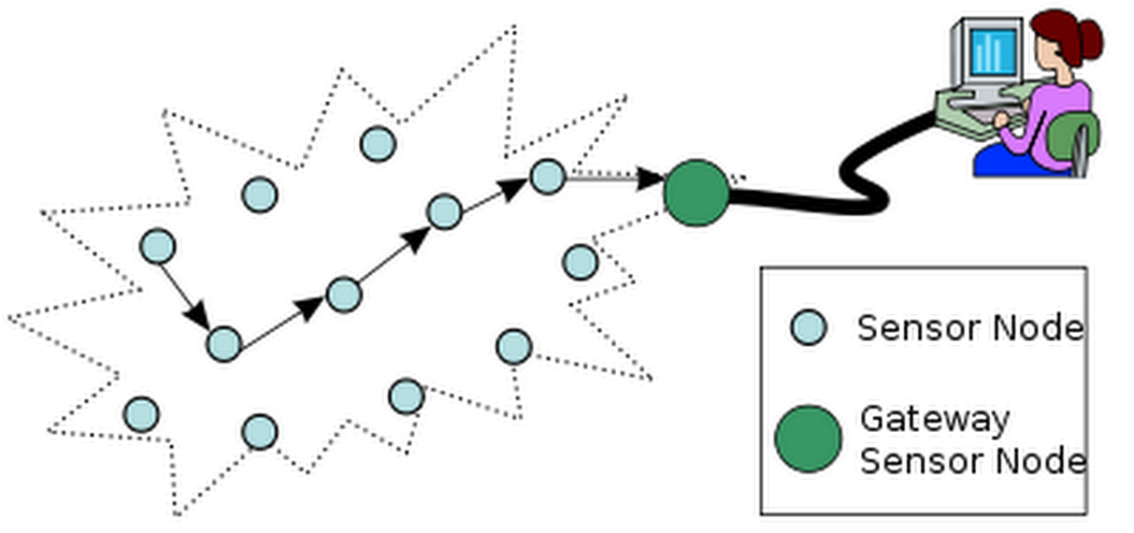
Bridging to IP Networks
A sensor network is treated as a large-scale distributed database, logically
separated from the Internet by a database application program interface and physically partitioned by a gateway that resides at the border between the sensor network and an Internet-connected machine.
The gateway’s primary task is to collect data from the sensor network, then store the data in a local or remote database.

Slide 18

The TinyOS operating system utilizes a unique software architecture that was designed specifically for resource-constrained sensor nodes.
Primarily based on the concept of wiring together components to create an application, the paradigm strives to use as little memory as possible, while still handling multiple roles in a sensor networking environment.
Initially written in standard C, the project has since moved to a custom language, nesC. This “Network Embedded Systems C” uses C-like syntax, but adds some new features to support the structure and execution model of a TinyOS application.

Slide 19
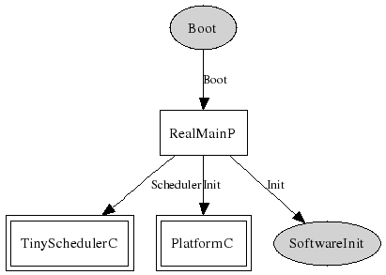
Execution Model
In order to minimize the amount of memory used during execution, TinyOS
applications consist of multiple tasks that all share a single stack.
Because of this design, a task must run to completion before giving up the processor and stack memory to another task.
These tasks can be preempted by hardware event handlers, which also run to completion, but before giving up the shared stack a task must store
any required state in global memory.

Slide 20
TinyOS Components
Components are separate blocks of code that have clearly defined interfaces for both input and output. In order to “provide” an interface, a component must implement a set of commands defined by the interface.
In order to “use” an interface, a component implements a different set of functions, called events.
Using this structure, a component that wants to utilize the commands of a specific interface must also implement the events for that same interface.
Once a variety of components have been developed they must be organized in an application-specific way to implement the desired application functionality.
This is done by using configuration components. These components essentially connect, or “wire,” the functional components together.
In wiring components, any component that implements an interface can use or provide multiple interfaces as well as multiple instances of a single interface.

Slide 21

MANTIS OPERATING SYSTEM (MOS)
The MANTIS Operating System (MOS) is a larger sensor operating system that is designed to behave similarly to UNIX and provide more built-in functionality than TinyOS.
MOS applications are written in standard C and executed as threads; the MOS kernel includes scheduling and synchronization mechanisms.
MOS also includes a framework to allow a high degree of integration between device drivers, network protocols, and the operating system.

Slide 22
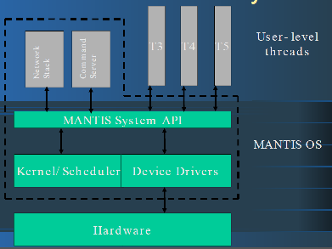
MOS is based on a multithreaded kernel, with Portable Operating System Interface for UNIX like semantics.
Scheduling is priority-based; round-robin scheduling is used for multiple threads at the same priority level.
Since all threads must coexist in the
same address space, the maximum
stack size of each thread must be
specified when the thread is spawned.
This allows the kernel to allocate a
block of data memory for the
thread’s stack.
The need to keep multiple stacks in memory at the same time makes MOS
more resource-intensive than single-threaded systems like TinyOS.

Slide 23
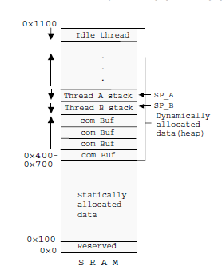
Memory Management in MOS
Statically allocated memory, whose size is known at
start-up, begins at low addresses.
When the node first starts up, the stack pointer is at
the high end of memory, and therefore the INIT
thread stack is located in the top block of memory.
After start-up, the INIT thread becomes the idle
thread, and it keeps the same stack.
All of memory between the data section and the
INIT/idle stack is managed as a heap. When a thread
is spawned, its stack space is allocated out of the available heap space.
The space is reclaimed when the thread exits.
MOS fills a thread’s stack with a flag byte when the thread is spawned, so stack usage can be determined while a thread is running by counting the number of flag bytes still present from the end of the thread’s stack space.

Slide 24
Power Management in MOS
MOS includes both explicit and implicit forms of power management.
To encourage power-efficient programming, all devices in MOS are set to the off state initially, where they consume the minimum amount of power possible.
All of the device drivers currently implemented for MOS include logic to turn the device on and then off again if the user attempts to perform a synchronous operation while in the off mode.
While device power management is handled explicitly, MOS handles CPU power management implicitly.
The MOS kernel may be in one of three modes: active, idle and power-save.
In active mode, the CPU is fully powered and running instructions.
In idle mode, the CPU is not running instructions, but interrupts and peripherals are enabled. Power consumption in idle mode is roughly half that of active mode.
In power-save mode, the CPU is completely powered down except for external interrupts and the watchdog timer, and power consumption is reduced by three orders of magnitude.

Slide 25
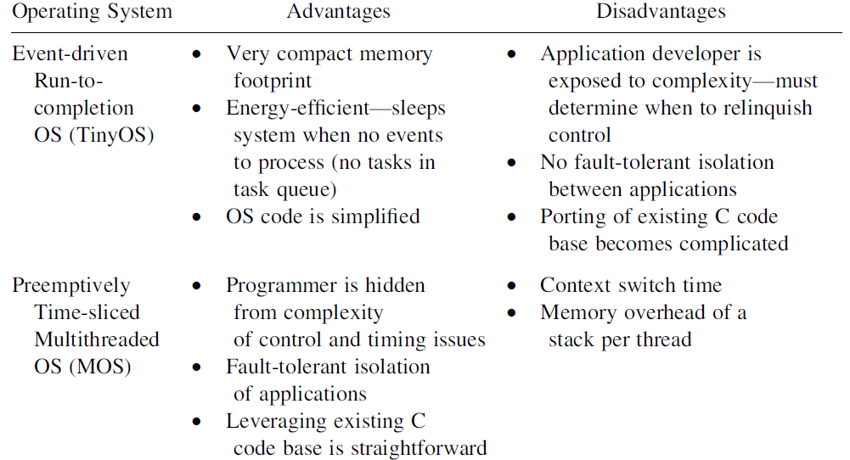
Comparing Event-Driven and Multithreaded Sensor Operating Systems

Slide 26
Dynamic Network Reprogramming
Wireless sensor networks consist of a collection of programmable
radio-equipped embedded systems.
The behavior of a wireless sensor network is encoded in software running on the wireless sensor network nodes.
The software in deployed wireless sensor network systems often needs to be changed, both to update the system with new functionality and to correct software bugs.
For this reason dynamically reprogramming of wireless sensor network is an important feature.
Furthermore, when developing software for wireless sensor networks, being able to update the software of a running sensor network greatly helps to shorten the development time.

Slide 27
The limitations of
communication bandwidth,
the limited energy of the sensor nodes,
the limited sensor node memory
which typically is on the order of a few thousand bytes large, the absence of memory mapping hardware, and the limited processing power make reprogramming of sensor network nodes challenging.
Many different methods for reprogramming sensor nodes have been developed, including
full system image replacement,
approaches based on binary differences
and virtual machines.
These methods are either inefficient in terms of energy or require non-standard data formats and tools.

Slide 28
Scenarios for Software Updates
Software updates for sensor networks are necessary for a variety of reasons ranging from implementation and testing of new features of an existing program to complete reprogramming of sensor nodes when installing new applications.
Software Development
During the development cycle developers typically change only one part of the system, possibly only a single algorithm or a function. A sensor network used for software development may therefore see large amounts of small changes to its code.
Sensor Network Testbeds
New applications can be tested in a realistic setting and important measurements can be obtained

Slide 29
Correction of Software Bugs
Even after careful testing, new bugs can occur in deployed sensor networks caused by, for example, an unexpected combination of inputs or variable link connectivity that stimulate untested control paths in the communication software
Application Reconfiguration
In an already installed sensor network, the application may need to be reconfigured. This includes change of parameters, or small changes in the application such as changing from absolute temperature readings to notification when thresholds are exceeded
Dynamic Applications
When the fire detection application has detected a fire, the fire fighters might want to run a search and rescue application as well as a re tracking application.

Slide 30
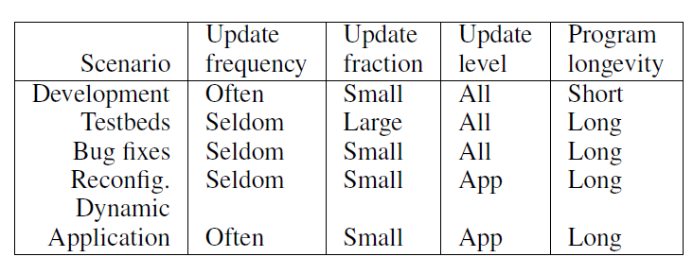
Qualitative comparison between different reprogramming scenarios.

Slide 31
Code Execution Models and Reprogramming
Many different execution models and environments have been developed or adapted to run on wireless sensor nodes.
Some with the notion of facilitating programming, others motivated by the potential of saving energy costs for reprogramming enabled by the compact code representation of virtual machines
The choice of the execution model directly impacts the data format and size of the data that needs to be transported to a node.
Script Languages
There are many examples of script languages for embedded systems, including BASIC variants, Python interpreters, and TCL machines

Slide 32
Virtual Machines
The use of a VM allows nodes to be retasked through small virtual programs— high-level program specifications that can be interpreted by the VM—that can be disseminated throughout the network at a lower cost than an entire code image.
Upon receiving an updated virtual program, a node’s VM can interpret the instructions into byte code, at which point the new program can replace the existing code.
While the use of VMs can provide a low-cost approach to dynamic network reprogramming, it is still necessary to support raw binary retasking, since the VM itself may require changes.
Native Code
The most straightforward way to execute code on sensor nodes is by running native code that is executed directly by the microcontroller of the sensor node.
Full Image Replacement
It compiles a complete new binary image of the software together with the operating system and overwrite the existing system image of the sensor node.

Slide 33
Diff-based Approaches
Often a small update in the code of the system, such as a bug fix, will cause only minor differences between in the new and old system image. Instead of distributing a new full system image the binary differences, deltas, between the modified and original binary can be distributed. This reduces the amount of data that needs to be transferred.

Slide 34
R2: Incremental Reprogramming using Relocatable Code in Networked Embedded Systems
It is a novel incremental reprogramming approach to effectively reduce the delta size by exploiting the similarity between two program versions.
The key idea to improve the program similarity is to keep multiple references to the same symbol unchanged when the program changes.
function shifts
data shifts
This approach obtains a higher degree of similarity by keeping all references in the instructions the same in both program versions. Moreover, it makes efficient use of the memory and does not degrade the program quality.

Slide 35
Design
The main idea of applying relocatable code is to make all the references to symbols the same when the program changes.
By filling the absolute addresses in those reference instructions to a predefined value (e.g., zero) in all program versions, we keep those reference instructions the same when the functionality of the program changes.
In order to make these reference instructions behave correctly at run time, we must generate additional metadata, i.e., relocation entries, for a loader software residing on the nodes to perform load-time modifications.
In general, a relocation entry contains the following information
(i) at which address to apply the modification, and
(ii) the correct target address for the reference.

Slide 36
Question1
In bridging to IP networks , a sensor network is treated as a large-scale distributed database, logically separated from the Internet by a database application program interface and physically partitioned by a gateway that resides at the border between the sensor network and an Internet-connected machine.
The gateway’s primary task is to collect data from the sensor network, then store the data in a local or remote database. This architecture makes it difficult to introduce and integrate sensor networks with new Internet-based applications.
In order to add new features or new Internet based services, such as monitoring and management, each application developer must either develop their own application-specific gateway or modify an existing gateway’s API. The gateway is therefore a bottleneck when multiple applications require access to the sensor network.
How this Problem can be solved?

Slide 37
Answer:
Solution to this problem is to overlay sensor networks over portions of the
Internet. The gateway could encapsulate the sensor network packets within
(TCP/IP) packets, which would then be sent over the Internet to the appropriate application end point on a remote IP host.
With this approach, the gateway only needs to understand the lowest level (i.e., the network layer) of the sensor network in order to handle the translation between IP and sensor network routing.

Slide 38
Question 2
MANTIS OS fills a thread’s stack with a flag byte when the thread is spawned, so stack usage can be determined while a thread is running by counting the number of flag bytes still present from the end of the thread’s stack space.
Why this approach is not a full proof solution to check stack overrun?

Slide 39
Answer
While this makes it possible to detect stack overruns after the fact, it does not prevent them. Determining the amount of stack space necessary for a thread—and not overrunning it—is still the application programmer’s responsibility.

Slide 40
Question 3
Dynamic network reprogramming is defined as the process of programming the sensor nodes by disseminating code over a multihop network
Following are some techniques used to re-program a sensor network
1) Full image replacement
Technique is to transmit the entire code image as raw binary data.
2) Use of virtual machines
The use of a VM allows nodes to be retasked through small virtual programs—Upon receiving an updated virtual program, a node’s VM can interpret the instructions into byte code, at which point the new program can replace the existing code.
Explain there drawbacks?

Slide 41
Answer
1) The main drawback of Full Imgae Replacement approach is that it requires synchronizing large amounts of data across a multihop wireless network: the size of the updated code image is often much larger than main memory
2) While the use of VMs can provide a low-cost approach to dynamic network reprogramming, it is still necessary to support raw binary retasking, since the VM itself may require changes.

Slide 42
References
1) Embedded Operating Systems for Wireless Microsensor Nodes
BRIAN SHUCKER, JEFF ROSE, ANMOL SHETH, JAMES CARLSON, SHAH BHATTI, HUI DAI, JING DENG, and RICHARD HAN
University of Colorado at Boulder, Boulder, Colorado
2) Run-Time Dynamic Linking for Reprogramming Wireless Sensor
Networks
Adam Dunkels, Niclas Finne, Joakim Eriksson, Thiemo Voigt
Swedish Institute of Computer Science, Box 1263, SE-16429 Kista, Sweden
3) Elon: Enabling Efficient and Long-TermReprogramming for
Wireless Sensor Networks
Wei Dong†‡, Yunhao Liu‡?, Xiaofan Wu†, Lin Gu‡, and Chun Chen†
†Zhejiang Key Laboratory of Service Robot, College of Computer Science, Zhejiang University ‡Hong Kong University of Science and Technology
Tsinghua National Laboratory for Information Science and Technology
4) R2: Incremental Reprogramming using Relocatable Code in Networked Embedded Systems
Wei Dong|}, Yunhao Liu}, Chun Chen|, Jiajun Bu|, and Chao Huang|
|Zhejiang Key Laboratory of Service Robot,
College of Computer Science, Zhejiang University
Department of Computer Science, HKUST

Slide 43
Thank You

