Slide 1
Transactional Memory
Patrick Santos (4465359)

Slide 2
Agenda
What is transactional memory (TM)?
  Example transactions
  Deadlocks and Cache Coherence
Types of TM
Implementations & proposals in industry
  Sun / Oracle
  Intel
  AMD

Slide 3
What is Transactional Memory
Synchronization Mechanism
  Alternative of locks for critical sections [1]
Divides a series of memory operations into a single atomic operation [1]
No lock required [1]
  “Commit” or “abort” entire transaction
May be implemented in hardware, software, or both (hybrid) [2]

Slide 4
Example Transaction
Code inside block is atomic, may either:
  Execute completely and write to memory (commit)
  Be disrupted by some another thread or processor and not change anything (abort)
Memory locations are not locked
__transaction {
t = x;
x = t+1;
}
Intel’s Syntax
Copied from [3]

Slide 5
Example Transaction (commit)
CPU 1
CPU 2
__transaction {
t = x;
x = t+1;
}
__transaction {
a = b;
b = b+1;
}
Time
COMMIT
COMMIT
No conflict for either transaction – COMMIT in parallel

Slide 6
Example Transaction (abort)
CPU 1
CPU 2
__transaction {
t = x;
x = t+1;
}
__transaction {
x = 5;
}
Time
COMMIT
ABORT
CPU2 wrote to x before CPU1 read – CPU1 aborts
  Change to “t” is also discarded

Slide 7
TM vs. Lock / Mutex
Pros
  Not as error prone (to human error) [1]
  Better scalability
  Multiple access to critical section
  Can eliminate deadlocks
Cons
  Different way of programming [1]
  Algorithms and hardware can be more complex than locking

Slide 8
Deadlock Prevention with TM
Deadlock requires circular waiting
With TM, operations are non-blocking
  Either an operation completes or it fails
  No blocking, so no possibility for deadlock

Slide 9
Types of Transactional Memory
Hardware Transactional Memory (HTM) [2]
  Exploits cache coherence or dedicate cache
  Sun / Oracle: Custom instructions
Software Transactional Memory (STM) [2]
  Offers flexibility at cost of performance
Hybrid Transactional Memory (HyTM) [2]
  Small transactions done with hardware, large transactions done with software

Slide 10
HTM and Caches
Keep temporary “speculative” data in LOCAL cache until commit [1]
  Commit made to shared memory
For abort, discard (cache invalidate or otherwise) temporary data [1]
Some hardware implementations keep the old data in a dedicated buffer [1]

Slide 11
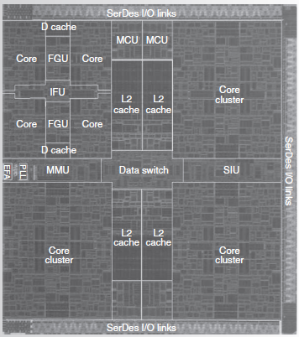
Sun “ROCK” Chip-Multithreading Processor
SPARC
16 processors, 2 software threads / processor
Clusters of 4 processors – each cluster has shared L1 I-cache, but 2 L1 D-caches
  Crossbar network between clusters
Global L3 cache
Uses HTM
[4]

Slide 12
Sun “ROCK” HTM
TM implemented as part of “Checkpoint Architecture” [4]
  Takes a “snapshot” in dedicated buffers then makes “speculation”
  Custom instructions: checkpoint, commit
Requires extra buffers to implement TM to store snapshots
Conflict occurs if cache line used in transaction is replaced or invalidated

Slide 13
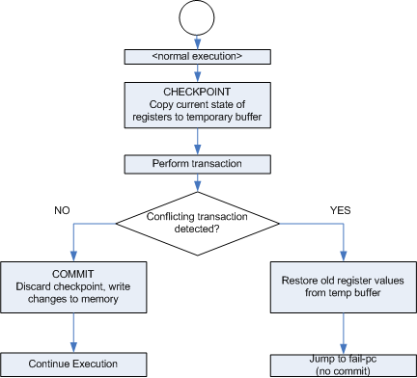
Sun“ROCK”

Slide 14
Intel® C++ STM Compiler
Prototype
Wrap transactions in __transaction{}
  Shown in previous slides
IA-32 (x86) or Intel 64 bit support, Windows and Linux
[5]

Slide 15
AMD Advanced Synchronization
Facility
Proposal (no implementation yet)
HTM support in the form of added instructions:
  SPECULATE (begin transaction)
  COMMIT
  ABORT
  LOCK MOVx (protect region for atomic access)
  [6]

Slide 16
References
Harris, T.; Cristal, A.; Unsal, O.S.; Ayguade, E.; Gagliardi, F.; Smith, B.; Valero, M.; , "Transactional Memory: An Overview," Micro, IEEE , vol.27, no.3, pp.8-29, May-June 2007 doi: 10.1109/MM.2007.63
Xiang Li; Jing Zhang; Jun-huai Li; , "Hardware/hybrid transactional memory," Computer, Mechatronics, Control and Electronic Engineering (CMCE), 2010 International Conference on , vol.6, no., pp.68-71, 24-26 Aug. 2010 doi: 10.1109/CMCE.2010.5609908
Adl-Tabatabai, A., Shpeisman, T. (2009, August 4.) “Draft Specification of Transactional Language Constructs for C++.” Version 1.0., [Online]. Available: http://software.intel.com/en-us/articles/intel-c-stm-compiler-prototype-edition/#Constructs
Chaudhry, S.; Cypher, R.; Ekman, M.; Karlsson, M.; Landin, A.; Yip, S.; Zeffer, H.; Tremblay, M.; , "Rock: A High-Performance Sparc CMT Processor," Micro, IEEE , vol.29, no.2, pp.6-16, March-April 2009 doi: 10.1109/MM.2009.34
Intel Corporation. (2009, April 20.) “Intel® C++ STM Compiler, Prototype Edition.” [Online]. Available: http://software.intel.com/en-us/articles/intel-c-stm-compiler-prototype-edition
Advanced Micro Devices. (2009, March) “Advanced Synchronization Facility: Proposed Architectural Specification.” Rev. 2.1. [Online]. Available: http://developer.amd.com/assets/45432-ASF_Spec_2.1.pdf

