Slide 1
Hardware Support for Real Time Operating Systems
A presentation by: Jake Swart

Slide 2
Questions Answered in the Presentation:
Describe a state-of-the-art solution that implements task scheduling, multiprocessor dispatch, time management and event management in hardware.
Are there any industrial solutions in which the scheduler is implemented in FPGA or ASIC?

Slide 3
Overview
Concepts & Definitions
Review of the ARPA-MT Processor
Review of the MERASA Processors
The review is performed on the following topics:
  Task Management
  Scheduling
  Time management & event management in hardware

Slide 4
Concepts & Definitions [1]
A Real-Time Operating System (RTOS) is an operating system designed specifically to support real time operations
In order to be accepted as a RTOS, is must have:
  Response time predictability
  Determinism
A hard RTOS, ideally, must never miss a deadline
Only hard RTOS are considered in this presentation

Slide 5
Concepts & Definitions
Worst-Case Execution Time (WCET) [2]
  The longest amount of execution time used to complete a task.
Task Management [3]
  Process of determining which task should be running at any given time. The most commonly implemented approach to scheduling in commercial RTOSs is based on task priorities.
Task Control Block (TCB) [4]
  A data structure containing information needed to manage a task
Simultaneous Multithreading (SMT) [5]
  Multiple independent tasks are able to execute at one time in a modern multiprocessor architecture

Slide 6
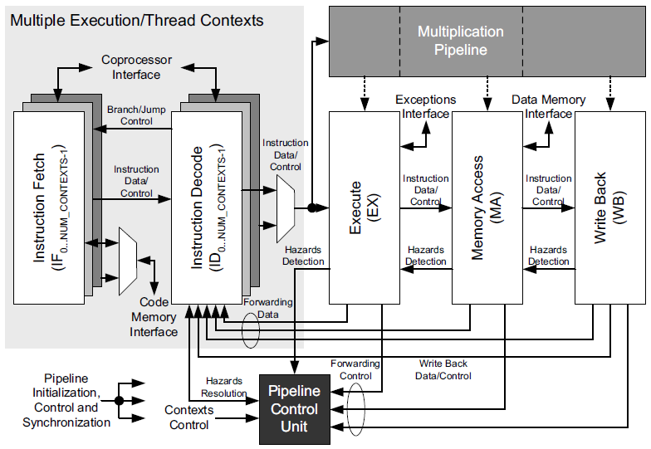
Advanced Real-time Processor Architecture-MultiThreaded
The ARPA-MT Processor [5]
A modern multiprocessor for real-time systems with hardware acceleration

Slide 7
The ARPA-MT Embedded Project [5]
Focuses on providing specialized, time predictable, power efficient systems for hard real time systems
Uses a multiprocessor based implementation
Design process focused on WCET determinism, task scheduling and resource assignment
Xilinx XC3S1500 Spartan-3 FPGA used in implementation

Slide 8
Increasing Execution Time Determinism [5]
Uses a simple pipelining for instructions from each task and avoids complex superscalar techniques
Simultaneous task execution using SMT
  Fine-grained time sharing of the processor
  Interleaving order of issued instructions from tasks reduces global processor stalls caused by data and control hazards
Increasing processor availability by reducing context switching and operating system overhead using an “Operating System Co-Processor”

Slide 9
The ARPA-MT Processors [5]
Three Processors:
  Design based off the MIPS32 architecture using SMT
  Focus will be on Co-Processor-2
CPU – MIPS32
Integer instruction set
Co-Processor-0
Memory manager
Exception Processing
Co-Processor-2
RTOS hardware support
Interrupt handling
Uses the five tradition pipeline stages (IF, ID, EX, MA, WB)
High resolution real-time clock
Notes:
MIPS32 chosen for its simplicity and tool availability
CPU duplicates the IF and ID stages for each thread within the processor (SMT)

Slide 10
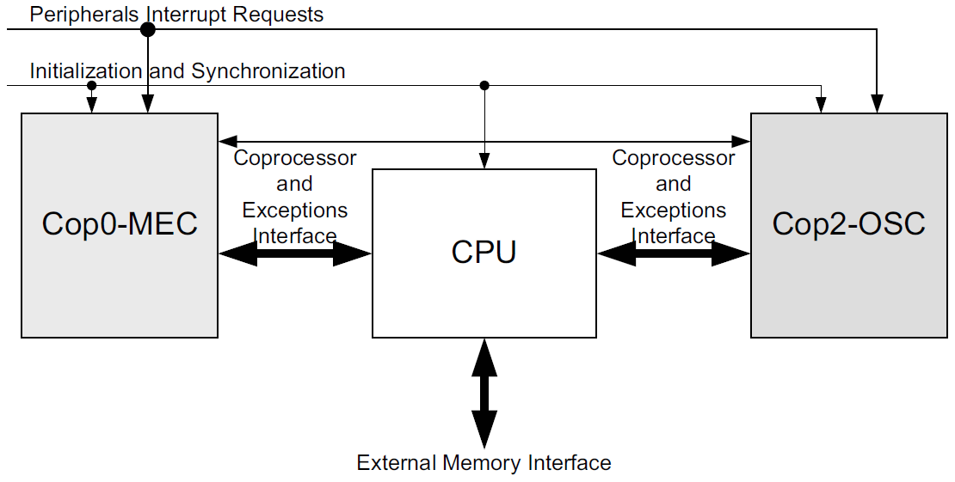
Processor Communication [5]

Slide 11
Co-Processor-2: The Task Handling Unit [5]
All tasks are managed by a module called the Task Handling Unit
The Task Handling Unit performs the following:
  Task handling
  Implementation of specialized instructions
  Scheduling
  Dispatching
  Management of interrupts
  Timing constraints verification
  Table storage for task parameters (TCB)

Slide 12
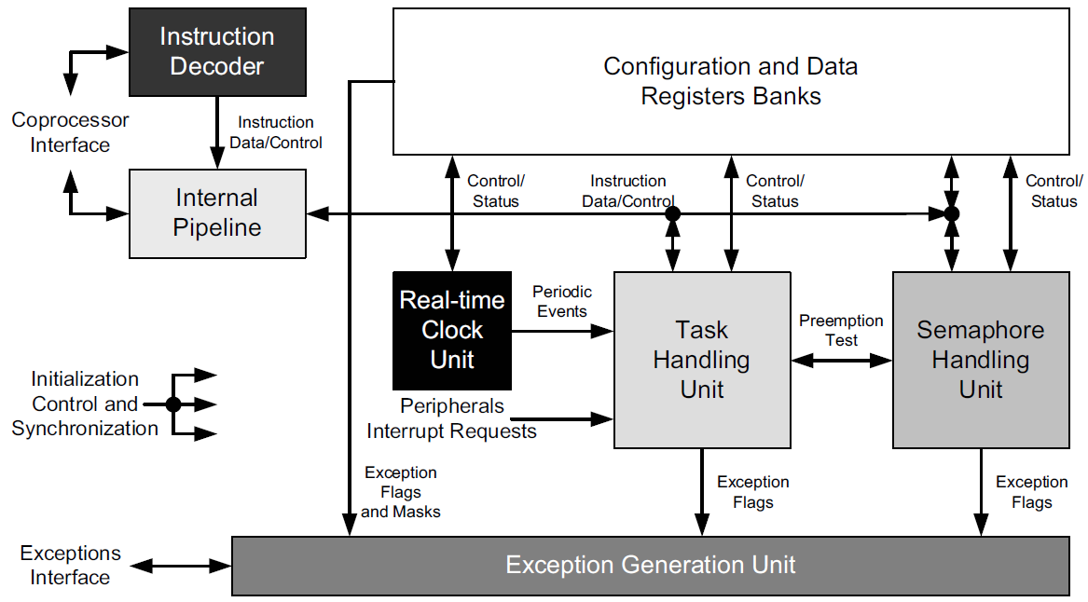
Co-Processor-2: Block Diagram [5]

Slide 13
Co-Processor-2: Task Management [5]
Application timing constraints are transparent to this processor allowing for real-time task management
Hard real-time tasks can be periodic or aperiodic
Task are synchronized using:
  Pre-emption (LIFO or stack resource synchronization)
  Binary semaphores (for simple access to shared resources)
Notes:
All task types: non-real time, soft-real time and hard-real time were considered in the design

Slide 14
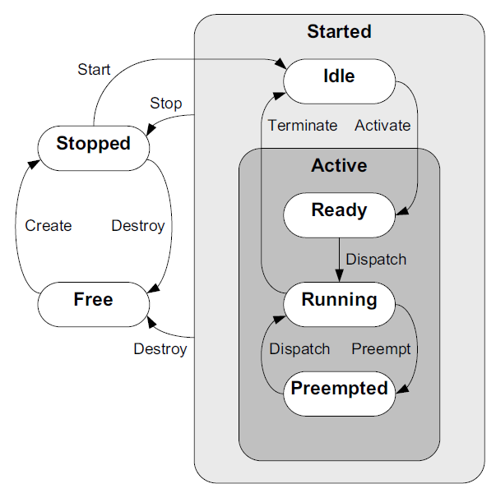
Co-Processor-2: Task States and Transitions [5]
Two important states are excluded from this processors design
  Blocked
  Suspended/sleeping
Blocking is bad
Wait/Sleep states can be simulated using timers
Notes:
Pre-emption: LIFO protocol used to lock and unlock a shared resource. A running task is only pre-empted an active task has all the resources it needs. Non-blocking.
The pre-emption strategy:
Reduces the blocking time of tasks with high priority
Prevents deadlocks
Allows for the use of RM and EDF (discussed in next slide)
“Blocking is bad” – there’s more to this statement
Blocking doesn’t make sense for Stack Resource Policy (SRP) protocol used for shared resources (synchronization)

Slide 15
Co-Processor-2: Scheduling [5]
Scheduling is done in hardware using priority criticality
Scheduling Decisions (in ascending order of priority):
  Non real-time: First Come First Serve (FCFS)
  Soft real-time: Rate Monotonic policy (RM)
  Hard real-time: Earliest Deadline First (EDF)
In the case of EDF:
  As a task comes closer to its deadline, its priority is raised
  Maximizes processor utilization and ensure deadlines met

Slide 16
Co-Processor-2: Block Diagram [5]

Slide 17
Co-Processor-2: Time & Event Management [5]
A task can be event or time triggered
The Real-time Clock Unit
  Generates periodic events assigned by the programmer
  Triggers other scheduled tasks (most likely garbage handling)
External events are managed again by the Task Handling unit

Slide 18
Co-Processor-2 Block Diagram [5]

Slide 19
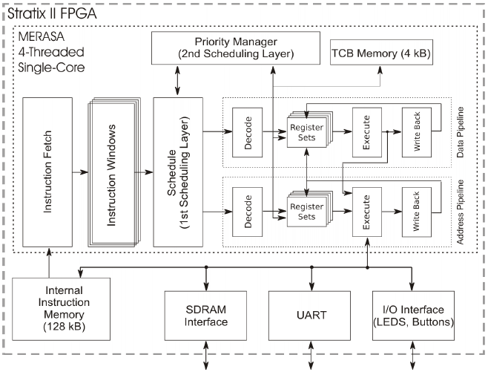
Multi-Core Execution of Hard Real-Time Applications Supporting Analysability
The MERASA Project [6]
A state-of-the-art multiprocessor using SMT and hardware scheduling

Slide 20
The MERASA Project [7] [8]
Aims to minimize the gap between the real and computed value for WCET
Embedded designs use multicore processors to enable:
  Low WCET
  Tight, or almost real, WCET Analysis
Uses WCET timing-focused system design to develop an FPGA based implementation with SMT
Provides developers with tools for WCET analysis
Works with industry partners in WCET and application development

Slide 21
MERASA Processor: Task Management [8]
Mixed tasks with criticality (only two classes)
  Non hard-real time task (NHRTT)
  Hard real time task (HRTT)
WCET estimation is considered independently from the workload a task performs
HRTTs execute in complete isolation
Notes:
Note: I have added an extra ‘T’ onto the definitions NHRT and HRT. This just makes it easier for me when I present the material to remember to say “Task”.

Slide 22
The MERASA Core [8]
4 core implementations on FPGA
16 core implementations on simulators
On each core:
  1 HRTT using scratch pad memory
  3 NHRTTs using I-caching and D-caching
*Provides transparent execution for determinism

Slide 23
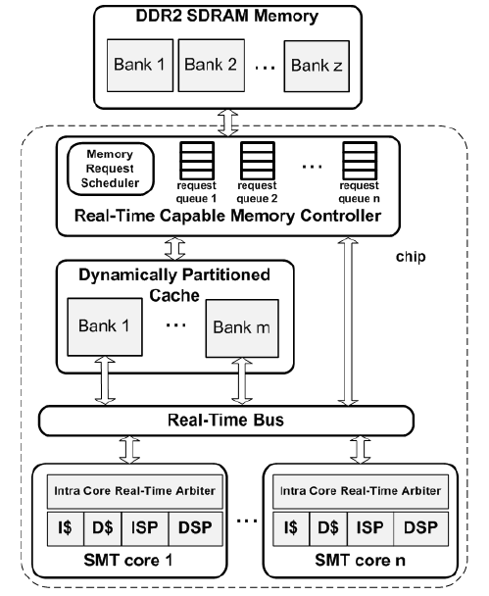
The MERASA Chip [8]
Uses a real-time bus
A reconfigurable cache using dynamic partitioning
Real-time memory controller
*Controlled execution of interleaving tasks

Slide 24
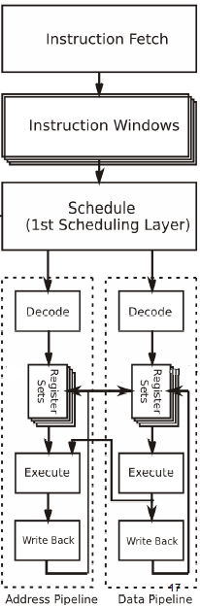
MERASA Processor: Scheduling [8]
Hard real-time scheduler performs SMT
Priority is given to the HRTT to finish execution
A HRTT pre-empts a NHRTT in the pipeline
The pipelines are non-blocking
Time-bounded task synchronization
Notes:
Time and Event management is not here because not enough detailed information could be collected on it

Slide 25
MERASA Processor: Implementation [8]
Honeywell International
  Stereo navigation or GPS navigation (automotive)
  Collision avoidance (aerospace)

Slide 26
References
[1] http://chibios.sourceforge.net/. “RTOS Concepts“ [Online Article]. Available: http://chibios.sourceforge.net/dokuwiki/doku.php?id=chibios:articles:rtos_concepts
[2] Reinhard Wilhelm et al. The Worst-Case Execution Time Problem. 2005.
[3] J. Liu. Reol-Time Systems. Prentice Hall, Upper Saddle River, NJ, 2000.
[4] Harvey M. Deitel. 1990. An Introduction to Operating Systems (2nd Ed.). Addison-Wesley Longman Publishing Co., Inc., Boston, MA, USA.
[5] Oliveira, A. S. R.; Almeida, L; Ferrari, A. B.; , "The ARPA-MT Embedded SMT Processor and Its RTOS Hardware Accelerator," Industrial Electronics, IEEE Transactions on , vol.PP, no.99, pp.1-1, 0
[6] Prof. Dr. Theo Ungerer, “Multi-Core Execution of Hard Real-Time Applications Supporting Analysability (MERASA)” [Online Document]. Available: ftp://ftp.cordis.europa.eu/pub/fp7/ict/docs/computing/merasa-computing-frontiers08_en.pdf
[7] http://www.merasa.org/. “The MERASA Project - Vision, Overview and Achievements” [Online Document]. Available: http://www.merasa.org/dissemination/ 01_overview.pdf
[8] http://www.merasa.org/. “The MERASA Project - Vision, Overview and Achievements” [Online Document]. Available: http://www.merasa.org/dissemination/ 02_overview.pdf

