Slide 1
Network-on-chip
Mathieu Thibault-Marois
(5049388)

Slide 2
Overview
Network-on-a-chip issues and challenges
    Serial versus Parallel
    Interconnect Optimization
    Leakage Power Consumption
    Router Architecture
    Quality of Service
    System-level Simulation Environments
    NoC Implementations
SPIN
    Network Description
    Virtual Socket
    Reconfigurability

Slide 3
NoC – Issues and Challenges [1]
Serial versus Parallel
  Parallel
    Can use a slower clock
    Reduced power dissipation
    High silicon cost
      Interwire spacing, shielding, repeaters
  Serial
    Save wire area
    Needs serializer and de-serializer circuits
    Simple layout
    Reduced signal interference and noise
    Simple timing verifications

Slide 4
NoC – Issues and Challenges [1]
Interconnect optimization
  Timing optimization
    Generally performed by repeater insertion
  Inverters used as repeaters use a large portion of chip resources
    Area
    Power
  Need for optimizing power
    Dynamic power consumption
    Encoding

Slide 5
NoC – Issues and Challenges[1] [12]
Leakage Power Consumption
  Becomes more important as manufacturing processes produce smaller and smaller transistors
  Link utilization rates vary
    Is usually very low in order to meet latency requirements
  Idle links still consumer power in repeaters
    Need new techniques to reduce leakage

Slide 6
NoC – Issues and Challenges [1]
Router Architecture
  Complex routing algorithms
    Very effective at routing traffic
    Complicate design
    Higher power consumption
  Simple routing algorithms
    Less effective at routing traffic
    Cost less
    Lower power consumption

Slide 7
NoC – Issues and Challenges [1]
Quality of service
  Real-Time Operating System requirements
    Network must be able to guarantee a timely exchange
    Not easy as NoC are often adaptive and prone to congestion
    Variability and non-determinism not acceptable

Slide 8
NoC – Issues and Challenges [1][6]
Quality of service
  Solutions
      Adding redundant paths, nodes and buffers
        Higher silicon cost, complexity and power consumption
      Reserve paths for real-time applications
        Same, but by a lower amount
      Priority levels
        Complexifies routing
        May create starvation
          Need Approriate scheduling

Slide 9
NoC – Issues and Challenges [11][9]
Memory addressing
  Compatibility concern for features relying on snooping
    Semaphores
    Cache Invalidation
  Support possible
    Problem : Too complex for embedded systems
  Embedded systems are rather heterogeneous
    Simple synchronization primitives
    Explicit invalidations

Slide 10
NoC – Issues and Challenges [1]
System-Level Simulation Environments
  There is a need for simulators providing ability to
    Model a system well in advance of building it
    Model concurrency issues
    Manipulate QoS parameters
    Manipulate performance metrics
    Integrate different models of computation
    Provide access to well defined libraries of components

Slide 11
NoC – Issues and Challenges [1]
System-Level Simulation Environments
  Already existing simulation environments :
    NS-2
      [http://www.isi.edu/nsnam/ns/]
    RSIM
      [http://rsim.cs.illinois.edu/rsim/]
    NOCSim
      [http://nocsim.blogspot.com/]
    Orion
      [http://www.princeton.edu/~peh/orion.html]

Slide 12
NoC – Issues and Challenges [1][2][3]
NoC Implementation
  XPIPES
    Static « Street Sign » rooting
    Wormhole routing
    Pipelined Links
    Parameterizable using SystemC
    Arbitrary topology
  QNOC
    Provides 4 different levels of QoS
    Wormhole routing
    Mesh Topology
    Static X-Y routing
    Credit-based flow control

Slide 13
NoC – Issues and Challenges [1][4][5]
NoC Implementation
  Æthereal
    Developed by Philips
    Topology independent
    Wormhole routing
    Provides guaranteed throughput and latency services
    Credit-based flow control
    2 levels of QoS
      Guaranteed and Best Effort
  Arteris
    Provides commercially available products for NoC design
    Partners with QualComm, ARM, Samsung, LG, TI, etc.

Slide 14
SPIN [7][8][9]
History :
  Developed at University Pierre et Marie Curie
  First drafted in 1999
Scalability
  Support up to 256 terminals
  Diameter : 2*log4(n) (where n is # of terminals)
Uses Wormhole routing
Both Adaptive and Deterministic

Slide 15
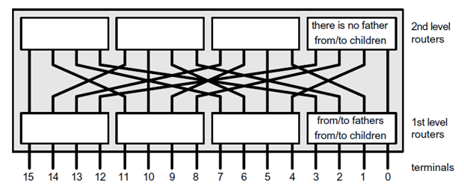
SPIN – Topology [8]
Uses “Fat Tree” Topology
16 terminals example :
Figure 1 : 16 terminals SPIN NoC [8]

Slide 16
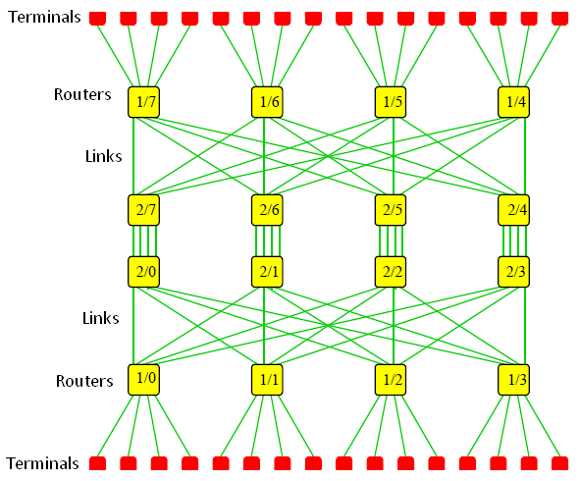
SPIN – Topology [10]
Figure 2 : 32 terminals SPIN NoC [10]

Slide 17
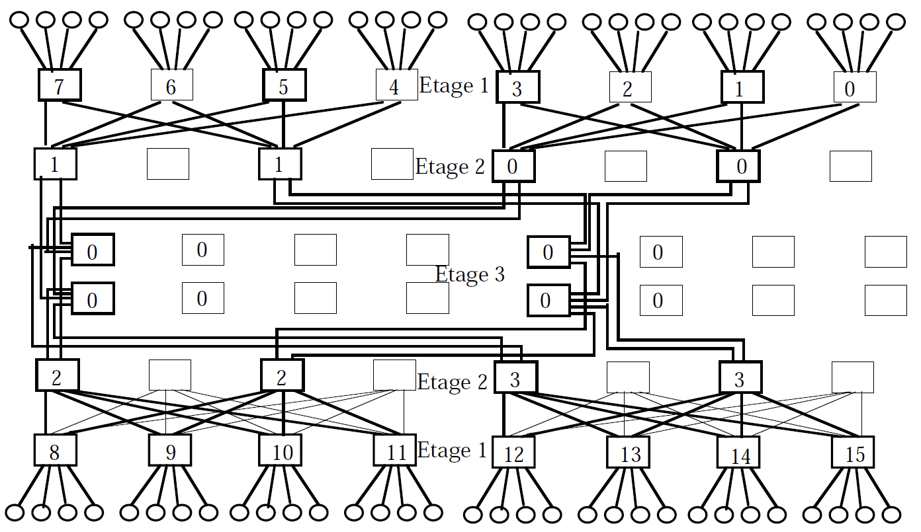
SPIN – Topology [7]
Can become very complex
Figure 3 : 64 terminals SPIN NoC [7]

Slide 18
SPIN – Flow Control [11]
Credit Based
  Buffer overflows are checked at the source
    Dedicated feedback wire
  Counters track the amount of free buffer space
  Bounds amount of outstanding stream data
  Prevent catastrophic network congestion

Slide 19
SPIN – Packets [11][16]
Payload can be infinite number of flits
Flit : 36 bits
  32 bits data words
  4 framing bits
    1 parity bit, 3 type bits
Header
  Contains data about the destination and the packet itself
« Trailer »
  Marks the end of a packet
  Identified by a dedicated control line
  Contains a checksum

Slide 20
SPIN – Links [11]
Point to Point
Full Duplex
38 bits width
  36 wires for flit data
  2 wires flux control
Links are reserved until the trailer is received

Slide 21
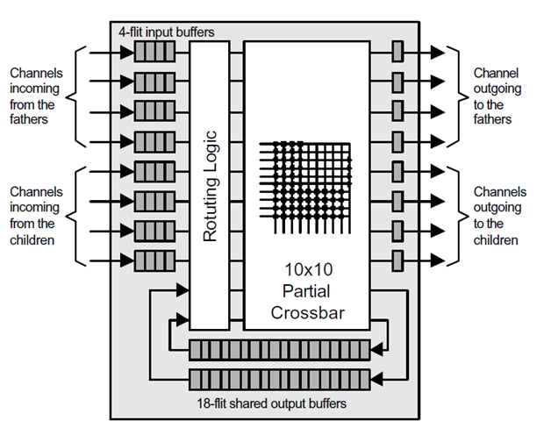
SPIN – Router [8]
Figure 4 : RSPIN diagram [8]

Slide 22
SPIN – Router [10]
Output Buffers :
  Shared between all outputs
  Reduce « head of line blocking »
  Reserved for packets flowing DOWN the tree
    One Buffer for packets coming from down the tree and going down.
    One Buffer for packets coming from up the tree and going down.

Slide 23
SPIN – Router – Control Logic [7]
Decode
  Analyze header
  Send request signals for ALL outputs concerned
    (including shared buffers for packets going down)
Arbitration
  Chose one request from all requests received
    Priority to shared buffers over all inputs
    Priority to superior inputs over inferior inputs
    Round-Robin on inputs of same priority

Slide 24
SPIN – Router – Control Logic [7]
Allocation
  General behavior
    Goes from inactive to state chosen by arbitration
    Goes back to inactive when trailer is detected
  Two difficulties
    Latency
    Multiplicity of requests
  Solution :
    Allocators must be able to verify each others states
    Allocators must be able to come to an agreement before changing state
  In case of a competition to serve a request
    True outputs have priority over shared buffers
    Round Robin for outputs going up.
    Outputs going up that are in conflict apply Round-Robin

Slide 25
SPIN – Wrappers [9][11]
Hide internal behavior
Offer high-level services
  VCI interface for bus-oriented IPs
  Simple FIFOs for stream IPs
Implemented in hardware

Slide 26
SPIN – Wrappers [7]
Services
Table 1 : Packet types [7]
Code | Service | Utilisation
000 | System | Rerouting, test, etc.
001 | System | Reserved for future evolutions
010 | Stream | Stream fragment
011 | Stream | Credit return
100 | - | Free for user services
101 | - | Free for user services
110 | Address Space | VCI Initiator
111 | Address Space | VCI Target

Slide 27
Virtual Component Interface[13][14]
Introduced by the Virtual Socket Interface Alliance
Aims to provide a standard set of interfaces for reusing IPs
Enables an integrated, platform independant environment

Slide 28
Virtual Component Interface [15]
Request-Response Protocol
3 levels of complexity
  Peripheral VCI
    Simplest, easily implementable
  Basic VCI
    Suitable for most implementation
  Advanced VCI
    Support for high-performance applications

Slide 29
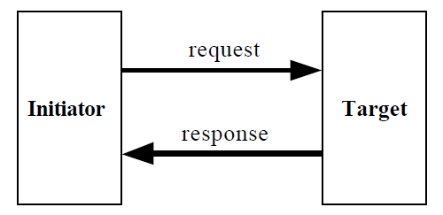
Virtual Component Interface [15]
Point-to-point connection
Figure 5 : VCI point to point interface [15]

Slide 30
Virtual Component Interface [15]
Split Transaction
  Multiple request without waiting for a response
  PVCI
    Not Supported
  BVCI
    Order of responses MUST match order of requests
  AVCI
    Tagging supported
    Allows for interleaved request threads
    Order of responses can be different than order of requests

Slide 31
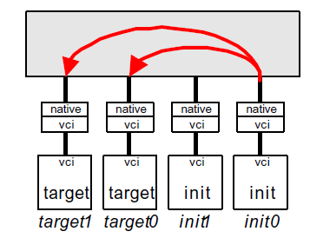
SPIN & VCI [8]
Performance on SPIN vs. BUS
  Measure time to complete a pooling
    Pooling : «Messages exchanged when each initiator sends a request to each target»
  Example :
Figure 6 : VCI Pool [8]

Slide 32
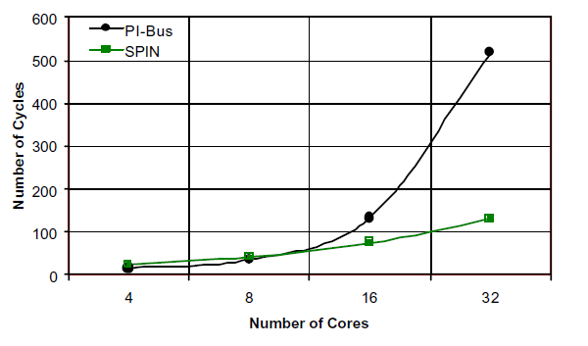
SPIN & VCI [8]
Performance on SPIN vs. BUS
Figure 7 : VCI and PI-BUS latency for different pooling size[8]

Slide 33
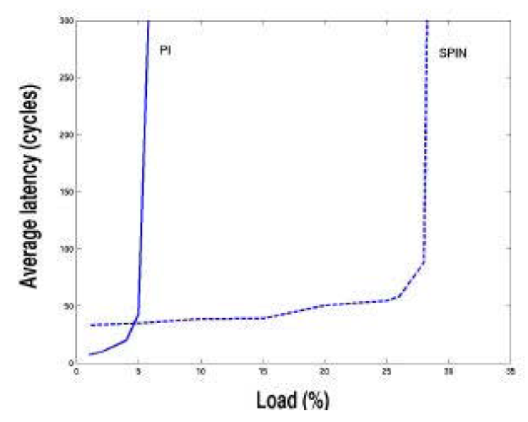
SPIN & VCI [8]
Saturation threshold (32 terminals)
Figure 8 : VCI and PI-BUS latency vs Load [8]

Slide 34
References
[1] Ankur Agarwal, Cyril Iskander, and Ravi Shankar, “Survey of Network on Chip (NoC) Architectures & Contributions”, Journal of Engineering, Computing and Architecture[online], vol.3, no.1, 2009 [cited Nov. 21, 2010], available : http://www.scientificjournals.org/journals2009/articles/1.
[2]Davide Bertozzi and Luca Benini, "Xpipes: a network-on-chip architecture for gigascale systems-on-chip“, Circuits and Systems Magazine, vol.4, no.2, 2004[cited Nov. 22, 2010], available :http://www.ieeexplore.ieee.org.proxy.bib.uottawa.ca/stamp/stamp.jsp?tp=&arnumber=1330747&isnumber=29380.
[3] Evgeny Bolotin, Arkadiy Morgenshtein, Israel Cidon, Ran Ginosar, and Avinoam Kolodny, "Automatic hardware-efficient SoC integration by QoS network on chip“,in Proceedings of the 2004 11th IEEE International Conference on Electronics, Circuits and Systems, vol.1, Tel-Aviv, Israel, Dec. 13-15, 2004, pp. 479- 482.
[4] Kees Goossens, John Dielissen, and Andrei Radulescu, "AEthereal network on chip: concepts, architectures, and implementations“, Design & Test of Computers[online], vol.22, no.5, 2005 [cited Nov. 23, 2010], available : http://www.ieeexplore.ieee.org.proxy.bib.uottawa.ca/stamp/stamp.jsp?tp=&arnumber=1511973&isnumber=32372.
[5] Arteris Inc., Sunny Vale, CA, online : http://www.arteris.com.

Slide 35
References
[6]Ankur Agarwal, Mehmet Mustafa, and A. S. Pandya, "QOS Driven Network-on-Chip Design for Real Time Systems“, Canadian Conference on Electrical and Computer Engineering, Ottawa, Canada, May 7-10, 2006.
[7]Pierre Guerrier, "Un Réseau d'Interconnexion pour Systèmes Intégrés", Ph. D. thesis, Université Pierre et Marie Curie, Paris, France, may 2000.
[8]Adrijean Andriahantenaina, Hervé Charlery, Alain Greiner, Laurent Mortiez, Cesar Albenes Zeferino, "SPIN: a Scalable, Packet Switched, On-Chip Micro-network", Design Automation and Test in Europe Conference Embedded Software Forum, Munchen, Germany, 3-7 march 2003, pp. 70-73.
[9]Pierre Guerrier, Alain Greiner, "A Scalable Architecure for System-On-Chip Interconnections",in Proceedings of the Sophia-Antipolis MicroElectronics Conference, Sophia Antipolis, France, October 1999, pp. 90-93.
[10]Adrijean Andriahantenaina, Alain Greiner, "Micro-réseau pour systèmes intégrés : Réalisation d'un réseau SPIN à 32 ports", Troisième Colloque du GDR CAO de circuits et systèmes intégrés, Paris, France, Mai 2002, pp. 71-74.

Slide 36
References
[11]Pierre Guerrier, Alain Greiner, "A Generic Architecture for On-chip Packet-switched Interconnections", in Proceedings of the DATE'2000 Conference, Paris, France, Mars 2000, pp. 250-256.
[12]Arkadiy Morgenshtein, Israel Cidon, Avinoam Kolodny, and Ran Ginosar, "Low-leakage repeaters for NoC interconnects“, in Proceedings of the IEEE International Symposium on Circuits and Systems, vol.1, Kobe, Japan, May 23-26, 2005, pp. 600- 603.
[13]Chauchin Su, and Yue-Tsung Chen, "Comprehensive interconnect BIST methodology for virtual socket interface“, in Proceedings of the Seventh Asian Test Symposium, Singapore, Dec. 2-4, 1998, pp.259-263.
[14]Yifeng Qiu, and Wael Badawy, “A Prototyping Virtual Socket System-On-Platform Architecture with a Novel ACQPPS Motion Estimator for H.264 Video Encoding Applications”, EURASIP Journal on Embedded Systems[online], vol.2009, 2009 [cited Nov. 25,2010], available : http://www.hindawi.com/journals/es/2009/105979.html.
[15]OCB 2 2.0, VSI Alliance™ Virtual Component Interface Standard Version 2.
[16]Hervé Charlery, and Alain Greiner, "Systèmes intégrés : un micro-réseau d'interconnexion à commutation de paquets respectant la norme VCI", Troisième Colloque du GDR CAO de circuits et systèmes intégrés, Paris, France, Mai 2002, pp. 75-78.

