Slide 1
Message passing architectures and routing
CEG 4131 Computer Architecture III
Miodrag Bolic
Material for these slides is taken from the book:
W. Dally, B. Towles, Principles and Practices of Interconnection Networks, Morgan Kaufmann, 2004
Notes:
This lecture deals with the topic of inter-processor communications. The emphasis is put on routing algorithms.

Slide 2
Definitions [1]
A network channel c=(x,y) is characterized by
  width wc: the number of parallel signals it contains,
  frequency fc: the rate at which bits are transported at each signal
  latency tc is the time required for a bit to travel from x to y.
A bandwidth of a channel is W= wc * fc.
The throughput Θ of a network is the data rate in bits per second that network accepts per input port.
Under a particular traffic pattern, the channel that carries the largest fraction of the traffic determines the maximum channel load γ. Load on the channel can be equal or smaller than channel bandwidth.
Θ=W/γ
Notes:
Here are the simplest metrics used for analysis of networks and their performance. The objective is to maximize bandwidth, throughput and maximum channel load.

Slide 3
Taxonomy of Routing Algorithms [1]
Deterministic: The simplest algorithm - for each source, destination pair, there is a single path. This routing algorithm usually achieves poor performance because it fails to use alternative routes, and concentrates traffic on only one set of channels.
Oblivious: So named because it ignores the state of the network when determining a path. Unlike deterministic, it considers a set of paths from a source to a destination, and chooses between them.
Adaptive: The routing algorithm changes based on the state of the network.
Notes:
Two types of routing are discussed in this lecture:
Oblivious routing attempts to spread the load on each path without knowledge of its status (traffic, buffer loads, etc.). Very little overhead in routing but does not maximize resource usage.
Adaptive is the more dynamic solution which constantly re-analyzes the status of the network before the next hop. The overhead is multiplied by the number of hops but can lead to higher performance due to its knowledge of the network conditions. However this procedure, if done incorrectly, can lead to both deadlocks and starvation. The logic for each router is also much greater than the two other forms of routing.

Slide 4
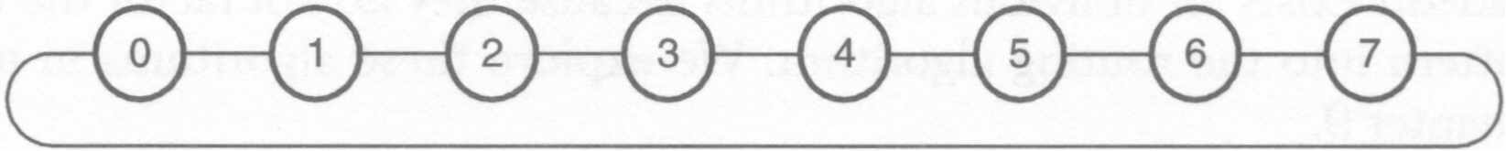
Routing algorithms [1]
Greedy: Always send the packet in the shortest direction around the ring. For example, always route from 0 to 3 in the clockwise direction and from 0 to 5 in the counterclockwise direction. If the distance is the same in both directions, pick a direction randomly.
Uniform random: Randomly pick a direction for each packet, with equal probability of picking either direction.
Weighted random: Randomly pick a direction for each packet, but weight the short direction with probability 1 - Δ /8 and the long direction with Δ/8, where Δ is the (minimum) distance between the source and destination.
Adaptive: Send the packet in the direction for which the local channel has the lowest load. We may approximate load by either measuring the length of the queue serving this channel or recording how many packets it has transmitted over the last T slots.
Notes:
Here we analyze several tactics (both oblivious and adaptive) of routing upon a ring topology of 8 nodes.

Slide 5
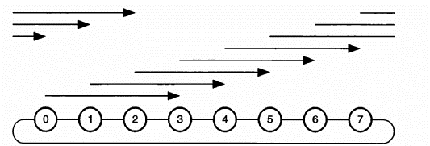
Example [1]
Consider a tornado traffic pattern in which each node i sends a packet to i + 3 mod 8. Which algorithm gives the best worst-case throughput?
Notes:
At first glance:
The greedy algorithm will send all of its packets in the clockwise direction. At first it will be completely used with no collisions. But subsequent transmissions will have to wait until the first set is completely finished before they may begin.
The uniform random’s behavior should be better than greedy because it will at least spread out the flow of data.
Weighed random should perform better than the previous two as it takes the best of the two approaches. It spreads the load and attempts to use the shortest path.
The adaptive algorithm could perform the best but it might be limited by the size of the network and the number of connections.

Slide 6
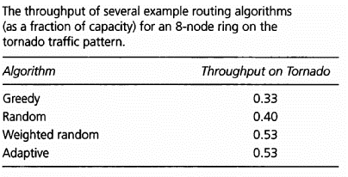
Notes:
As we see, the deterministic algorithm (greedy) does fairly poorly but its oblivious counterpart does not much better. Both weighted random and adaptive perform relatively well considering the topology of the network. One can hypothesize that adaptive would scale better than weighted random in more interconnected topologies.

Slide 7
Explanation [1]
With the greedy routing algorithm, all of the traffic routes in the clockwise direction around the ring, leaving all of the counterclockwise channels idle and loading the clockwise channels with 3 units of traffic, that is, γ = 3, which gives every terminal a throughput of Θ = W/3.
With random routing, the counterclockwise links become the bottleneck with a load of γ = 5/2, since half of the traffic traverses 5 links in the counterclockwise direction. This gives a throughput of 2W/5.
Weighting the random decision sends 5/8 of the traffic over 3 links and 3/8 of the traffic over 5 links for a load of γ = 15/8 in both directions giving a throughput of 8W/15.
Adaptive routing, with some assumptions on how the adaptivity is implemented, will match this perfect load balance in the steady state, giving the same throughput as weighted random routing.
Notes:
The analysis matches the hypothesis. Although the behavior of the latter two algorithms is complex and could change drastically under different network loads.

Slide 8
Message Formats [2]
Message: logical unit for internode communication
Packet: basic unit containing destination address for routing
Packets have sequencing # for reassembly
Flits: flow control digits of packets
Store-and-forward: packets
Wormhole routing: flits
Notes:
The discrete units of data transmitted may differ depending on the type switching chosen. Nonetheless, the routing information is located in the header of each packet. The packet may be fragmented during transmission if a cut-through switching model is in use.

Slide 9
Packets and Flits [2]
Header flits contain routing information and sequence number
Flit length affected by network size
Packet length determined by routing scheme and network implementation
Lengths also dependent on channel b/w, router design, network traffic, etc.
Notes:
The flits used by wormhole routing will be used in the same fashion independently of the routing scenario but will change in length. The large they are, the larger the buffer size for each router. The smaller they are, the more congestion and fragmentation will occur. This can also lead to deadlocks and starvation. An adaptive routing algorithm may modify this length depending on traffic.

Slide 10
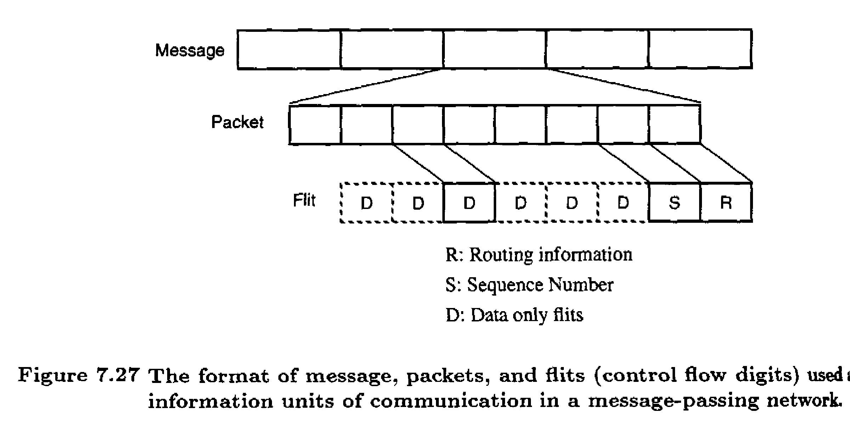
Message Format [2]
Notes:
Here we see the data hierarchy in network communications. The content of the message is not important here. However, the packet size is. The pipelining of switching allows the packet to be divided further by the routers along the path.

Slide 11
Latency Analysis [2]
L=packet length W=channel b/w (bits/s)
D=distance F=flit length
T_{SF}=(D + 1)L/W
T_{WH}=L/W + D*F/W
Store-and-forward: controlled by s/w
Wormhole: controlled by h/w
Notes:
As we can see, the delay for store-and-forward is controlled mainly by distance and packet length. The wormhole switching approach is sensitive to flit length and distance.
The smaller the flit relative to packet size, the smaller the wormhole latency will be.

Slide 12
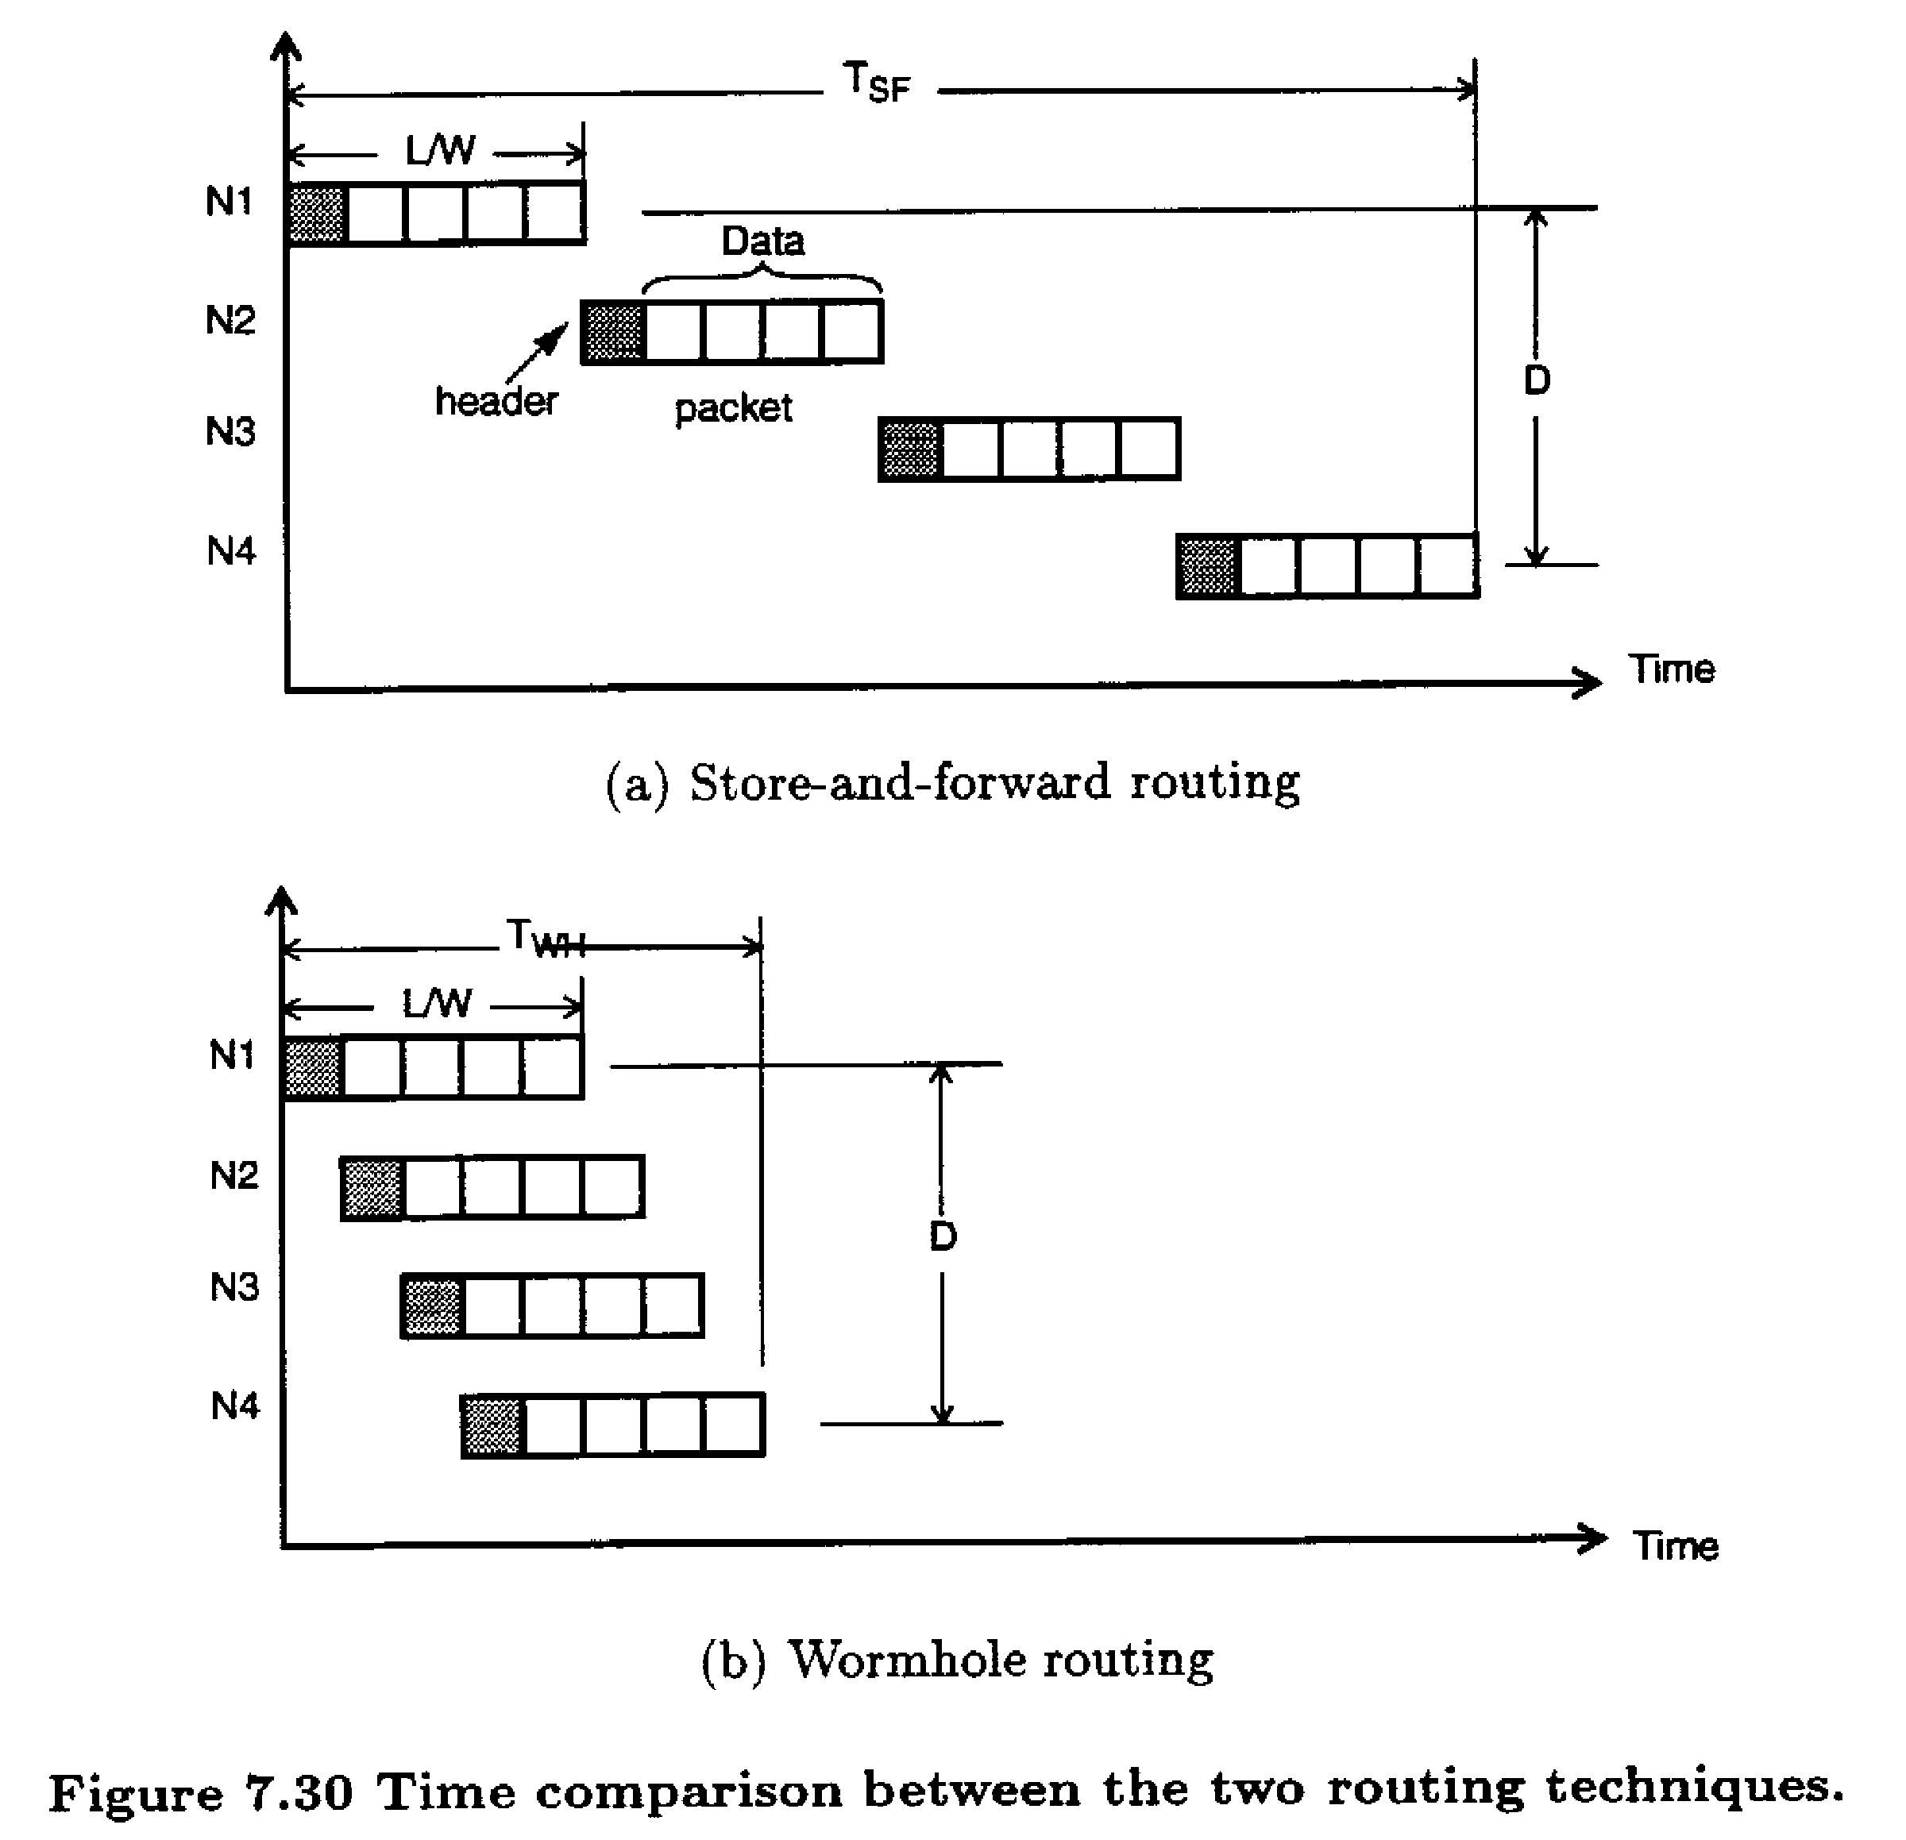
From [3]
Notes:
Here we see a graphical analysis portraying the parallel nature of wormhole routing. The analysis of the previous slide is clear: the smaller F becomes, the more parallelized the transmission becomes.

