Slide 1
Directory-Based Cache Coherence
Marc De Melo

Slide 2
Outline
Non-Uniform Cache Architecture (NUCA)
Cache Coherence
Implementation of directories in multicore architecture

Slide 3
Non-Uniform Cache Architecture [1]
Uniform Cache Architecture
  Multi-level cache hierarchies
    Organized into a few discrete levels
    Each level reduces access to the lower level
      Inclusion overhead
    Internal wire delays
    Restricted number of ports
  Large on-chip cache
    Single and discrete hit latency
      Undesirable due to increasing wire delays
Notes:
[1] ftp://ftp.cs.utexas.edu/pub/dburger/papers/ASPLOS02.pdf

Slide 4
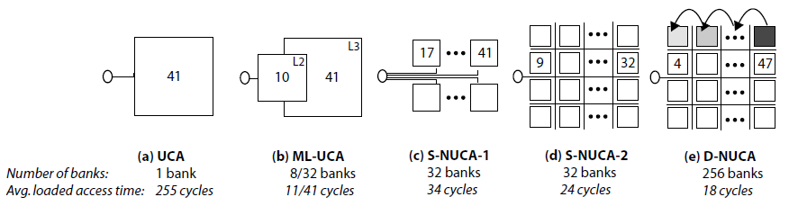
Non-Uniform Cache Architecture [1]
Non-uniform cache architecture (NUCA)
  Exploit non-uniformity
    Data in large cache closer to processor is accessed faster than data residing physically farther
Level 2 caches architectures, 16MB with 50nm technology (taken from [1])

Slide 5
Non-Uniform Cache Architecture [1]
Static NUCA
  Each bank can be accessed at different speeds
    Proportional to the distance from the controller
    Lower latency when closer to controller
  Mapping of data into banks based on block index
  Banks are independently addressable
  Access to banks may proceed in parallel
    Banks have private channels
  Large number of wires
  Access time and routing delay increase with time
    Best organization at smaller technologies uses larger banks

Slide 6
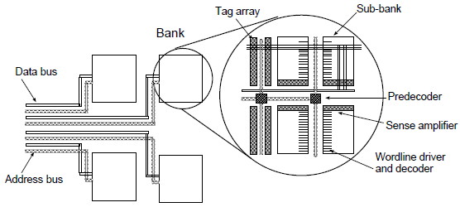
Non-Uniform Cache Architecture [1]
Static NUCA design (taken from [1])

Slide 7
Non-Uniform Cache Architecture [1]
Switched Static NUCA
  2D Mesh, point-to-point links
  Removes most of the large number of wires
  Allows a large number of faster, smaller banks
Dynamic NUCA
  Allows data to be mapped to many banks
  Allows data to migrate among the banks
  Frequently used data can be promoted to faster banks

Slide 8
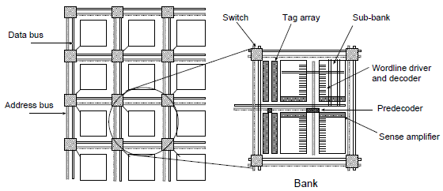
Non-Uniform Cache Architecture [1]
Switched NUCA design (taken from [1])

Slide 9
Non-Uniform Cache Architecture [2]
Policies
  Bank placement policy
    Where is data placed in the NUCA cache memory
  Bank access policy
    Determines bank-searching algorithm
  Bank migration policy
    Determines if a data element is allowed to change its placement from one bank to another
    Regulates migration of data
  Bank replacement policy
    How NUCA behaves when there is a data eviction from one of the banks
Notes:
[2] http://www.cercs.gatech.edu/mmcs09/papers/lira.pdf

Slide 10
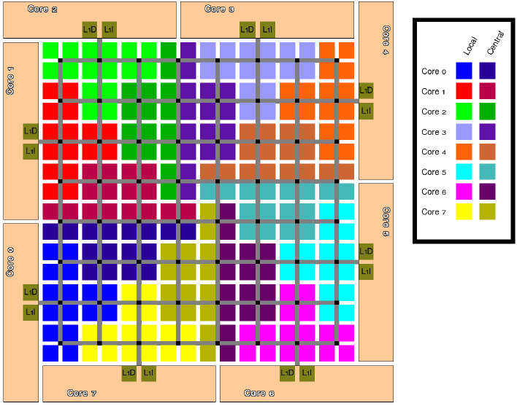
Non-Uniform Cache Architecture [2]
Taken from [2]

Slide 11
Cache Coherence
Cache-coherence problem
Support for large number of processors
  Need for high bandwidth
  Bus architecture insufficient
Point-to-Point networks
  No broadcast mechanism
  Snooping protocol unusable
Directory
  Solution for point-to-point networks
  Stores location of cache copies of blocks of data
  Centralized or distributed

Slide 12
Implementation of directories in multicore architectures [3]
DRAM (off-chip) directory
  Stores directory information in DRAM
    Ex: full-map protocol
  Does not exploit distance locality
  Treats each tile as a potential sharer of data
  Directory can be cached in on-chip SRAM
    Do not need to access off-chip memory each time
Notes:
[3] http://www.cs.wisc.edu/multifacet/papers/isca07_virtual_hierarchy.pdf

Slide 13
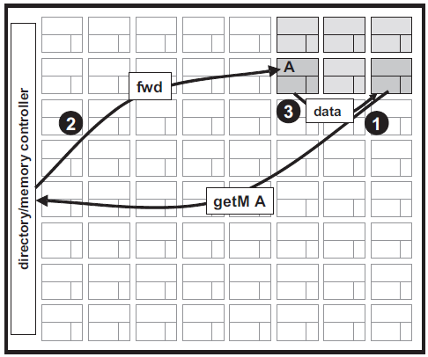
Implementation of directories in multicore architectures [3]
Taken from [3]
Notes:
http://www.cs.wisc.edu/multifacet/papers/isca07_virtual_hierarchy.pdf

Slide 14
Implementation of directories in multicore architecture [4]
DRAM (off-chip) directory with directory caches
  Private cache
  Directory is cached in each tile
    Do not need to access off-chip memory each time
    Non-coherent caches
      Home node for any given cache line
      Different range of memory address for each tile
  Directory controller in each tile
    Controls coherency between private caches
Notes:
http://cseweb.ucsd.edu/users/tullsen/spaa07.pdf

Slide 15
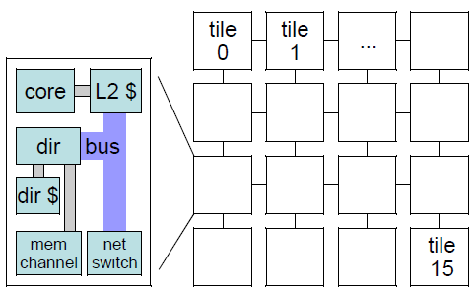
Implementation of directories in multicore architecture [4]
Taken from [4]
Notes:
[4] http://cseweb.ucsd.edu/users/tullsen/spaa07.pdf

Slide 16
Implementation of directories in multicore architectures [3]
Duplicate tag directory
  Directory centrally located in SRAM
  Connected to individual cores
  Exact duplicate tag store
    Directory state for a block is determined by examining copy of tags of every possible cache that can hold the block
    Keep copied tags up-to-date
  No more need to read states from DRAM memory
  Challenging as the number of cores increases
    64 cores, 16-way associative cache = 1024 aggregate associativity of all tiles
Notes:
http://www.cs.wisc.edu/multifacet/papers/isca07_virtual_hierarchy.pdf

Slide 17
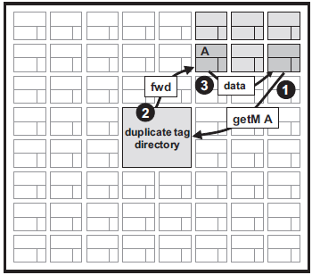
Implementation of directories in multicore architectures [3]
Taken from [3]
Notes:
http://www.cs.wisc.edu/multifacet/papers/isca07_virtual_hierarchy.pdf

Slide 18
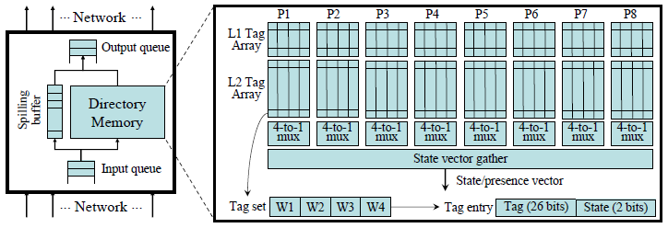
Implementation of directories in multicore architecture [5]
Directory memory, 4-way associative caches (taken from [5])
Notes:
[5] http://pages.cs.wisc.edu/~mscalar/papers/2006/isca2006-coop-caching.pdf

Slide 19
Implementation of directories in multicore architectures [3]
Static cache bank directory
  Distributed directory among the tiles
    Mapping block address to a tile (called the home tile)
      Home tiles selected by simple interleaving
      Location can be sub-optimal (see next slide)
    Tile’s cache extended to contain directory information
      Integrates directory states with cache tags
      Avoids SRAM or DRAM separate directory
Notes:
[3] http://www.cs.wisc.edu/multifacet/papers/isca07_virtual_hierarchy.pdf

Slide 20
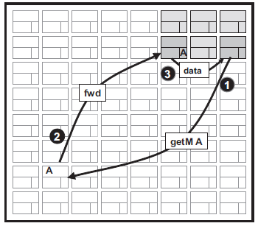
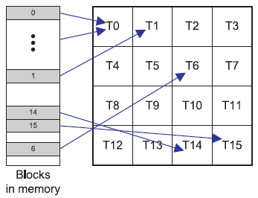
Implementation of directories in multicore architectures [3,6]
Taken from [6]
Taken from [3]
Notes:
1- http://www.cs.pitt.edu/cast/papers/cho-micro06.pdf
2- http://www.cs.wisc.edu/multifacet/papers/isca07_virtual_hierarchy.pdf

Slide 21
Implementation of directories in multicore architecture [7]
SGI Origin2000 multiprocessor system
  Directory memory connected to on-chip memory
    Shared L2 cache
    Directory memory distributed over multiple tiles
    Cache coherence controller
    Home tile sends appropriate messages to cores
Notes:
http://www.cs.pitt.edu/cast/papers/lee-tc10.pdf

Slide 22
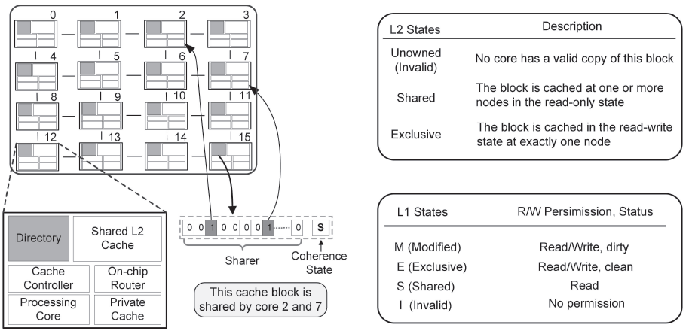
Implementation of directories in multicore architecture [7]
SGI Origin2000 multiprocessor system (taken from [7])
Notes:
http://www.cs.pitt.edu/cast/papers/lee-tc10.pdf

Slide 23
Implementation of directories in multicore architecture [8]
Tilera Tile64 architecture
  2d mesh network (8X8)
  Provides coherent shared-memory environment
  Uses neighborhood caching
    Provides on-chip distributed shared cache
  Coherency is maintained at the home tile
    Data is not cached at non-home tiles
  Communication over a Tile Dynamic Network
Notes:
[8] http://www.ieeexplore.ieee.org.proxy.bib.uottawa.ca/stamp/stamp.jsp?tp=&arnumber=4378780

Slide 24
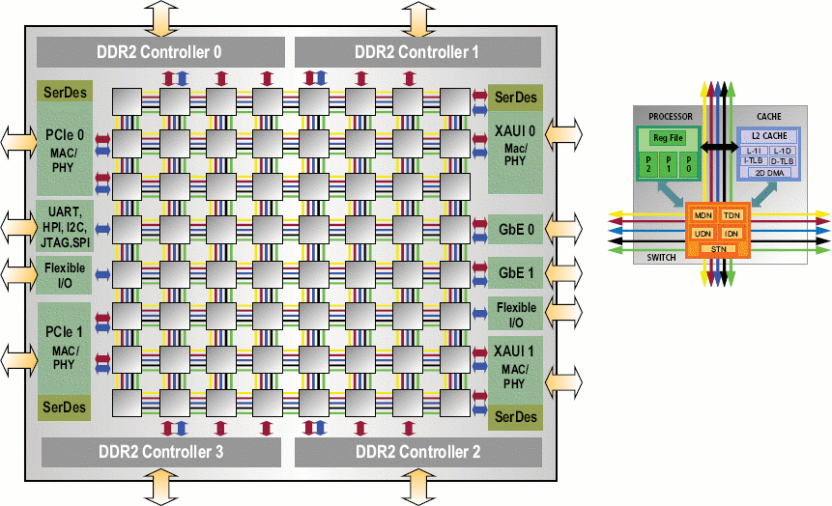
Implementation of directories in multicore architecture [9]
Tilera Tile64 (taken from)
Notes:
[9] http://www.linuxfordevices.com/files/misc/tilera_tile64_arch_diag2.gif

Slide 25
References
[1] C. Kim, D. Burger, S.W. Keckler, “An Adaptative, Non-Uniform Cache Structure for Wire-Delay Dominated On-Chip Caches”, in Proc. 10th Int. Conf. ASPLOS, San Jose, CA, 2002, pp. 1-12
[2] J. Lira, C. Molina, A. Gonzalez, “Analysis of Non-Uniform Cache Architecture Policies for Chip-Multiprocessors Using the Parsec Benchmark Suite”, MMCS’09, Mar. 2009, pp. 1-8
[3] M.R. Marty, M.D. Hill, “Virtual Hierarchies to Support Server Consolidation”, ISCA’07, June 2007, pp. 1-11
[4] J.A. Brown, R. Kumar, D. Tullsen, “Proximity-Aware Directory-based Coherence for Multi-core Processor Architectures”, SPAA’07, June 2007, pp. 1-9
[5] J. Chang, G.S. Sophi, “Cooperative Caching for Chip Multiprocessors”, Computer Architecture, ISCA '06. 33rd International Symposium on, 2006, pp.264-276
[6] S. Cho, L. Jin, "Managing Distributed, Shared L2 Caches through OS-Level Page Allocation“, Microarchitecture, 2006. MICRO-39. 39th Annual IEEE/ACM International Symposium on, Dec. 2006, pp.455-468
[7] H. Lee, S. Cho, B.R. Childers, "PERFECTORY: A Fault-Tolerant Directory Memory Architecture“, Computers, IEEE Transactions on , vol.59, no.5, May 2010, p.638-650
[8] D. Wentzlaff, P. Griffin, H. Hoffmann, L. Bao, B. Edwards, C. Ramey, M. Mattina, C.C. Miao, J.F. Brown, A. Agarwal, "On-Chip Interconnection Architecture of the Tile Processor“, Micro, IEEE , vol.27, no.5, Sept.-Oct. 2007, pp.15-31
[9] Linux Devices, “4-way chip gains Linux IDE, dev cards, design wins” [online], Linux Devices, Apr. 2008 [cited Oct. 21 2010] , available from World Wide Web: < http://thing1.linuxdevices.com/news/NS4811855366.html >

