Slide 1

Trends in Multiprocessor Thread Schedulers
Daniel Shapiro
dshap092@uottawa.ca
http://site.uottawa.ca/~dshap092
Notes:
20-25 minutes on new achievements in the area

Slide 2

Thread Scheduler
Multithreading
Thread scheduler
  Quickly choose among the list of ready-to-run threads to execute a subset of them on the available hardware
  Maintain the ready-to-run and stalled thread lists.
  Different thread priority schemes can be used by the scheduler.
  The thread scheduler can be implemented in software, hardware or a mix.

Slide 3

Overview
Problems
Papers
Progress
Clustering
Performance metrics
Metrics analysis
Performance Gains (not completed)

Slide 4
MP Thread Scheduling Problems
OS jitter
Scheduling algorithm selection
Priority assignment
Priority inversion
Thread competition
Dynamic scheduling and resource utilization
Inter-processor communication
Interrupts: Low priority interrupts halt high priority threads
Intermittent slowdown in thread due to hidden OS activity
Many possible algorithms
Threads do not have HW priorities
Medium priorities starve high priority threads
Deadlocks and livelocks
Hard to assign threads to maximize HW utilization
Dependencies tend to ruin the available parallelism
Notes:
OS Jitter http://domino.research.ibm.com/comm/research_projects.nsf/pages/osjitter.index.html

Slide 5

Paper Titles
“Predictable performance in SMT processors: synergy between the OS and SMTs”
“Preemption threshold scheduling: Stack optimality, enhancements and analysis”
→PTS tries ad-hoc to minimize preemptions as much as possible while preserving the system’s schedulability.
“Performance effect of localized thread schedules in heterogeneous multi-core processors”
“On better performance from scheduling threads according to resource demands in MMMP” → Multi-core Multi-threading Microprocessor →balance CPI_mem
“Parallelism-aware batch scheduling: Enabling high-performance and fair shared memory controllers”
→“Preemptive virtual clock: A flexible, efficient, and cost-effective QoS scheme for networks-on-chip” →priority inversion, buffering, trade-off between the strength of the guarantees and throughput, bandwidth provision per thread.
“Thread priority sensitive simultaneous multi-threading fair scheduling strategy”
“Improving priority enforcement via non-work-conserving scheduling” → co-runners
“A dual-priority real-time multiprocessor system on fpga for automotive applications”

Slide 6
Paper Titles
“Prioritized SMT architecture with IPC control method for real-time processing” →throughput vs priority
“Handling OS jitter on multicore multithreaded systems”
“Improving performance isolation on chip multiprocessors via an operating system scheduler” → co-runners
“Limos: A lightweight multi-threading operating system dedicated to wireless sensor networks” →2-level sched preempt/not, event driven
“Reservationbased interrupt scheduling” → trade-off between predictability and hardware performance
“Real-time java and multi-core architectures”
“Predictable interrupt management and scheduling in the composite component-based system” →security → dependable and predictable for untrusted user code
“Sloth: Threads as interrupts”

Slide 7

Areas of Progress
Well-Known Scheduling Problems
And Thread Performance
Handling OS Jitter
Preemption threshold scheduling (PTS) is the optimal real-time algorithm for reducing stack memory size.
Parallelism-aware batch scheduling
QOS Scheme prevents priority inversion
Synergy between the OS and SMTs
Performance Effect of Localized Thread Schedules
Thread Performance Isolation using Operating System Scheduler
Thread priorities during instruction scheduling in SMT
Priority enforcement via non-work-conserving scheduling
Prioritized SMT Architecture with Inter-processor communication (IPC) Control Method
Scheduling Threads According to Resource Demands

Slide 8
Areas of Progress
Applications
And Interrupt Ideas
A Dual-Priority MPSoC for cars
Multi-threading OS for WSN
Real-Time Java and Multi-Core Architectures
Threads as Interrupts
Reservation-Based Interrupt Scheduling
Predictable Interrupt Scheduling

Slide 9

Clustering of Topics
Scheduling Multiprocessor Threads
Scheduling to improve thread performance [1, 2, 3, 4, 15, 5]
Thread priority schemes [6, 7, 8, 9, 10, 15]
OS impact on thread performance [11, 12, 13]
Relationship between interrupts and threads [16, 14, 17]

Slide 10
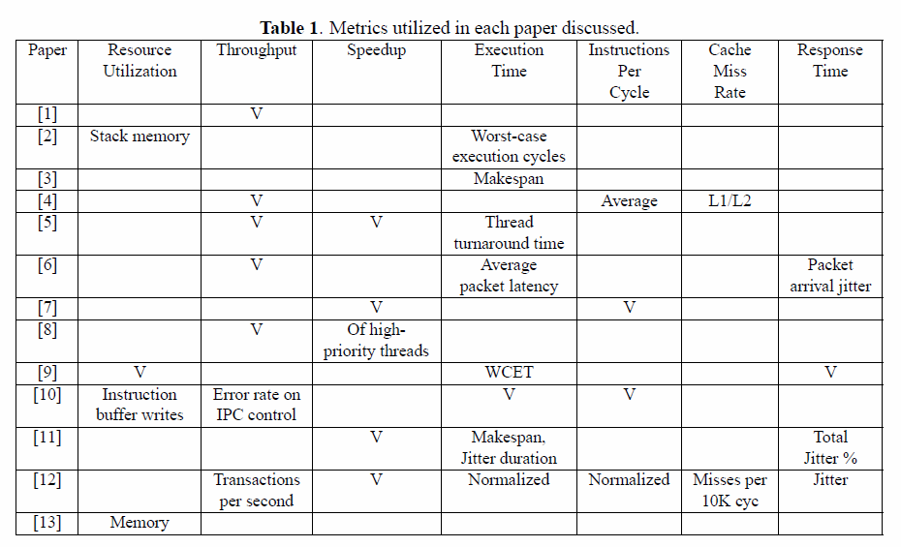
Performance Metrics

Slide 11
Resource Utilization Analysis
In [2, 9,10, 13], the units for resource utilization were memory bytes[2, 13], shared PE hardware [9], and the common instruction buffer [10].
The resource utilization is not necessarily a good metric for performance.
One can imagine that keeping hardware units busy or memory usage low does not necessarily translate into a higher throughput of threads or a bigger speedup.

Slide 12

Throughput Analysis
In [1, 4, 5, 6, 8, 10, 12], throughput is discussed in terms of the balance between instructions issued and fairness to priority.
IPC control: balancing priority and throughput.
Clearly, throughput maximization in a system with multiple threads is nominally good, but as with IPC, this number does not represent a full picture of the system performance.

Slide 13
Speedup Analysis
[12] used slowdown as a measure of performance, but then also had negative slowdown to represent speedup. Speedup was used as a metric in [5, 7, 8, 12, 11].
This metric is very commonly in computer architecture papers for expressing the benefit of an approach.
Speedup may abstract the finer grained details of a multiple thread program, where situations such as priority inversion and thread starvation are often more important than the overall system speedup.

Slide 14
Exec Time Analysis
[2, 3, 5, 6, 9, 10, 11, 12] used seconds, microseconds, abstract units in a simulation (called time, latency), and cycles as units for execution time.
While cycles and ticks in a simulation remove the clock frequency from consideration, real time units provide a much better understanding of the real-world implications of a given approach.

Slide 15

IPC Analysis
[12, 7] normalized the collected samples, while [4] gave an average IPC, and [7, 10] presented raw IPC values.
Maximizing IPC does not guarantee better throughput, as we have seen in the RISC versus CISC comparison.
  Specifically, RISC has a simpler instruction set and so even though the Cycles Per Instruction (CPI) is minimized compared to the CISC, the CISC can perform a broader range of operations, and can directly access the global memory in a single cycle.
Having said this caveat, IPC is probably interesting for thread analysis because it gives an idea of the number of events happening in parallel.

Slide 16
Caches Analysis
Cache miss rates: the number of misses was observed by [4] and the miss rate was observed by [12].
Scheduling is so sensitive to cache coherence policy, size, and structure that it should probably be reported on more often.
Sometimes there is not enough data available on the inner workings of the cache at runtime, and so a simulator or hardware debug support is required.
In some cases there is no cache or limited caching present in the hardware, such as the multiprocessor MicroBlaze system in [9] where there is a local memory for data and an L1 instruction cache.

Slide 17

Response Time Analysis
Response time and/or the jitter in response time was noted by [6, 9, 11, 12]
Was represented as a percentage of total execution time [11], and time spent waiting.
Jitter is typically random a runtime effect, and so static scheduling will not be able to take such noise into account easily.

Slide 18
Benchmark Analysis
The benchmark used to obtain the stated metrics were:
  IDCT in [10]
  MiBench in [9, 7]
  SPEC CPU2000 in [1, 12,7, 4]
  SPEC CPU2006 for [8]
  Trace Collector in [11]
  PapaBench in [2]
  PARSEC in [6]
  netperf in [14]
  PCMark05 in the related work of [3]
  In [16] the programs referred to as ”microbenchmarks” were non-standard.
It is proposed in [15] that a new benchmark suite is needed for real-time Java on parallel processors.
This will only continue the trend (e.g. ISE identification) that one can see in performance evaluation where the benchmarks used are not the same even for a small cluster of papers in a subspecialty of computer architecture.
It is worth noting that SPEC CPU and MiBench are broadly used.

Slide 19

Performance Gains
Not done yet ☺
+taxonomy
qualitative

Slide 20
References
[1] F.J. Cazorla, P.M.W. Knijnenburg, R. Sakellariou, E. Fernandez, A. Ramirez, and M. Valero, “Predictable performance in smt processors: synergy between the os and smts,” Computers, IEEE Transactions on, vol. 55, no. 7, pp. 785 – 799, 2006.
[2] R. Ghattas and A.C. Dean, “Preemption threshold scheduling: Stack optimality, enhancements and analysis,” in Real Time and Embedded Technology and Applications Symposium, 2007. RTAS ’07. 13th IEEE, 2007, pp. 147 –157.
[3] F.N. Sibai, “Performance effect of localized thread schedules in heterogeneous multi-core processors,” in Innovations in Information Technology, 2007. IIT ’07. 4th International Conference on, 2007, pp. 292 –296.
[4] Lichen Weng and Chen Liu, “On better performance from scheduling threads according to resource demands in mmmp,” in Parallel Processing Workshops (ICPPW), 2010 39th International Conference on, 2010, pp. 339 –345.
[5] O. Mutlu and T. Moscibroda, “Parallelism-aware batch scheduling: Enabling high-performance and fair shared memory controllers,” Micro, IEEE, vol. 29, no. 1, pp.22 –32, 2009.
[6] B. Grot, S.W. Keckler, and O. Mutlu, “Preemptive virtual clock: A flexible, efficient, and cost-effective qos scheme for networks-on-chip,” in Microarchitecture, 2009. MICRO-42. 42nd Annual IEEE/ACM International Symposium on, 2009, pp. 268 –279.
[7] Cheng Lian and Yang Quansheng, “Thread priority sensitive simultaneous multi-threading fair scheduling strategy,” in Computational Intelligence and Software Engineering, 2009. CiSE 2009. International Conference on, 2009, pp. 1 –4.
[8] J.C. Saez, J.I. Gomez, and M. Prieto, “Improving priority enforcement via non-work-conserving scheduling,”in Parallel Processing, 2008. ICPP ’08. 37th International Conference on, 2008, pp. 99 –106.
[9] A. Tumeo, M. Branca, L. Camerini, M. Ceriani, M. Monchiero, G. Palermo, F. Ferrandi, and D. Sciuto,“A dual-priority real-time multiprocessor system on fpga for automotive applications,” in Design, Automation and Test in Europe, 2008.DATE ’08, 2008, pp. 1039–1044.
[10] N. Yamasaki, I. Magaki, and T. Itou, “Prioritized SMT architecture with ipc control method for real-time processing,” in Real Time and Embedded Technology and Applications Symposium, 2007. RTAS ’07. 13th IEEE, 2007, pp. 12 –21.
[11] P. De, V. Mann, and U. Mittaly, “Handling os jitter on multicore multithreaded systems,” in Parallel Distributed Processing, 2009. IPDPS 2009. IEEE International Symposium on, May 2009, pp. 1 –12.
[12] A. Fedorova and M. Seltzer, “Improving performance isolation on chip multiprocessors via an operating system scheduler,” in Parallel Architecture and Compilation Techniques, 2007. PACT 2007. 16th International Conference on, 2007, pp. 25 –38.
[13] Hai ying Zhou and Kun mean Hou, “Limos: A lightweight multi-threading operating system dedicated to wireless sensor networks,” in Wireless Communications, Networking andMobile Computing, 2007.WiCom 2007. International Conference on, 2007, pp. 3051 –3054.
[14] N. Manica, L. Abeni, and L. Palopoli, “Reservationbased interrupt scheduling,” in Real-Time and Embedded Technology and Applications Symposium (RTAS), 2010 16th IEEE, 2010, pp. 46 –55.
[15] V. Olaru, A. Hangan, G. Sebestyen-Pal, and G. Saplacan,“Real-time java and multi-core architectures,” in Intelligent Computer Communication and Processing, 2008. ICCP 2008. 4th International Conference on, 2008, pp. 215 –222.
[16] G. Parmer and R. West, “Predictable interrupt management and scheduling in the composite component-based system,” in Real-Time Systems Symposium, 2008, dec. 2008, pp. 232 –243.
[17] W. Hofer, D. Lohmann, F. Scheler, and W. Schroder- Preikschat, “Sloth: Threads as interrupts,” in Real-Time Systems Symposium, 2009, RTSS 2009. 30th IEEE,2009, pp. 204 –213.

Slide 21

Questions?

Slide 22
SCRIBING, AND ANSWERING TO THE QUESTIONS
Report (total 3 weeks after the lecture):
  Scribing of the lecture
  Questions and paper analysis need to be answered
New questions/problems need to be defined and solved (5 problems (programming, algorithm, computer architecture design) and 5 questions)
Review (1 week)
Final submission (1 week)
The goal of this exercise is:
  To do review
  To prepare slides with the comments
  To prepare questions for the others
  To answer to the reviewer comments

Slide 23
SCRIBING, AND ANSWERING TO THE QUESTIONS
Scribing
- Is the lecture correctly covered? If not, please provide recommendations.
- Are the references correct? Are they up-to-date? Are they in correct format?
- Is every figure properly referenced?
- Is there any copy-paste?
Answering to the questions
- Are all the questions answered properly
- Did the student consult the appropriate literature? If not, please recommend more references.
- Did the student perform proper comparison?
Proposed questions and their solutions
- Do the questions and problems make sense? Are they too easy? If yes, then suggest some other.
- Did the student answered correctly?
Style and format
- Are the paper and references in IEEE format?
- Please correct English
The technical report will be marked based upon the advice in the document "The best method for presentation of research results in theses and papers" by Prof. Ivan Stojmenovic.
http://www.site.uottawa.ca/~dshap092/ceg4136/Stojmenovic.pdf

