Slide 1
Programming of parallel systems
Shared memory systems

Slide 2
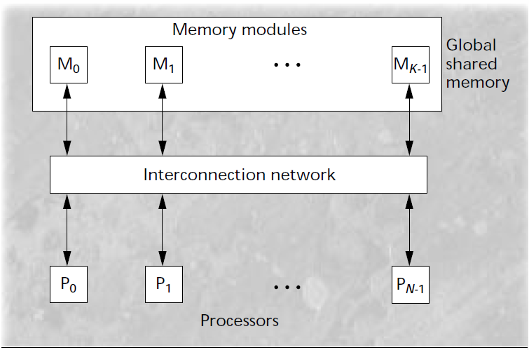
What is a shared memory system
Single memory space accessible to the programmer
Processor communicate through the network to the memories
Might have one or multiple memory per processor [1]
If there is less memory than processor
Memory contention
All processor can write to the same memory at the same time
Notes:
System where there is n processor
Whole space is accessible to the programmer
Processor communicate through the network
Might have one or multiple memory per processor
If there is less memory than processor, there will be contention

Slide 3
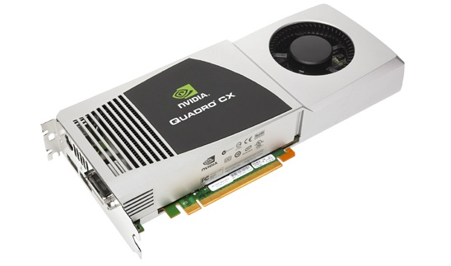
Examples of shared memory system
Shared memory systems are popular because of their ease of use.
CPU
Central processing unit
Shares the main memory among many processor to provide a way for communication between threads.
GPU
Graphics processing unit
Typically runs hundreds to thousands of threads in parallel organized in SIMD blocks. [2]
EX: ATI Radeon™ HD 4870 Architecture has 800 threads in 10 SIMD core [3]
Notes:
Can be 16 multiprocessor with 80 thread each. Each thread does the same job
Called stream processing units for AMD

Slide 4
Frameworks using shared memory for massively parallel systems
Due to the massive number of threads, applications have to be rewritten
OpenCL (Open Computing Language) [4]
Royalty Free
Originally developed by Apple, it was submitted to the non-profit Khronos Group
Heterogeneous computing, same code run CPUs, GPUs and other
CUDA (Compute Unified Device Architecture)
Proprietary to NVIDIA video cards
Has an API to run OpenCL on CUDA
Notes:
For massively parallel systems, it needs special frameworks to schedule thousand of threads.
On June 16, 2008 the Khronos Compute Working Group was formed.

Slide 5
CUDA vs OpenCL
Feature | OpenCL | CUDA
C Language Support | Yes | Yes
CPU Support | Yes | No
License | Royalty Free | Proprietary
Community size | Medium | Large
Speed | Fast | Very fast
CUBLAS (math API) | no | yes
CUFFT (FFT API) | no | yes

Slide 6
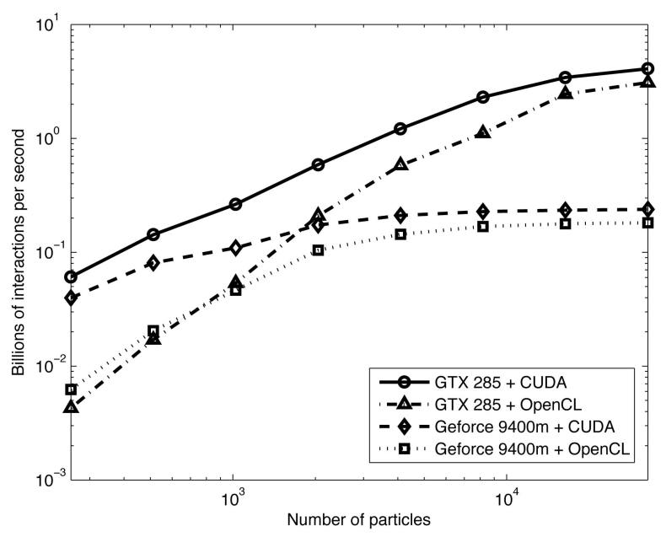
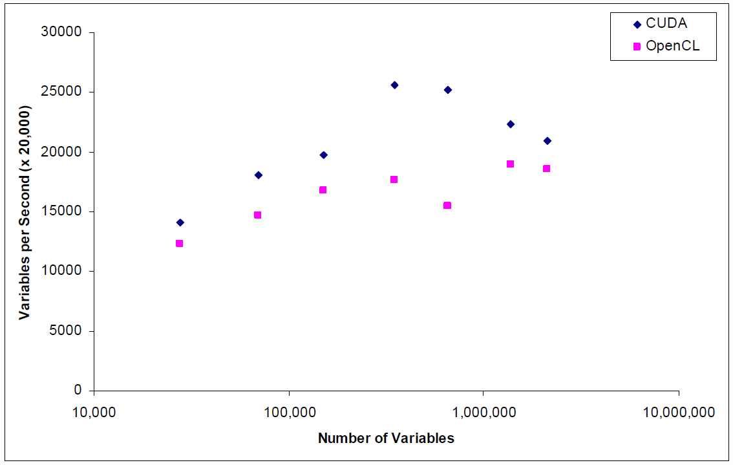
CUDA vs OpenCL - performance
[5]
[6]
Benchmarks were run using the same hardware and code

Slide 7
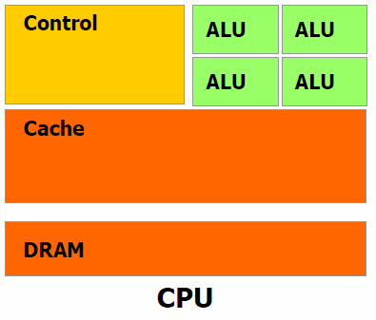
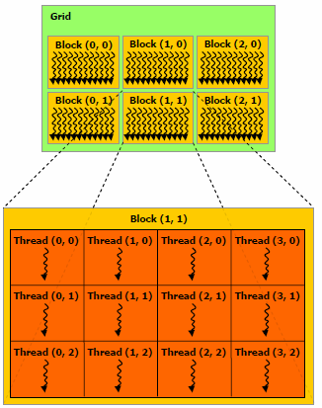
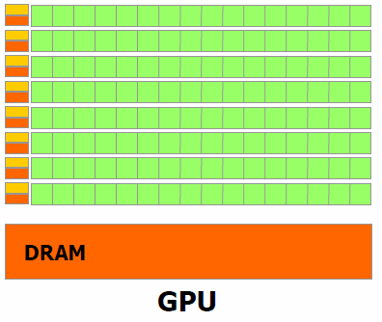
GPU architecture

Slide 8
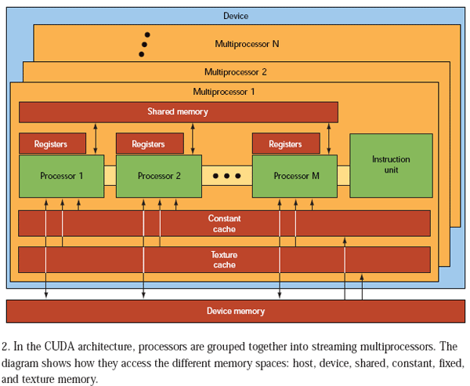
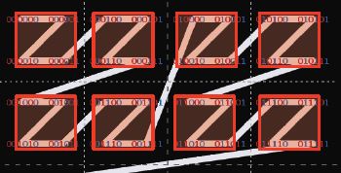
CUDA memory types 1/2
Device memory – global memory
shared
large DDR5 memory (> 1GB)
off-chip - no cache - slow
Texture cache
opaque memory layout optimized for texture fetch [7]
Free interpolation
off-chip - cached
Notes:
Talk about CUDA because there is a single design.
Texture cache size depend on the board, varies from 32KB to 1 MB

Slide 9
CUDA memory types 2/2
Constant cache
Off-chip
Cached
Slow
Small (8KB)
Shared memory
One per multiprocessor
On-chip
Fast (one clock cycle)
Small (16KB)
Can serve as a cache for the global memory
Notes:
Constant data size = 64KB and the cache is 8KB

Slide 10
Support for shared memory in hardware
Two types of shared memory
Global memory
Shared among the multiprocessor
No cache ... cache coherent
Support for atomic operations
Shared memory
Not a truly shared memory, because it is local to a multiprocessor
Support for atomic operations
Often serve a manual cache for the global memory
The program explicitly write to the shared memory
Private to a multiprocessor, shared between its threads

Slide 11
Memory bandwidth 1/4
The memory is often the restricting factor in a system
Using a single bus and a single memory module restricts the system scalability [8]
Only one processor could access the memory at one time
Leads to serialization
Solution on the GPU:
Use a LARGE memory bus width such as 384-bit. [9]
This can lead to 48 byte read in parallel
Use a hardware scheduler to send the right data to the right thread.
There is no shuffling, first thread gets the first 4 byte, and so on.
Software is responsible to read continuous data
Notes:
Using a common, limited-bandwidth bus as an
interconnection network severely restricts system
scalability. Furthermore, this type of interconnection
network allows only one processor at a time to
communicate with the memory, leading to performance
degradation. To avoid this problem, the
shared memory is divided into memory modules, as
Figure 1 shows.

Slide 12
Memory bandwidth 2/4
For a GeForce 480 GTX, theoretical scenario [9]
The Memory Bandwidth can be as high as 177.4 GB/sec
The performance can be as high as 1.35 Tflops
1350 * 10⁹ floating point operation per second
Float = 4 byte
Load 44.35 * 10⁹ float/s
Process 1.35 * 10¹² float/s
To have maximum utilisation we need
1,350 * 10⁹ / 44.35 * 10⁹ = 30.5 operations per memory access

Slide 13
Memory bandwidth 3/4
In the GPU, the memory bandwidth is really high (177.4 GB/sec) and it is determined by the type of card
The bandwidth between the CPU and the GPU is limited by the communication link
PCI-Express in most cases
Max speed: 8GB/s
Important to minimize the communication between the CPU and the GPU
Notes:
The bandwidth between the CPU and the GPU is also important as it

Slide 14
Memory bandwidth 4/4
In practice it is almost impossible to achieve maximum throughput because of the memory alignment requirements.
Solution: Shared memory
Acts as a programmable cache
It is possible to order the reads from the global memory and do the computation on a faster smaller memory

Slide 15
Example of CUDA code
__global__ void example(float* A, float* B)
{
int i = threadIdx.x;
if (i > 0)
B[i] = S[i - 1];
}
int main()
{
float* A, * B;
cudaMalloc(&A, 1000);
cudaMalloc(&B, 1000);
example<<<1, 1000>>>(A, B);
}
Takes 3 second
Notes:
Declares 2 array, and allocate memory on the GPU
In the real life we should populate the arrays
Calls a Kernel Times2 <<< >>> indicates it runs on the GPU
In times2
Declare an array of shared memory (max 16KB)
Gets the index for the thread, will be between 0 and 999
Copies from the global to the shared memory, will be optimized away and perform 384-bit load
Synchronize, to make sure the memory is all loaded
Add two values of the array and put them in B
Without the shared memory, it may be a lot slower.

Slide 16
Code with shared memory
__global__ void example(float* A, float* B)
{
__shared__ float S[1000];
int i = threadIdx.x;
S[i] = A[i];
__syncthreads();
if (i > 0)
B[i] = S[i - 1];
}
int main()
{
float* A, * B;
cudaMalloc(&A, 1000);
cudaMalloc(&B, 1000);
example<<<1, 1000>>>(A, B);
}
Notes:
Declares 2 array, and allocate memory on the GPU
In the real life we should populate the arrays
Calls a Kernel Times2 <<< >>> indicates it runs on the GPU
In times2
Declare an array of shared memory (max 16KB)
Gets the index for the thread, will be between 0 and 999
Copies from the global to the shared memory, will be optimized away and perform 384-bit load
Synchronize, to make sure the memory is all loaded
Add two values of the array and put them in B
Without the shared memory, it may be a lot slower.

Slide 17
Example
I ran that simple program on my computer
Versus the simple solution without shared memory
GPU: GeForce 8800 GTS
 | Time (ms) | Load coalesced | Load uncoalesced
Shared memory | 325.6 | 9376 | 0
Global memory | 2965.98 | 0 | 298424
Notes:
Yes, if we remove the S[i - 1] both methods are as fast.

Slide 18
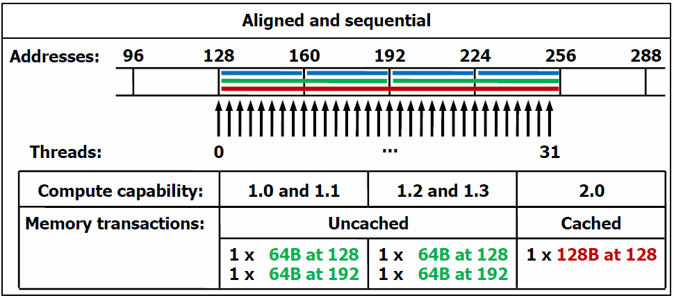
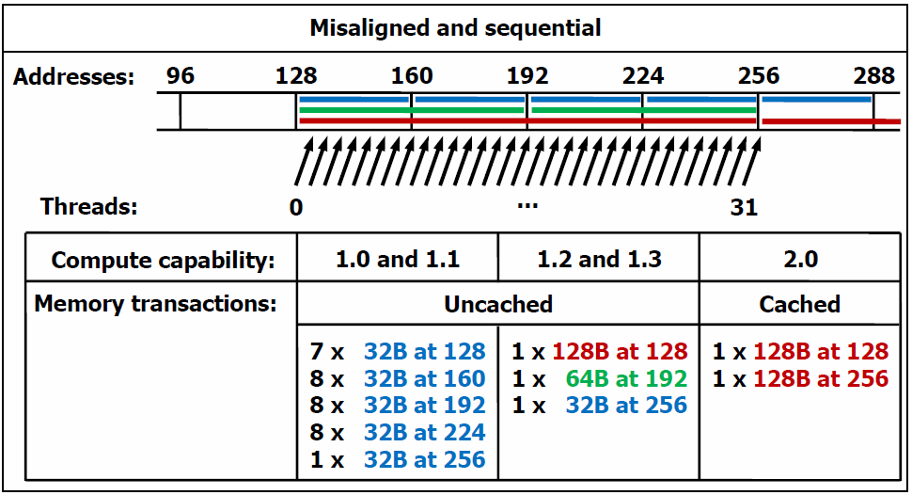
Explanation
2 load
32 load

Slide 19
The state of the art graphics cards that have come out in April 2010 now use caches for global memory
Two types of caches
L2 cache shared between multiprocessors
Cache-coherent
L1 cache local to a multiprocessor
Not cache-coherent

Slide 20
Conclusion
CUDA vs OpenCL
Fast, easy: CUDA
Portable: OpenCL
Quick development
Started in 2008
Added a cache recently
Memory bandwidth limitations are major
Use larger memory bus
Use caching

Slide 21
References
[1] Dandamudi, S.P.; , "Reducing run queue contention in shared memory multiprocessors," Computer , vol.30, no.3, pp.82-89, Mar 1997
doi: 10.1109/2.573673
URL: http://www.ieeexplore.ieee.org.proxy.bib.uottawa.ca/stamp/stamp.jsp?tp=&arnumber=573673&isnumber=12418
[2] http://developer.download.nvidia.com/compute/cuda/3_1/toolkit/docs/NVIDIA_CUDA_C_ProgrammingGuide_3.1.pdf
[3] http://developer.amd.com/gpu_assets/GPU%20Computing%20-%20Past%20Present%20and%20Future%20with%20ATI%20Stream%20Technology.pdf
[4] http://www.khronos.org/developers/library/overview/opencl_overview.pdf
[5] Weber, R.; Gothandaraman, A.; Hinde, R.; Peterson, G.; , "Comparing Hardware Accelerators in Scientific Applications: A Case Study," Parallel and Distributed Systems, IEEE Transactions on , vol.PP, no.99, pp.1-1, 0
doi: 10.1109/TPDS.2010.125
URL: http://www.ieeexplore.ieee.org.proxy.bib.uottawa.ca/stamp/stamp.jsp?tp=&arnumber=5482576&isnumber=4359390
[6] http://arxiv.org/abs/1005.2581v2
[7] http://www.math.ntu.edu.tw/~wwang/mtxcomp2010/download/cuda_04_ykhung.pdf
[8] Dandamudi, S.P.; , "Reducing run queue contention in shared memory multiprocessors," Computer , vol.30, no.3, pp.82-89, Mar 1997
doi: 10.1109/2.573673
URL: http://www.ieeexplore.ieee.org.proxy.bib.uottawa.ca/stamp/stamp.jsp?tp=&arnumber=573673&isnumber=12418
[9] http://www.nvidia.com/object/product_geforce_gtx_480_us.html

Slide 22
Backup Slide

Slide 24
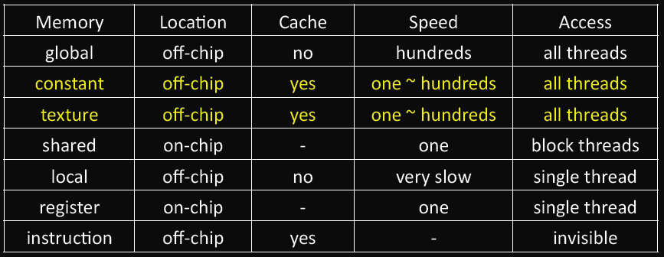

Slide 25
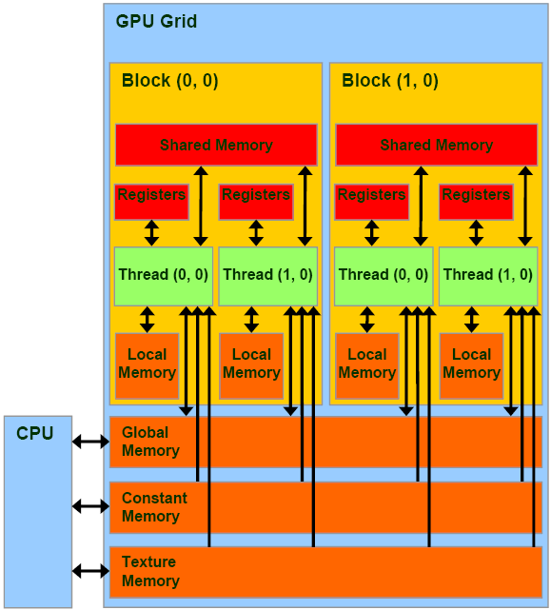
http://www.realworldtech.com/page.cfm?ArticleID=RWT090808195242&p=3

