Slide 1
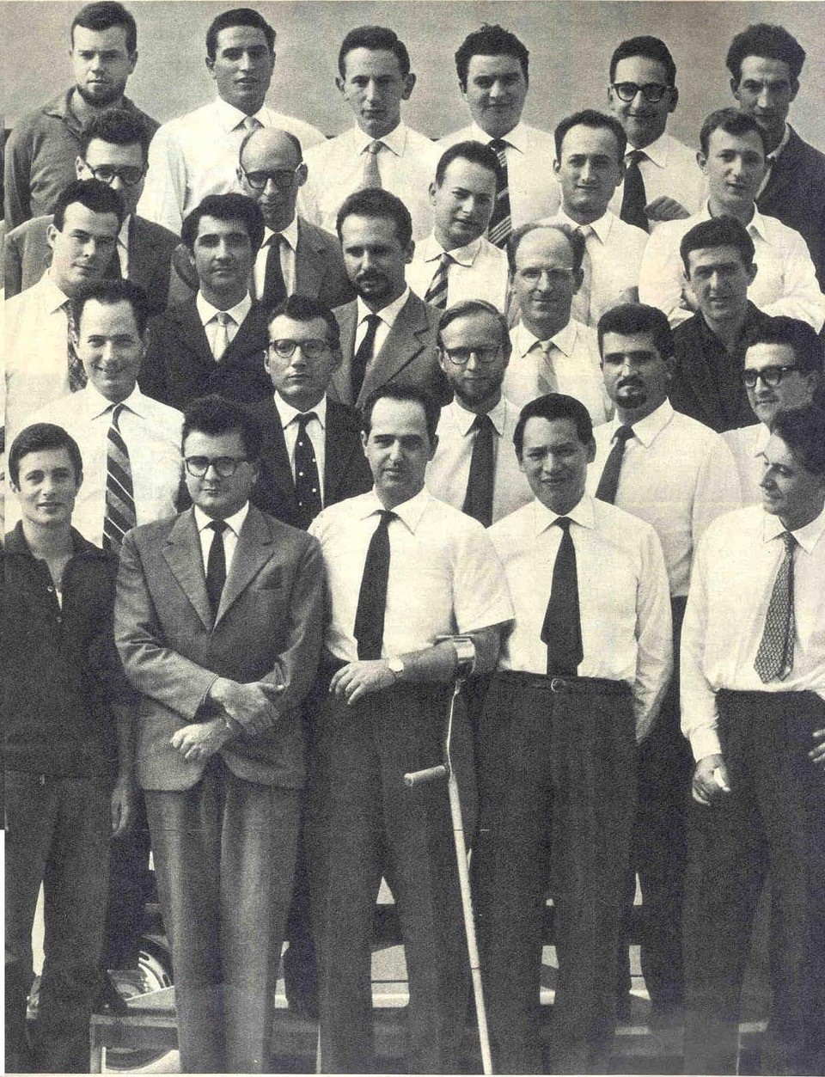
The group of Elea hardware engineers and associates involved in the design of the Elea 9000 series. Some names are;
Giorgio Sacerdoti and Mario Tchou, project leaders, first row center.
Franco Filippazzi, second on the second row
Architect Ettore Sottsass, fourth on the second row
Pier Giorgio Perotto (later responsible for the Programma 101) third on the third row
Simone Fubini, third on the fourth row

