Slide 1
Contract Specification and Verification: Experience with the Symboleo Language
Daniel Amyot
University of Ottawa, Canada damyot@uottawa.ca
15th Int. Workshop on Value Modeling and Business Ontologies (VMBO 2021)

Slide 2
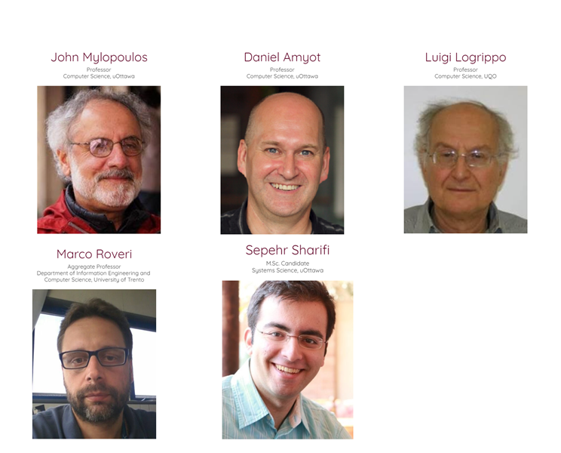
Contract Specification and Monitoring Lab @ uOttawa
Collaborators
HEC Paris
David R. Amariles
Pablo M. Baquero
Rajaa El Hamdani
IEMS Inc.
Ashkan R. Kian
https://sites.google.com/uottawa.ca/csmlab

Slide 3
On Legal and Smart Contracts
Legal contracts specify the terms and conditions that apply to business transactions
Commonly expressed in natural language, often with ambiguous or incomplete text
Difficult/laborious to analyze, both when designed and when executed/performed
Problems compounded by the presence of many documents, e.g., subcontracts
Smart contracts are programs intended to partially automate and control some aspects of the execution of legal contracts, and also monitor them for compliance with relevant terms and conditions
Closer to the original definition from Nick Szabo (1997)
Do not necessarily imply blockchain-dependent “smart contracts” (name hijacked!)

Slide 4
Research Questions
How can legal contracts be formally specified?
What types of analysis (at design time) and compliance monitoring (at execution time) could be done?
How can formal contract specifications be generated from existing contracts?
How can formal contract specifications be used to support code generation, e.g., of smart contracts implementations (on blockchain or other platforms)?

Slide 5
Our proposed language: Symboleo
From the Greek word Συμβόλαιο, meaning contract and pronounced ‘simvoleo’

Slide 6
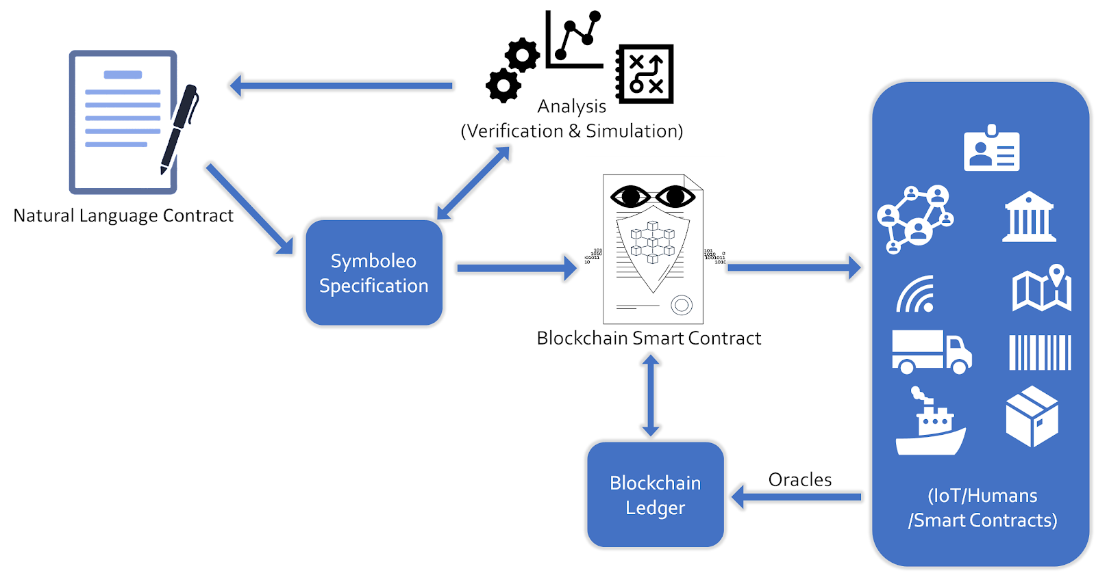

Slide 7
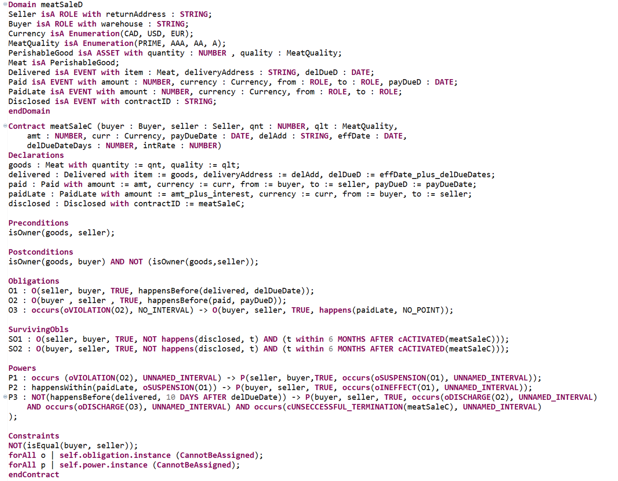
Meat Purchase Contract Template in Symboleo

Slide 8
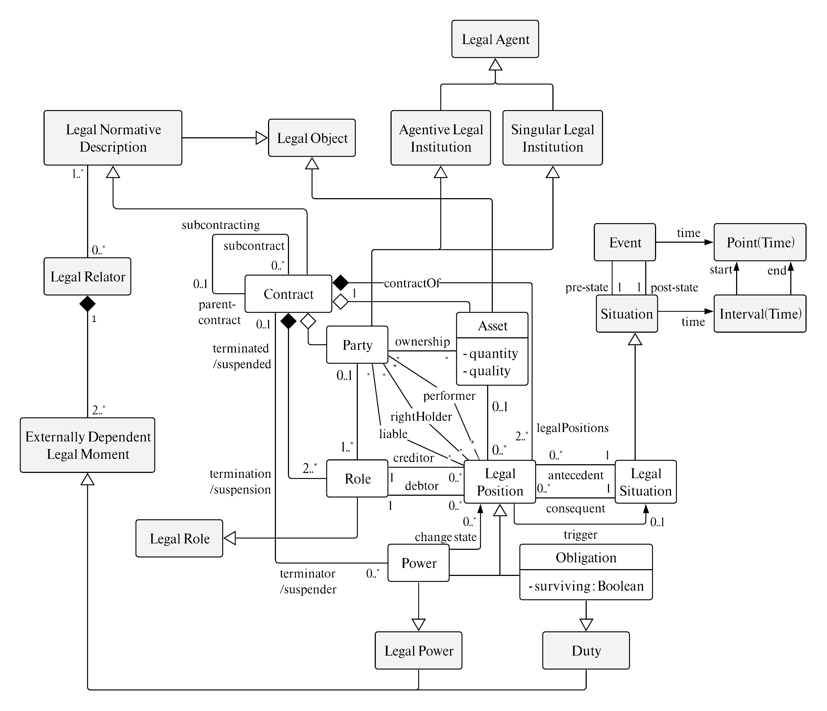
Symboleo Ontology (1/3)
Inspired from a legal foundational ontology
Unified Foundational Ontology – Legal (UFO-L), in gray
C. Griffo, J.P.A. Almeida, and G. Guizzardi. “Conceptual Modeling of Legal Relations.” ER 2018, 169–183.
Extensive for legal aspects in general, but needs more specialized contractual concepts
UFO-L not all implemented…
Focus on contract-specific concepts

Slide 9
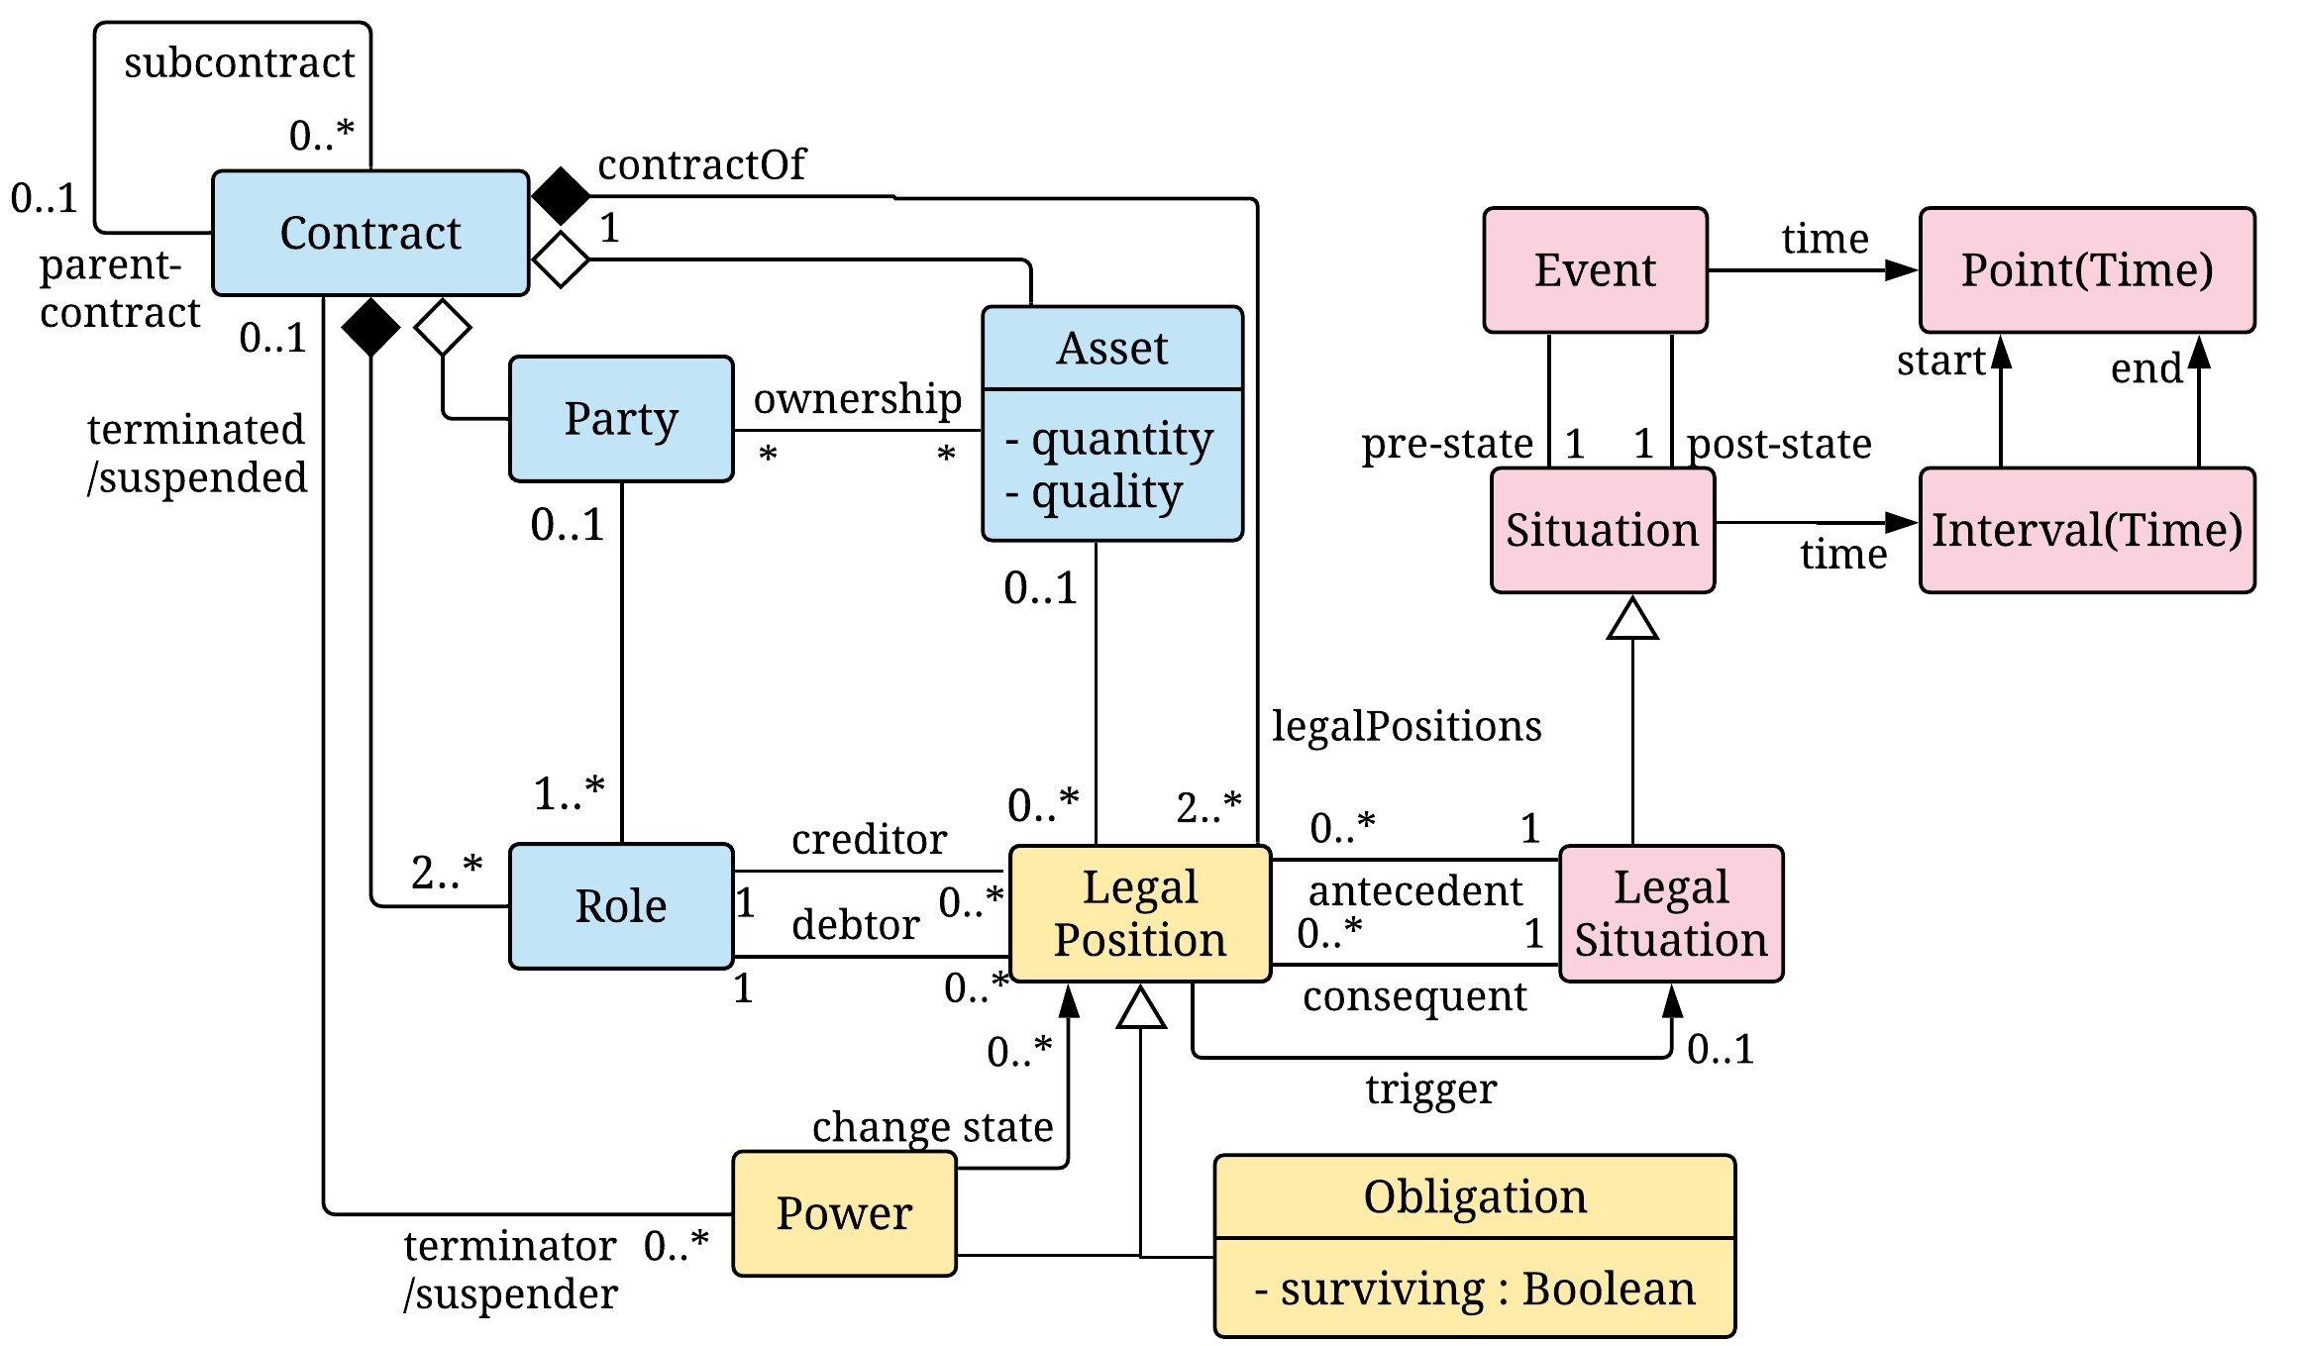
Symboleo Ontology (2/3)
Contract, Party, Role, and Asset
Common to all contracts
Obligation and Power
A power can create, suspend, or terminate obligations and other powers
Situation, Event, Interval
The vast majority of contracts include time concepts

Slide 10
Symboleo Ontology (3/3)
3 important primitive relations between Parties and Obligations/Powers
Who can share/transfer (rightHolder)
Who must act (performer)
Who is responsible when things go wrong (liable)
Execution-time relations that can be shared with or transferred to other roles at runtime
Enable subcontracting, assignment, party substitution, novation, and other contractual manipulations

Slide 11
State/Event View of Contracts
Each instance of a contract, obligation, or power has a state
Events enable transitioning between states. They come from:
Monitored execution, or
Other instances
Instances can be suspended and can terminate successfully or not

Slide 12
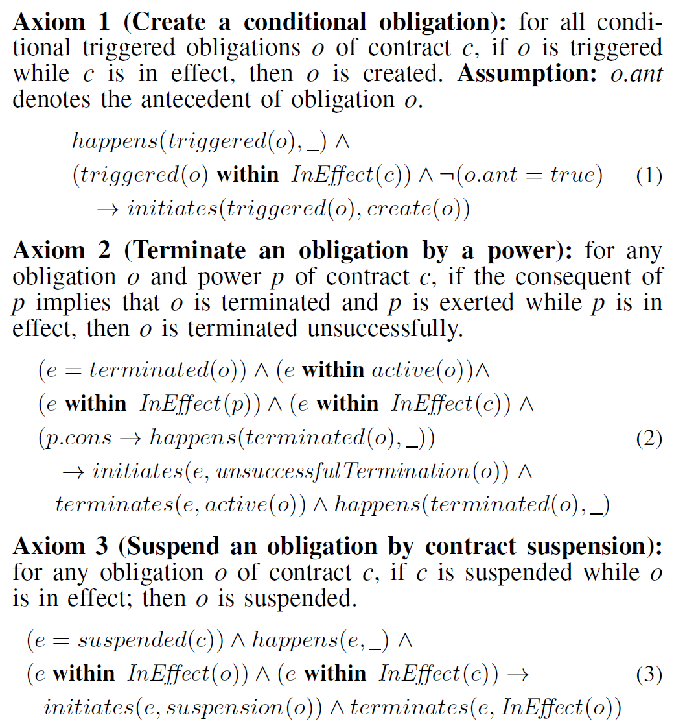
Formal Axiomatic Semantics (38+ Axioms)
Do not read all of this! Bottom line:
Formal underpinning in Event Calculus, with support for temporal aspects
Enables many types of formal and automated analyses, including compliance monitoring
Enables the handling of many advanced dynamic aspects (subcontracting, party substitution, assignment of rights), taking into account the specifics of a given jurisdiction

Slide 13
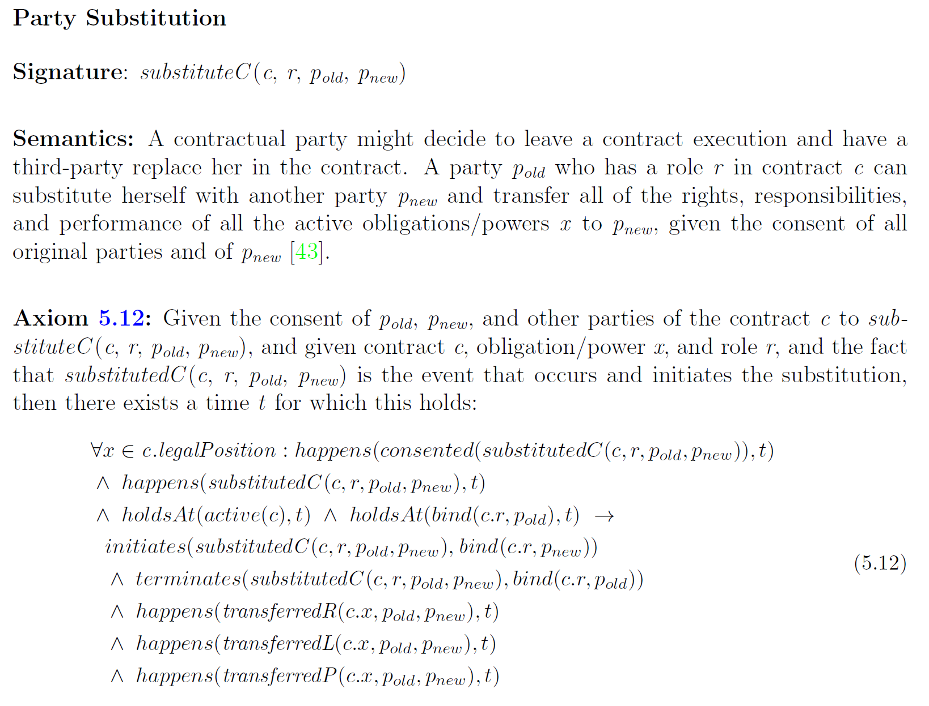
Jurisdiction- Specific Axioms
Take advantage of primitive execution-time operators for transferring or sharing liable, rightHolder, and performer relations
Like macros!

Slide 14
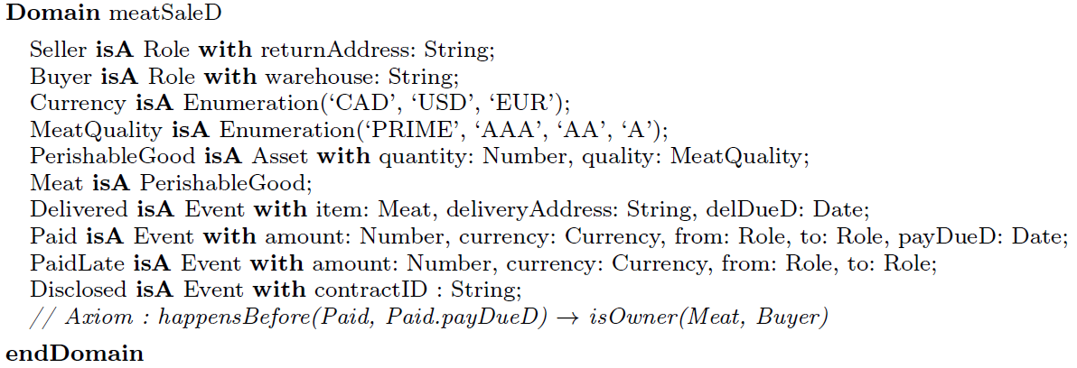
Symboleo’s Syntax by Example (1/4)
An Eclipse-based editor is available (https://doi.org/10.5281/zenodo.3903951)
Cloud-based editor under development…
First, the domain (vocabulary, data structures) is described, as an extension of the Symboleo ontology

Slide 15
Symboleo’s Syntax by Example (2/4)
The contract’s signature defines the template parameters
Specific values are passed when instantiating the contract
Local declarations as well as pre/post conditions can be defined

Slide 16
Symboleo’s Syntax by Example (3/4)
Obligations and Powers are then defined
[trigger -> ] O(debtor, creditor, antecedent, consequent)
[trigger -> ] P(creditor, debtor, antecedent, consequent)

Slide 17
Symboleo’s Syntax by Example (4/4)
Lastly, additional constraints on some parameters can be imposed, e.g.:
The buyer must be different from the seller
Obligations and powers cannot be assigned to another party

Slide 18
Application Example: Transactive Energy (TE)
Electricity produced and shared on demand by producers/consumers (prosumers) over a smart grid
Involves Distributed Energy Resource Provider (DERP) that produces energy and creates bids, and Independent System Operator (e.g., California’s CAISO) that runs the supply market
Many contracts (as short as a few minutes long) are created dynamically in a TE market. Hundreds of contracts daily
Most contract obligations and powers triggered dynamically

Slide 19
Sample Clauses of a Transactive Energy Agreement

Slide 20
Symboleo Specification of a Transactive Energy Contract

Slide 21
Great! Now, what can we verify in such contract specifications?

Slide 22
Verification with Model Checking
Model checking is an algorithmic procedure that enables the verification of (state-based) formal specifications against properties, usually expressed in temporal logic
Linear Temporal Logic (LTL)
Compositional Tree Logic (CTL)
Liveness properties: “good things will eventually happen”
The meat sale contract eventually terminates.
Safety properties: “something bad will not happen”
In case of late payment, the buyer cannot be penalized more than once.
Payment and late payment obligations cannot be active together.

Slide 23
From Symboleo to nuXmv
The nuXmv model checker tool is the evolution of the NuSMV tool
nuXmv has its own textual input format for specifications
nuXmv supports LTL and CTL properties, provides some time-related constructs, and generates counter-examples in case of violations
Symboleo’s semantics and axioms are state-based, and hence a good match for a mapping to nuXmv!

Slide 24
Overview

Slide 25
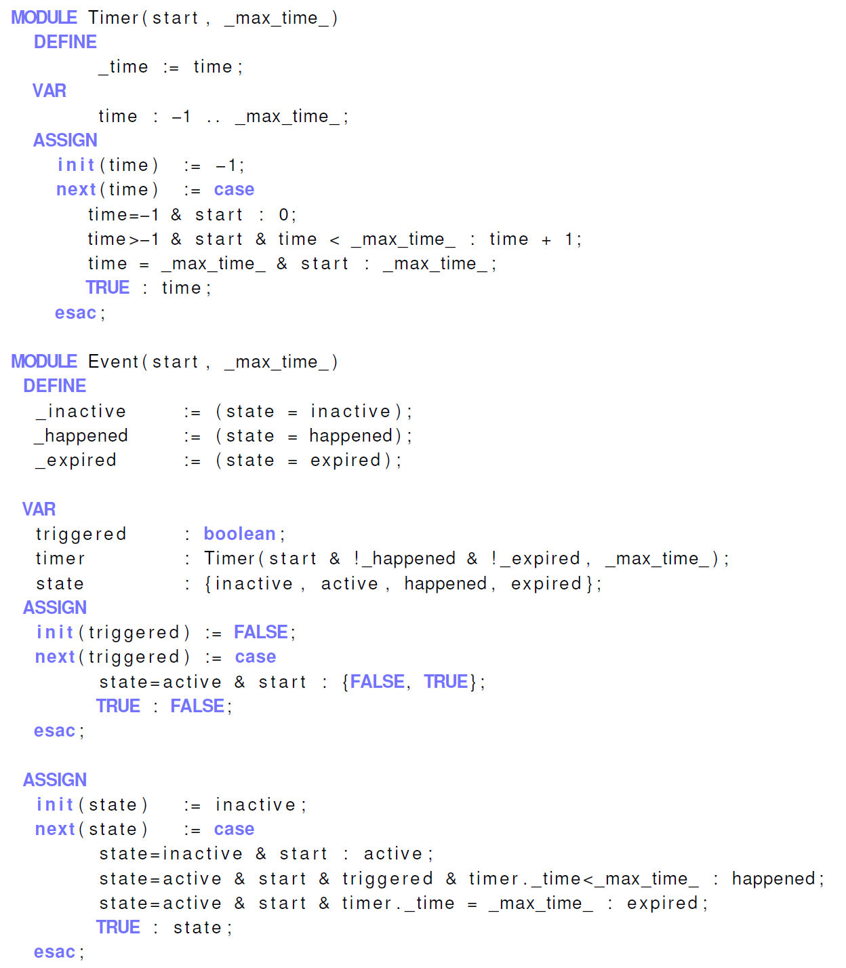
Primitive Symboleo Concepts in nuXmv: Timer and Event
Simple local CTL and LTL properties used to augment our “trust” in such primitive modules

Slide 26
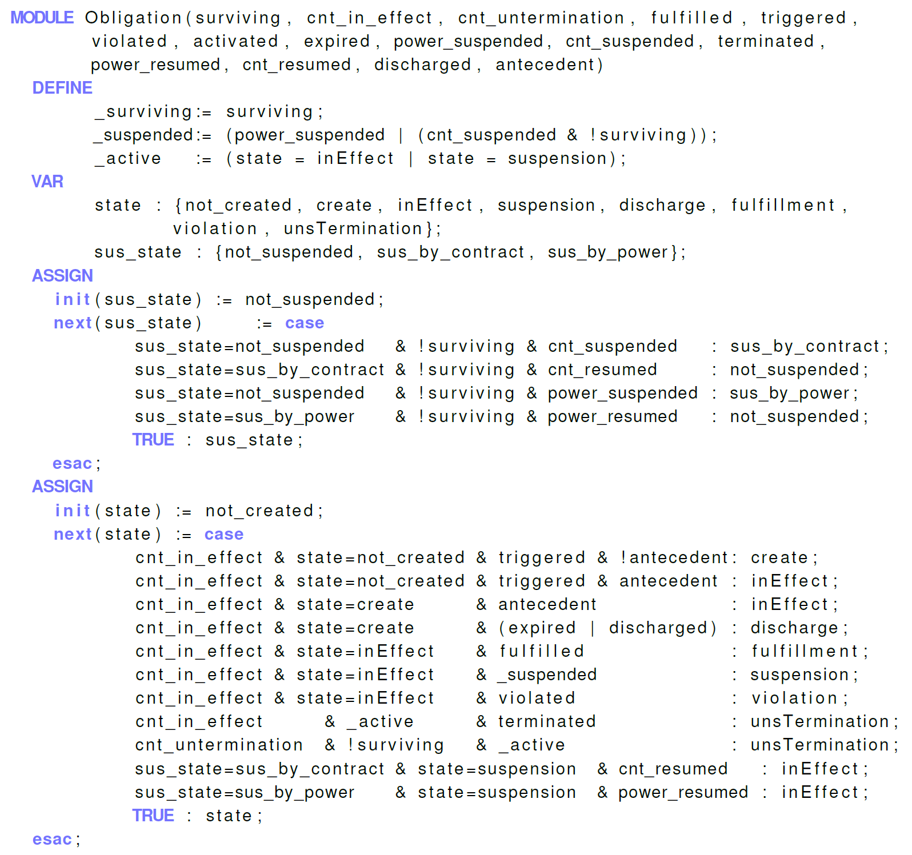
Primitive Axioms for the Obligation Concept in nuXmv
Similar trusted modules exist for the other language concepts
These trusted modules are for the language itself, and are reusable for all Symboleo specifications

Slide 27
Tracking of Relations between a Party and Legal Positions (Obligation/Power)

Slide 28
Contract-Specific Axioms in nuXmv

Slide 29
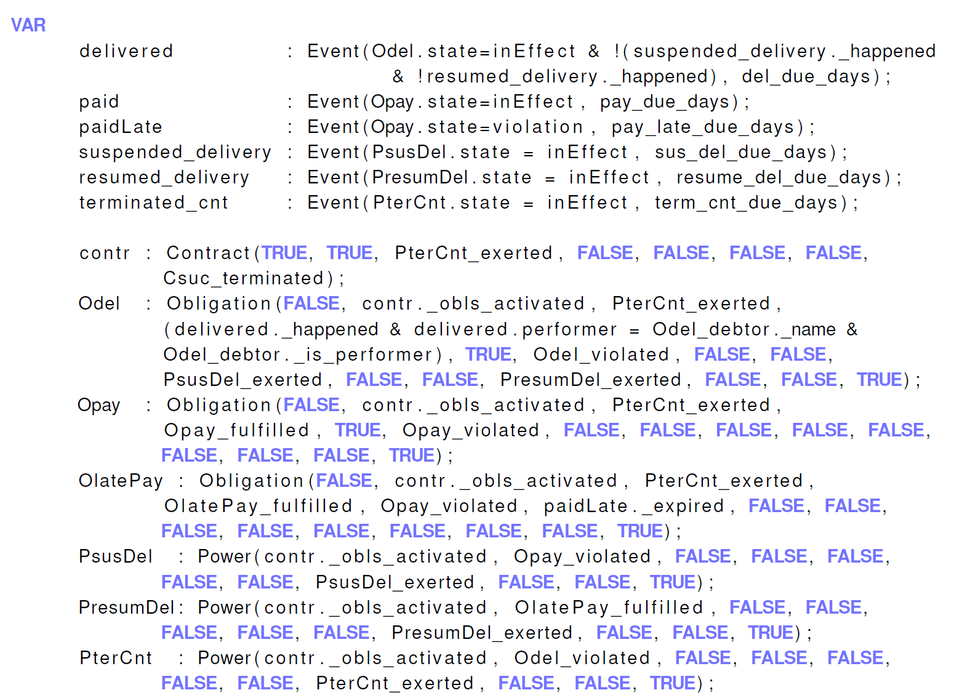
Contract-Specific Obligations/Powers

Slide 30
Example of Successful CTL Property

Slide 31
Example of Failing LTL Property

Slide 32
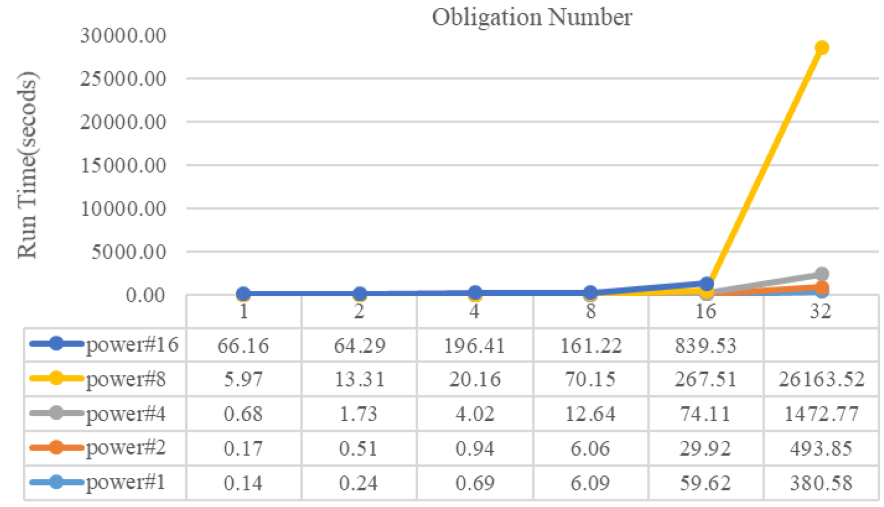
How Scalable is Verification of Symboleo Contracts?
State reachability time (in seconds) per numbers of independent terms (obligations and powers).

Slide 33
Verification in the Presence of Dependencies
Comparison of reachability check time (s) per number of powers and obligations, with and without dependencies.

Slide 34
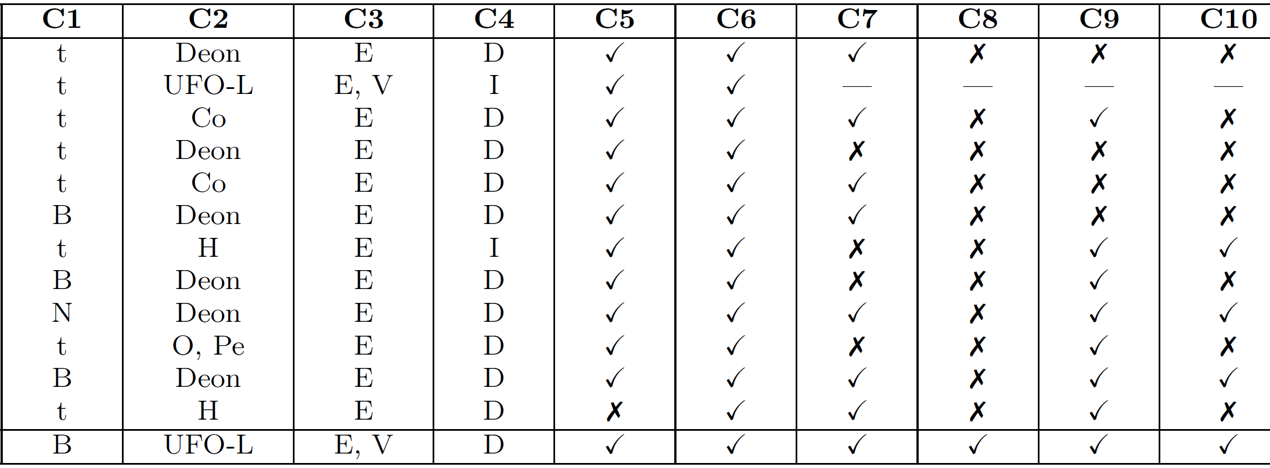
Comparison with Formal Contractual Languages
Time support
Legal concepts
Events/Values
Imperative/ Declarative
Contract reparations
Contract parameterization
Compliance monitoring
Subcontracting
Executable analysis
Automated verification
Formal Contract Language (FCL)
Unifying Model of Legal SC
Time-Aware Commitments
Business Contract Language (BCL)
Defeasible Contract Machines
RuleML and OASIS LegalRuleML
MODELLER
A Logic Model of Contracts
Contract Language CL
PENELOPE
SCIFF
eFlint
Symboleo

Slide 35
Conclusions and Future Work
Symboleo, a formal specification language for contracts with:
Ontology inspired from UFO-L and many existing legal contracts
Event-based state machines and axiomatic semantics exploiting event calculus
Support for time and sub-contracting
Verification of safety/liveness properties via a transformation to nuXmv
Useful for checking collections of contracts against properties, at design time
Some results on the monitoring side too
Prolog-based testing and monitoring tool, not presented here

Slide 36
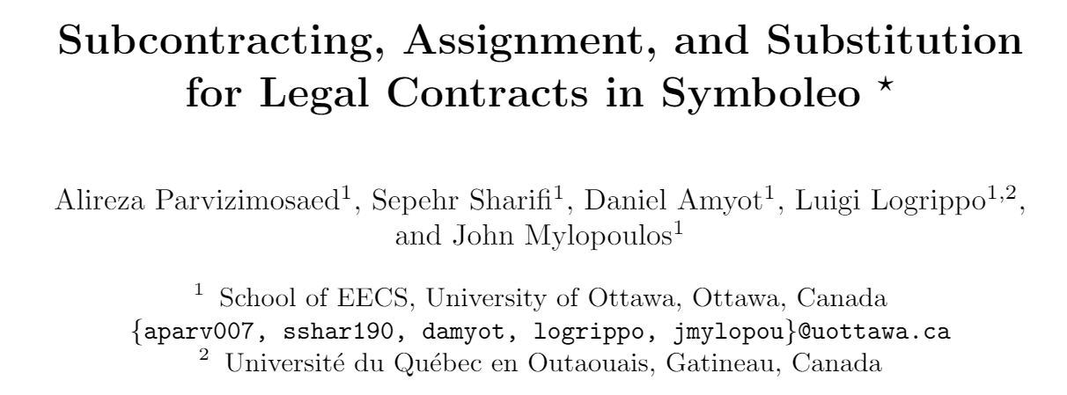
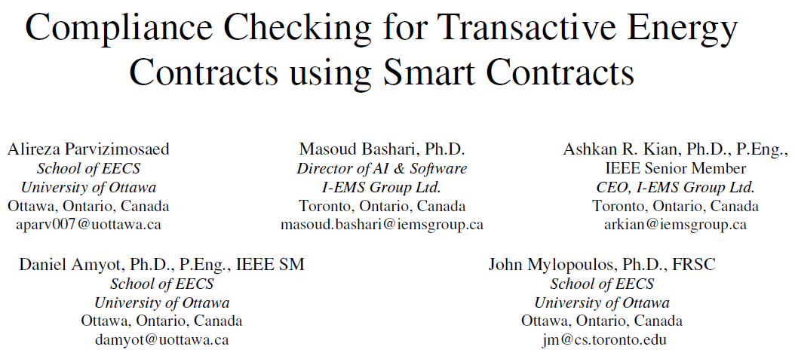
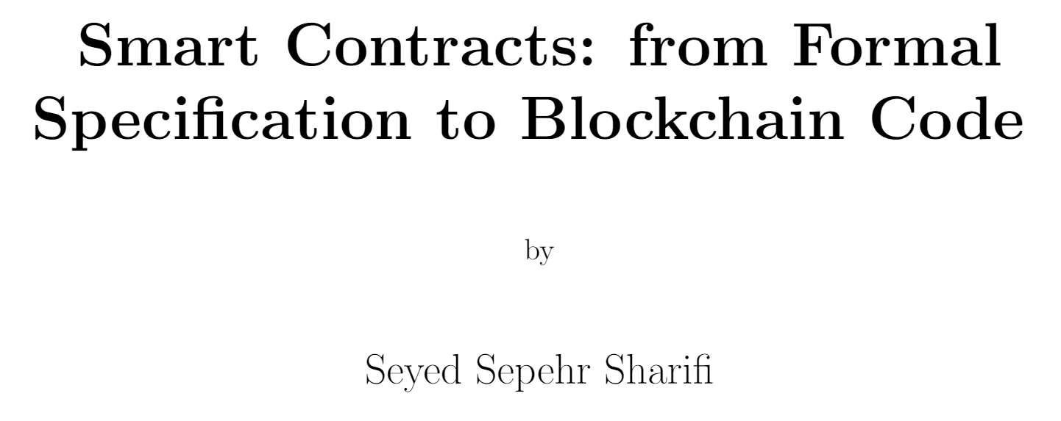
28th IEEE Requirements Engineering Conference (RE’20)
RE’20, Doctoral Symposium
39th International Conference on Conceptual Modelling (ER’20)
2020 IEEE PES Transactive Energy Systems Conference (TESC’20)
M.Sc. Thesis, uOttawa 2020
Tools available

Slide 37
Research Opportunities
How much of the UFO-L ontology to bring in beyond the current ontology?
Automation of transformation from Symboleo contracts to nuXmv
Development of Symboleo libraries of functions for specific domains, with corresponding nuXmv libraries
More usable Symboleo syntax and front-ends
Not yet usable by lawyers! Would a graphical representation help?
From existing contracts to Symboleo (NLP)
Libraries of domain-specific and reusable clauses in English and in Symboleo?
Code generation for monitorable contracts (e.g., in Ergo)
How much robustness should be handled in contracts (e.g., failing sensor)?
Additional case studies and further validation!

Slide 38
With Thanks
VMBO 2021 organizers and participants!
All project participants and industrial partners
ACT/AJC colleagues for feedback on subcontracting definitions and issues
P. Bacquero, V. Callipel, R. El Hamdani, F. Gélinas, E. Jonchères, D. Restrepo Amariles, G. Sileno, T. van Binsbergen, and T. van Engers
Many recent students
New: A. Roudak, S. Alfuhaid, A. Lopes
Graduated: S. Bhogal, F. Fang, T. Paul, A. Rizk, A. Roudak
Funding:
Middleware Framework and Programming Infrastructure for IoT Services (NSERC Strategic Partnership Grant)
An Automatic Tool for Developing Transactive Energy Smart-Contracts: Development, Validation and Integration with the IEMS Blockchain Platform (MITACS-Accelerate)
Autonomy through Cyberjustice Technologies (ACT) (SSHRC Partnership)

